Slide 1

My presents
I would like to have…
I would like to have
a book.

Slide 2
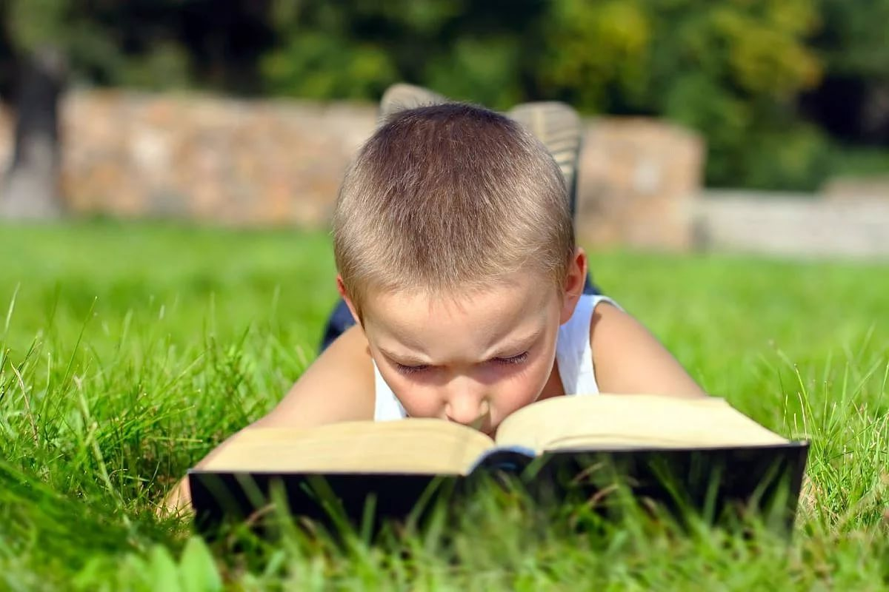
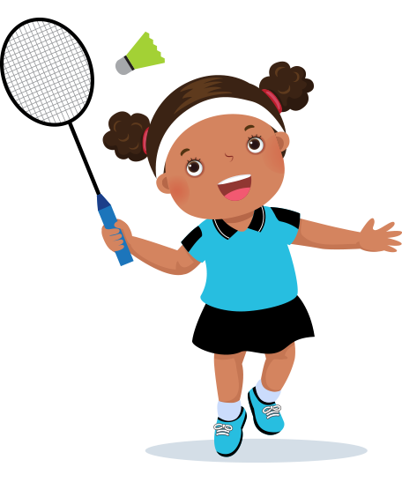


Закончи предложения
1. Billy can
2. Nick and Pam can
3. Martin likes
4. Mary and Bess like to

Slide 3
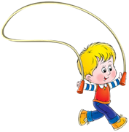
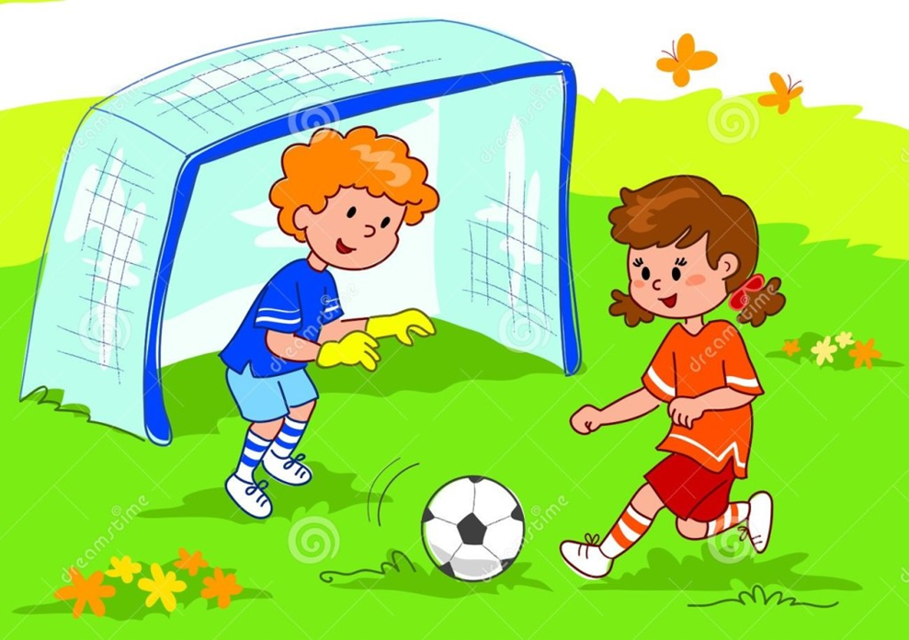
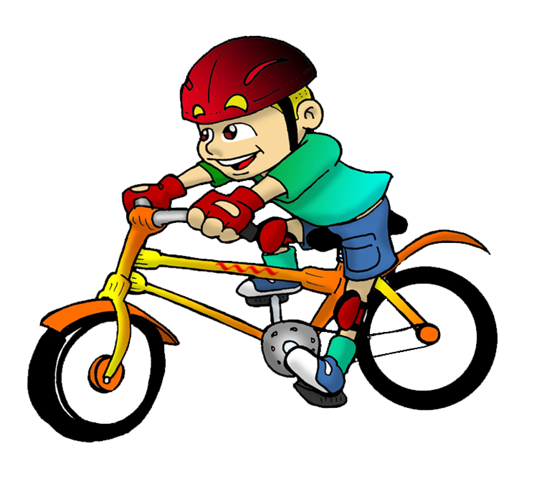
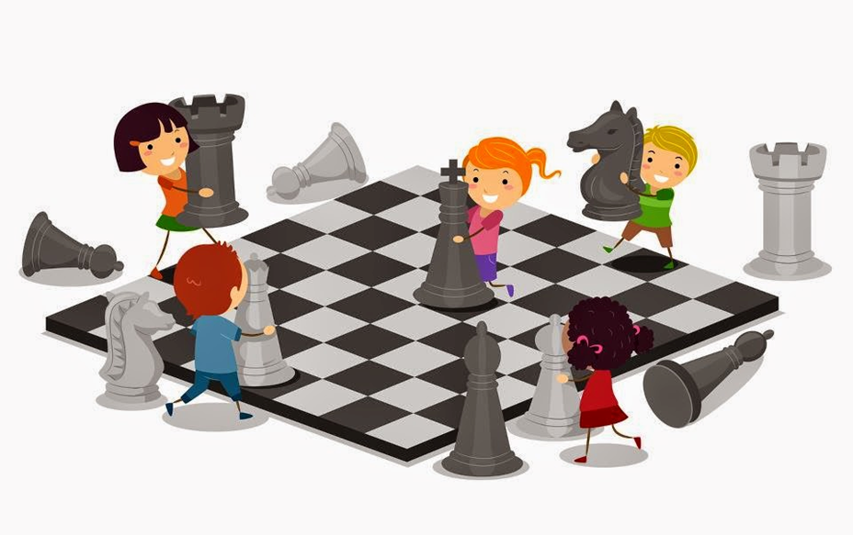
5. Jack and Tomas can
6. Jane can
7. Peter likes to
8. Dino likes to

Slide 4
a New Year
a happy holiday
a nice Christmas tree
a lot of presents
to sing happy songs
to dance with my friends
to eat many sweets and oranges

