Slide 1
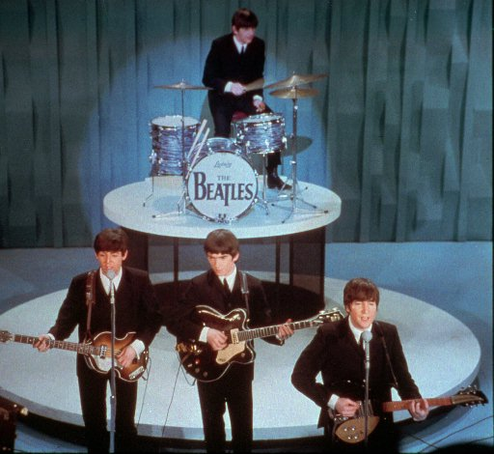
the “Beatles’’ and their music

Slide 2
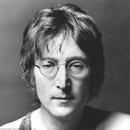
JOHN LENNON

Slide 3
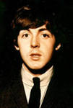
Paul mccartney

Slide 4
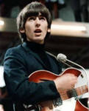
GEORGE HARRISON

Slide 5
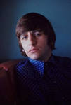
Ringo s tarr

Slide 6
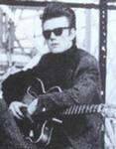
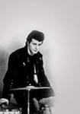
Pete Best stewart sutcliff

Slide 7
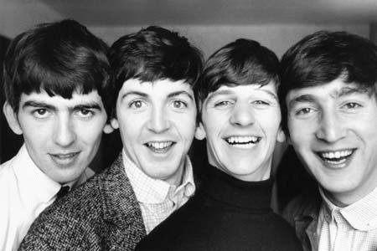
How did it happen that ordinary provincial boys were able to make a revolution in culture? What helped them to succeed?
They are not forgotten. WHY?

Slide 8
The first diagnosis was held in classes 7and 8 in the form of a questionnaire:
“What I know about the ‘beatles’.
49students were interviewed.
‘’
History-50 %
Creativity-45 %
Beatlemania-42 %

Slide 9
After some lectures the second diagnosis was held, which showed the increased knowledge of students.
History-95%
Creativity-92 %
Beatlemania-97 %

Slide 10
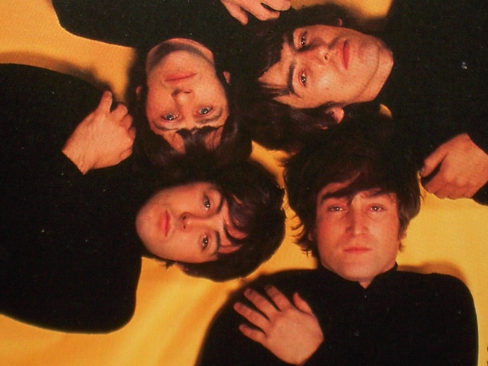
They had a desire to be the best.
Their goal was to make a real splash.

Slide 11
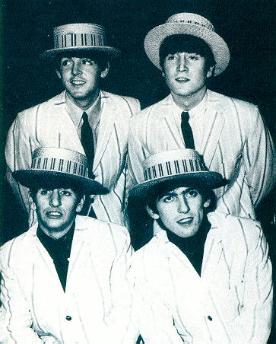
‘the beatles’ were not only brilliant musicians but also talented businessman .
They were hard-working and produced high quality products.

Slide 12
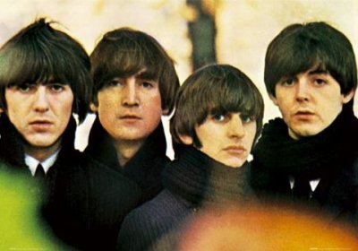
The “Beatles” watched that the talents of everyone in the group could be expressed. So they became “the brand within the brand”.
The art to create effective teams is the ability to mix specialists and professionals.

Slide 13
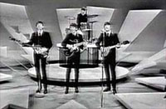
the ‘beatles’ revived rock ’ n’ roll music whose origin goes back to the tradition of american negro singing.

Slide 14
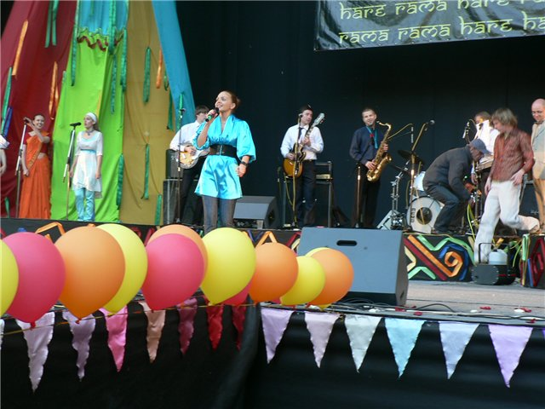
WHEN THE GROUP PLAYED ON THE STAGE EVERYBODY SAW AND HEARD HOW CLOSE THEY WERE!
THEY SANG IN UNISON AND MADE HARMONY.
ALL SONGS WERE SIMPLE AND FELL IN AT ONCE.
THE “BEATLES” NEVER REPEATED THEMSELVES.

Slide 15
The ‘beatles’ never repeated jokes , didn’t say the same thing like most celebrities.wit and directness were highly appreciated.their approval ‘yeah!yeah!yeah!’became a kind of a calling card,the way to look at life,it was accepted by millions of young people not only in england but also far beyond.they left an imprint on the culture of the 20th century.it’s not a surprise that Swedish magazine ‘aftonbladet’ called the band a group of the century.

Slide 16
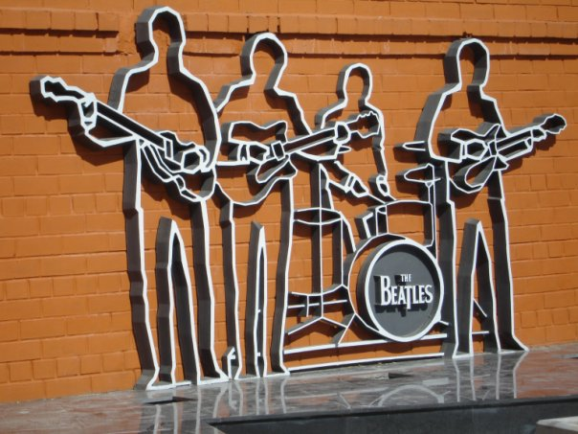
THANK YOU.

