Slide 1
Aikido-the world,uniting us
Author: Terskikh Evgeniia,
the pupil of the 11th grade.
Teacher: Gundarova V.N.

Slide 2
The aims of my research work are:
• To collect general information about aikido
• To analyze how aikido influences people’s relationships
• To tell about my own experience in this sport
• To make a conclusion
• To present the work

Slide 3
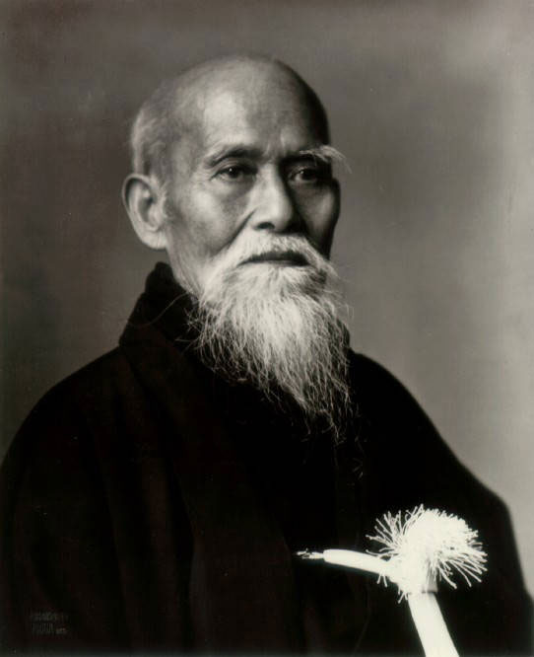
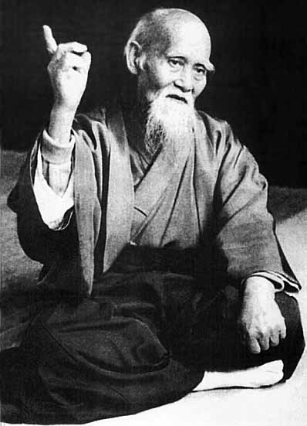
« Aikido begins in you»
Morihei Ueshiba, the founder of aikido

Slide 4

- Ai ( home)
- Ki (spiritual energy)
- Do ( way)

Slide 5

The true Warrior is invincible because he no one fights.

Slide 6


Slide 7
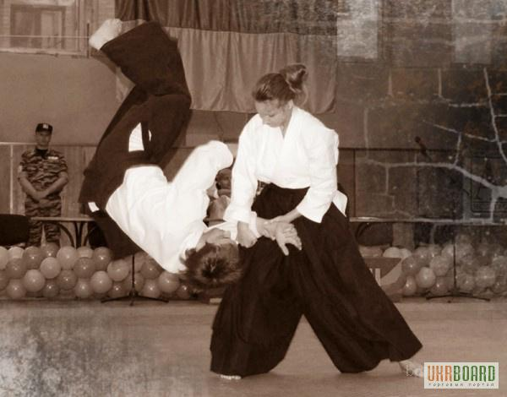

Slide 8
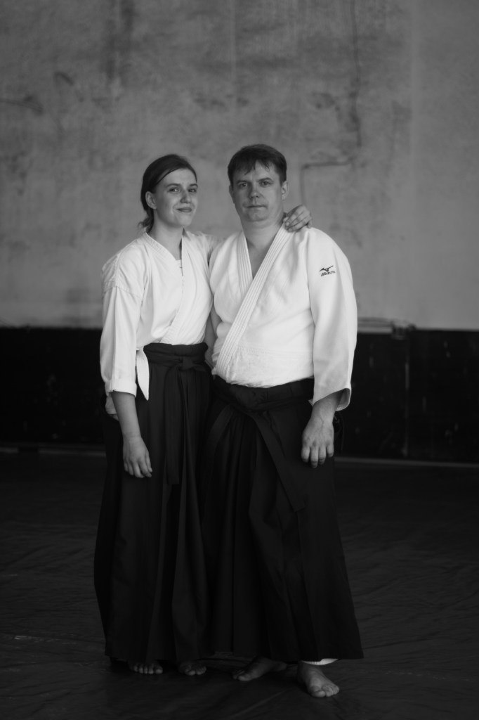
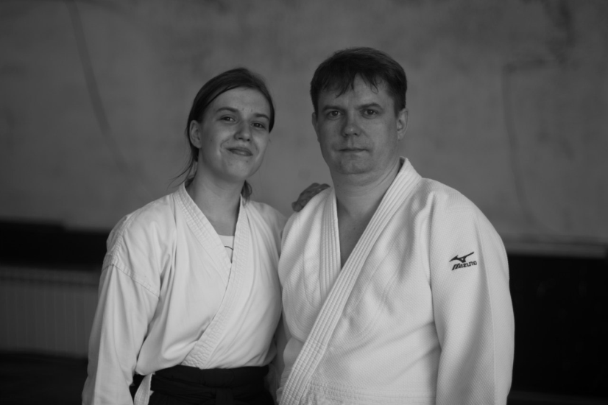
Family and sport

Slide 9
The results of the survey

Slide 10
How do you think aikido influence people’s relationships?

Slide 11
Do you agree with the statement: «Aikido unites people»?

Slide 12
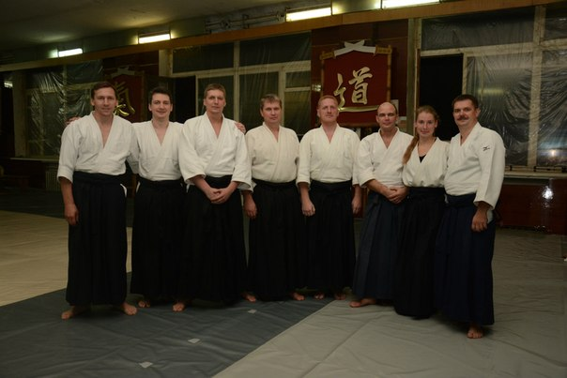

Slide 13
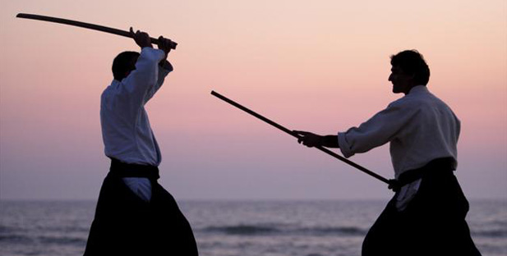

Slide 14
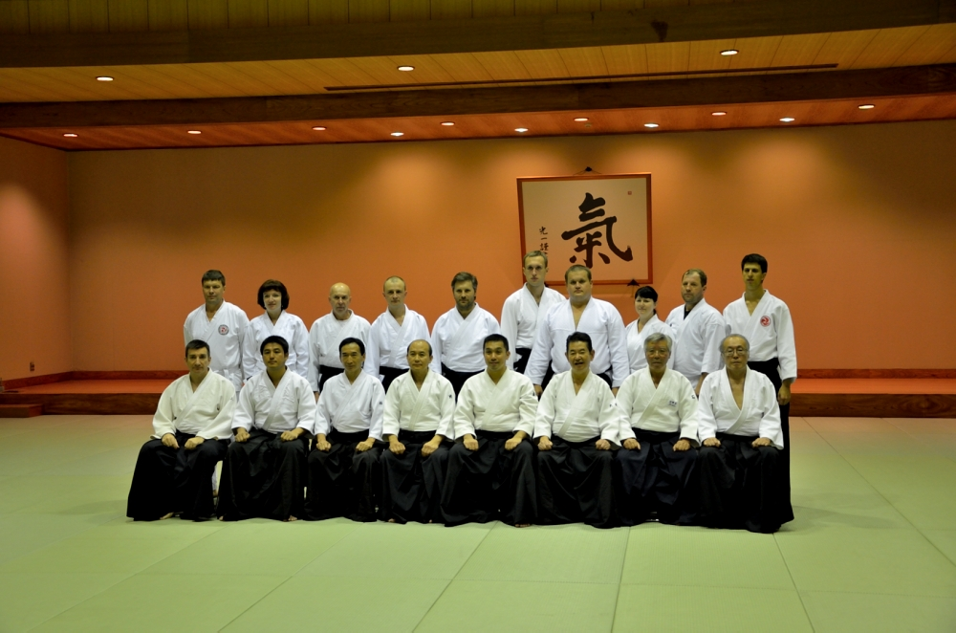

Slide 15
Thank you
for attention

