Slide 1
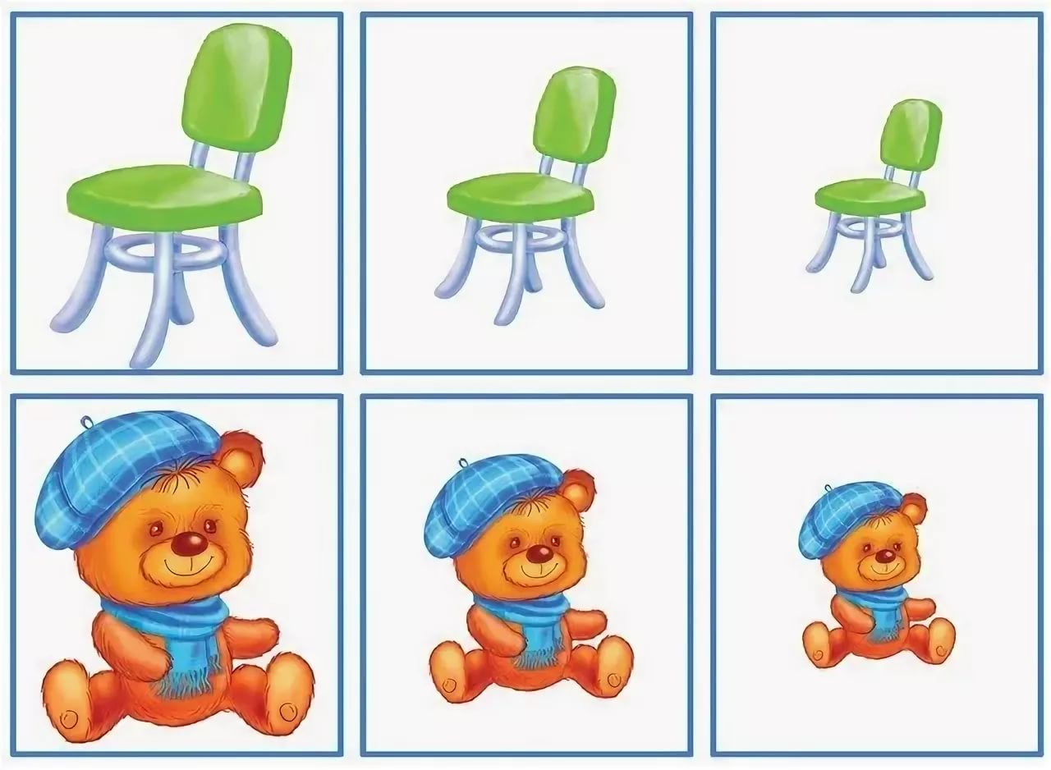
The degrees of comparison of adjectives

Slide 2
Adjectives
Односложное, двусложное
Многосложное
dirty nice
small warm
difficult famous
beautiful interesting

Slide 3
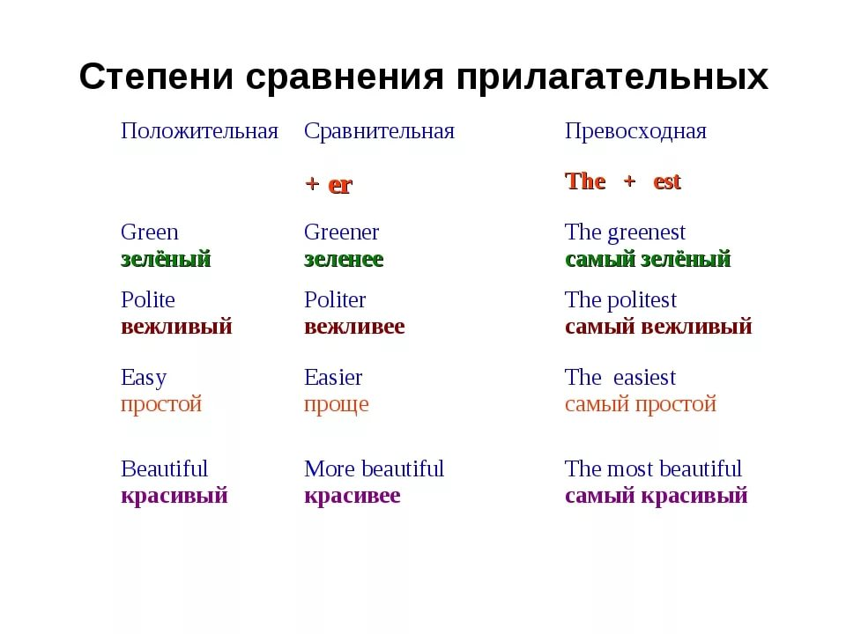

Slide 4
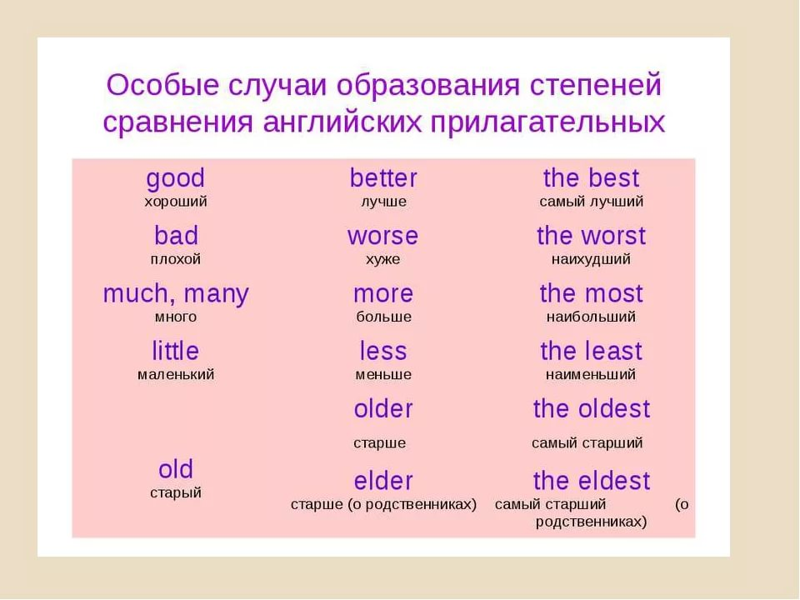

Slide 5
Make up the adjectives
happy
young
difficult
dirty
patient
hot
happier
the happiest
younger
the youngest
more difficult
the most difficult
dirtier
the dirtiest
more patient
the most patient
hotter
the hottest

Slide 6
comfortable brave wise friendly ridiculous late little

