Slide 1
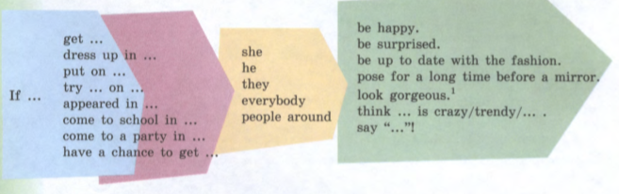
If I were you I….

Slide 2
Translate the sentences
If I were you, I would learn the rule.
If I were you, I would not ask too many questions.
If I were you, I would take an umbrella.
If I were you, I would do the homework and get a good mark.
If I were you, I would help to my parents.
If I were you, I would clean my room.
If I were you, I would ride on bike.
If I were you, I would eat more healthy fruit and vegetable.

Slide 3
Complete the sentences
1. If I were you, I __ (do) it now.
2. If Boris __ (visit) me, I would lend him my tools.
3. If I __ (be) at home, I will learn my new words.
4. If Valera has the book, he __ (lend) it to me.
5. If Masha helped in the kitchen, she __ (get) more pocket money.
6. If you __ (come), you would see him.
7. If we go to Kiev, we __ (see) the Lavra.
8. Maria will help you, if she __ (get) more pocket money.
9. I __ (tell) you, if you asked me.
10. He __ (wash) it, if you give him some soap.
11. If you use it, nobody __ (see) you.
12. If we __ (eat) enough, we wouldn’t be hungry.
13. I will travel to Germany if I __ (have) enough money.
14. If you __ (get) up early, you would catch the train.
15. If I have some money, I __ (buy) a new computer.

