Slide 1


Slide 2
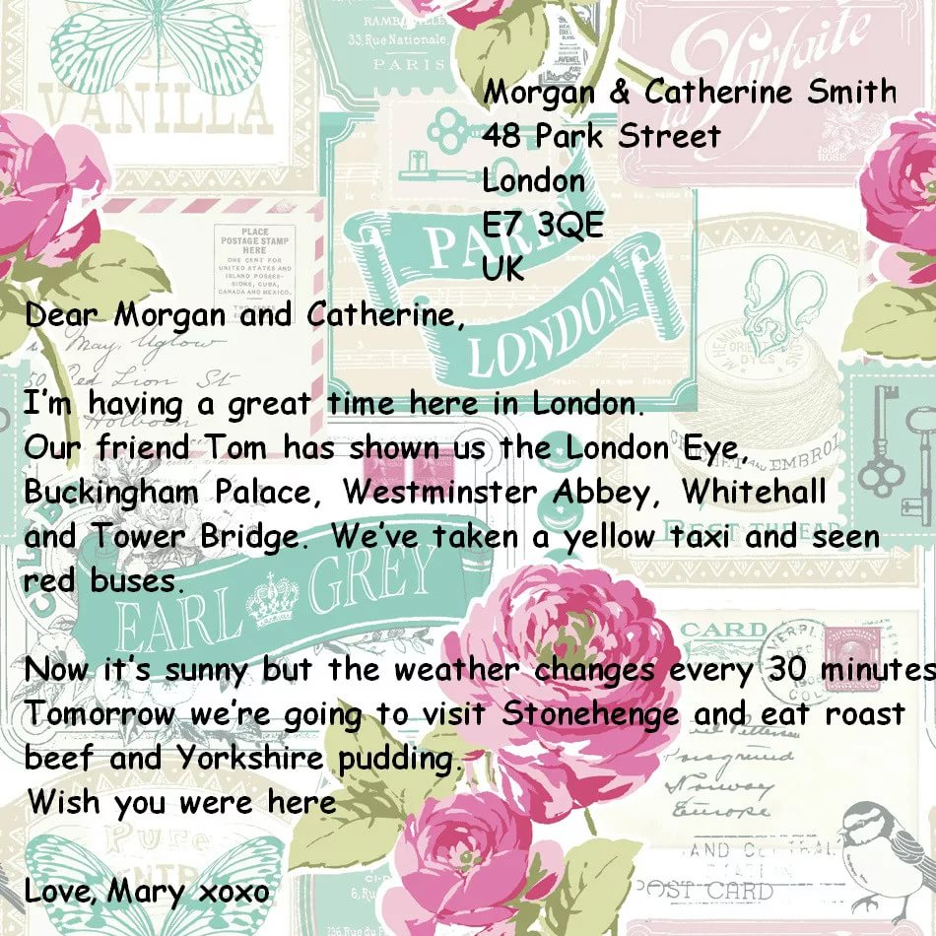
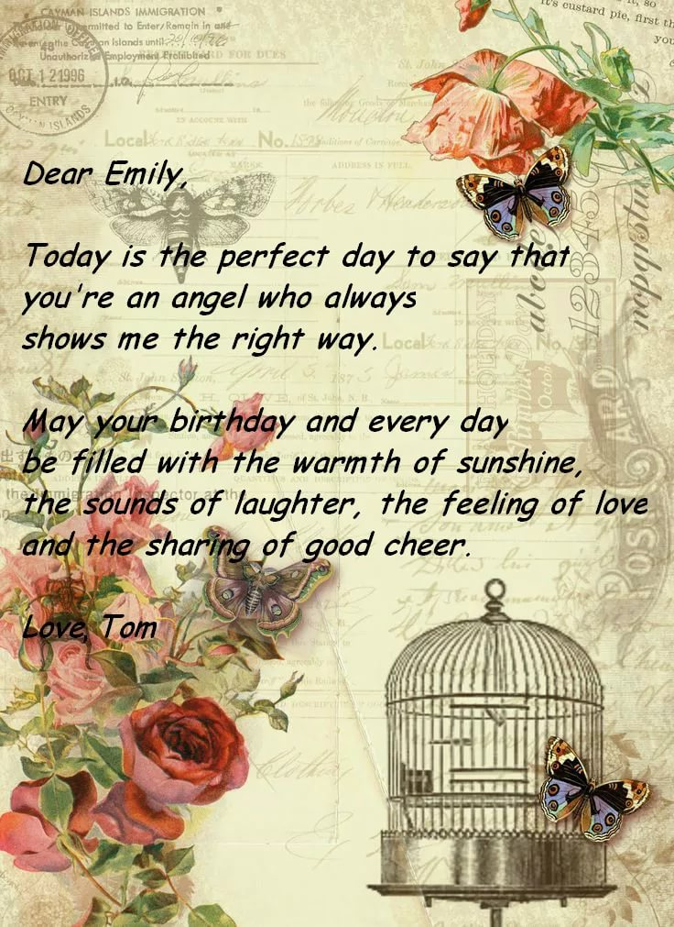

Slide 3

Dear…
I want to congratulate you with the New Year’s Day.
Wishing you…
(Health, love, success, wealth, prosperity, happiness, harmony, joy, peace) May this year be… for you.
(merry, bright, special, unique, unforgettable, successful)
Warmest Wishes for New Year!
With love/respect,
yours…

Slide 4


