Slide 1
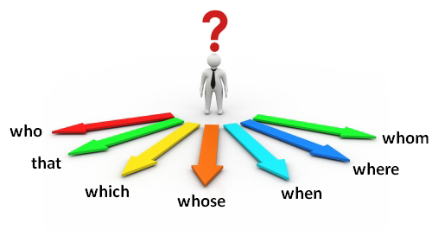
Придаточные предложения
с who, which, where
who/that/which – который

Slide 2
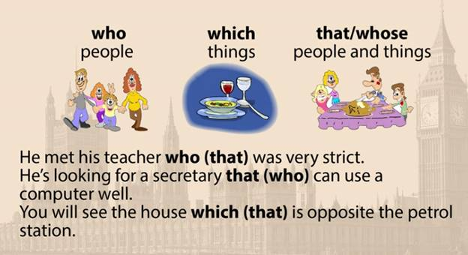

Slide 3
That is the film ____ I like very much.
1. Her last film____ I couldn’t understand at all, was a great success.
2. Give him something ____ will take away the pain.
3. We’ll show you the poem ____ changed my life.
4. Is there a shop near here … sells milk?
5. People … live in flats shouldn’t have animals.
6. The car … he bought last month is fantastic.
7. This is the most beautiful waterfall … we have ever seen!
8. The boy ____ won the prize was happy.
9. Those jeans____ you want to buy are really expensive.
10. Do you know the man ____ talked to me?
11. The peaches ____ are lying on the table are tasty.
12. We will stay at a hotel ____ is next to the beach.
13. That is the film ____ is very exciting.
14. Do you know the man ____ I talked to?
15. The peaches ____ you bought in the shop are tasty.
16. We will stay at a hotel ____ my friend has recommended to us.

Slide 4
Change the sentences, using the words who/that/which
Example: I wrote to the friend. He had a birthday last week. =
I wrote to the friend who had a birthday last week.
I bought a house. It was nice.
Alice has got a friend. He dances well.
He received the letter. He was waiting for it.
Max has become an actor. You met him last year.
I was happy to get a letter from my friend. He has been travelling around the world.
This dress costs a lot of money. It has a handmade embroidery.
I forgot to print the article. I wrote it yesterday.
The boy was sad. His bike was broken.

Slide 5
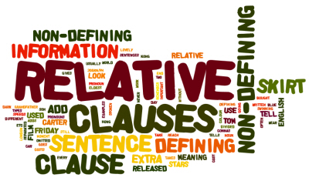
Where – to talk about a place
Why – to talk about a reason
When – to talk about time
This is the café where I ate a delicious cake yesterday.
Tell me the reason why you are crying.
My favorite day of the week is Friday, when the weekend is about to begin.

Slide 6

Fill in the gaps with when,where,why
We will visit the castle........the kings lived.
Winter is the time of the year..........many people suffer from flu.
I can’t understand the reason...........you have been late for work.
Do you know the reason............she is so upset?
This is the library...........you can find even rare books.
The school...........I study is near my house.
This is the reason...........I never invite her to the party.
I remember the day............I went to school.

