Slide 1

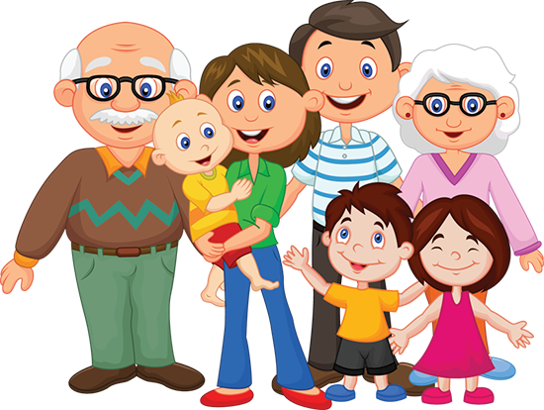
My family

Slide 2
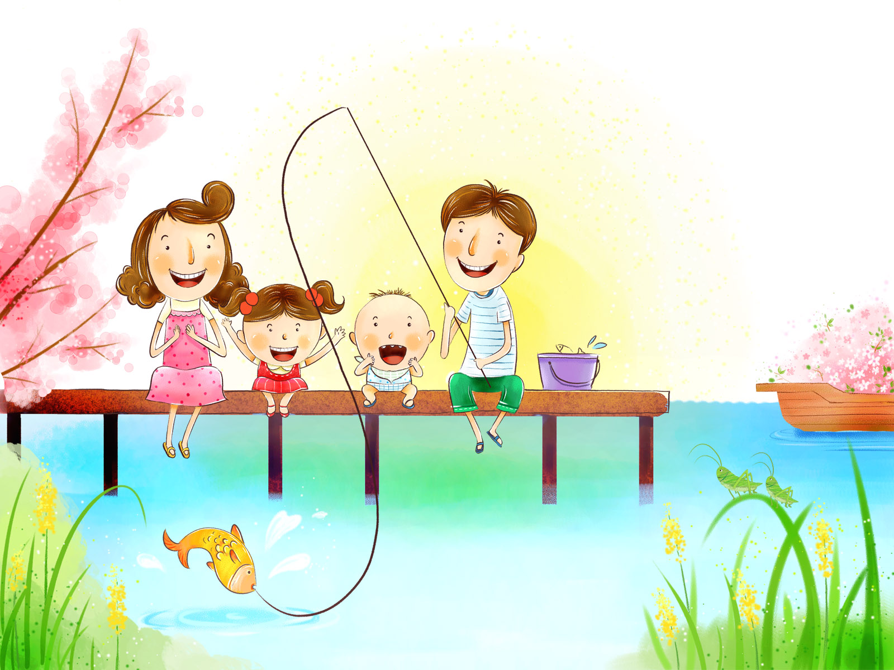
It’s a family.
What can you see?

Slide 3

a father
a sister
a daughter
a mother
a brother
a son
try to name all the members of a family you know

Slide 4
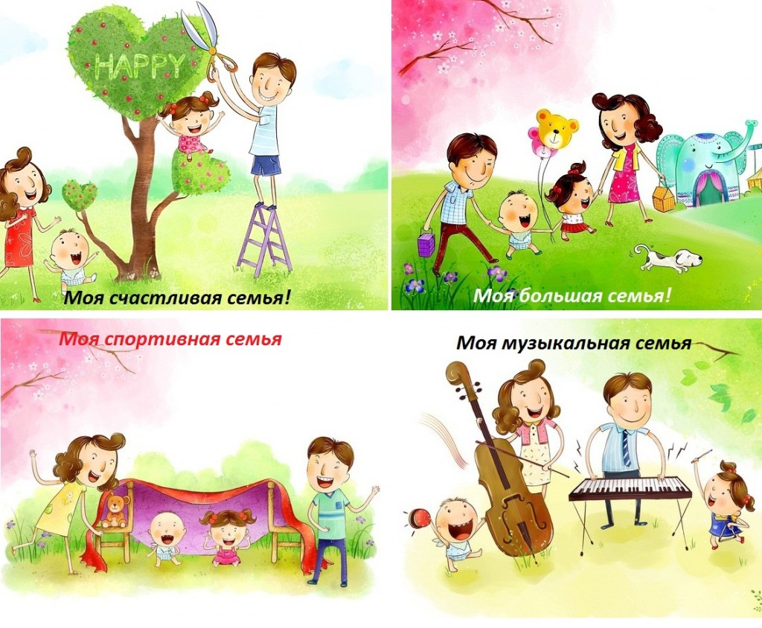
-Now, let’s make such sentences. For example: I have a mum, a dad, a brother, a sister …..

Slide 5

Family
Ты не ленись, а повтори:
Семья иначе … family.
Father, mother, sister, brother,
uncle, aunt, daughter, son,
Всех родных я перечислил,
я всю … family назвал.
Она мечтает быть артисткой
Моя сестренка – моя … sister.
Мой брат разбил сегодня вазу
Мой брат – малыш,
Мой братик - … brother.
Дядя Скрудж поехал в банк,
Дядю называю … uncle.
Тетя! А теперь твой фант!
Тетя по-английски … aunt.
Дочку как вы назовете?
Дочка по-английски … daughter.
Мой сынок испортил кран.
Сын, сынишка значит … son

Slide 6
Now, let’s make some grammar exercises
1. Your parents’ parents are your ___ and your ___ .
2. Your father’s brother and sister are your ___ and your ___ .
3. Your aunt’s and uncle’s children are your ___ .
4. Your brother’s son and daughter are your ___ and your ___ .
5. Your children’s children are your ___ and your ___ .

Slide 7


Вставьте have / has
I _____ a nice family.
______ you got a sister?
Dad ______ a brother.
Mom _____ a sister.
«Название конкурса»

Slide 8


Let’s make a project –
“My family.”
Hello!
My name is __________________.
I have got a big / small family.
I have got a mother, a father, a sister, a brother, a grandfather, a grandmother.
I love my family.

Slide 9
The lesson is over!

