Slide 1
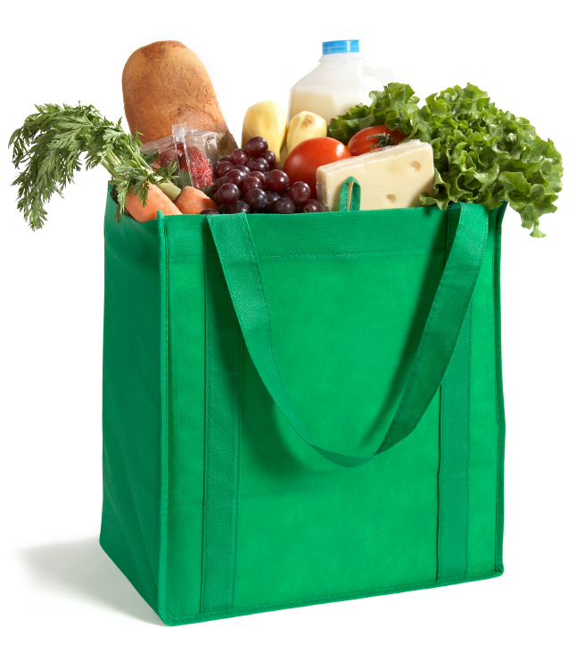
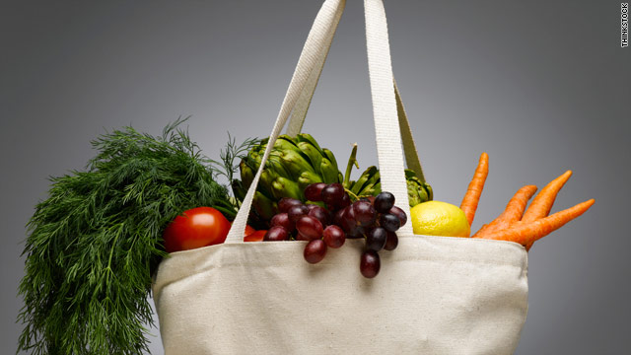
“What’s in the shopping bag?”

Slide 2
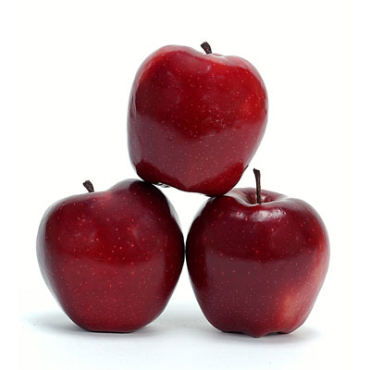
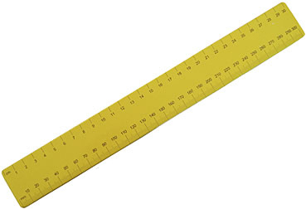
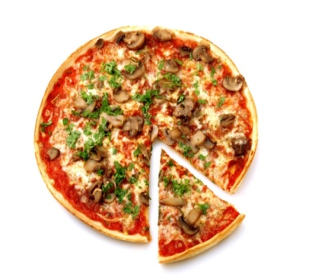
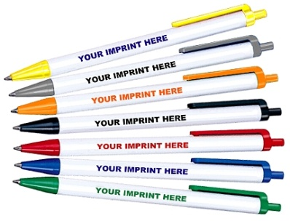
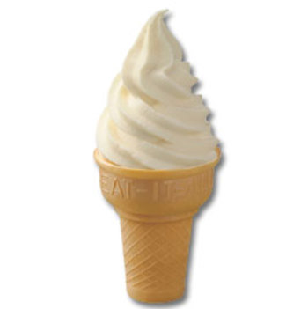
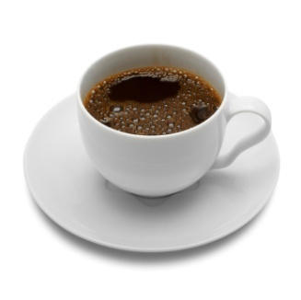
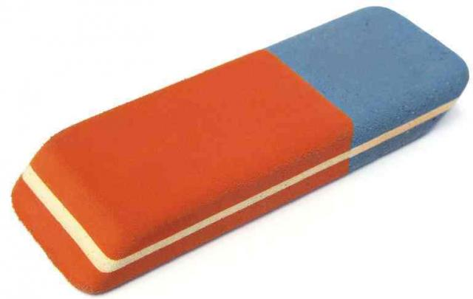

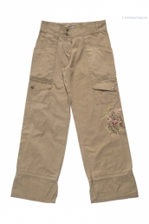

Look and sing!
“Have you got any apples?”
Have you got any apples?
No, we haven’t.
Have you got any pizzas?
No, we haven’t.
Have you got any ice cream?
Have you got any coffee?
Have you got trousers?
No, we haven’t.
We haven’t got any apples in the shop.
We haven’t got any pizzas in the shop.
We haven’t got apples,
We haven’t got any pizzas,
We haven’t got any trousers in the shop.
Would you like to have some rulers or some pens?
Would you like to have some rubbers or some books?
Would you like to have some rulers?
Would you like to have some rubbers?
Would you like to have some pencils?
Pencils, please!

Slide 3

What’s this?
ruler
pens

Slide 4

What’s this?
books
rubber

Slide 5
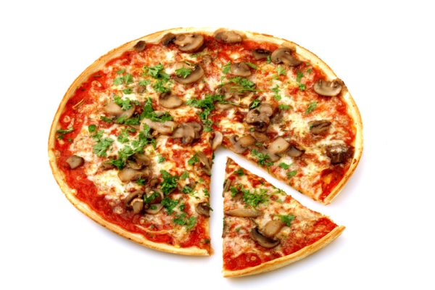
What’s this?
pizza
apples

Slide 6

What’s this?
coffee
Ice cream
trousers

Slide 7
Complete the sentences
I’ve got some…!
I haven’t got any...!
Have I got any….?

Slide 8
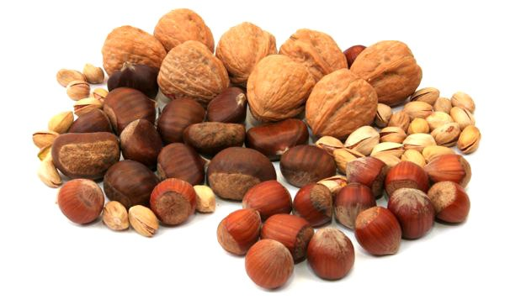
Have we got any…? What’s this?
nuts

Slide 9
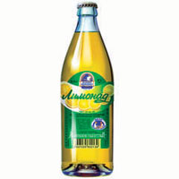
lemonade

Slide 10
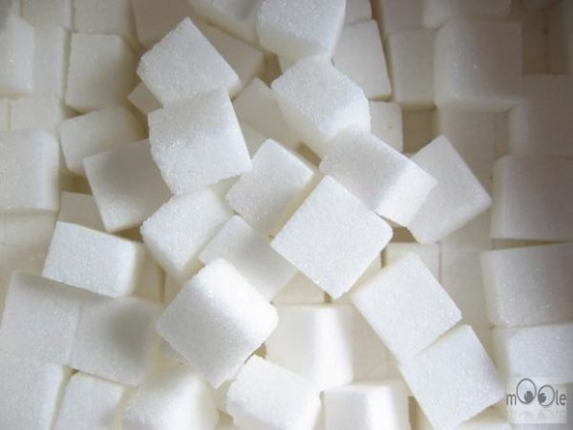
sugar

Slide 11
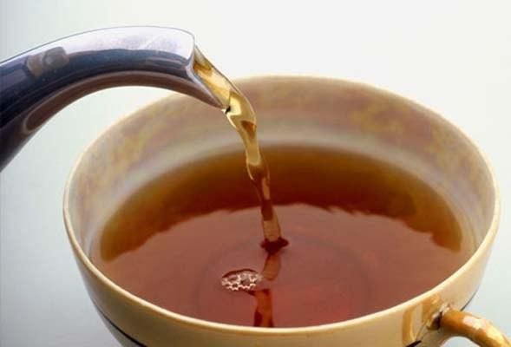
tea

Slide 12
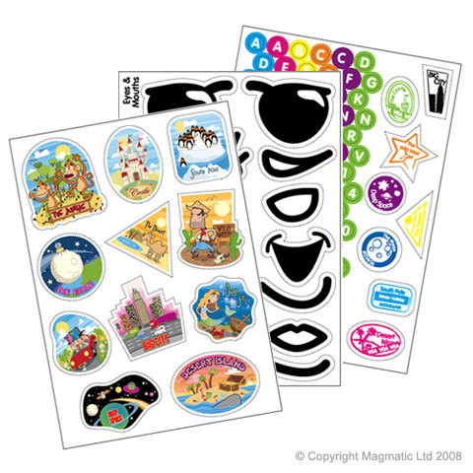
stickers

Slide 13

comic

Slide 14
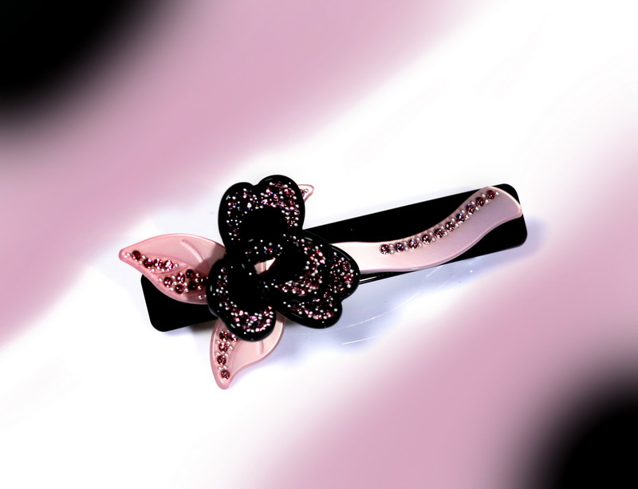
hairgrip

Slide 15
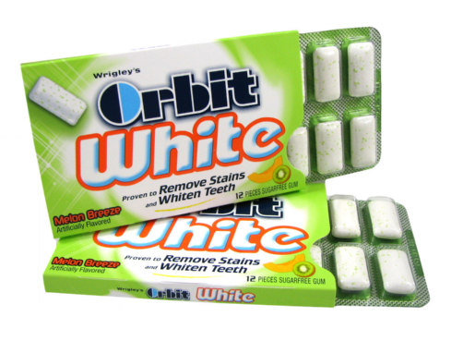
Chewing
gum

Slide 16
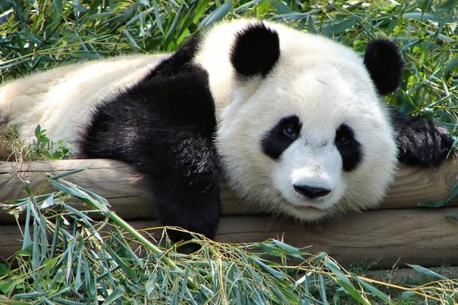
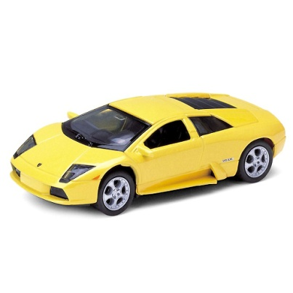
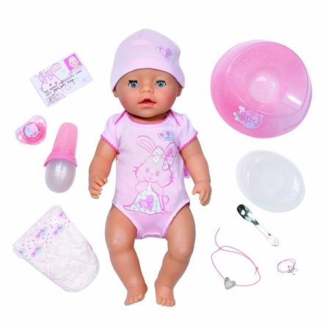
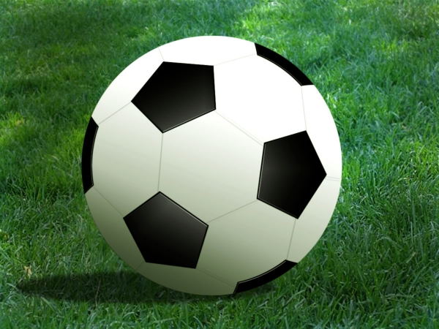
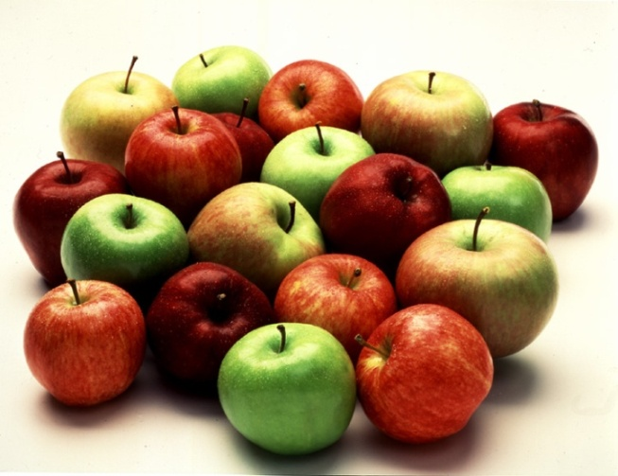
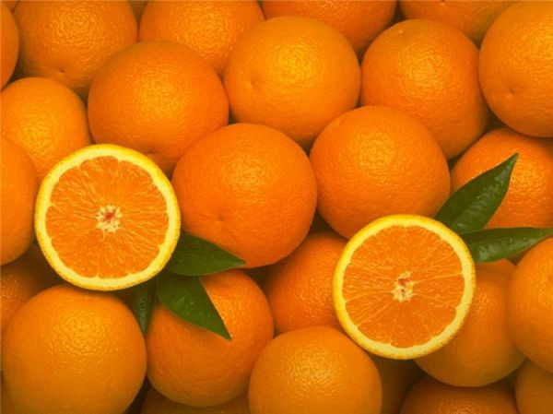
Panda’s got some…
Panda’s got a…

Slide 17
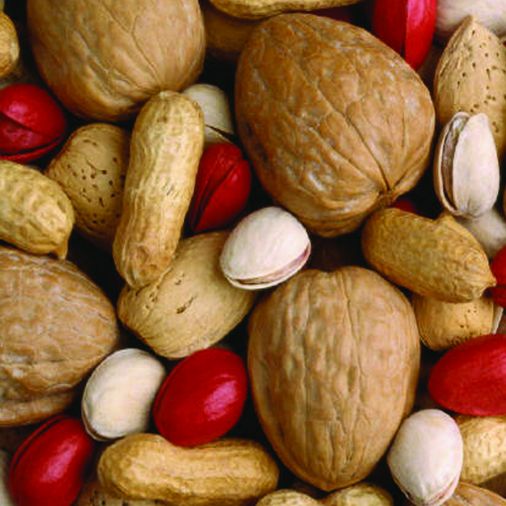
Put the missing letters
N_ts

Slide 18
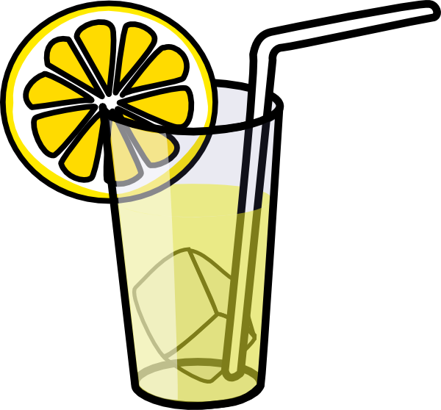
Lemon_de

Slide 19
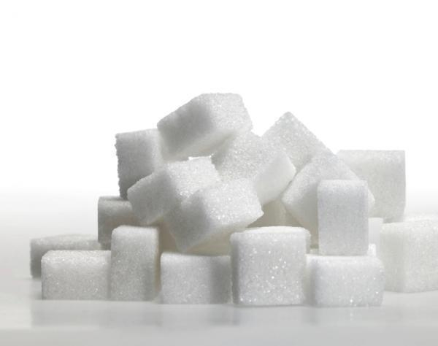
S_gar

Slide 20
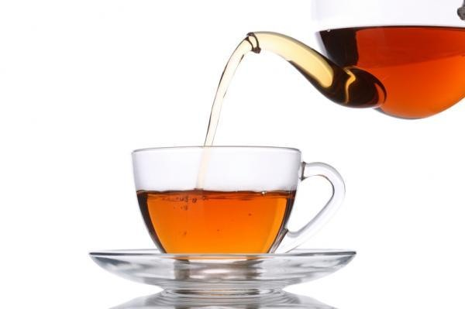
T_a

Slide 21
Sti_k_rs

Slide 22
Com_c

Slide 23
Hairgr_p

Slide 24
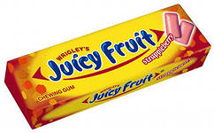
Chewing g_m

Slide 25
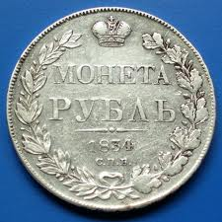
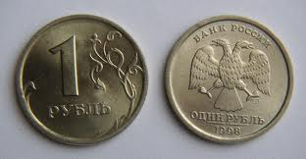
Prices
Rouble

Slide 26
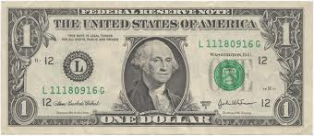

Dollar

Slide 27
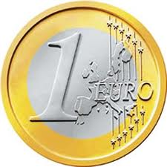

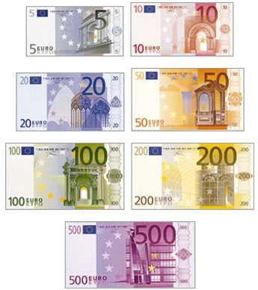
Euro

Slide 28
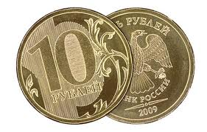
How much is/are…?
How much are the stickers?
10 roubles.

Slide 29
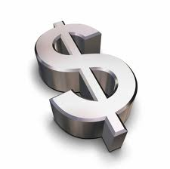
How much is the football?
8.00 dollars.

Slide 30
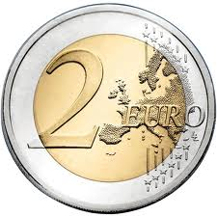
How much is the comic?
2.00 euro.

Slide 31
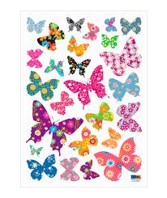
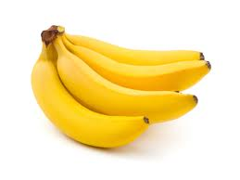
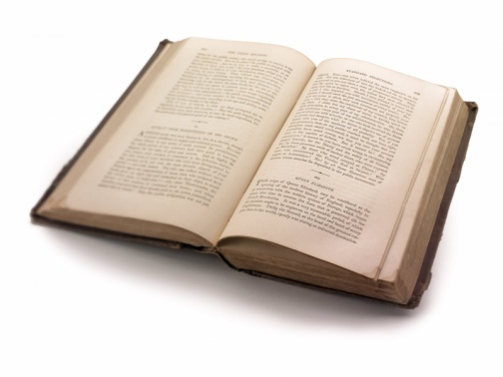
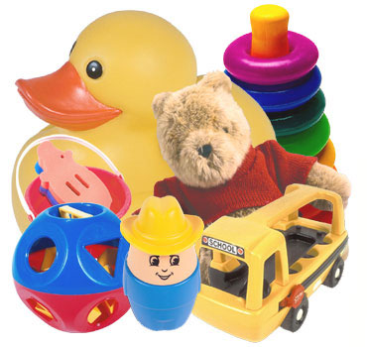
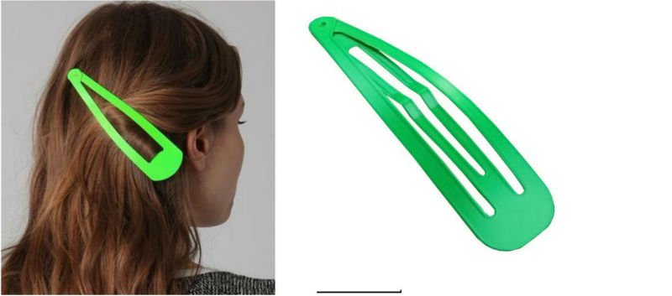
Ask each other
How much…?

Slide 32
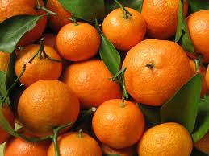
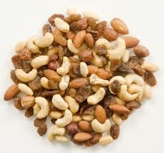
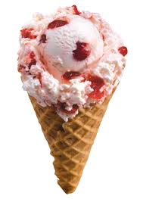
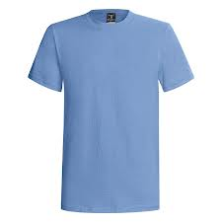
How much…?

Slide 33
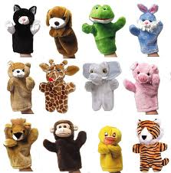
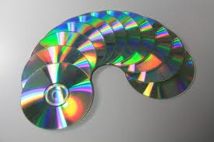
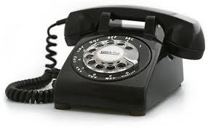
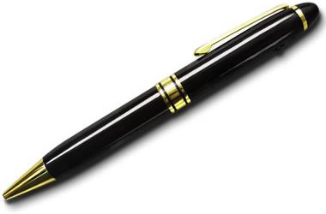

How much…?

Slide 34
Read the questions and find the answers
How much is the chewing gum?
2. Have you got any stickers?
3. How much are the hairgrips?
4. Have you got any comics?
No, sorry, we haven’t got any stickers.
b) It’s 8 roubles.
c) No, but we’ve got some interesting books.
d) They’re 20 roubles.

Slide 35

Вы молодцы!!!
Thank you)))

