Slide 1

The 29th of January.
The theme:
“Literary Almanac”

Slide 2
Three groups participate in our competition
Each team had to come up with:
Team’s name
Team’s logo
Team’s motto

Slide 3

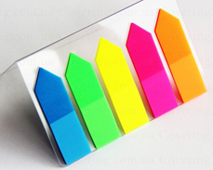
Assessment

Slide 4
Task 1 Grammar contest
Match the words
Say the sentences

Slide 5

1. Lewis Carroll a) Mary Poppins
2. Jonathan Swift b) Sherlock Holmes
3. Rudyard Kipling c) Alice in Wonderland
4. Alan Milne f) Robinson Crusoe
5. Pamela Travers e) Gulliver’s Travels
6. Conan Doyle d)Winnie – the – Pooh
7. Daniel Defo g) Mowgli

Slide 6
1. Lewis Carroll a) Alice in Wonderland
2. Jonathan Swift b) Gulliver’s Travels
3. Rudyard Kipling c) Mowgli
4. Alan Milne f) Winnie – the – Pooh
5. Pamela Travers e) Mary Poppins
6. Conan Doyle d) Sherlock Holmes
7. Daniel Defo g) Robinson Crusoe

Slide 7
The book “Mary Poppins” was written by Pamela Travers.

Slide 8
Task 2 Guess the writer
Name the writer
Name the works of this writer
You have to work fast

Slide 9
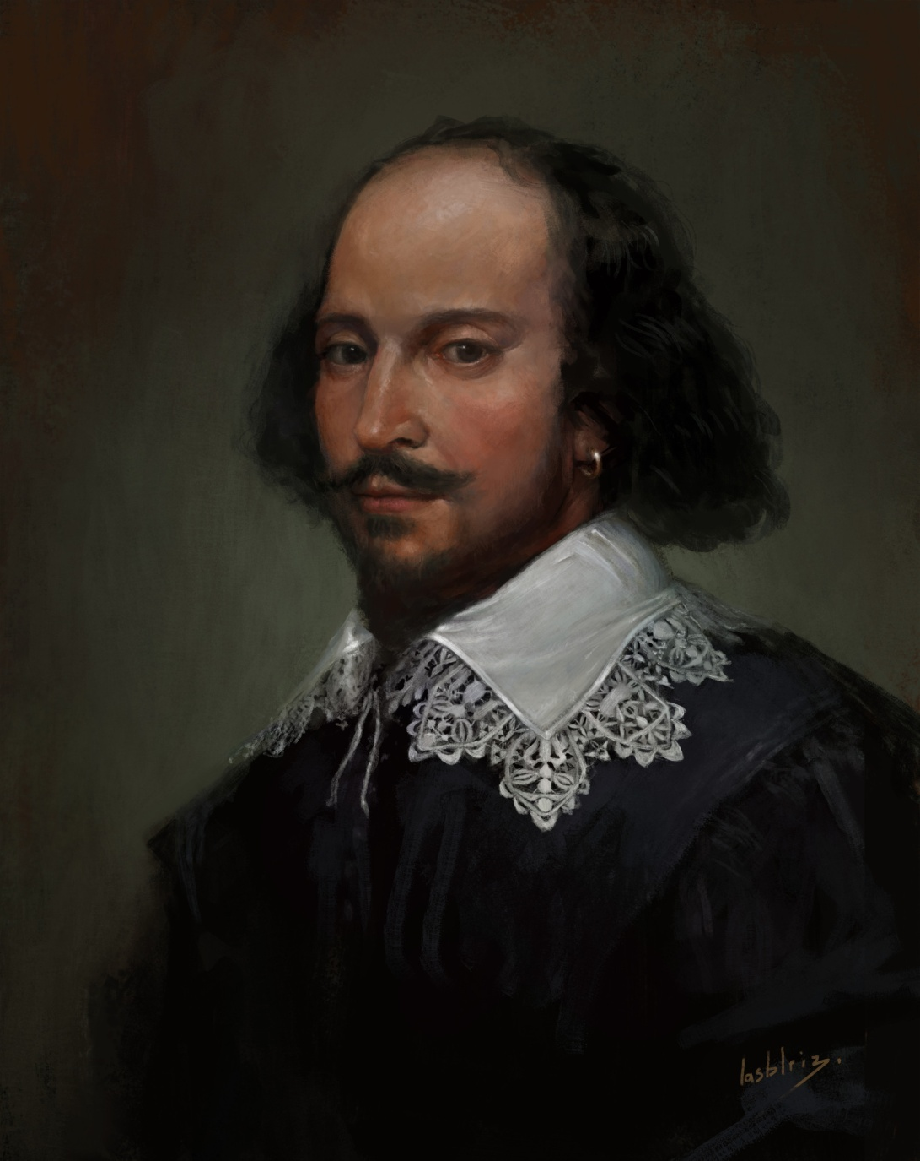

Slide 10
William Shakespeare

Slide 11
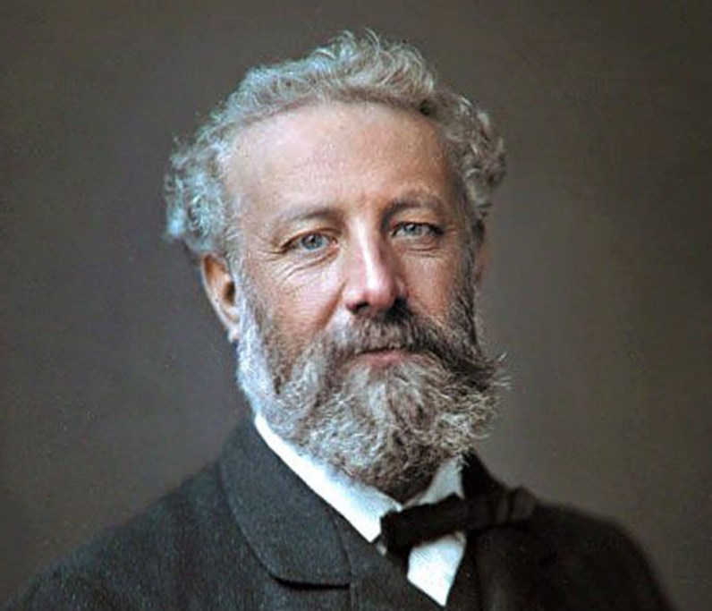

Slide 12
Jules Verne

Slide 13
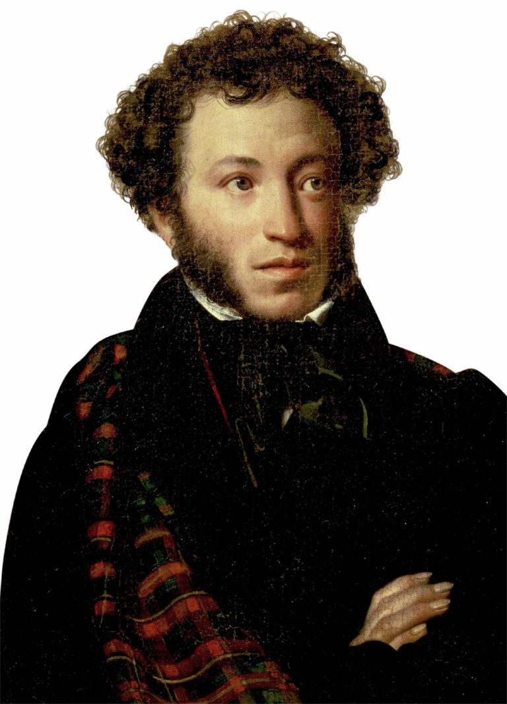

Slide 14
Alexander Sergeyevich Pushkin

Slide 15
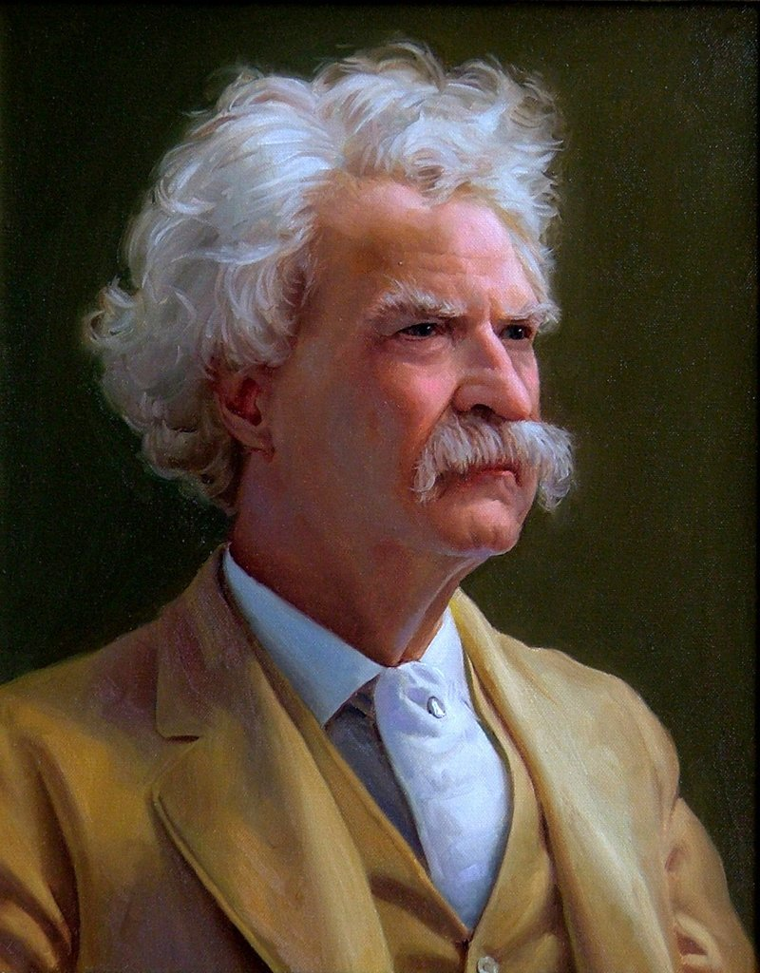

Slide 16
Mark Twain

Slide 17
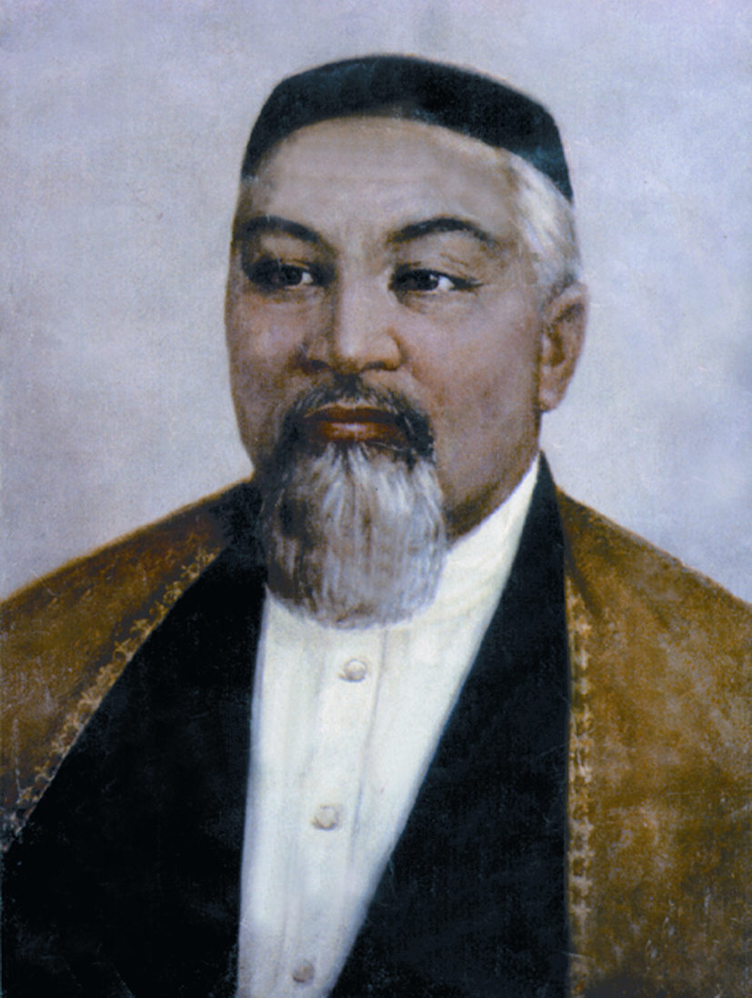

Slide 18
Abay Kunanbayev

Slide 19
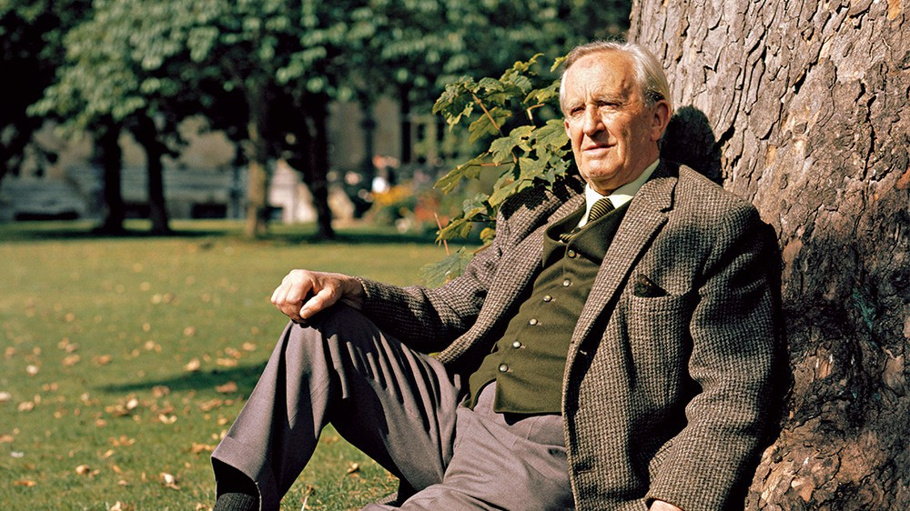

Slide 20
John Ronald Ruel Tolkien

Slide 21
Task 3 Guess the hero
read the description of the hero
name a hero
name the author of the story

Slide 22
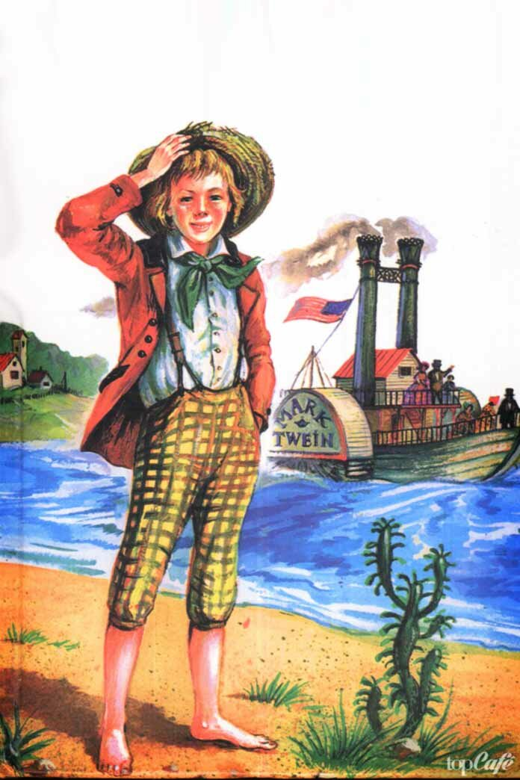
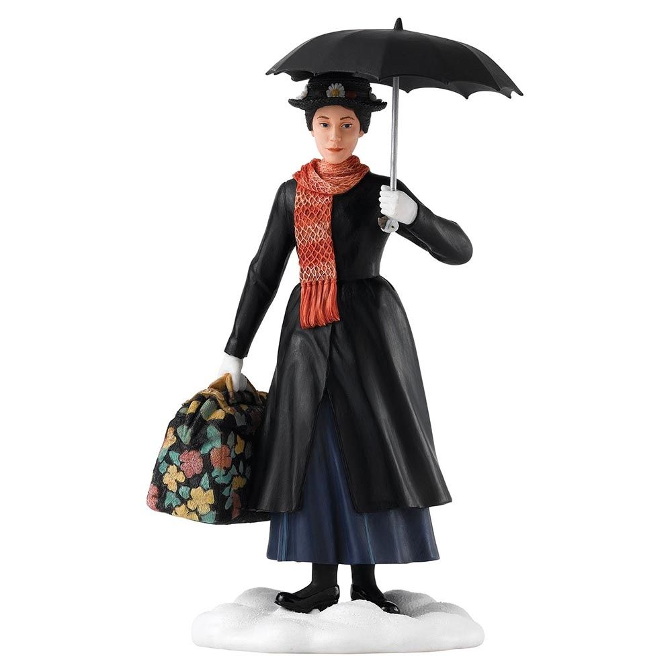
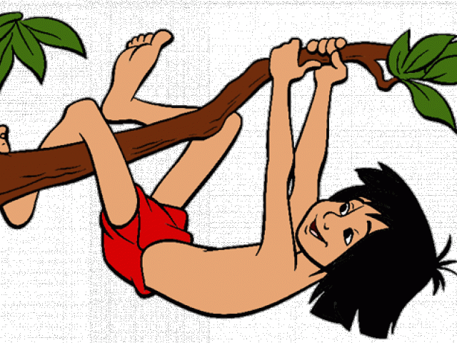
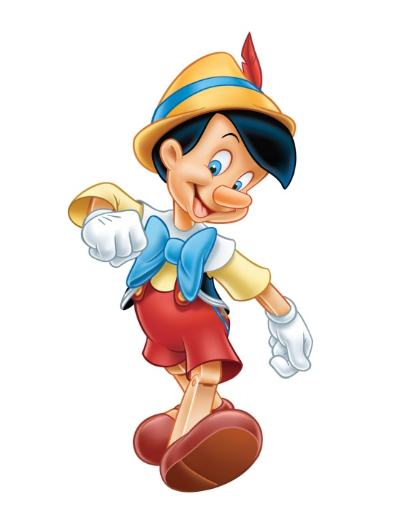
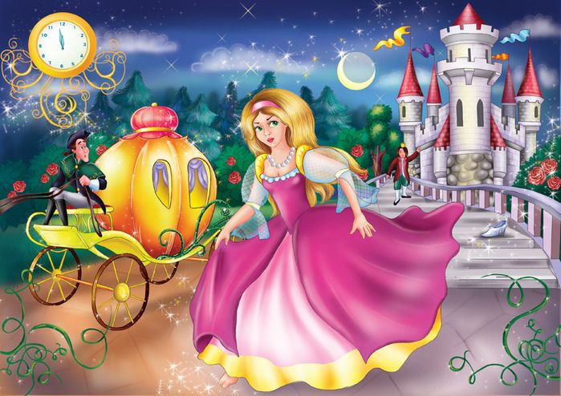

Slide 23
Task 4 Listening
“Books in our life”
listen to the text twice
fill in the missing words
give the answers to another group and check

Slide 24
Task 1
Don’t you think books 1)_________________ thing in the world? I can’t remember a time in my life when I wasn’t reading a book. 2)__________________ memories of being in my school library when I was about five years old. I have been 3)_______________ bookworm since then. You’ll usually see me 4)_____________buried in a book. I 5)_______________ of books. Novels are great 6)_______________ know other worlds and cultures. A good book is one where you never want the 7) __________________ . I also like autobiographies because I think it’s interesting 8)_______________ people’s lives. Encyclopedias are cool too – you can learn everything about everything in these. 9)__________________ books to the Internet. Books need to be in your hand and 10)________________ .

Slide 25
.
Don’t you think books are the best thing in the world? I can’t remember a time in my life when I wasn’t reading a book. I still have memories of being in my school library when I was about five years old. I have been a bit of a bookworm since then. You’ll usually see me with my head buried in a book. I love all kinds of books. Novels are great for getting to know other worlds and cultures. A good book is one where you never want the story to end. I also like autobiographies because I think it’s interesting to read about people’s lives. Encyclopedias are cool too – you can learn everything about everything in these. I still prefer books to the Internet. Books need to be in your hand and made of paper.

Slide 26
Task 5 Asking questions on the topic “Books”.
ask questions about the topic
make a dialog
tell a dialog

Slide 27
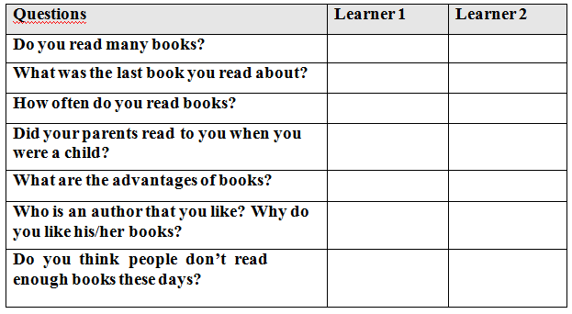

Slide 28
Reflection of the lesson

