Slide 1

Medical Tourism in
Perm Krai
Государственное бюджетное профессиональное образовательное учреждение
«Добрянский гуманитарно-технологический техникум им. П.И. Сюзева»
Выполнила обучающаяся II курса специальности 34.02.01
«Сестринское дело» : Овчинникова Евгения Юрьевна Руководитель: Рычагова Ольга Викторовна

Slide 2


'Health is wealth' is very much true. One must try hard to remain healthy. If we are healthy, we can easily fight with other problems of life. People do many different things to remain healthy: some go for a healthy diet, other recommend exercise, and the rest thinks that health awareness is important. Nowadays it is quite common for people to move to other city or countries for getting a good chance to be healthy. Medical tourism has become an important part of people's life.

Slide 3

What is medical tourism?
Medical tourism also known as medical travel or global healthcare is the process in which patients travel to another region or country for medical or health and wellness services. The term medical tourism may sound strange and exotic to some people but in fact it is rapidly growing phenomenon. The range of services is expanding every day. There are four main factors driving medical tourism:
affordability
accessibility
availability
better quality

Slide 4
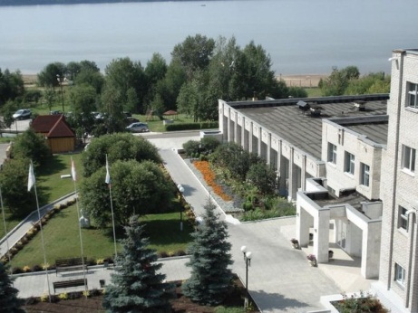
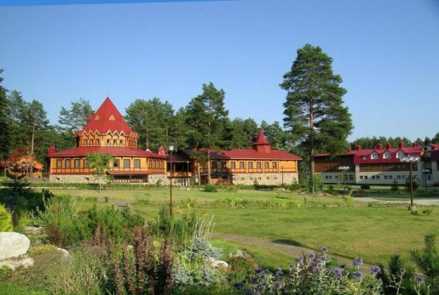
Medical tourism in Russia has been growing for several years. Practically everywhere around the country there are many health resorts and sanatoriums offering various programms. As for our region, it has lots of popular places to visit, but we would like to describe the most prestigious sanatoriums in Perm Krai – “Ural Venice” and “Demidkovo”.
The level of health care offered in our regional health centres fulfils the requirements of the most demanding patients. Reasonable prices, highly-qualified staff, unique nature and clean air assist quick recovery.

Slide 5
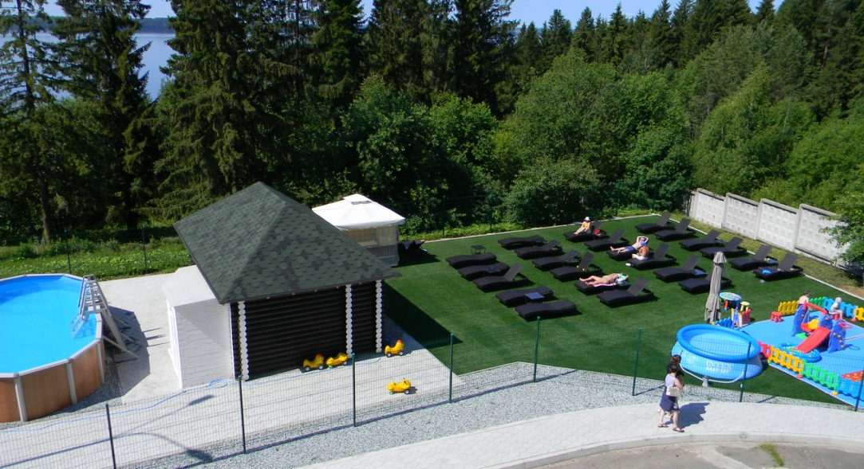
Sanatorium "Ural Venice"
What do you imagine when you hear the words "The Urals Venice?" Narrow channels and gondolas? And what is the connection with the Urals? In fact, such a romantic name was given our sanatorium, which is located in a picturesque town Dobryanka, near the pine forest and beautiful river.

Slide 6
Medical profile and programs
Qualified and friendly staff will help you to solve the problems associated with diseases of cardiovascular system, gastrointestinal tract, hearing, nervous system, musculoskeletal apparatus, respiratory organs, diseases of female and male sexual sphere, skin diseases.
We offer our famous programs "Antistress", "Healthy spine", "Women's health", "Hypertensive illness", "Respiratory system".
Our sanatorium is a unique child resort for treatment of musculoskeletal diseases, bronchial asthma, metabolic disorders.
We receive patients all the year round. After staying in this wonderful place patients get completely cured of stress and fatigue, and return home filled with vigour and vital energy.

Slide 7
Our sanatoriums are facilitated by cutting-edge equipment, and the prices for treatment remain quite affordable.
inhalation
speleotherapy
aromatherapy
phytotherapy
circular shower
dirty treatment
inversion therapy
We offer a variety of possibilities to attend steam and baths, sauna, to take recovery and relaxation procedures and spa procedures.

Slide 8
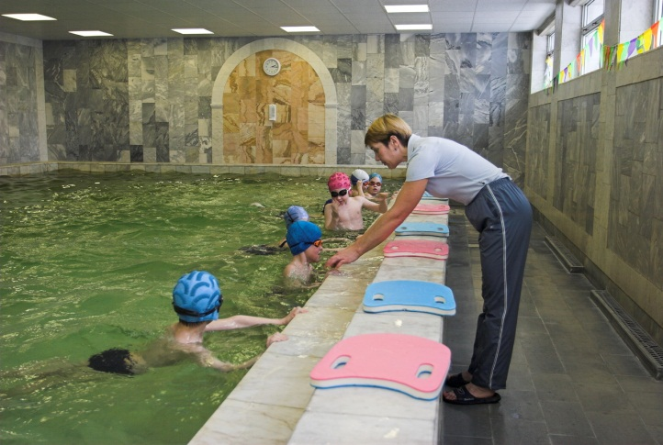
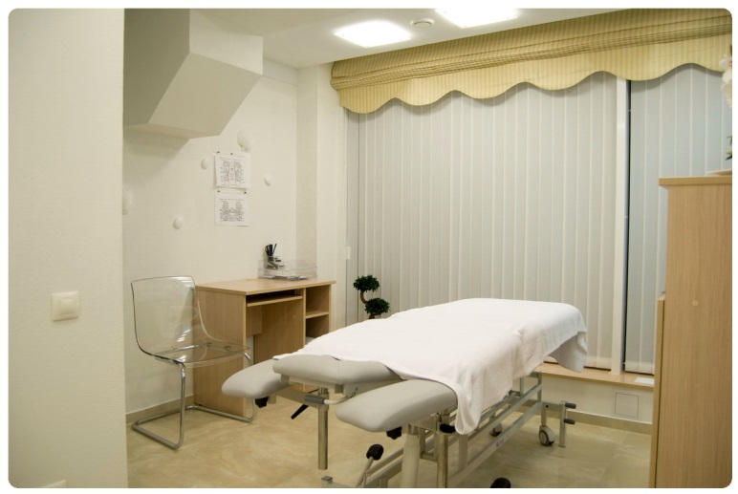
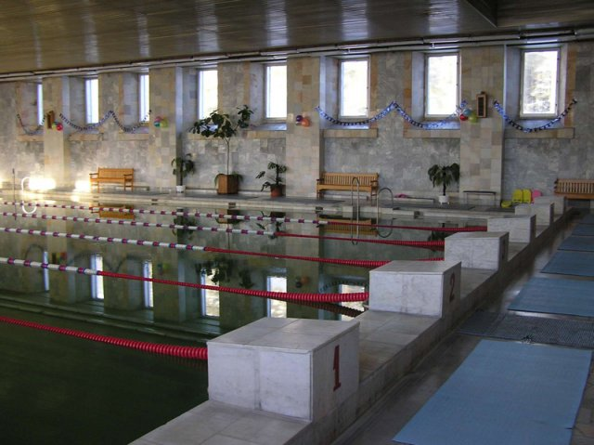
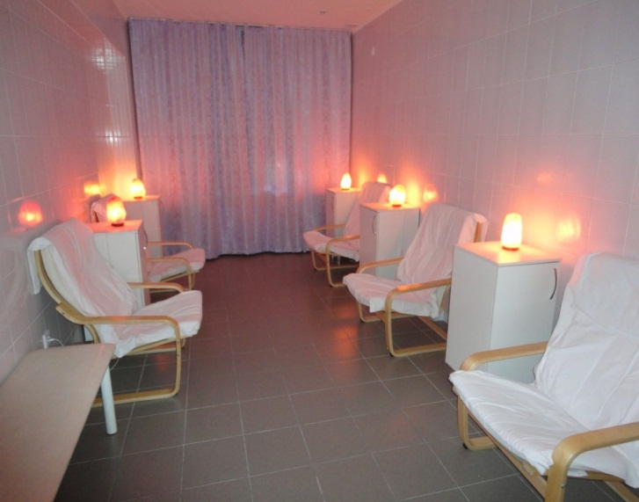
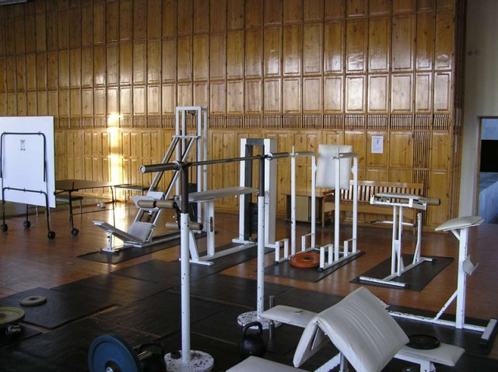
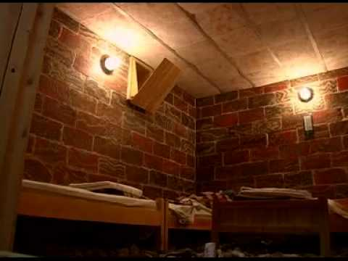

Slide 9
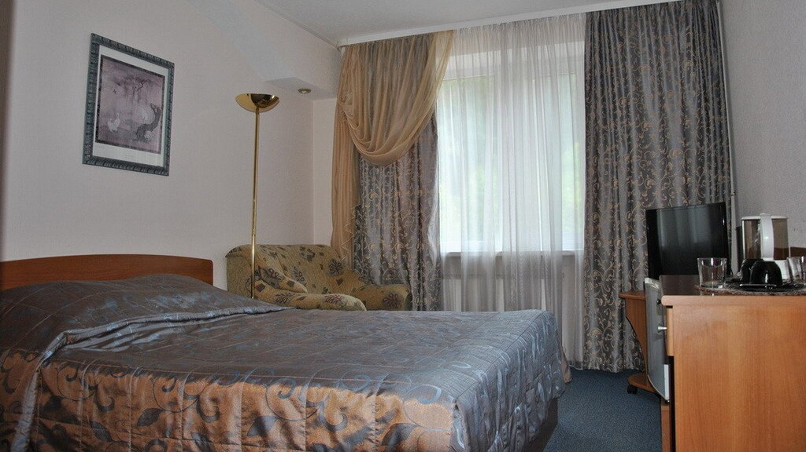
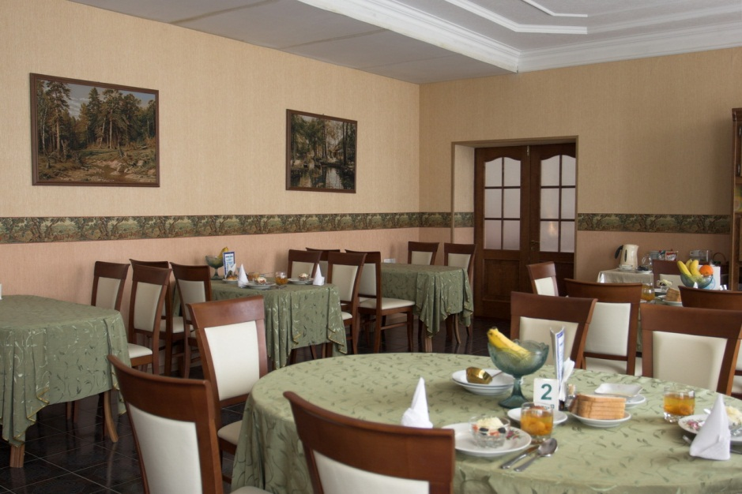
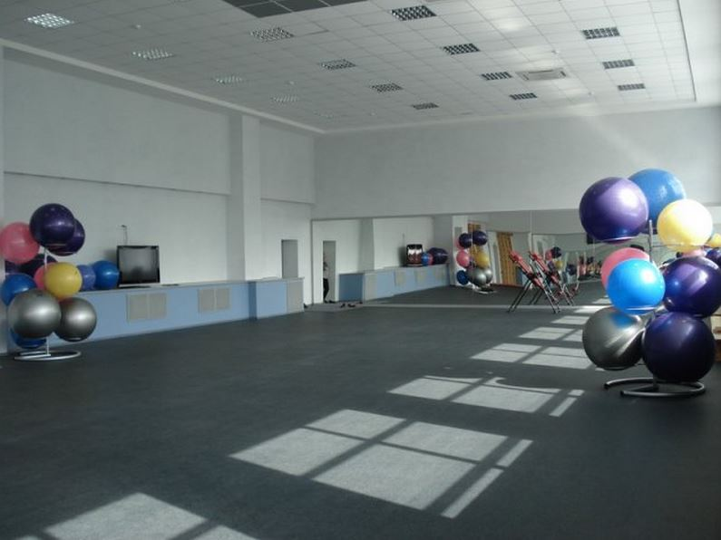
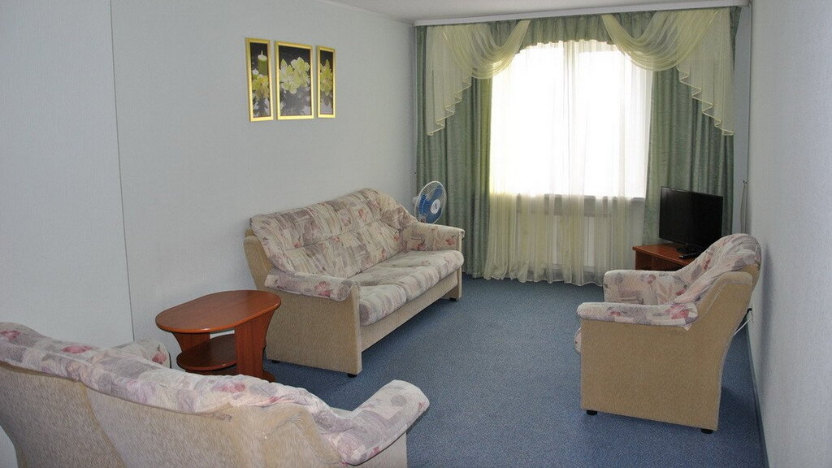

Slide 10







High personnel qualification attracts more and more foreign patients from the CIS countries. Excellent results of recovery and treatment are brought about by fresh pine air and first-class service. The range of services is expanding every day.
pure nature
single sanatorium complex
swimming pool with artesian water
reasonable prices
helpful highly qualified staff
healthy food

Slide 11

Rest in a sanatorium is a great way to improve your well-being and improve your health. Sanatorium treatment is aimed at improving a person's health, restoring the body after illness and surgery, preventing diseases. Today sanatoriums, boarding houses and recreation centers are inferior in popularity to overseas resorts of the "all inclusive" type. The modern sanatorium is not only the best holiday with children, but also an excellent way to strengthen the immunity of the whole family.
"Demidkovo" is a comfortable environment for everyone, regardless of age, type of activity and preferences. The prices for a holiday in a sanatorium depend on the accommodation, the program and the chosen type of food.

Slide 12
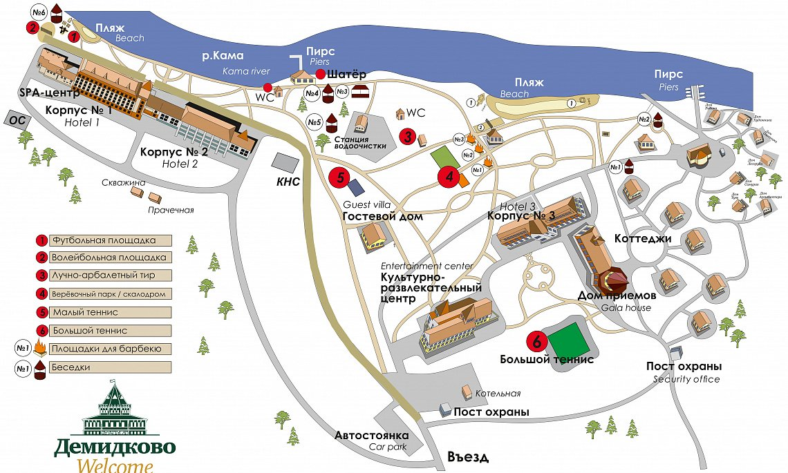
Lay-out

Slide 13
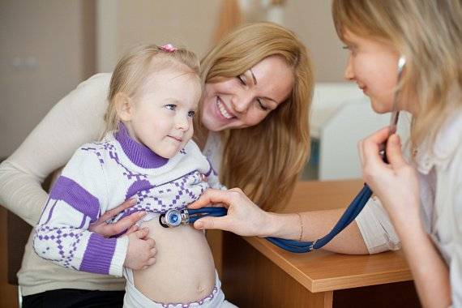
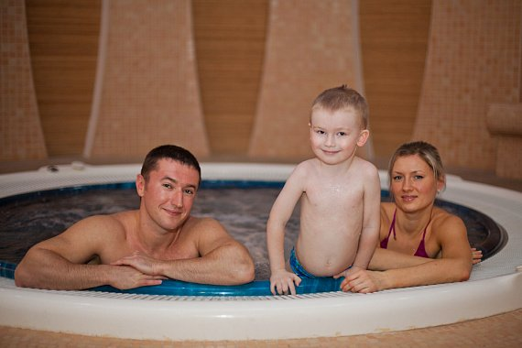
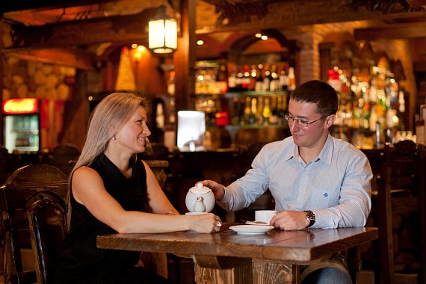
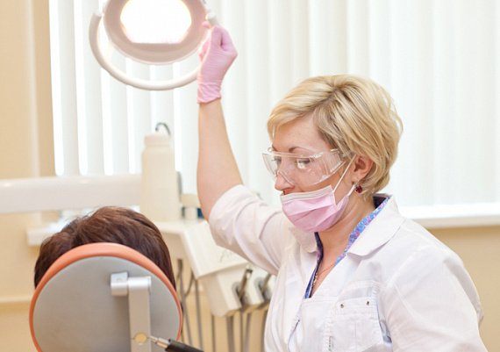
Medical programs
DETOX PROGRAMS
IMPROVEMENT OF EMPLOYEES OF ENTERPRISES
SPA TREATMENT
STOP-DIABETES
HEALTHY CHILD
MEN’S HEALTH PROGRAM

Slide 14
We offer a variety of entertainments, a possibility to attend steam and baths, sauna, to take recovery and relaxation procedures and spa procedures. Various types of massage (classical, sports, anti-cellulite) water procedures (Sharko douche or shower, circular and hydro massage, aroma baths) also enjoy great demand here. Tourists will also be offered aroma therapy, music therapy, and many other procedures.
On the territory there are: SPA-center, football, basketball and volleyball grounds, grounds for small and large tennis, rope park, ice rink, simulators, library. Even a walk through such scenery fills the soul with calm and peace.

Slide 15
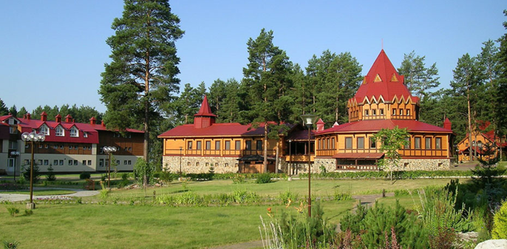
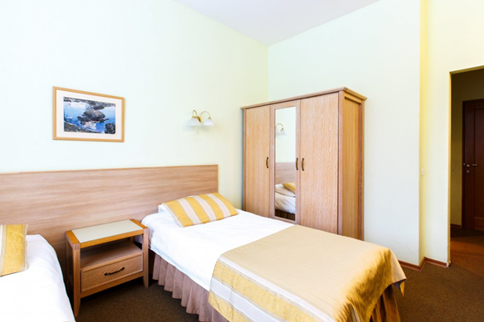
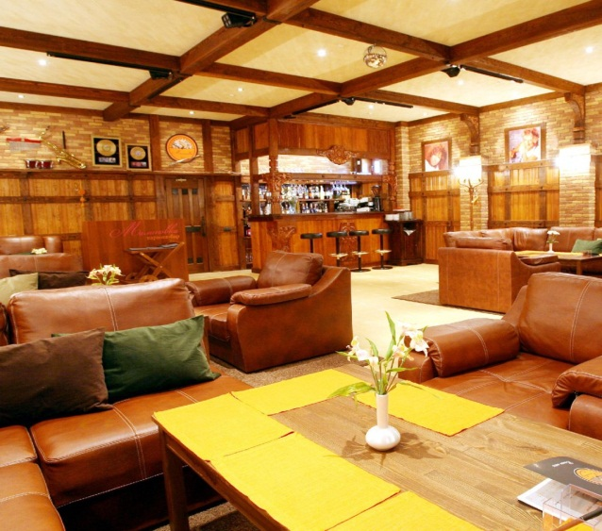
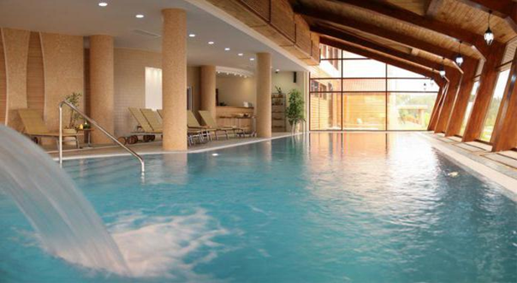
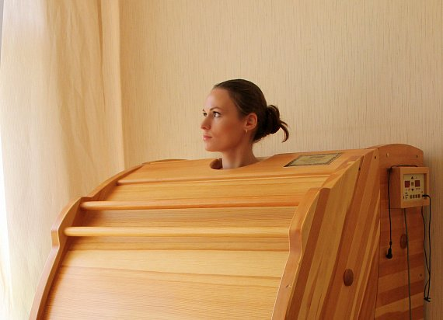
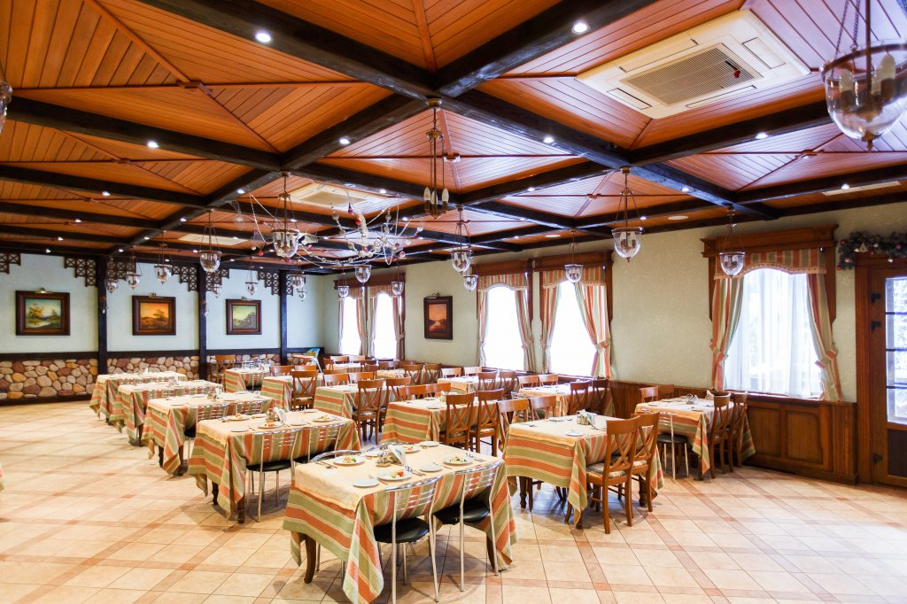

Slide 16
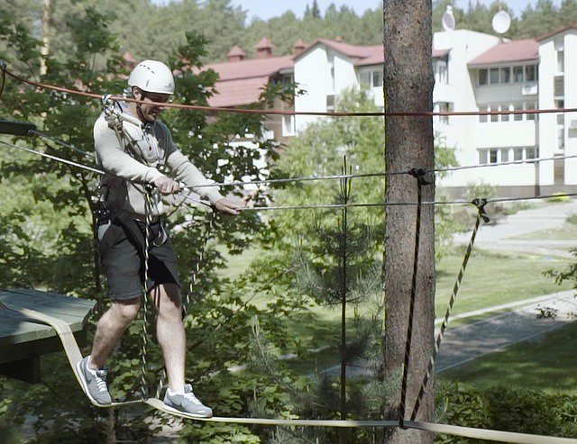
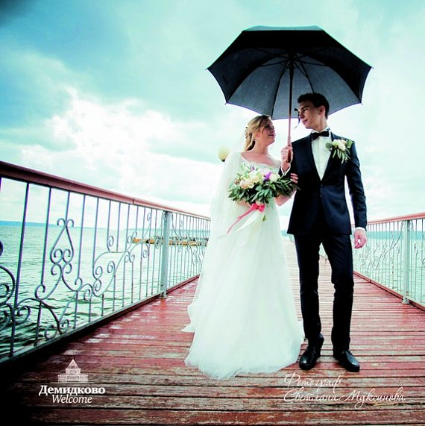
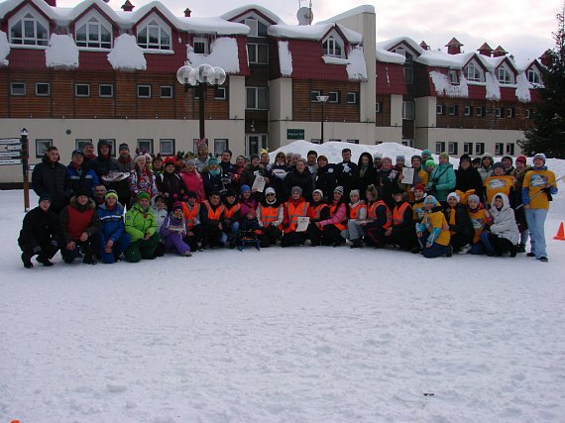
Rest and recovery possibilities are available here all the year. Sanatorium "Demidkovo" offers corporate leisure programs together with colleagues "Day in "Demidkovo". This is one of the best places in the Perm region for business tourism events! Your wedding in our sanatorium will become an unforgettable experience that you will cherish for many years.

Slide 17
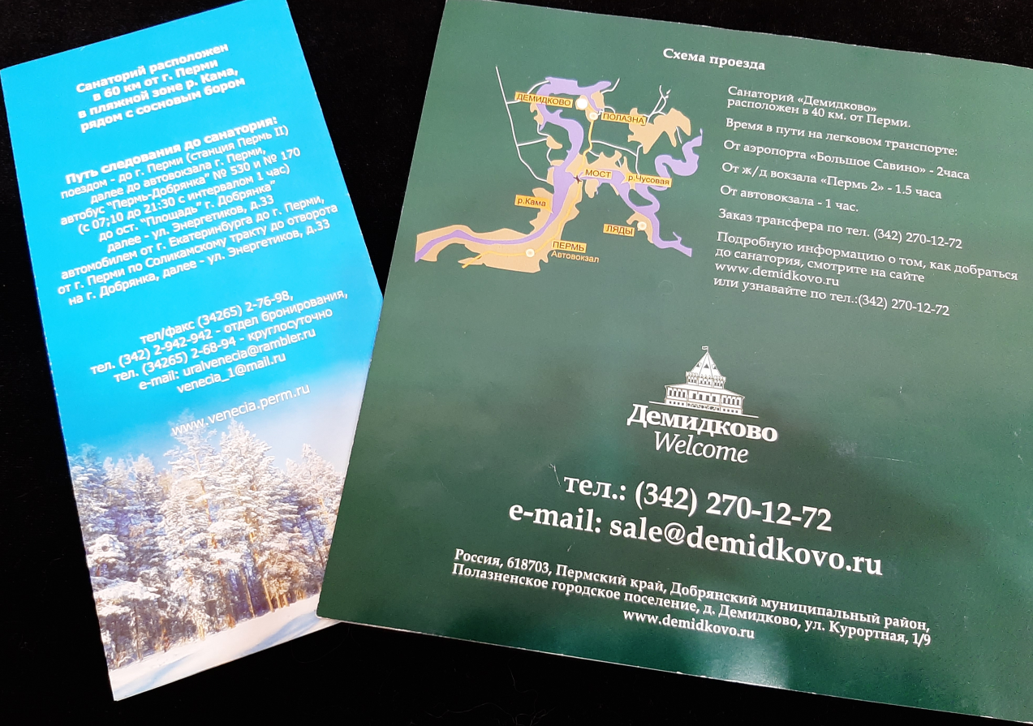
At present our sanatoriums apart from having natural riches are also facilitated with state-of-the-art equipment and widely employ advanced medical and recovery methods. Therefore a lot of clients from Russia and citizens from the CIS come here with pleasure.

