Slide 1

Welcome to Krasnoyarsk!
Project is made by:
Karnausov Alex
Tritenbah Vadim
Group: 5/2

Slide 2
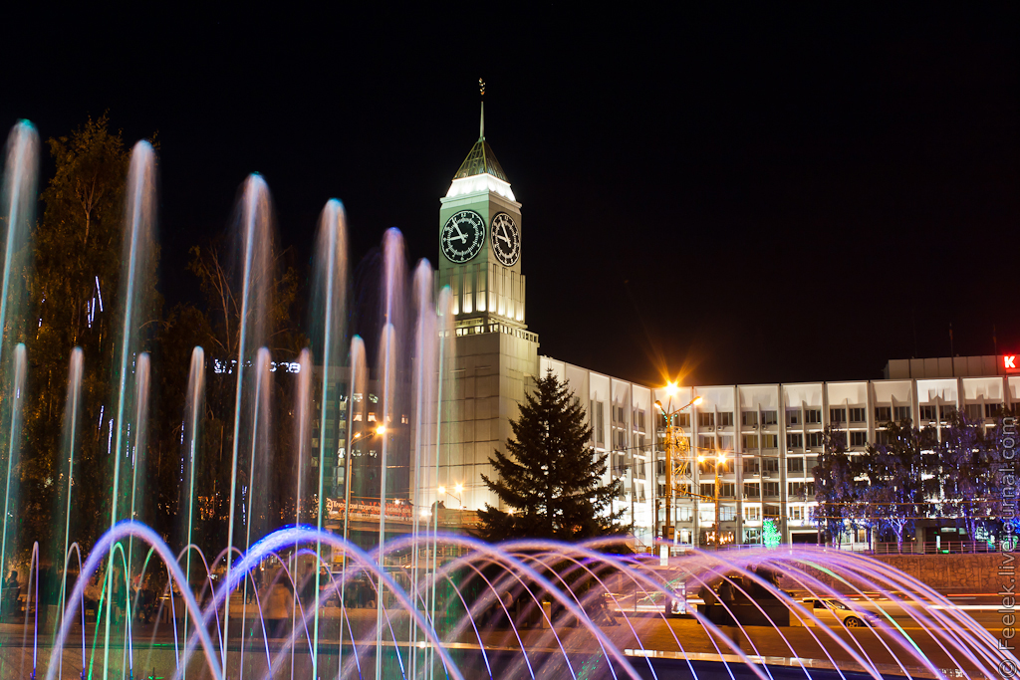
Good morning!
My name is Alex, and I am your guide.
I am glad to see you in one of the beautiful cities of Russia - Krasnoyarsk.

Slide 3
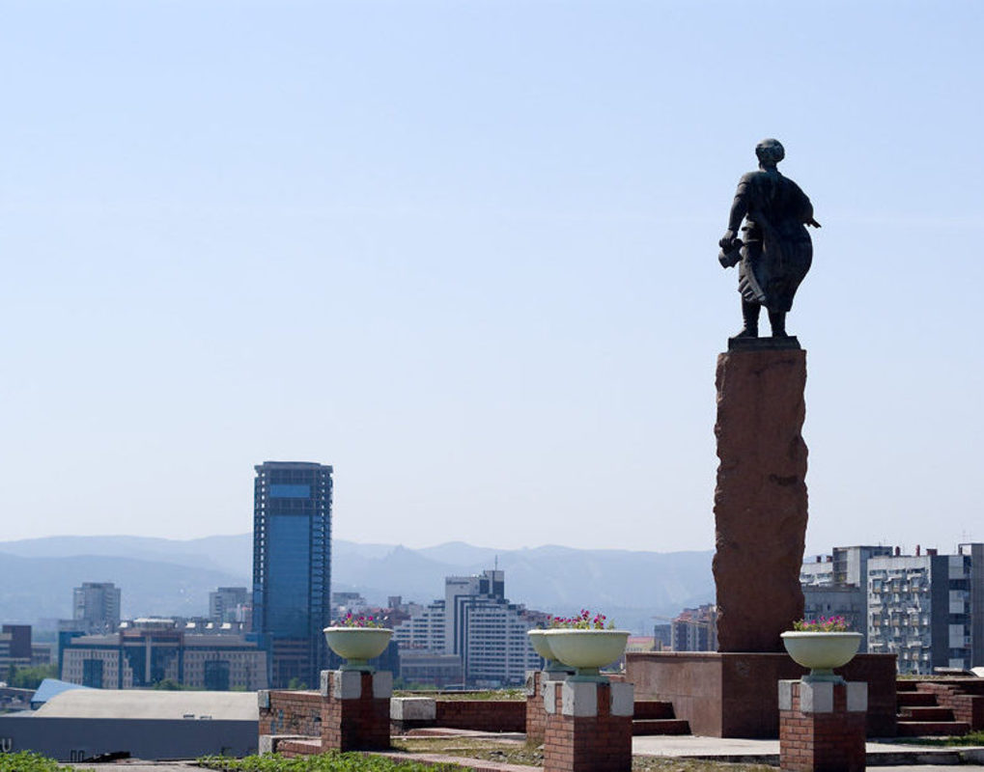
Krasnoyarsk – was founded in 1628, is the largest cultural and economic center of Eastern and Central Siberia.
First of all I tell you a little bit about Krasnoyarsk itself.

Slide 4

Emblem of Krasnoyarsk
The lion on the coat of arms of the city symbolizes courage and strength

Slide 5
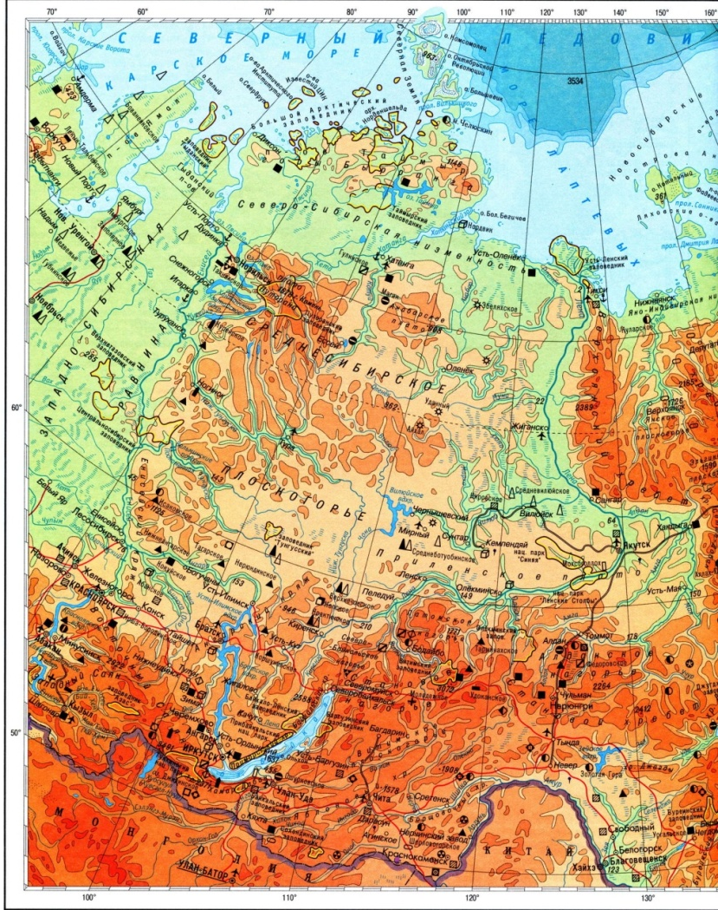
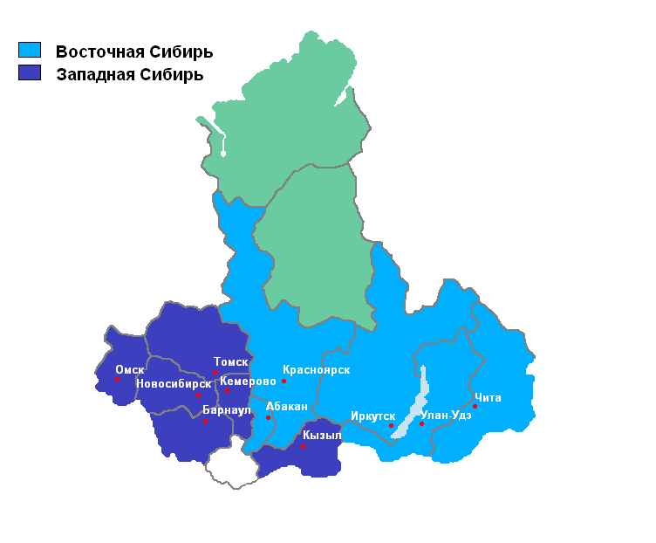
East Siberia
My region is located in the center of Siberia.
We have a harsh climate and vast natural resources.
The city is surrounded from all directions by mountains

Slide 6
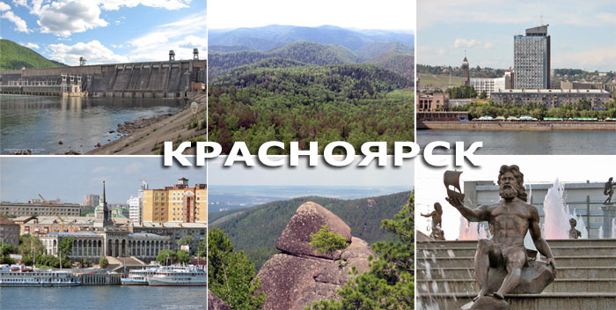
Krasnoyarsk is the largest city of Eastern Siberia and Far East. It was built by the Cossacks in 1628, and currently has a population of 1 million 50 thousand people.
The Yenisei River divides it into two districts - right bank and left bank.

Slide 7
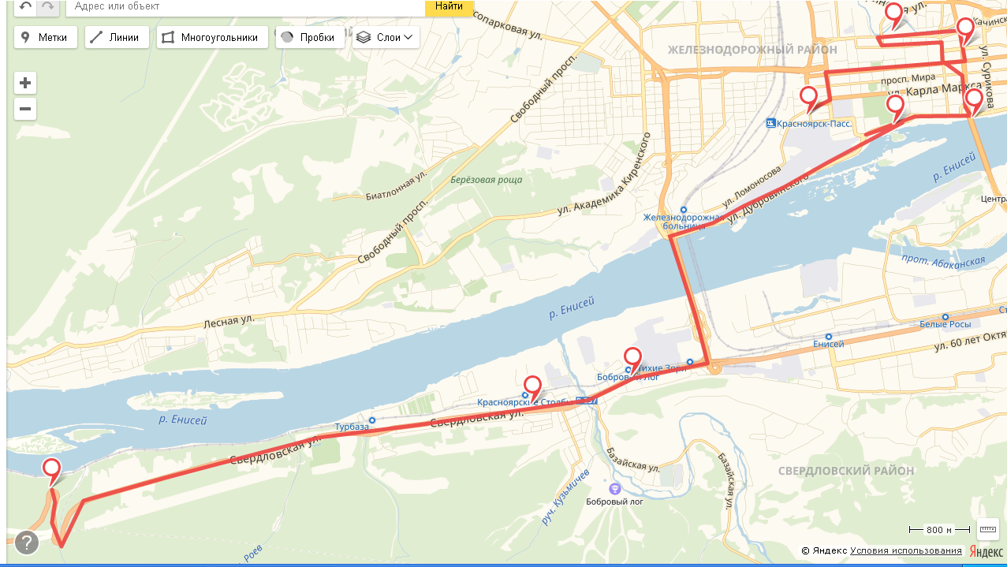
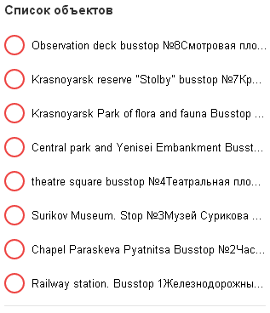
Pay your attention to the card.
This is a map of our voyage with bus stops.
To each of you, I will distribute these maps so that you can navigate the terrain

Slide 8
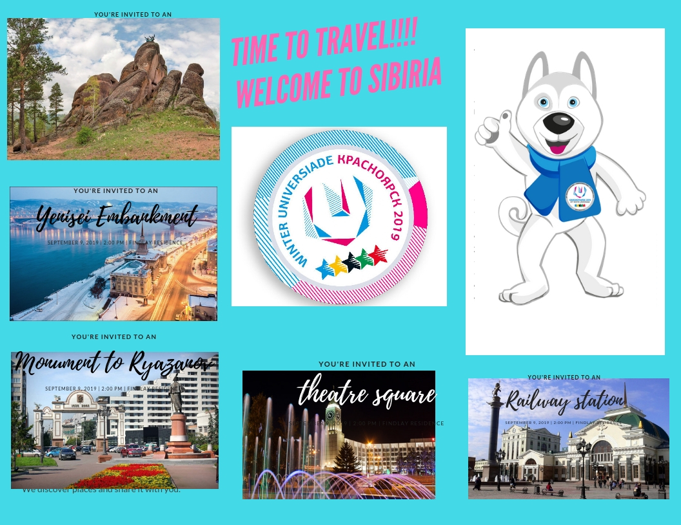
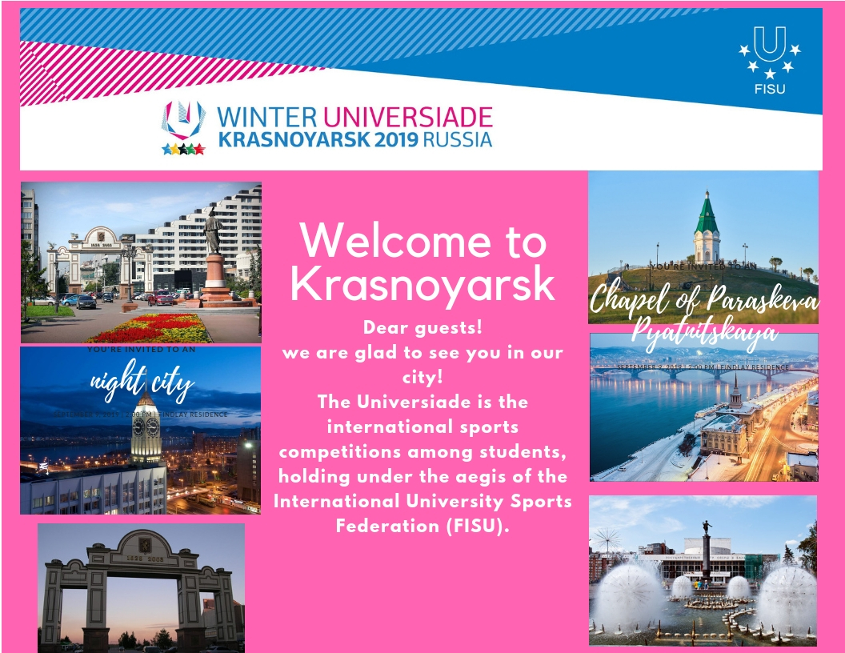
We also offer you a booklet
The main sights of our city are displayed.

Slide 9
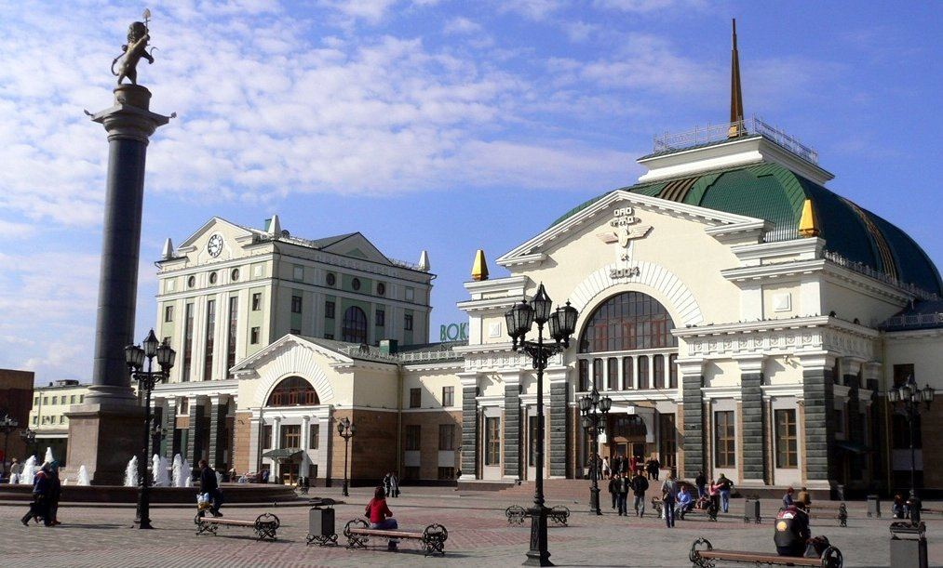
Dear guests!
We start our excursion from the railway station.
Today, the Krasnoyarsk railway station is the main transportation hub

Slide 10
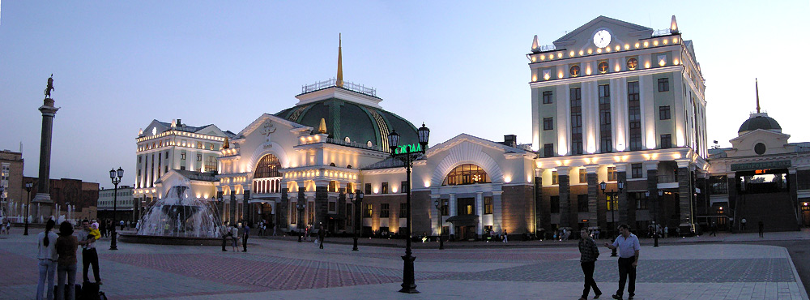
Stop 1 Railway station
The first building of the station of the station of Krasnoyarsk was erected in 1895 according to the design of the architect Nikolay Solovyov.
At the beginning of the twentieth century, the railway station was the site of folk festivals.

Slide 11
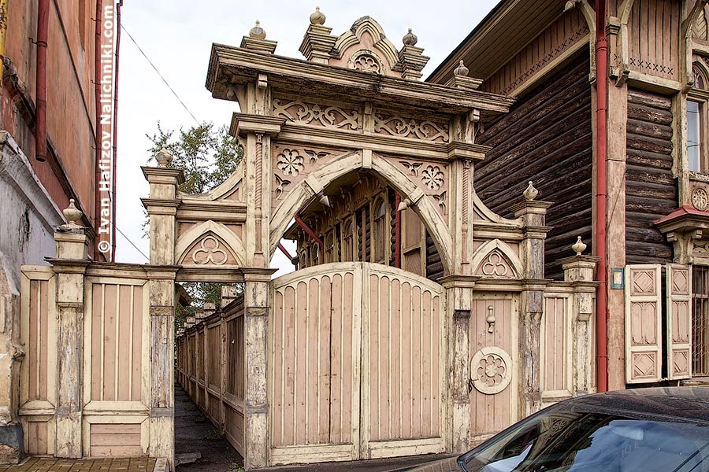
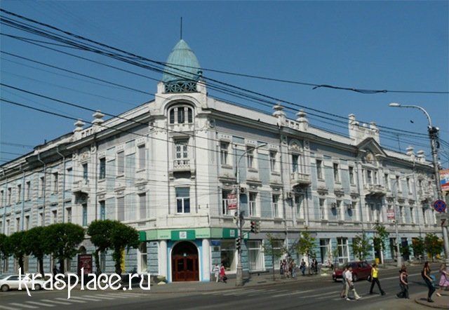
From the train station we go with you to the symbol of our city.
This is a chapel.
Now we pass with you the historical center of Krasnoyarsk.

Slide 12
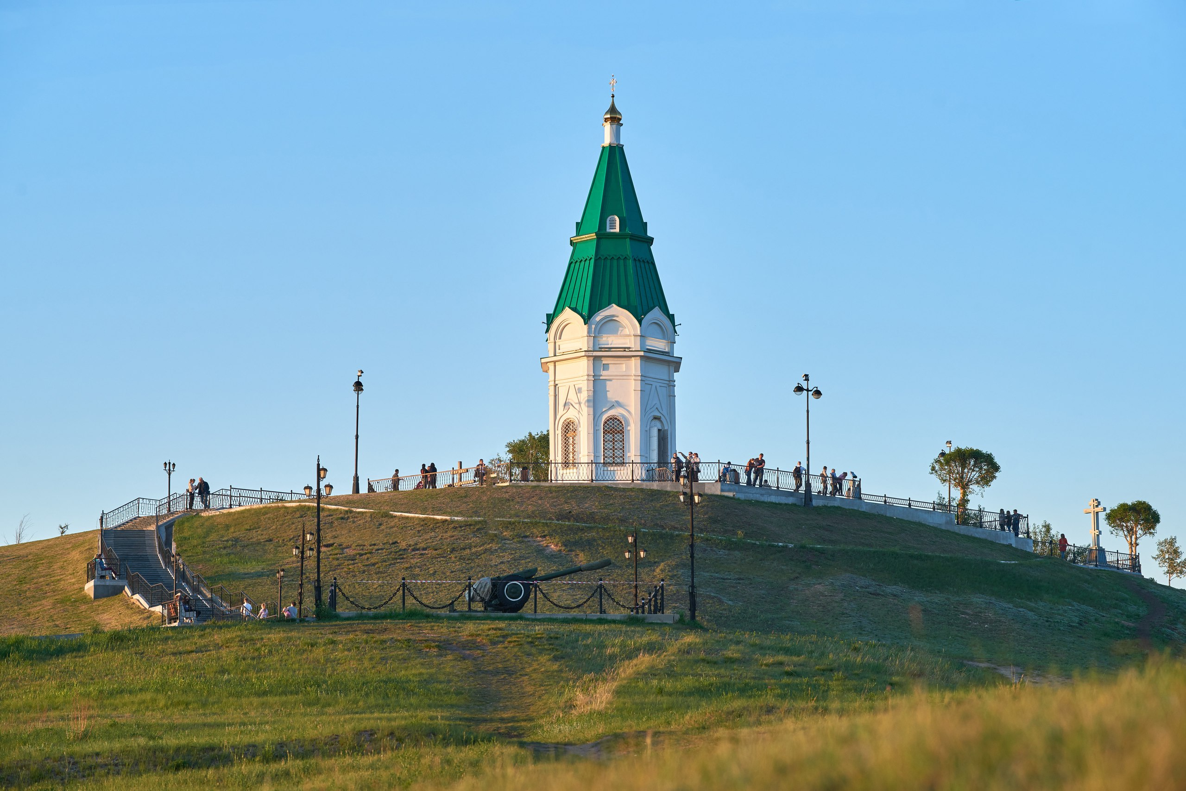
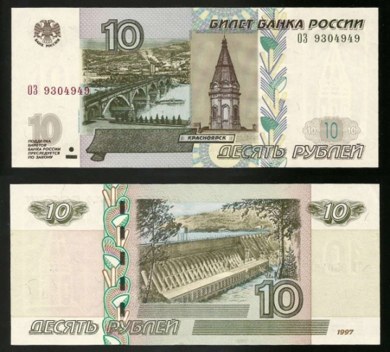
Stop 2 Chapel Paraskeva Pyatnitsa
Here is our second stop. This is Paraskeva Pyatnitsa chapel.
Paraskeva Pyatnitsa Chapel is a symbol of the city and is located on the Guard mountain – the highest point of the city.
In 1805, merchant I.L. Novikov erected a wooden chapel in the name of Paraskeva Pyatnitsa in memory of his rescue from the whirlpool on the river's threshold.
And this chapel is depicted on 10 rubles.

Slide 13
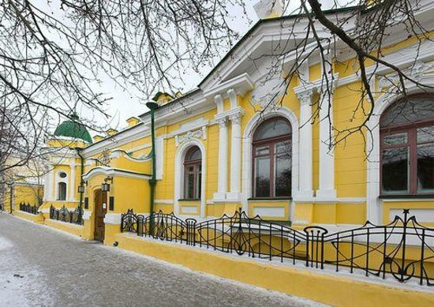
Stop 3 Surikov Museum
The Krasnoyarsk art museum of V. I. Surikov – the unique place for fans of art
The museum itself was created in 1948 in honor of the 100th anniversary of the artist’s birth.

Slide 14
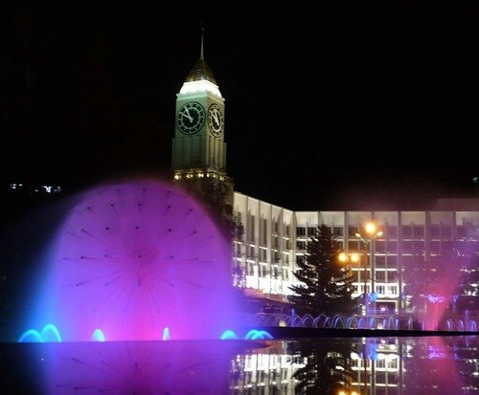
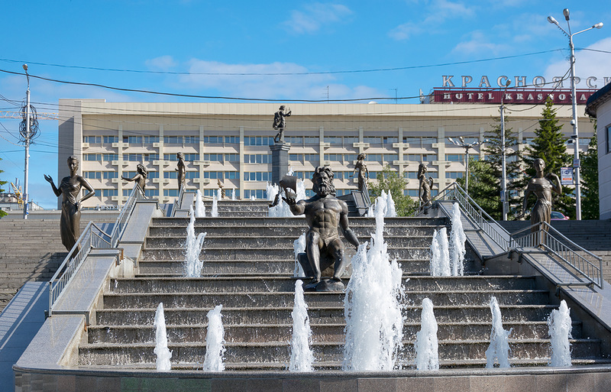
Stop 4 Theater Square
Clock tower – the integral symbol of the city for those who in it was born and grew up.
Theater Square - a great place to walk at any time of the year.
Here are the main events and festivals of the city.
The Rivers of Siberia fountain — is considered the most beautiful fountain of Krasnoyarsk, there is on the theater square, the central sculpture of the fountain – the father Yenisei, on each side sculptures – the girls representing inflows of Yenisei.

Slide 15
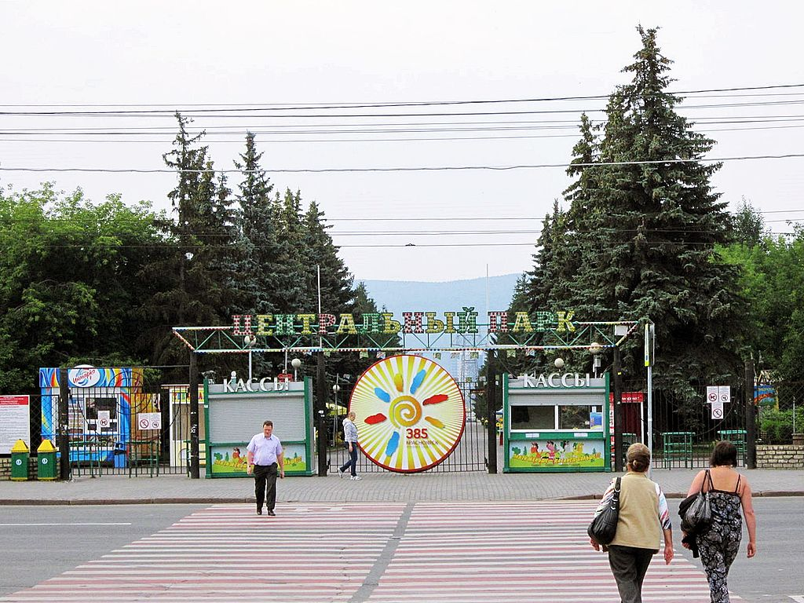
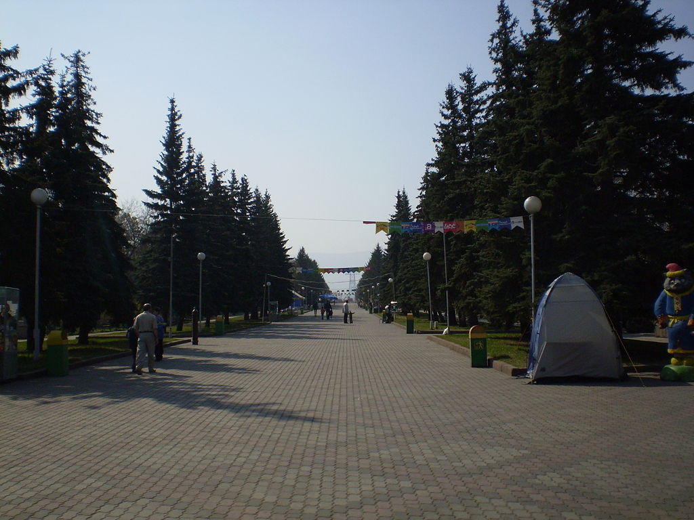
Stop 5 Central Park
Central Park of Culture and Leisure of A. M. Gorky – is on the left coast of Yenisei in a historical part of the city, the area of the park of 15 hectares, in the park there are a lot of attractions for adults and children

Slide 16
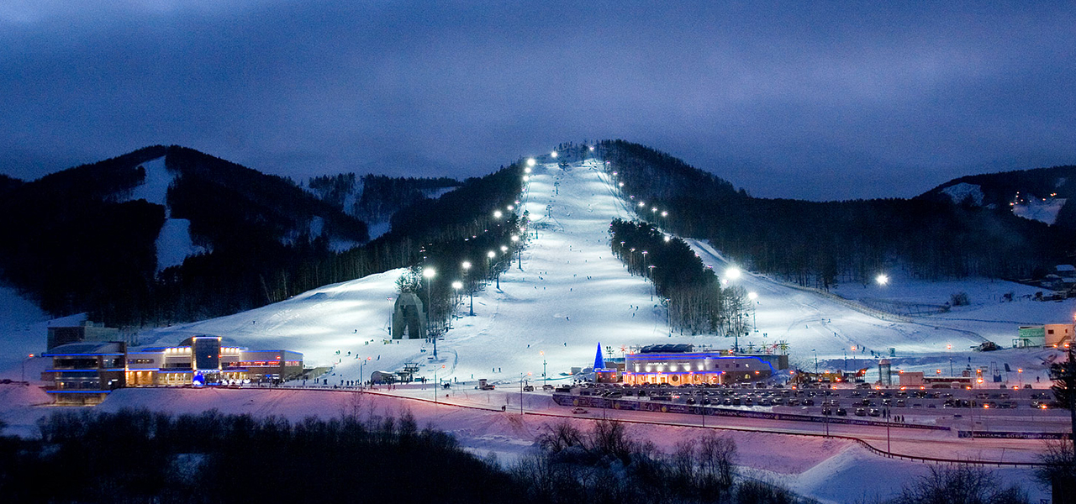
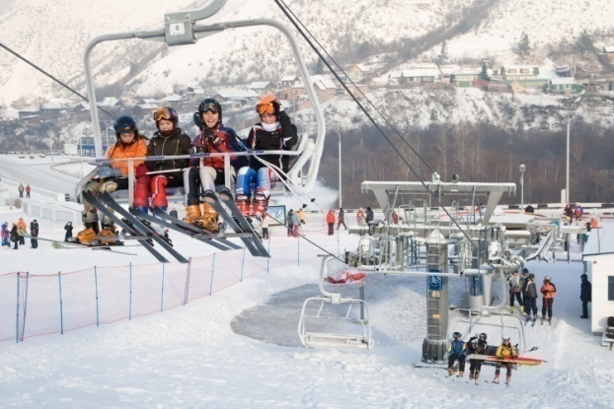
Stop 6 Fanpark «the Beaver Ravine»
All-weather park of sport and leisure – Fanpark «the Beaver Ravine», 5 ski slopes and an attraction Rodelban, in the summer – the swimming pool, attractions and the ropeway are opened in the winter.

Slide 17
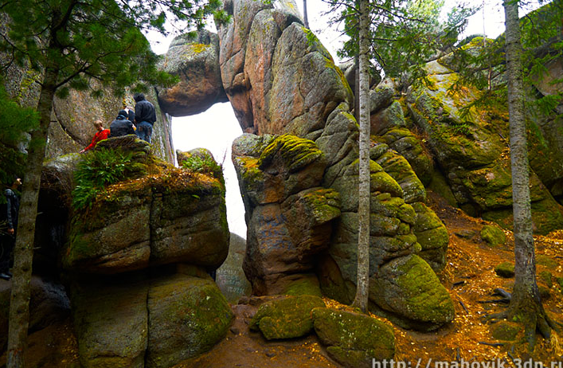
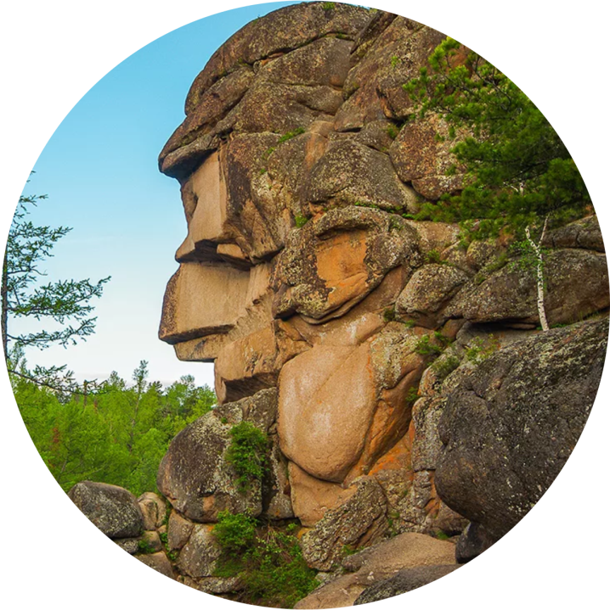
Stop 7 The reserve Krasnoyarsk «Stolby»
The reserve Krasnoyarsk «Stolby» — the hallmark of the city, is the brightest natural place of interest of the city and its vicinities, attracts travelers from around the world.

Slide 18
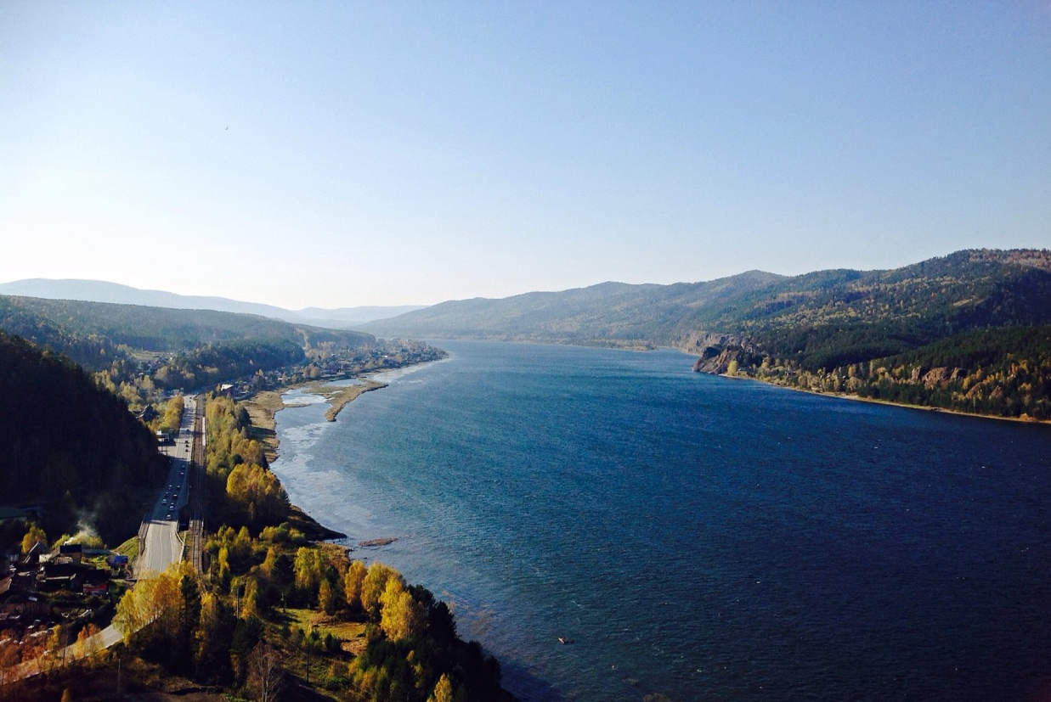
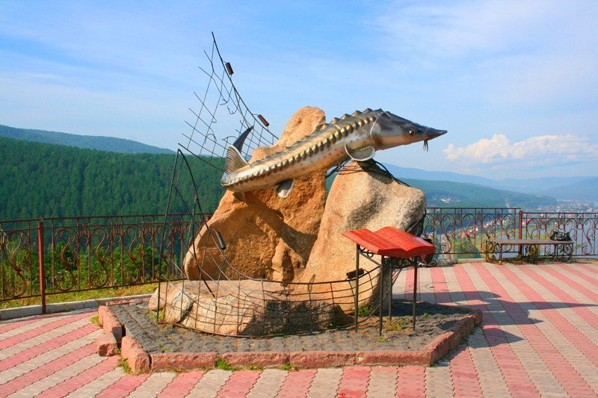
Stop 8 The observation deck
In 2004, on the Sliznevsky cliff near the village of Ovsyanka, an unusual forged monument to Viktor Petrovich Astafyev “Tsar-fish” was erected.
The monument is dedicated to the book of the same name, one of the writer's landmark works on the interaction of man and nature.
The observation deck and a place for rest near the monument are very popular among the citizens, guests and, especially, among the justmarried

Slide 19
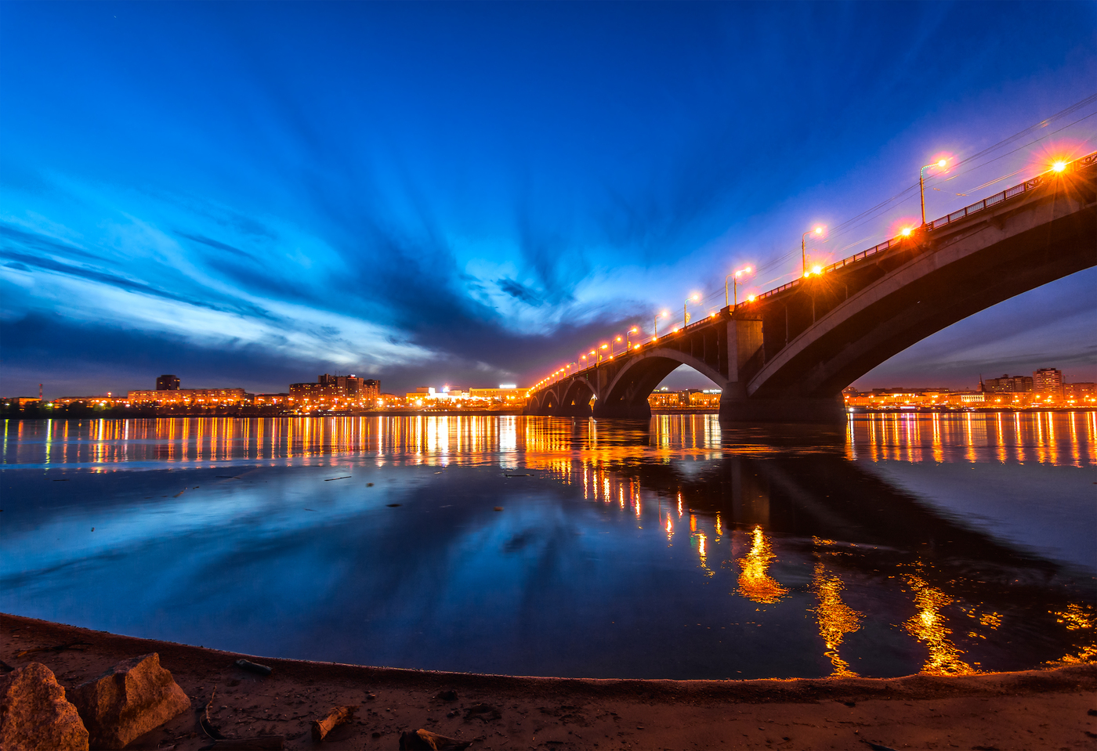
Dear guests of our city.
Our tour came to an end.
we really hope that you all enjoyed it and you will definitely want to come back to us.
See our handsome Yenisei, our magnificent Sayan mountains and go for a ride on mountain skiis

Slide 20
Thank you for your attention

