Slide 1
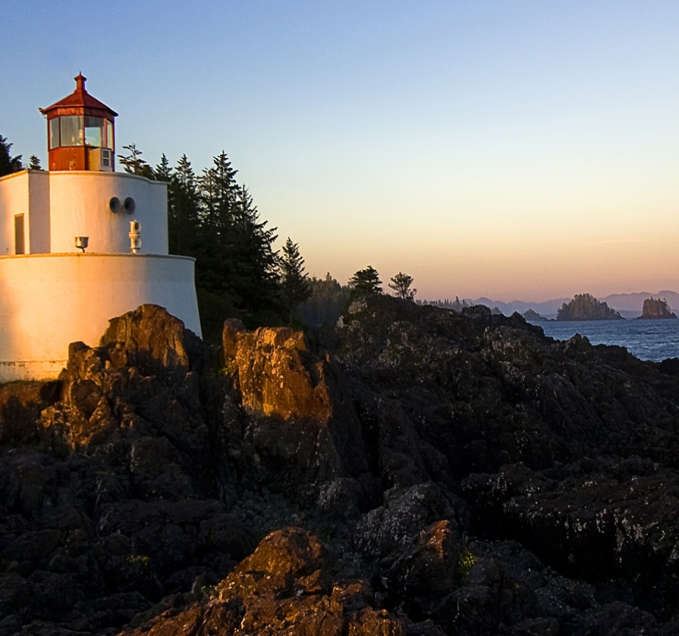
The theme: Talking about weather.
Aims: - to present and practice new vocabulary.
  to enable pupils to talk about the weather
Aids: pictures, cards, papers
The procedure of the lesson
I The beginning of the lesson
a) greeting
b) checking up homework
II warm up

Slide 2
Theme : Weather
new words:
-cold
-hot
-warm
-storm
-cloud
-hail
-rain
-snow
-sun

Slide 3

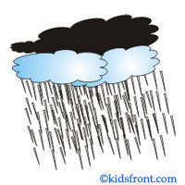

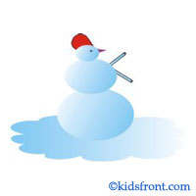
Weather
Summer
.
.
Spring
.
.
Autumn
.
.
Winter
.
.

Slide 4
To develop pronunciation new words cool, two, too, blue cold, hot, long mice: fine: bright, white, sky warm, short rain, skate

Slide 5
1) To write up the word “weather” on toster and that are connected to the word.
cold
Warm
weather

Slide 6
2. Speaking. Answering the questions
a) what’s the weather like in spring?
b) In wich season is the weather hot?
c) what weather do you like?
d) Is it often cold in winter?
e) Do you like winter and why?

Slide 7
3. Playing game “Snowball” (to through a ball to each of pupils in turn saying a word belongs to weather. The pupil who catches a ball must make up sentence).
Example: cold
it is cold in winter

Slide 8
II (Playing game) The main of the lesson.
  to develop pronunciation new words
cool, two, too, blue
cold, hot, long
mice: fine: bright: white, ski
warm: short
rain: skate

Slide 9
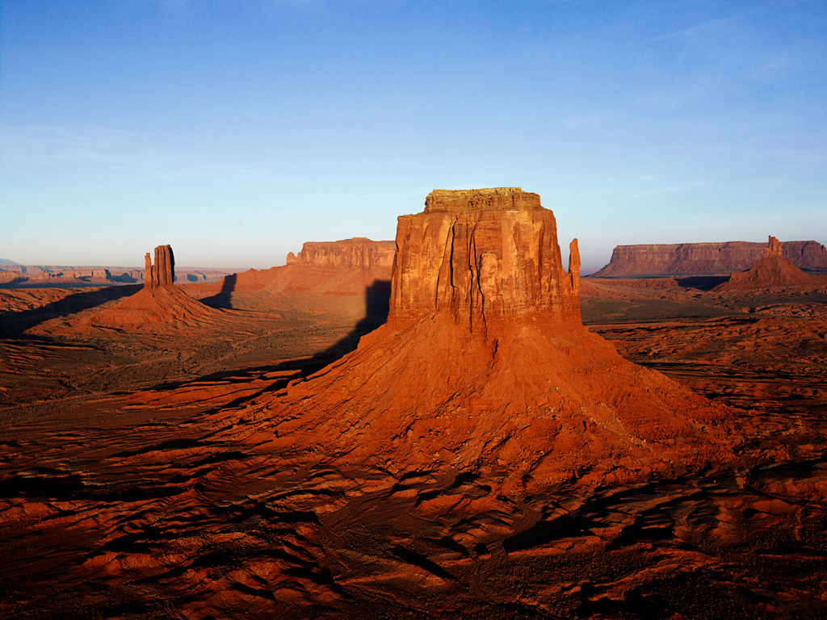
Puzzle time Build up the “ladder

Slide 10
Writing. Make up sentences
cold spring
often warm autumn
is always hot March
It usually fine April
Isn’t sometimes dry September
October
Example: It isn’t always hot in spring.

Slide 11
Listening. Play the tape and listen the poem world weather
In the North it’s snowing
And in the South it’s hot
In the East the wind is blowing
And in the west it is not.
In the South the sun is shining
And in the west the sky is blue
In the East it’s raining
And in the North it’s raining too.

Slide 12
Consolidation part. To practice asking questions complete the dialogue by asking.
- ?
  There are four seasons in a year
  ?
  The winter months are: December, January, February
  ?
  Yes, it is cold in winter
  ?
  Yes, I like spring.

Slide 13

The end of the lesson.
marking
Homework
Describe the weather in spring in Uzbekistan.
(Make up sentences and draw a picture about it)
b) Learn the poem “world weather”.

