Slide 1

Past Simple
Простое прошедшее время.
Notes:
Автор: Кузнецова Анна Николаевна
<номер>

Slide 2
Спутники Past Simple
Вчера
Yesterday
A week ago
2 hours ago
Неделю назад
2 часа назад
В прошлом году (месяце, неделе)

Slide 3

В утвердительных предложениях необходимо употреблять вторую форму глагола.
К правильным глаголам нужно прибавить окончание –ed.
Play - played
Неправильные глаголы имеют особую вторую форму.
Go-went-gone

Slide 4
ed / 2
didn’t 1
Did 1 ?
Wh did 1 ?

Slide 5
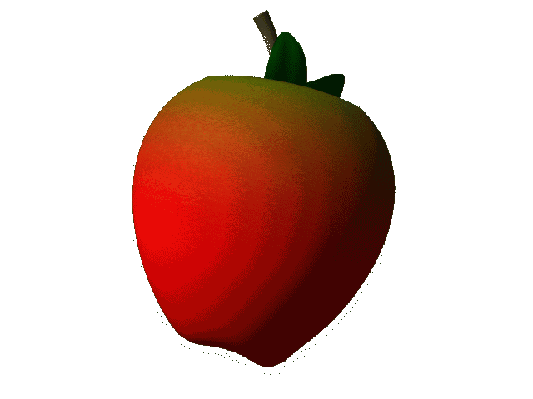
Сделай из утвердительных предложений отрицательные
1. I went shopping yesterday.
2. He watched TV yesterday.
3. She played tennis yesterday.
4. They swam in the river.
5. Tim flew a kite yesterday.
6. Jane did her homework.

Slide 6
Неправильные глаголы
Be - was/were – been
Begin – began – begun
Break – broke – broken
Bring – brought – brought
Buy – bought – bought
Choose- - chose – chosen
Come – came - come

Slide 7
Неправильные глаголы
Cut – cut – cut
Do – did –done
Draw – drew – drawn
Drink – drank – drunk
Eat – ate – eaten
Fall – fell – fallen
Feed – fed - fed

Slide 8
Find – found – found
Fly – flew – flown
Forget – forgot – forgotten
Get – got – got
Give – gave - given
Go – went - gone
Have – had - had

