Slide 1

Oh, Russia, I’m in love with you!

Slide 2
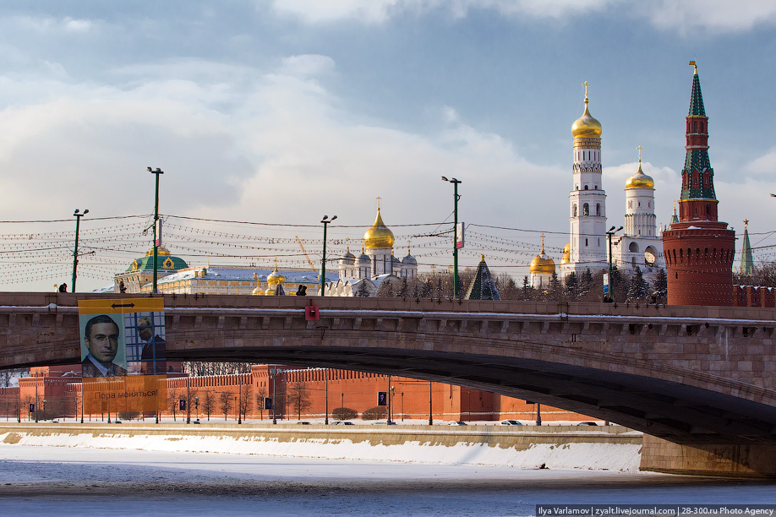
Remember, Russia, you are great

Slide 3

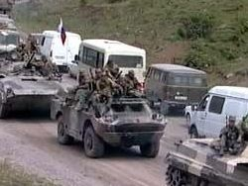
Not in the field of battles past

Slide 4
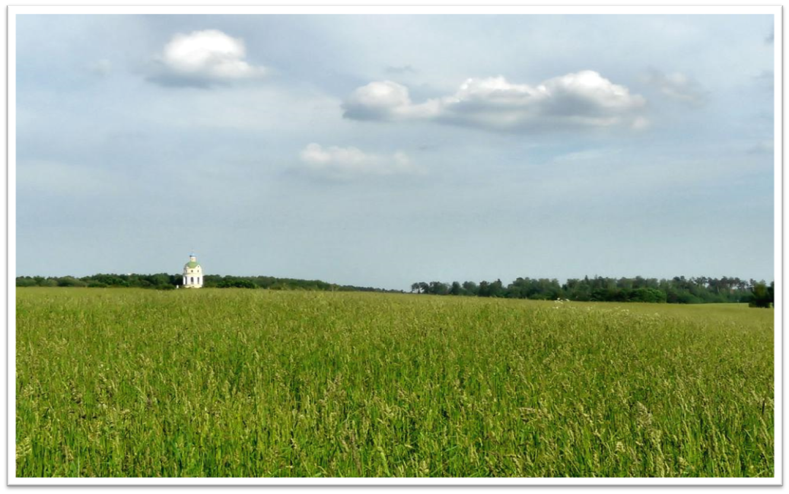
But in the green fields full of wheat

Slide 5

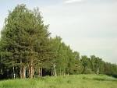
And forests, gardens, free of dust.

Slide 6
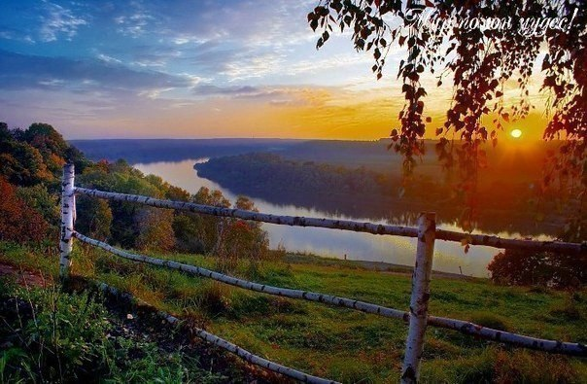
I love you deeply, dear land,

Slide 7
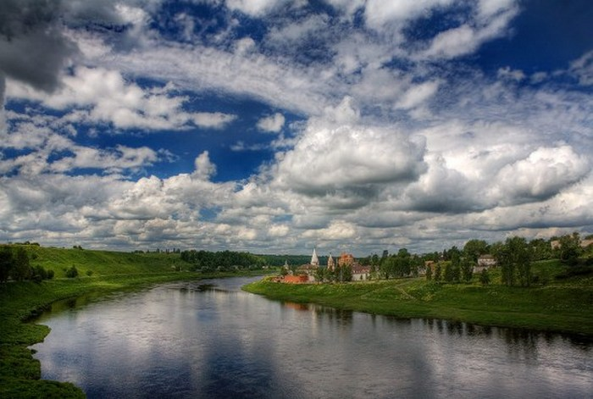
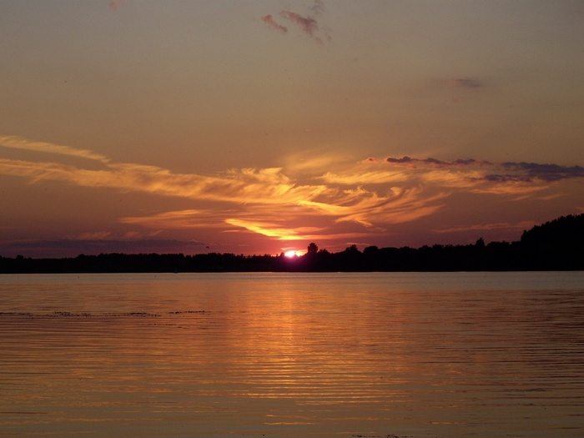
Your hills and rivers, sand on strand

Slide 8
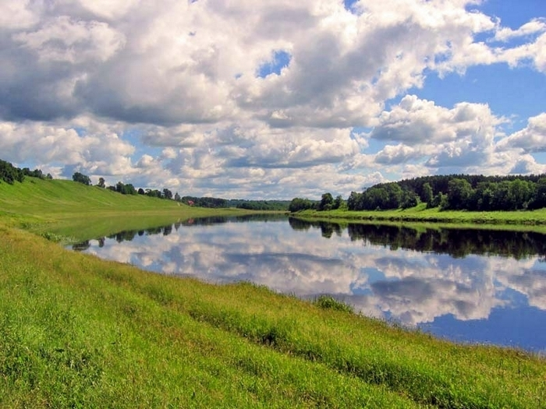
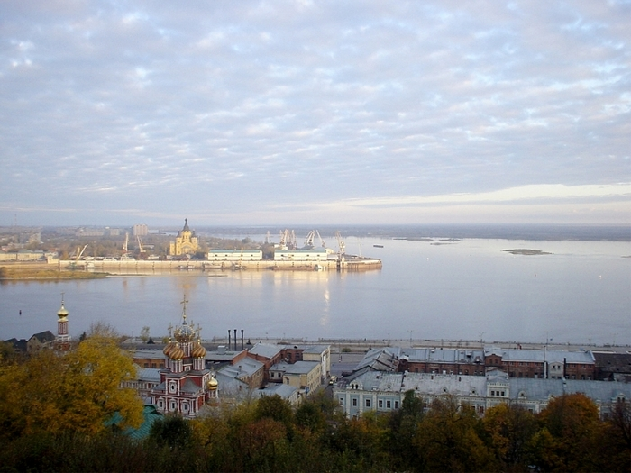
Your songs and dances, lakes and seas

Slide 9
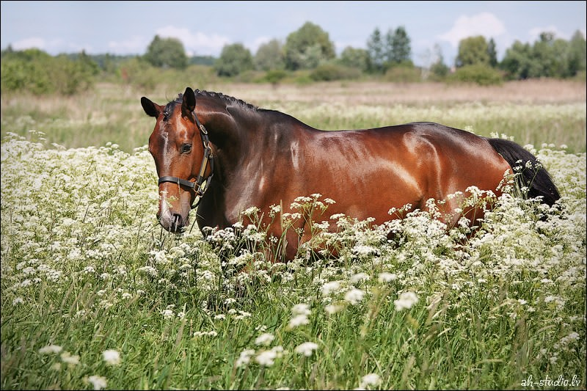
Your beasts and fish, birds in trees.

Slide 10
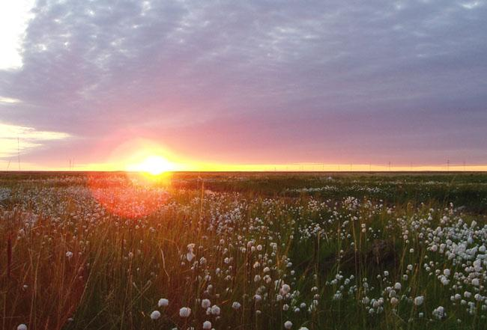
Your sunrise in a splendid sight

Slide 11
Which gives me always such delight!

