Slide 1
What Can We Do to Save the Earth?

Slide 2
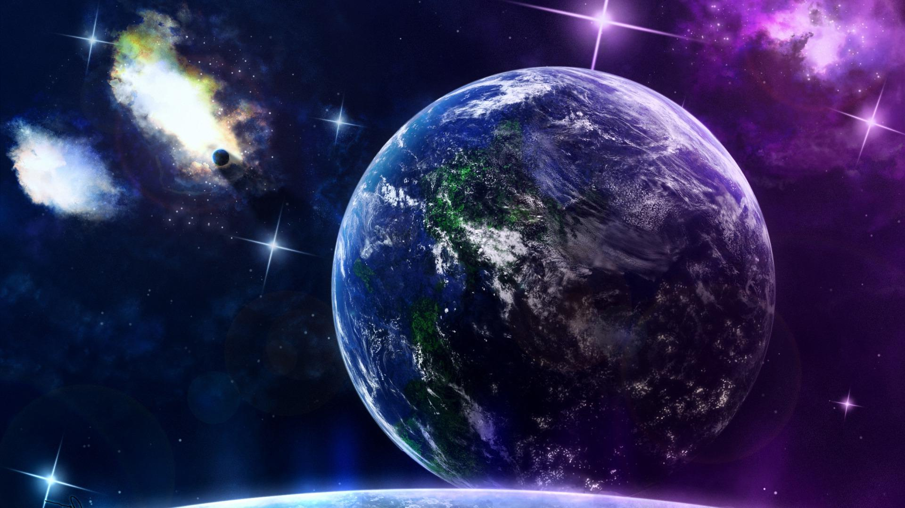
Its a wonderful world we live in. For thousands of years the Earth has given support to all forms of life — human beings, animals, birds, fishes, insects and plants.

Slide 3
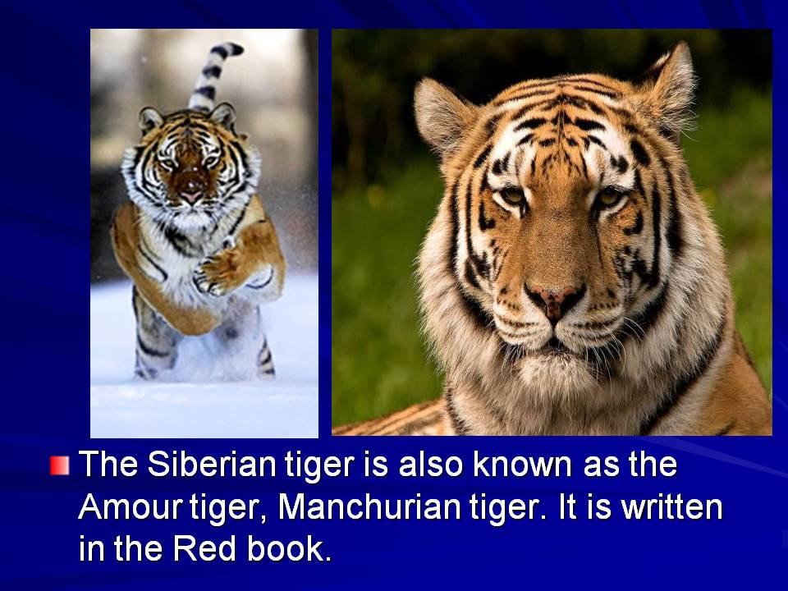
But now human beings are killing our planet. Many species of animals and birds have disappeared. Millions of animals die every year because man has polluted their natural homes.

Slide 4
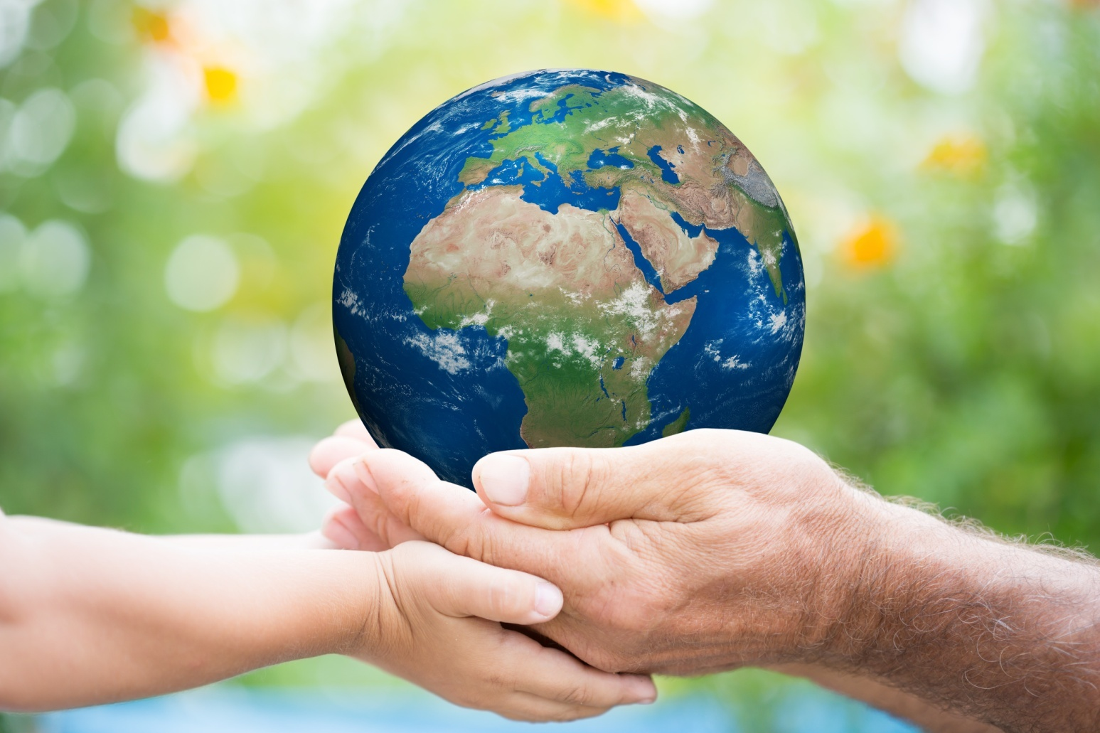
Here are several points towards saving the Earth. It won't always be easy to follow them.

Slide 5
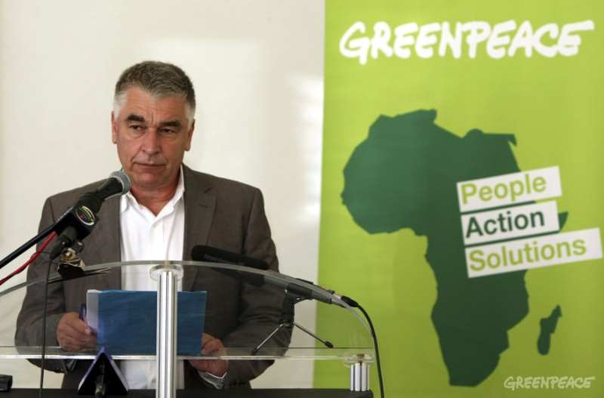
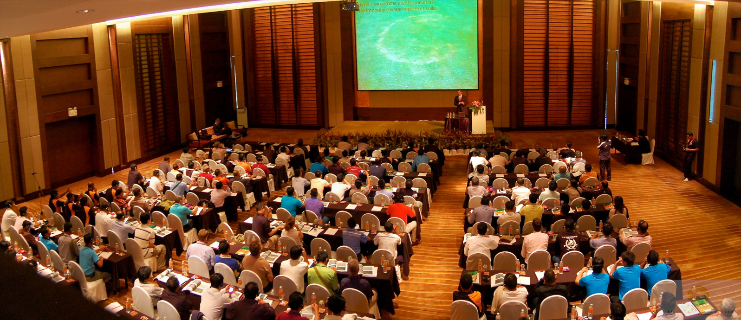
Keep yourself informed about environmental problems. These are some of the world's most serious environmental problems. And it's no good pretending they don't exist — they do. What's more, they are getting worse all the time! What will happen if we don't try to solve these problems: Scientists have made predictions and they are alarming.

Slide 6

Try not to waste energy.

Slide 7
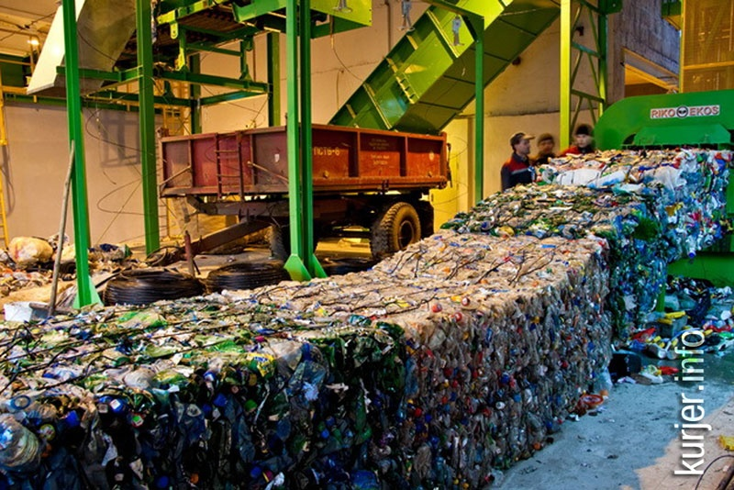
Take as much rubbish as you can to local recycling centres.

Slide 8
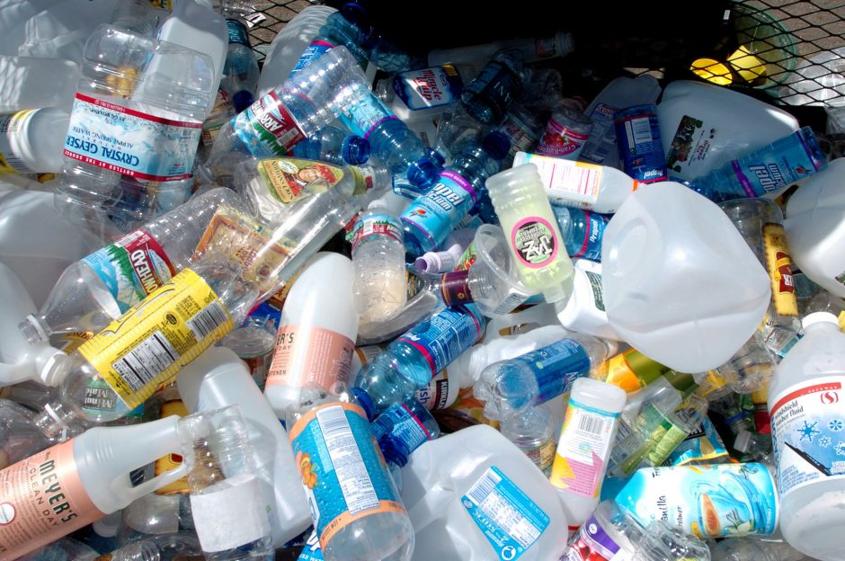
If you have a choice avoid buying packaged goods. We live among litter and wastes which we have created ourselves — fumes of cars, throwaway packaging'", etc.

Slide 9
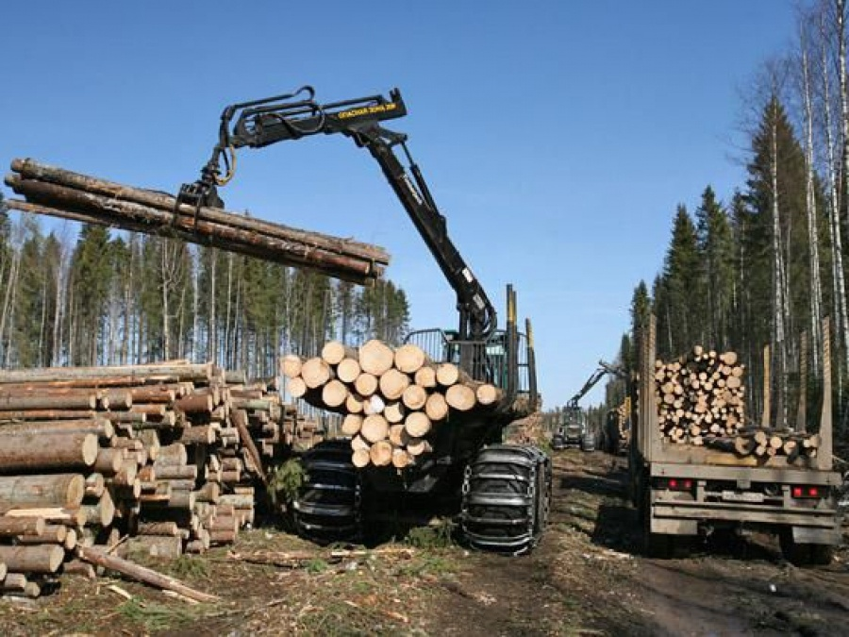
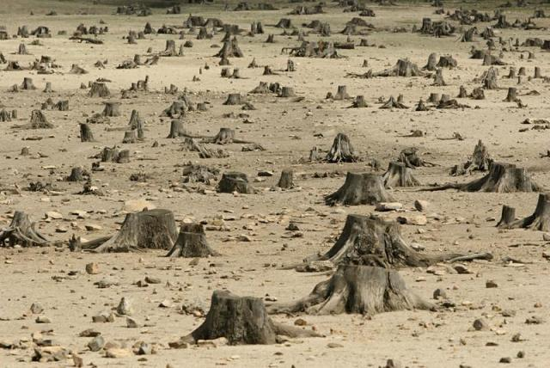
Don't waste paper. All over the world the forests are disappearing. People cut the trees down because they need wood and paper or new places for farms and houses. Forests the size of Belgium are destroyed every year. Its an international disaster. Even if new trees are planted, it takes many years for them to grow.

Slide 10
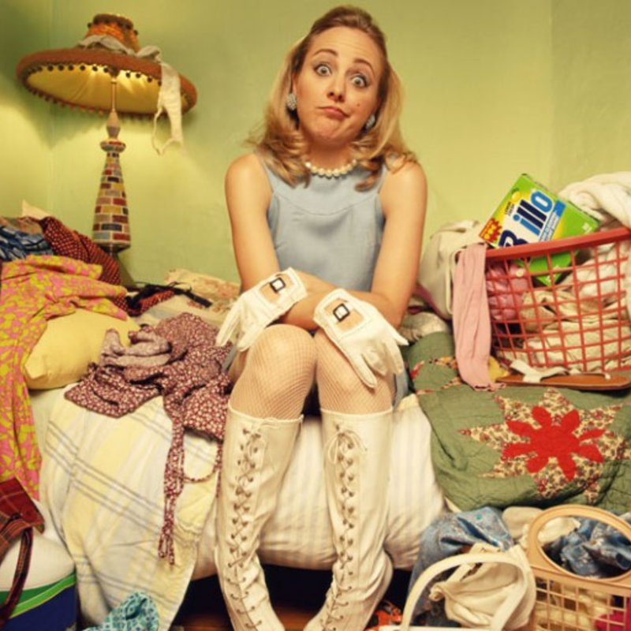
Before you buy anything, ask yourself if you really need it.

Slide 11
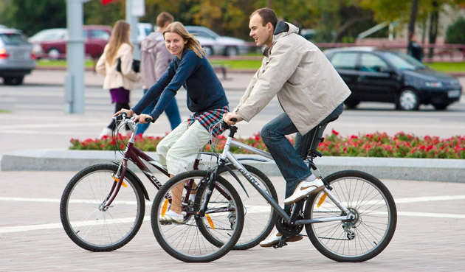
Walk or cycle whenever possible.

Slide 12
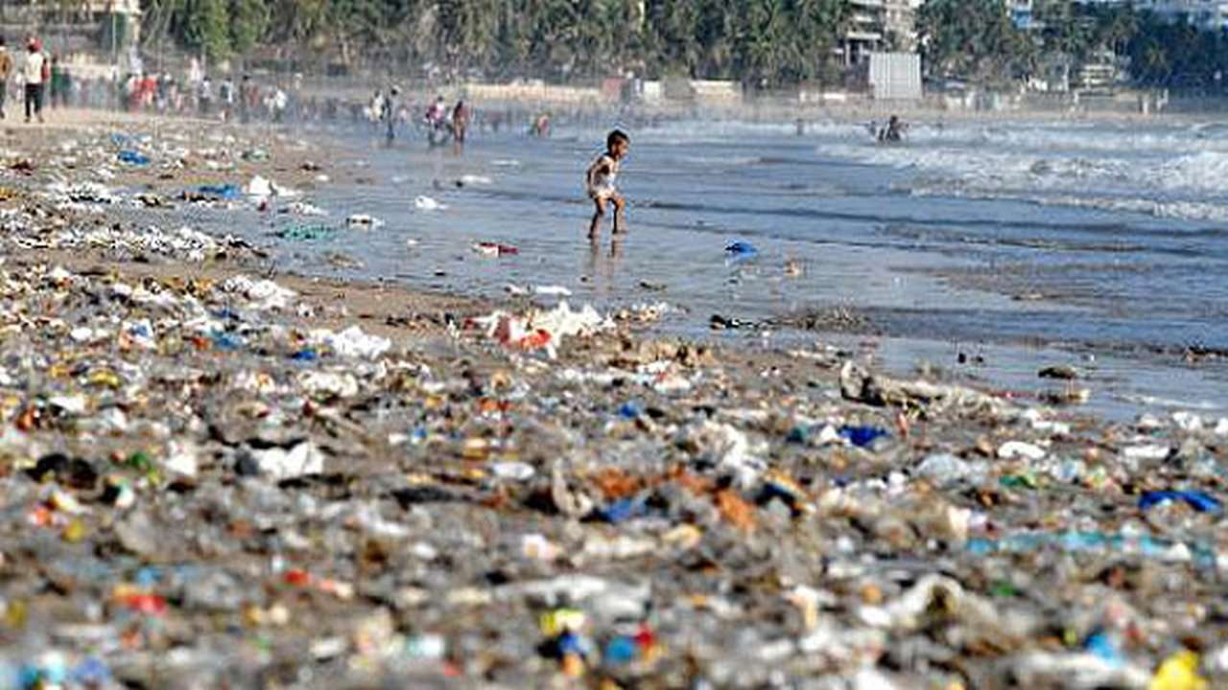
Never drop litter. Go to the seaside and you'll see the pollution around you. There is a lot of litter on the beaches. Some of it was left by people and some was brought by the water. Pollution is very dangerous for people, wildlife and the environment.

Slide 13
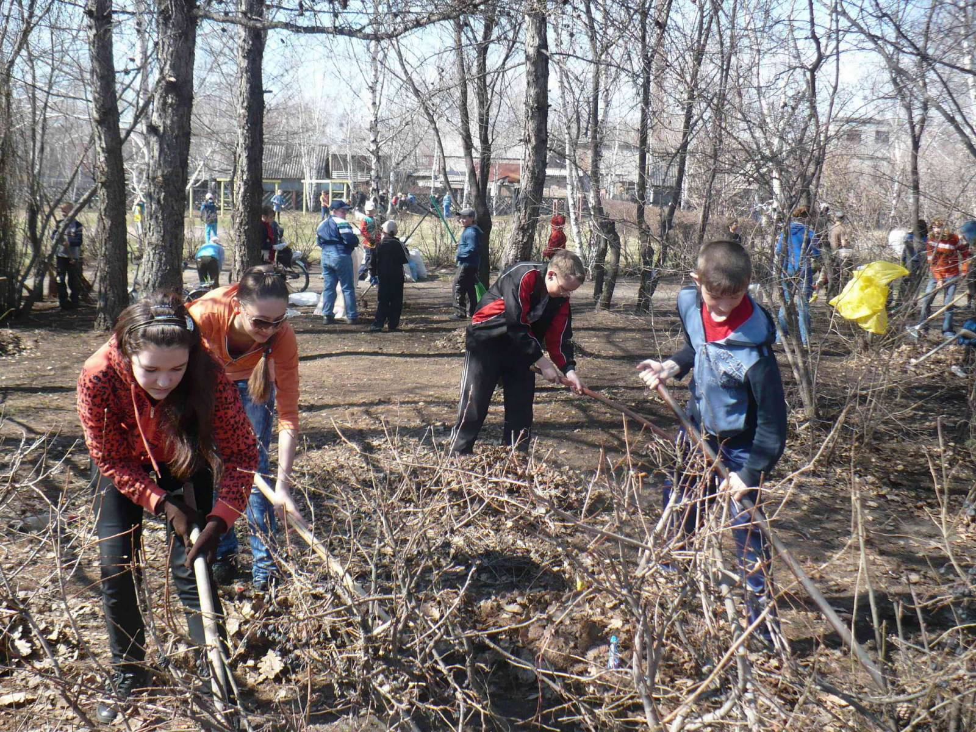
Help to clean up your local environment.

Slide 14

Try to reduce noise pollution.

Slide 15
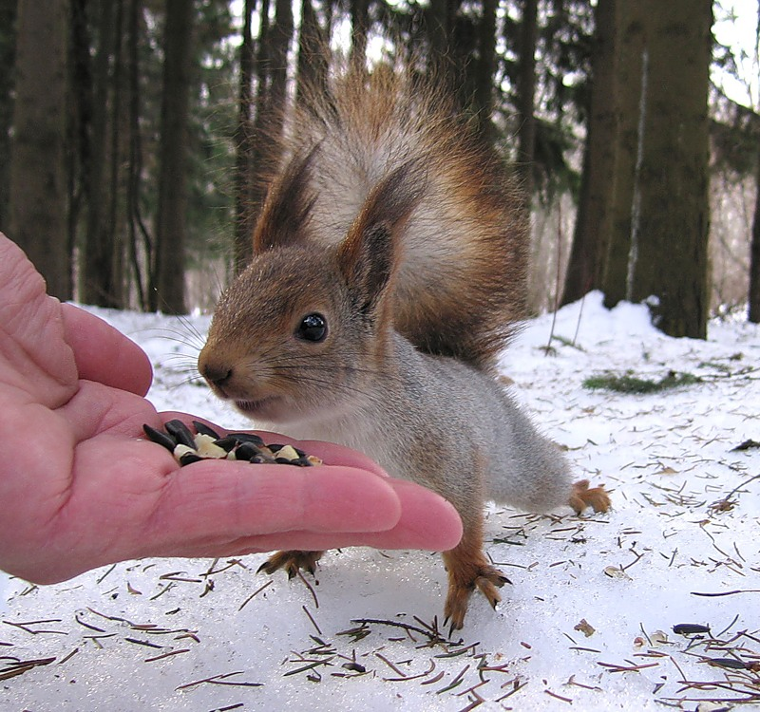
Put out food for wild animals in winter.

Slide 16
Please, think…
We must save the Earth!

