Slide 1
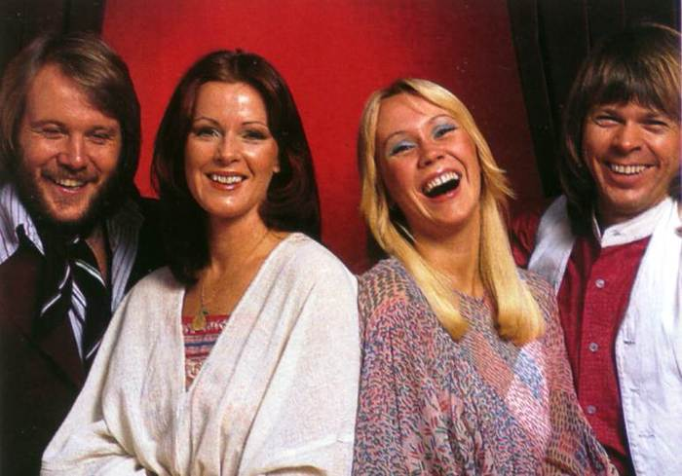
ABBA
Swedish music quartet,
They existed in the years 1972-1982

Slide 2
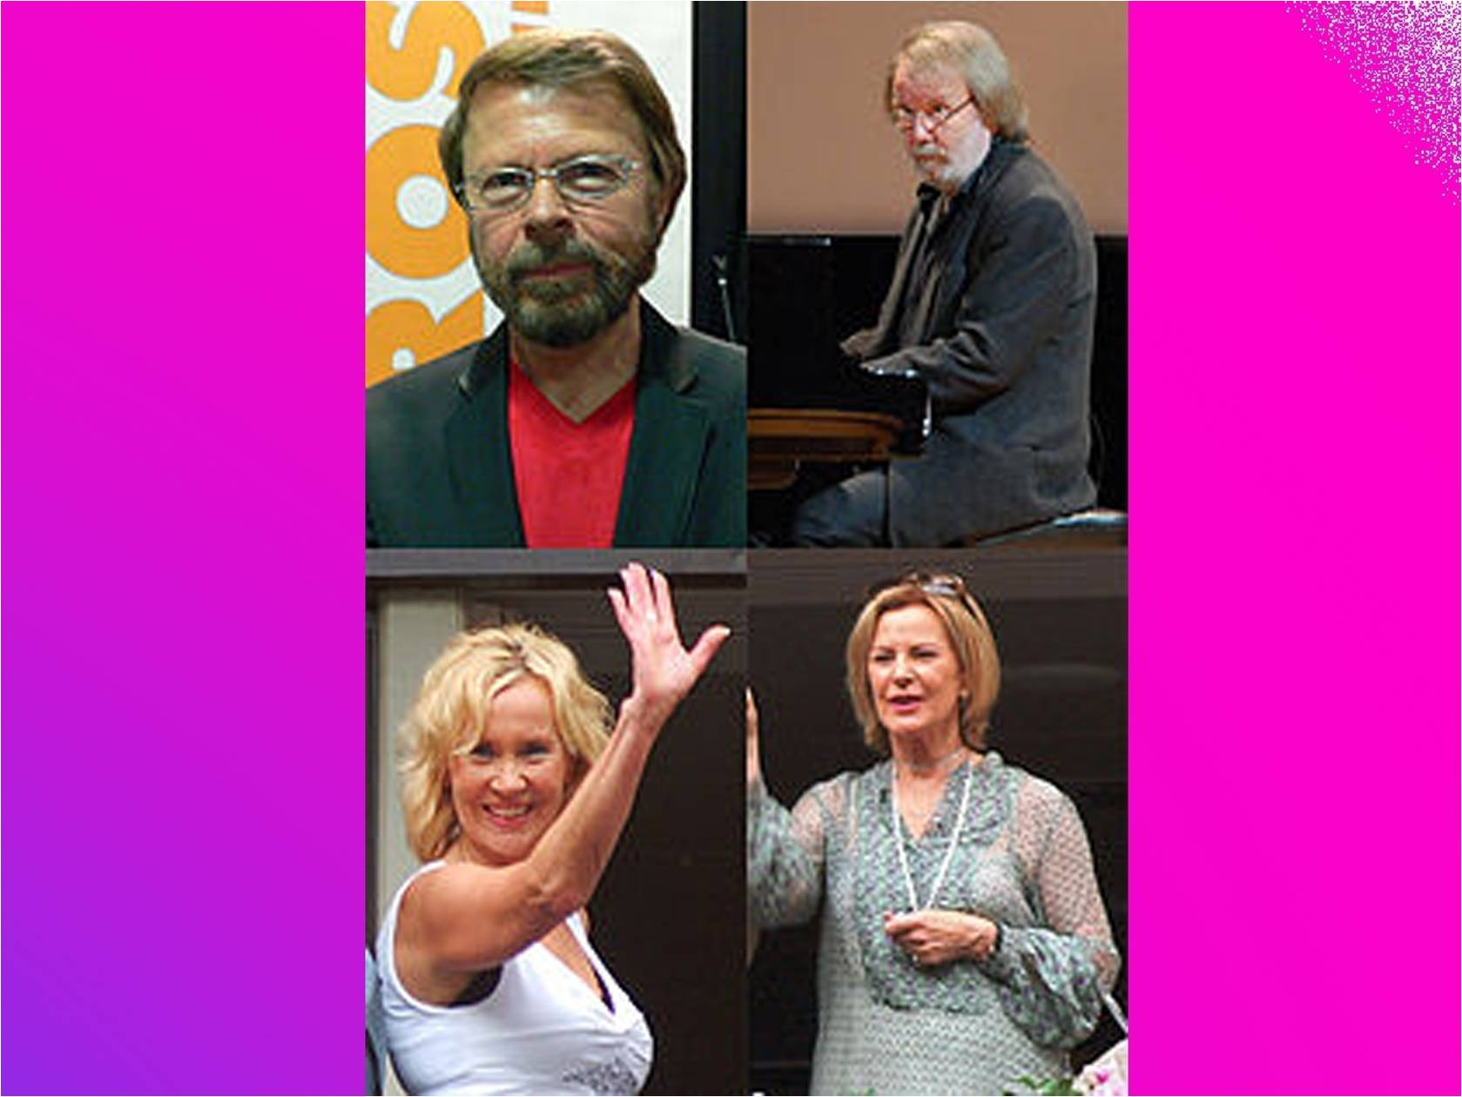

Slide 3
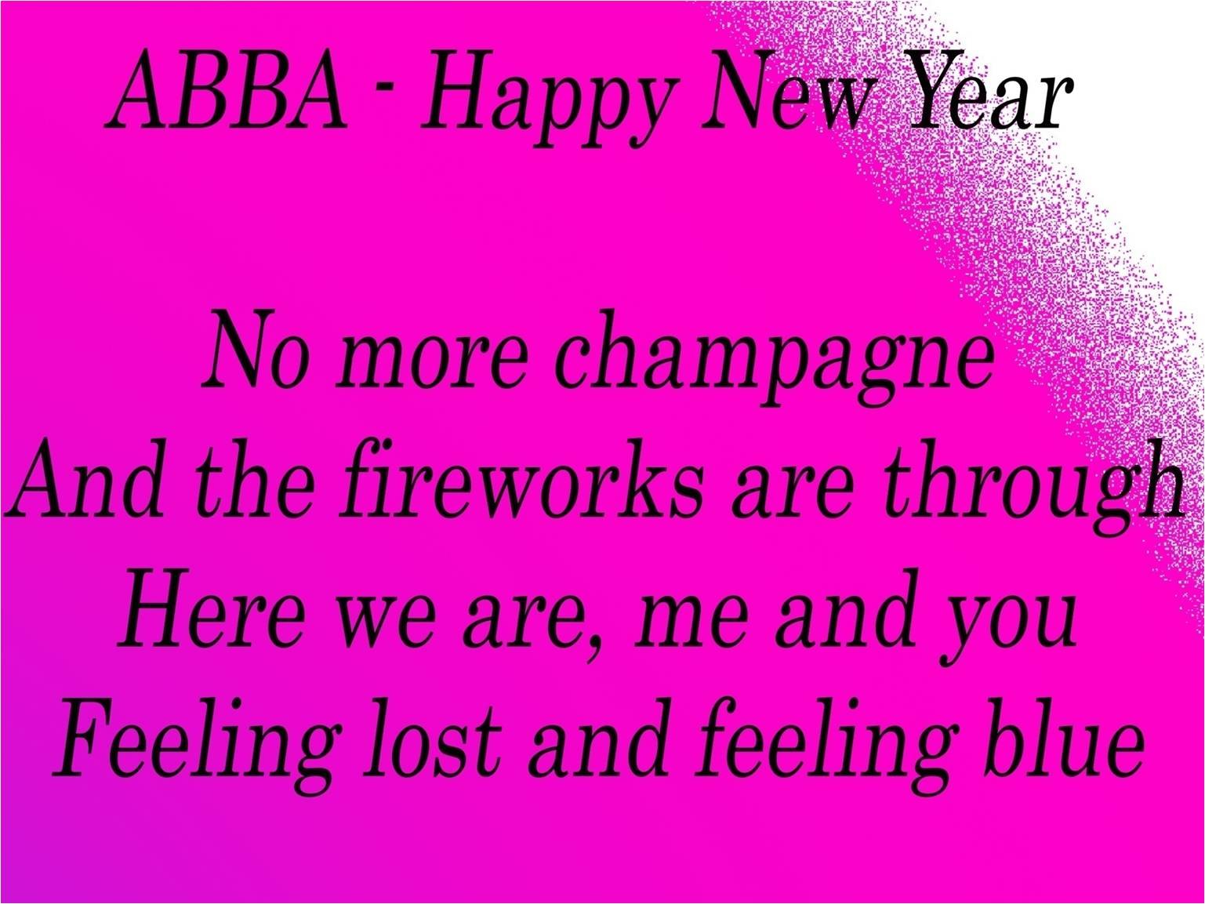

Slide 4
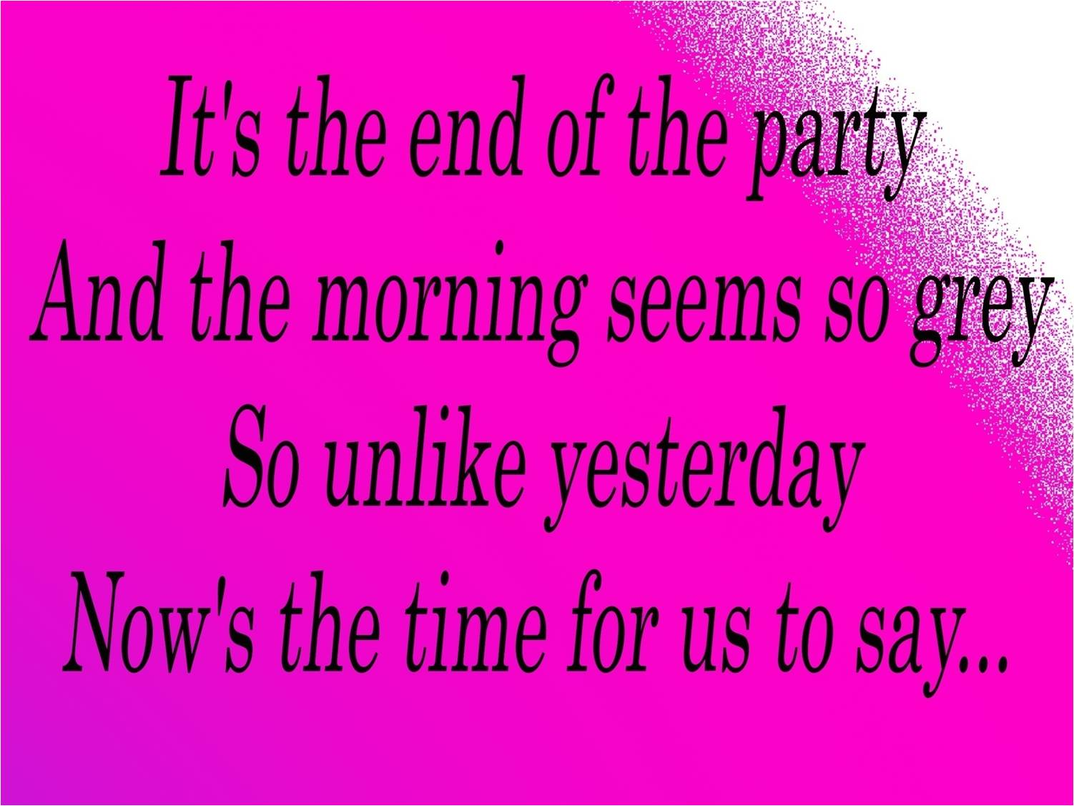

Slide 5
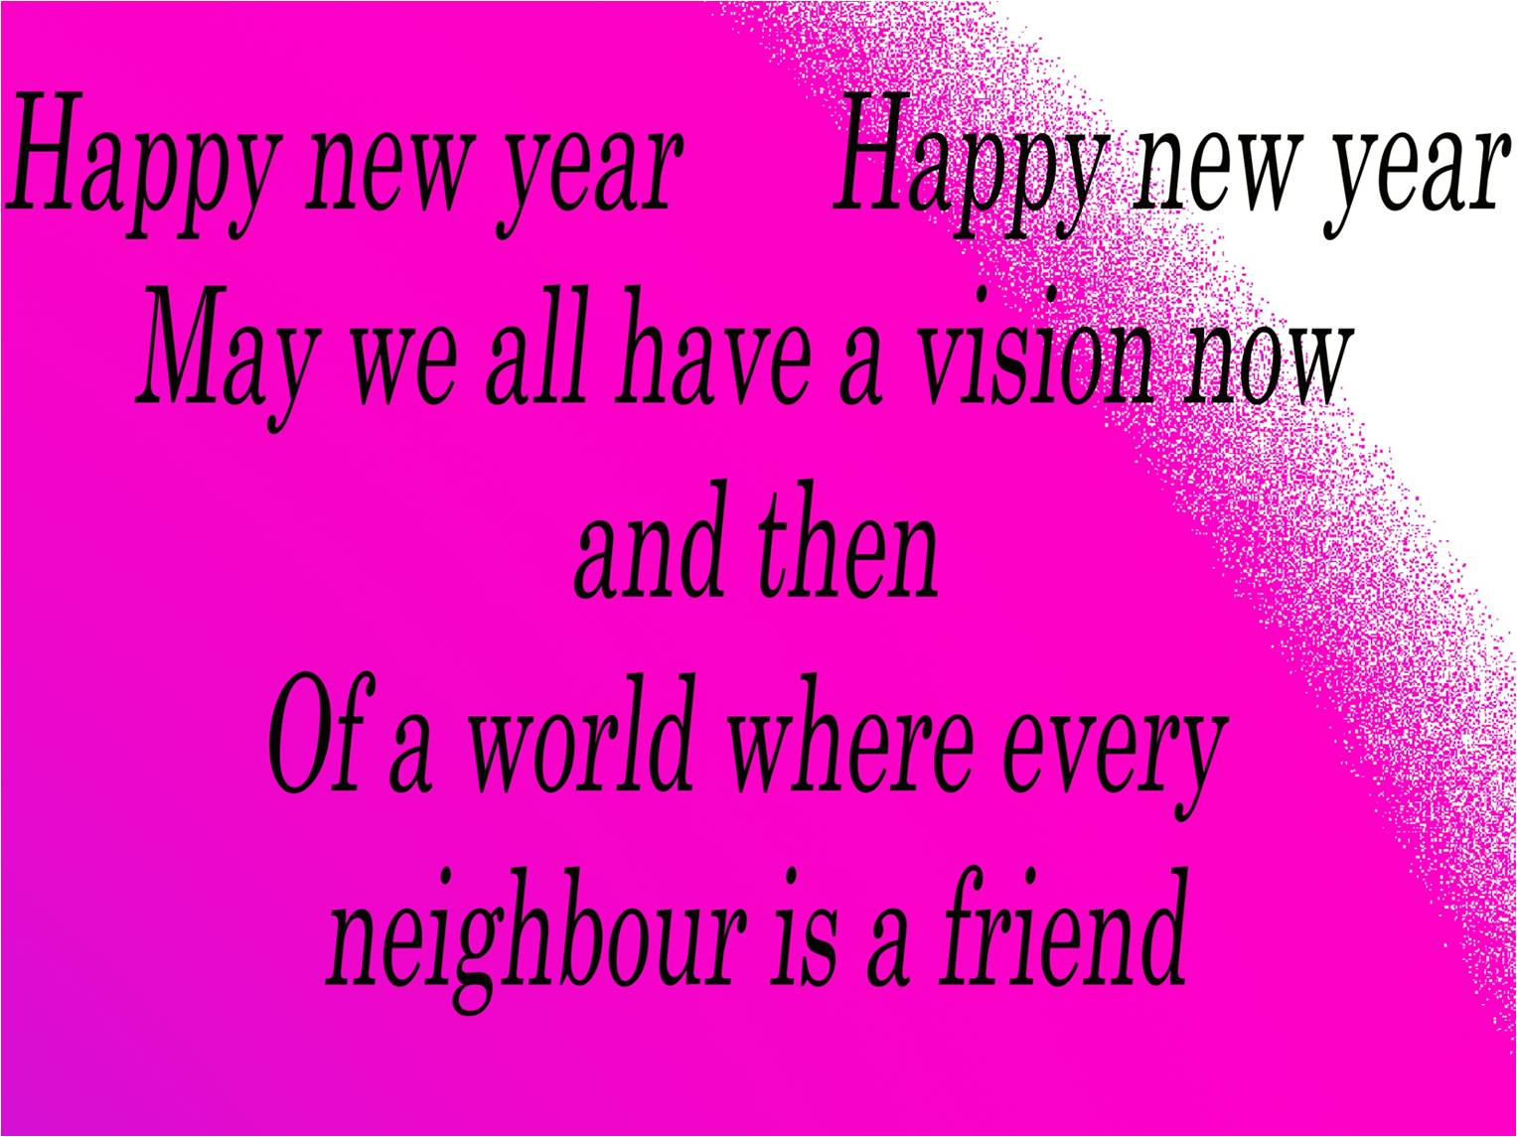

Slide 6


Slide 7
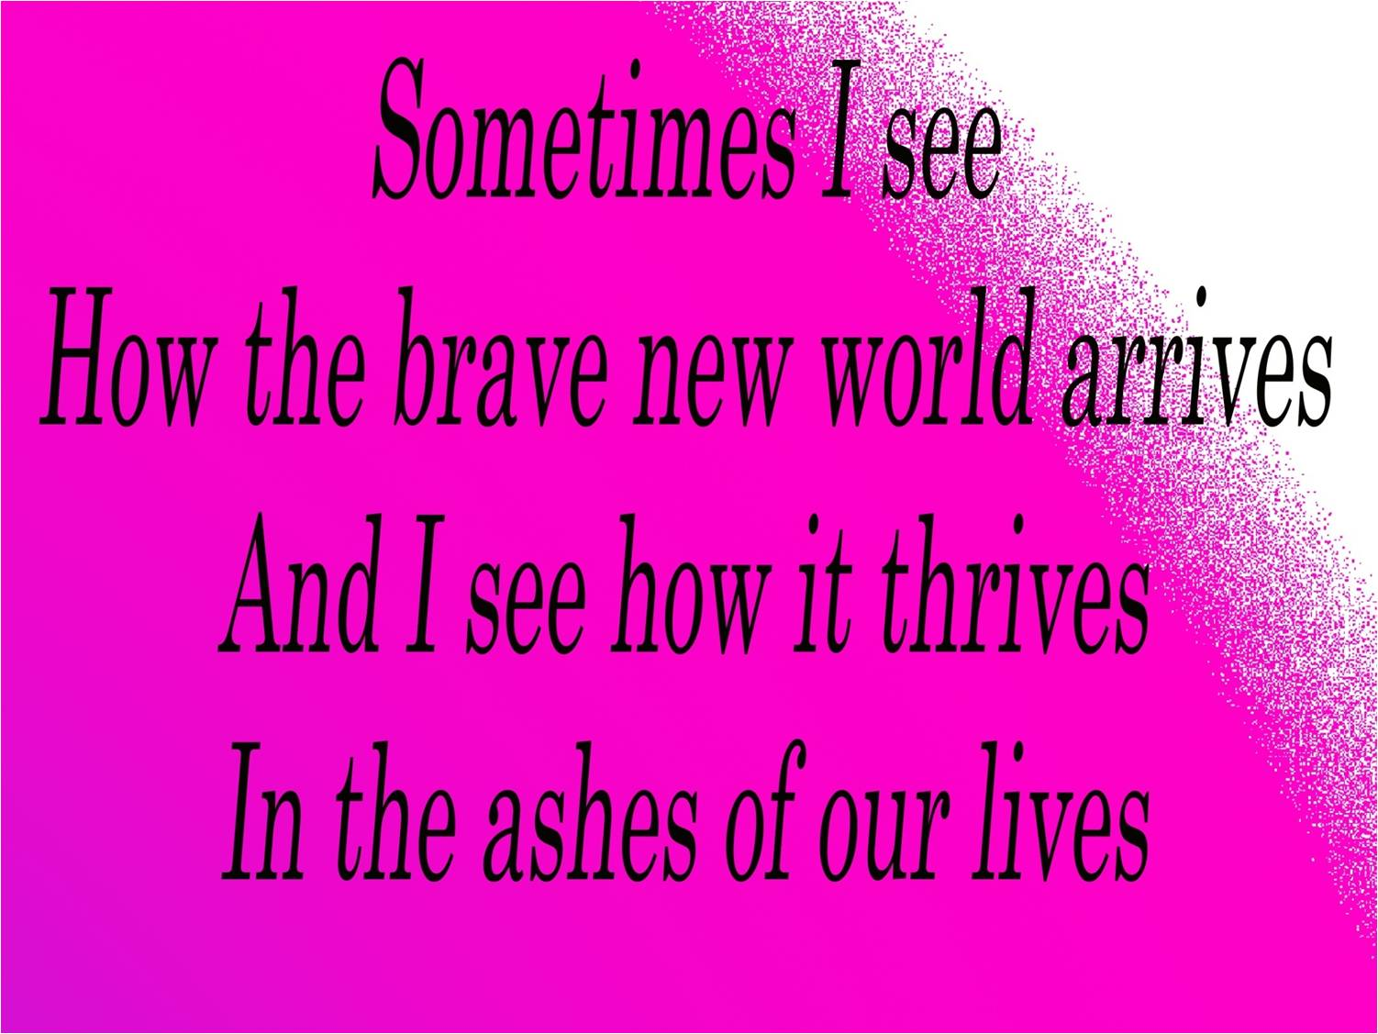

Slide 8
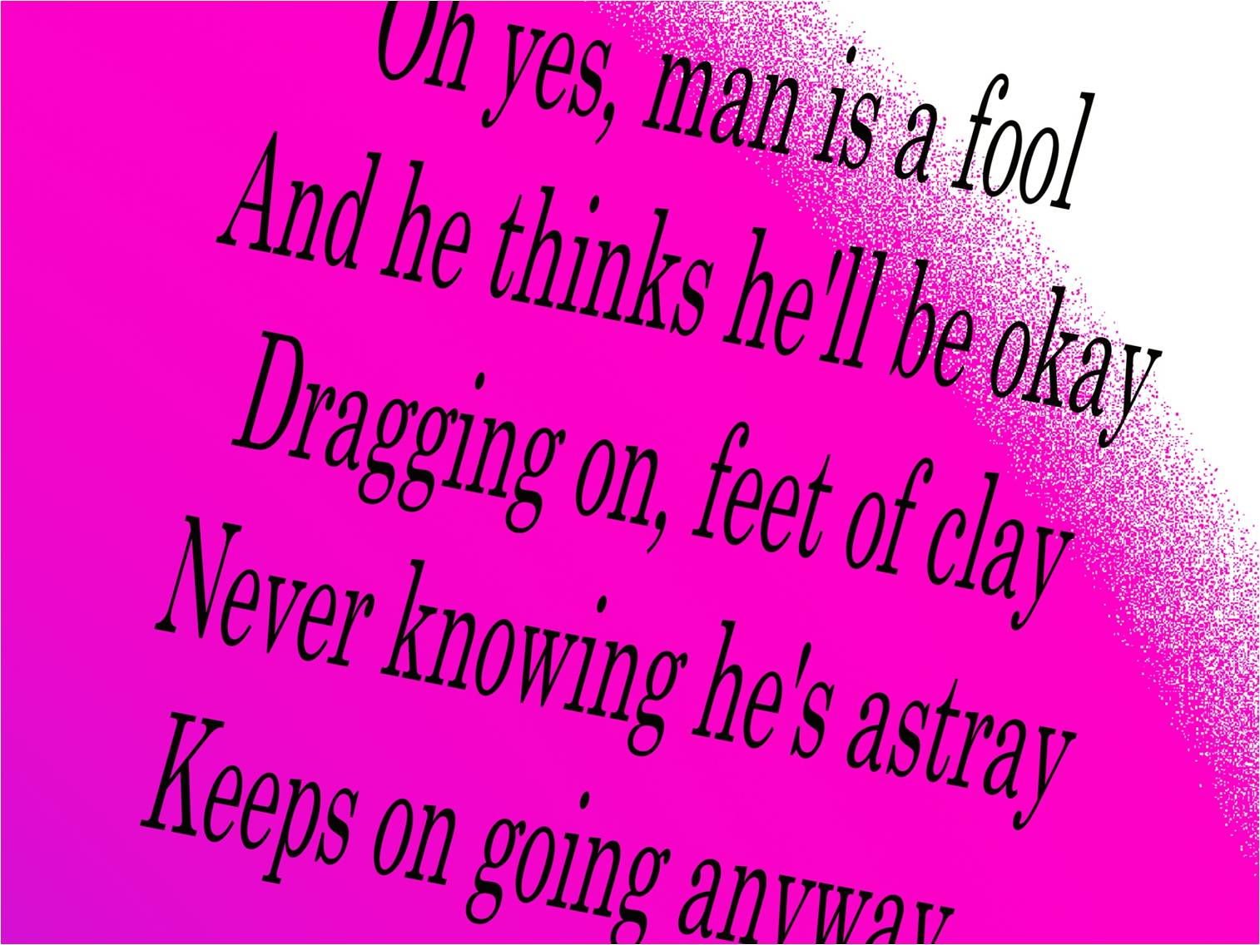

Slide 11
Seems to me now
That the dreams we had before
Are all dead, nothing more
Than confetti on the floor
It's the end of a decade
In another ten years time
Who can say what we'll find
What lies waiting down the line
In the end of eighty-nine...

Slide 12
