Slide 1

How do you understand this phrase?

Slide 2
I’d like to…
( choose what is the most interesting to you)
Learn words about homes and things in the houses
Practise speaking about homes and houses
Learn logical thinking
Describe a picture with a home

Slide 3
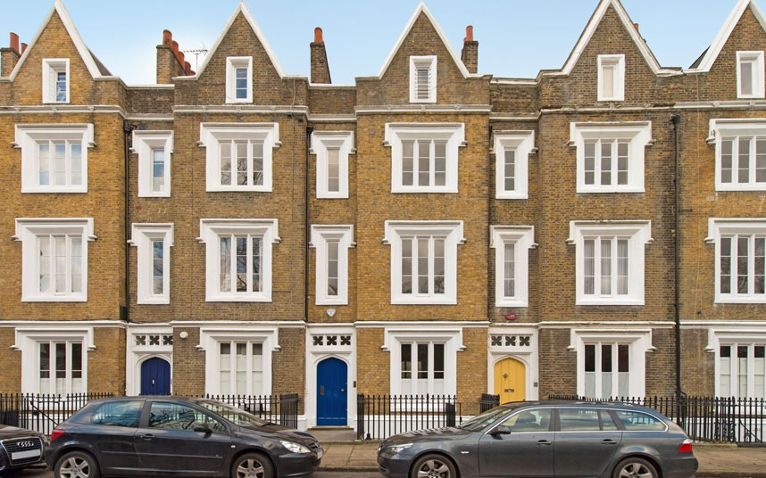
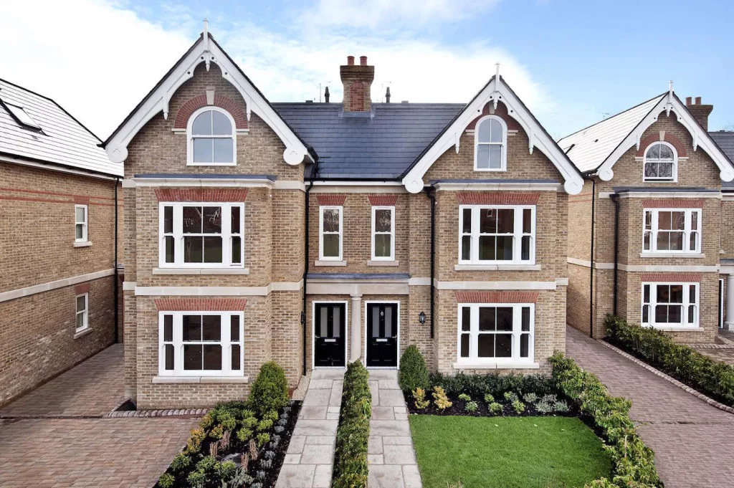
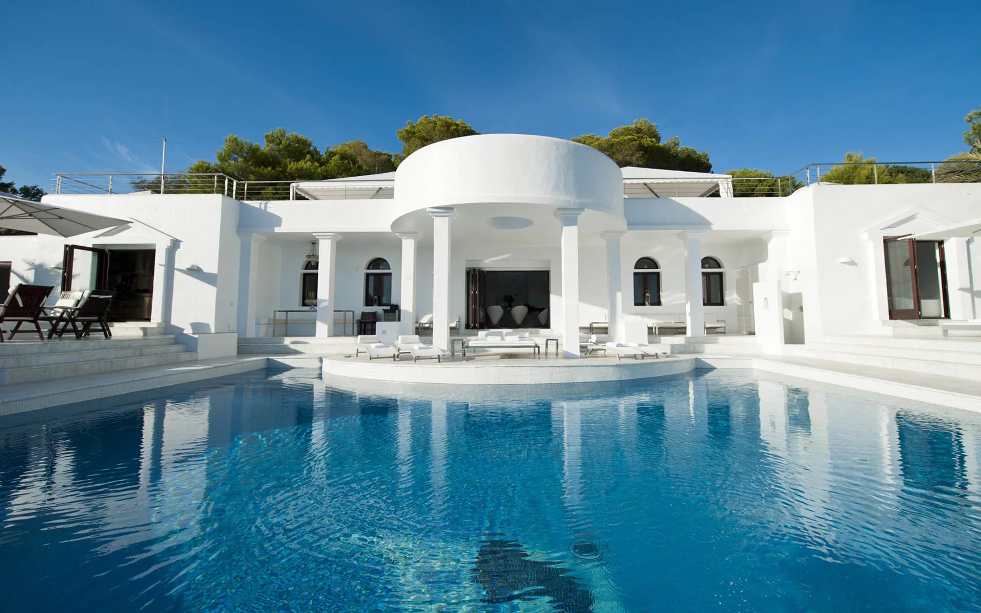
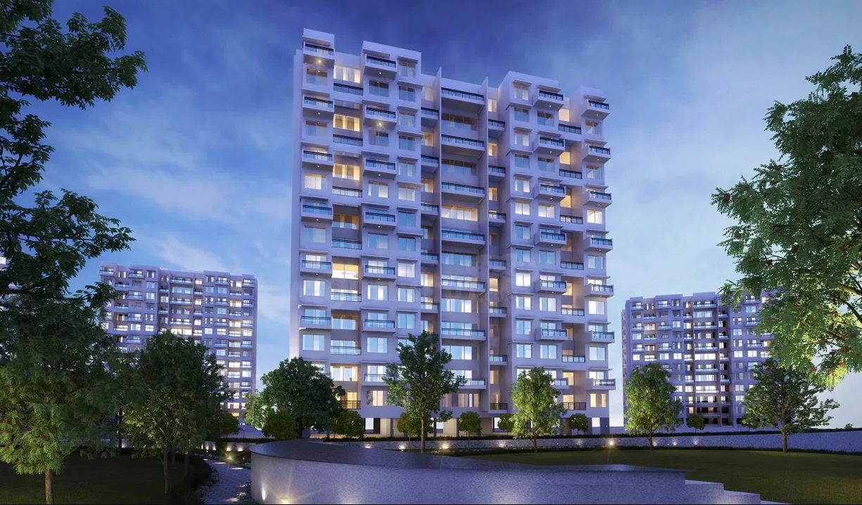
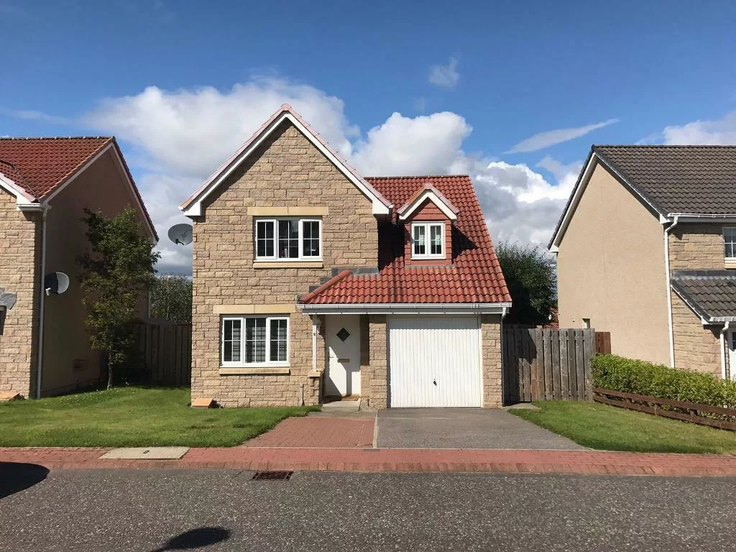
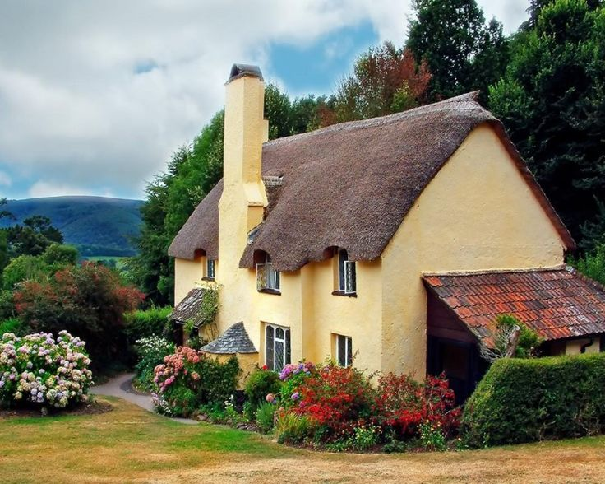
Types of the buildings
Terraced house/ town house
Detached house
Villa
Block of flats
Semi-detached house
Cottage

Slide 4
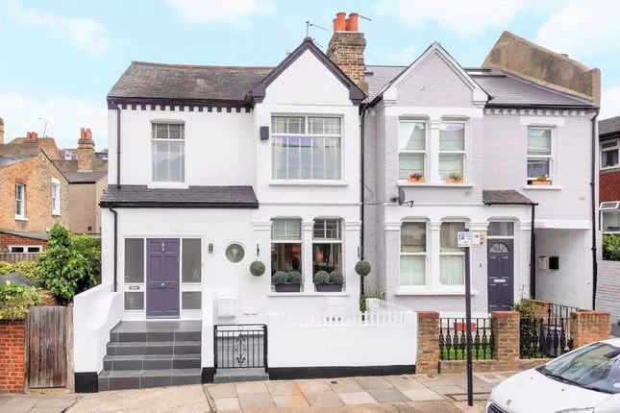
05 No place like home
Ex.1, p. 40
W1. semi-detached - один из особняков, имеющих общую стену
Is this kind of house common in your country?
How many families do you think live here?

Slide 5
Match the word with its description
(one word is odd)
A house that is not joined to another house
A building that consists of different levels and has several apartments on each level
A house that is joined to another house on one side
A house is in a row of houses that are all joined together
A house in the city or in the country with a yard and garden
Terraced house/ town house
Detached house
Villa
Block of flats
Semi-detached house
Cottage

Slide 6
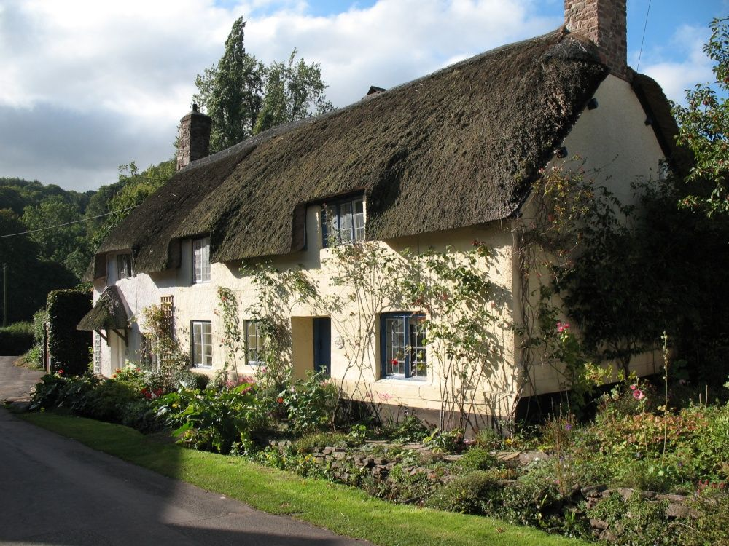
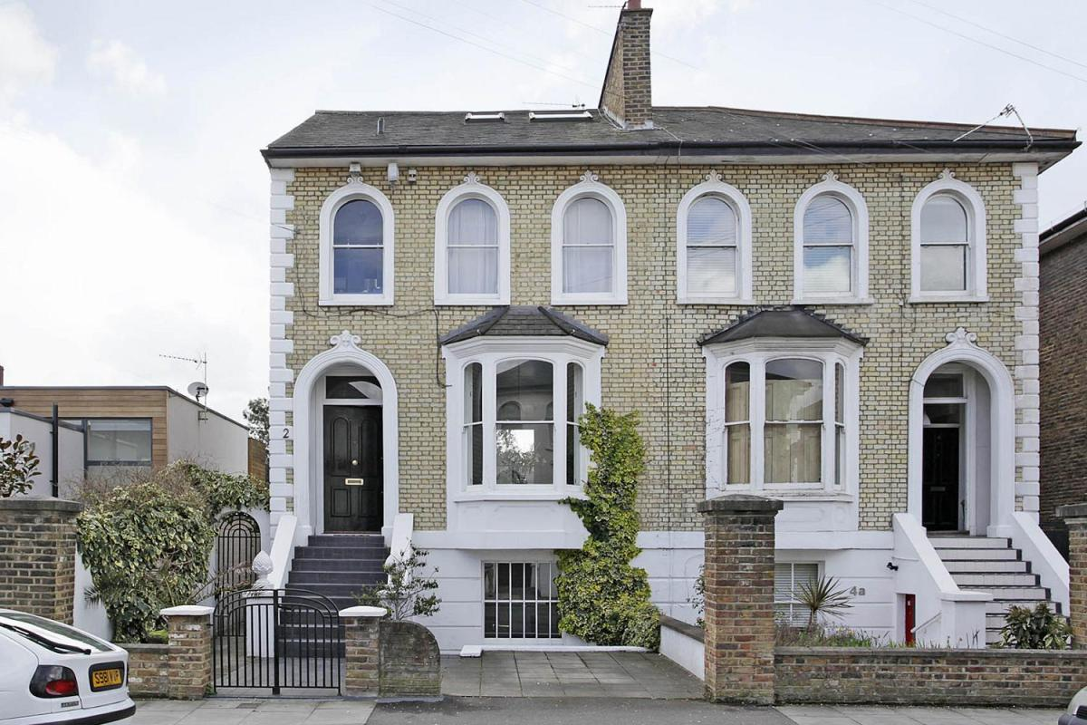
Let’s run a little
Group 1
Group 2

Slide 7

BSE Speaking part element 2020
p. 40 Text.
Listen to the text and read it out loud

Slide 8
Comparison of adjectives
 | Adjective | Comparative | Superlative
One syllable | Old large | __________ larger | (the) oldest _________
Two syllables ending in- y | Crazy pretty | Crazier __________ | _________ (the) prettiest
Two or more syllables | Expensive elegant | __________ More elegant | (the) most expensive __________
Irregular | Good Bad Far far | ___________ ___________ Further farther | (the) best (the) worst (the) furthest (the) furthest

Slide 9
BSE Grammar part element 2020

