Slide 1
Сolleges of England
finished: Kazakina Anastasia СР-171 VGPGK
Shekhovtsova I.I.

Slide 2
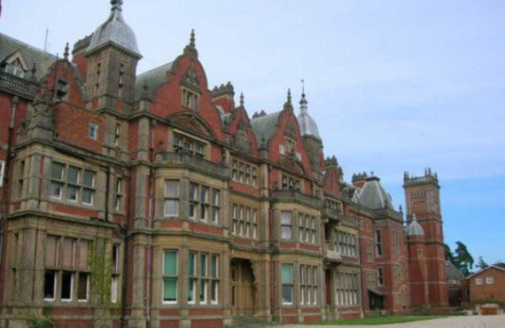
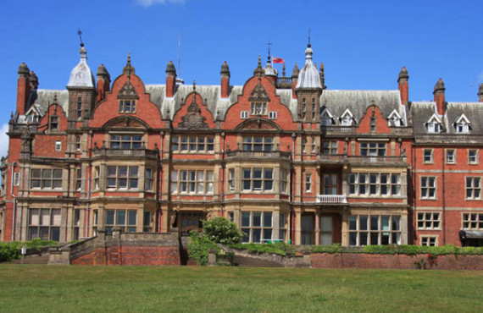
Location County Berkshire
Date of Foundation 1827
Age of students from 11 to 18 years
Type of accommodation Pension (11-18 years)
Type a-Level programs
GCSE
For whom the Combined
School type Average
Senior The number of students 494
Language of instruction English
Bearwood College

Slide 3
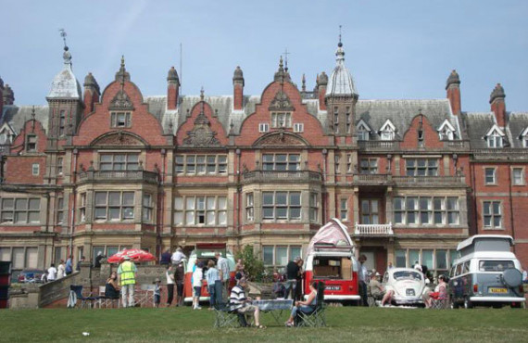
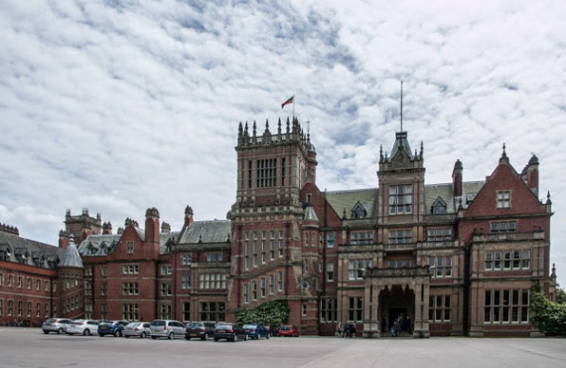
The Classic bearwood College British boarding school was founded in 1827.

Slide 4
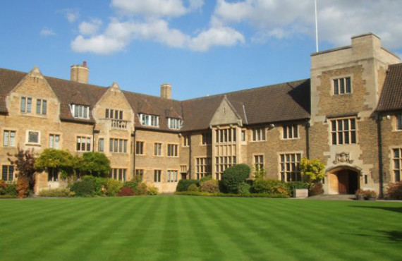
Bellerbys College
Location Cambridge
Date of Foundation 1959
Age of students from 14 to 18 years
Type of residence Residence (14-18 years) Family
Type a-Level programs
Foundation
GCSE
For whom the Combined
Language of instruction English

Slide 5
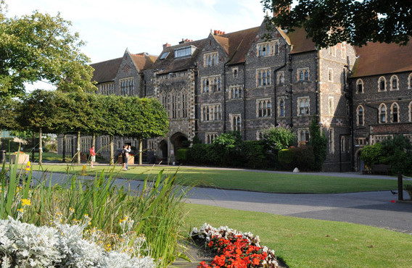
Вrighton College
Location Brighton
Date of Foundation 1845
Age of students from 11 to 18 years
Type of accommodation Pension (11-18 years) Type of program GCSE
A-Level
For whom the Combined
School type Average
Senior
The number of students 1219
Language of instruction English

Slide 6
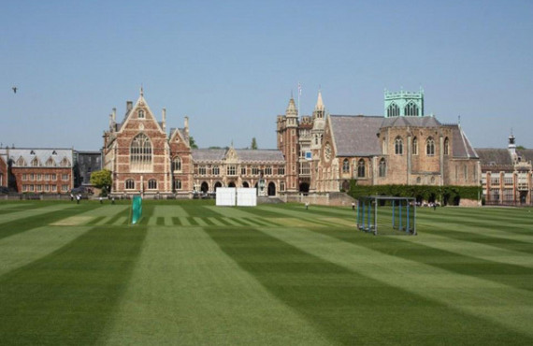
Clifton College
Location Bristol
Date of Foundation 1862
Age of students from 8 to 18 years
Type of accommodation Pension (8-18 years) Type a-Level programs GCSE
For whom the Combined
Type of school Elementary Average Senior
The number of students 1315
Language of instruction English

Slide 7


