Slide 1
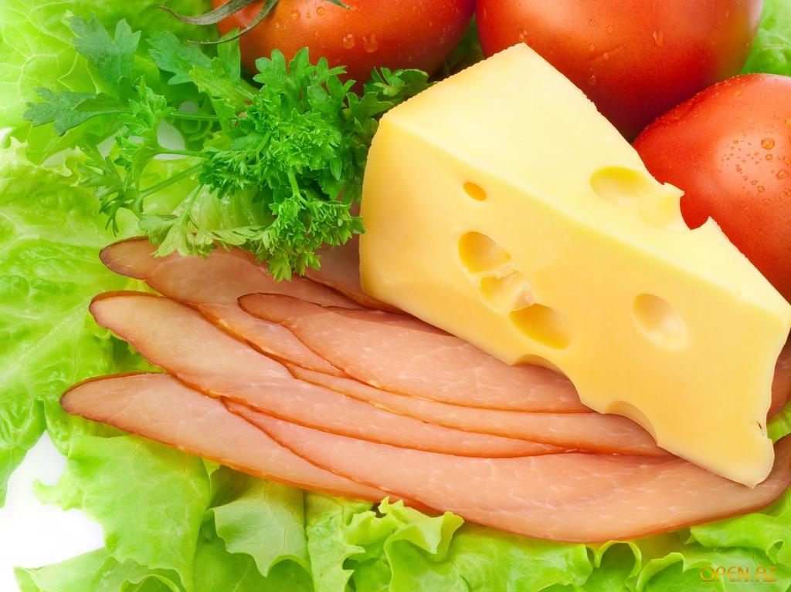
I like to eat porridge,
I like to eat cheese,
I like to eat carrots,
I like to eat sweets.
I like to drink coffee,
I like to drink milk,
I like to drink juice.
I am strong, I think.

Slide 2

Would You Like Some Coffee?

