Slide 1
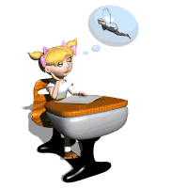

Passive Voice
The fundamentals of English grammar

Slide 2
In English there are two ways to describe actions
Active Voice
Passive Voice
Действительный залог
Страдательный залог
compare
Millions of people read this magazine.
Mary translated the article.
We will finish this work tomorrow.
This magazine is read by millions of people.
The article was translated by Mary.
This work will be finished tomorrow.
Пассивный залог используется, когда нам более важен объект действия, а не тот, кто его совершил.
При этом объект или предмет, над которым совершалось действие, встаёт на место подлежащего.

Slide 3
Forms of the verb in Passive Voice
Modal verbs
can/could be V3/ed
must be V3/ed
may be V3/ed
should be V3/ed
have/has to be V3/ed
To be
V
3/ed
 | Simple | Perfect | Continuous
Present | am is are | have been has | am is being are
Past | was were | had been | was being were
Future | will be | will have been
V3/ed
V3/ed
V3/ed
V3/ed
V3/ed
V3/ed
V3/ed
V3/ed

Slide 4

Prepositions
Mary painted the fence with a special brush.
by
with
употребляется перед предметом или объектом, совершившим действие
употребляется перед предметом, с помощью которого было совершено действие
The fence was painted
by Mary.
The fence was painted
with a special brush.
London was completely destroyed by fire in 1666.
Many beautiful museums in London are often visited by tourists.
The cheese was cut with a special knife.
Our furniture is cleaned only with a special substance.

Slide 5
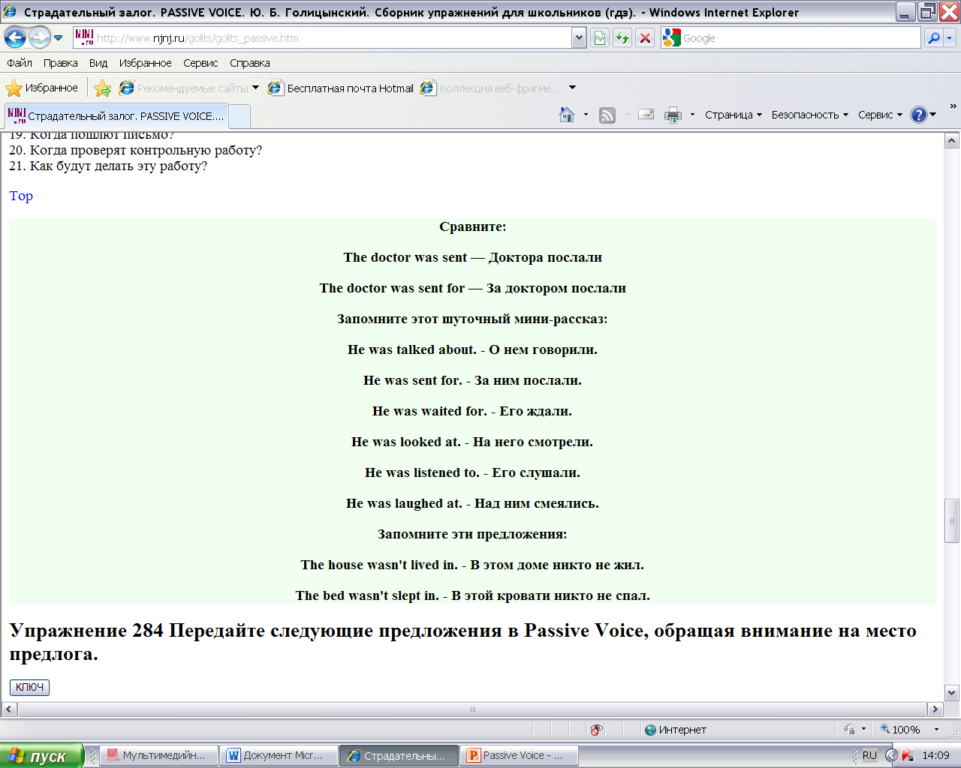
Phrasal verbs with prepositions
Глаголы, после которых нельзя забывать предлог!
hear of
pay attention to
take care of
laugh at
look at
look after
look for
listen to
make fun of
rely on
depend on
A Funny Story:
send for
speak of/about
talk about
think of
provide for
explain to
pay for
be rich in
be proud of/ take pride in
be responsible for
Be careful!!!

