Slide 1
Wellcome to our lesson

Slide 2
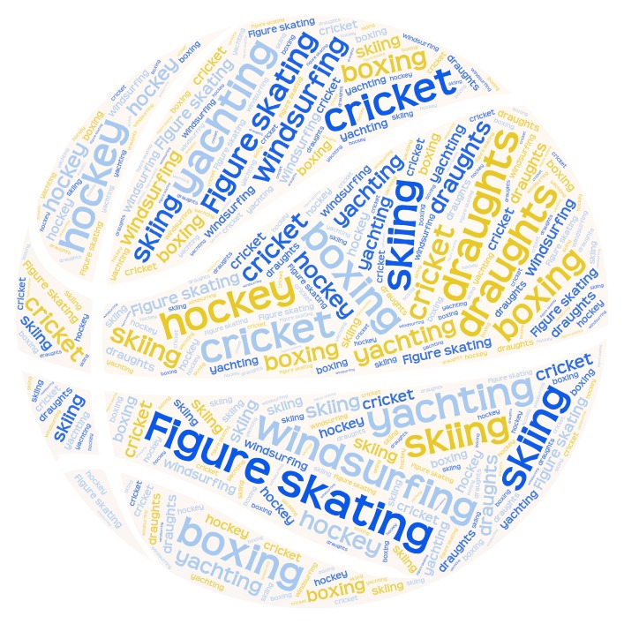

Slide 3
Exercise 16 on page 110 (textbook)
Which of these sports are indoor and outdoor?
Figure skating, draughts, windsurfing, table tennis, skiing, yachting, cycling, rugby, boxing, rock climbing, cricket, water polo, hockey, synchronous swimming, basketball, chess, water skiing, curling, roller skating, rowing, gymnastics, motor races, volleyball, diving, baseball, karate, skydiving, billiards, field hockey, rafting, judo, wrestling.

Slide 4
Indoor sports | Outdoor sports

Slide 5
DEGREES OF COMPARISON OF ADJECTIVES
Одно- и двухсложные прилагательные:
Многосложные прилагательные:
long | longer | the longest
interesting | more interesting | the most interesting

Slide 6
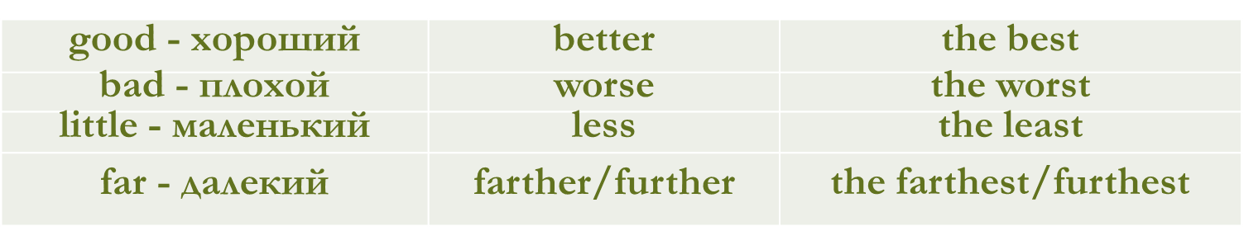
Исключения
Некоторые прилагательные имеют две формы:
polite — politer / more polite — the politest / most polite
simple — simpler / more simple — the simplest / most simple
clever — cleverer / more clever — the cleverest / most clever

Slide 7
Exercise 15 on page 110 (textbook)
Rock climbing is the most dangerous sport.
Rock climbing is more dangerous than tennis.
Rock climbing is as dangerous as parkour.
Rock climbing is not so dangerous as cave diving.
Rock climbing is less dangerous than cave diving.

Slide 8
1. What do you use to hit a ball in golf?
a. a racket
b. a club
c. a bat

Slide 9

2. Guess the rebus:

Slide 10
3. Which country was the original home of Olympic Games?
a. ancient Egypt
b. ancient Greece
c. ancient Rome

Slide 11
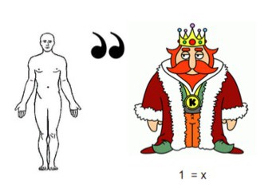
4. Guess the rebus:

Slide 12
5. What do the five rings on the Olympic flag represent?
a. the five continents of the world
b. the five original Olympic events
c. the first five Olympic winners

Slide 13
6. How many players are there in a hockey team?
10
11
12

Slide 14

7. Guess the rebus:

Slide 15
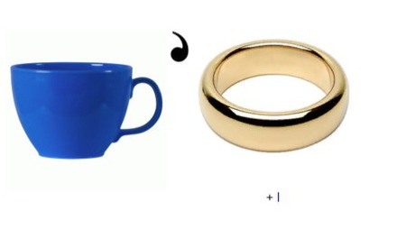
8. Guess the rebus:

Slide 16
9. If the score is 0-0, the game is a …
a. draw
b. win
c. zero

Slide 17
10. “The queen of all sports“ is … .
Gymnastics
Athletics
Diving

Slide 18

11. Guess the rebus:

Slide 19

12. Guess the rebus:

Slide 20
HOMEWORK
Make a report about your favourite sport.
Use Ex.11p.109

Slide 21
Thank you for your work!
The lesson is over!
Good bye!

