Slide 1
Презентация к уроку
в 4 а классе на тему
«The Past Simple tense»
с использованием элементов
биоадекватной методики

Slide 2
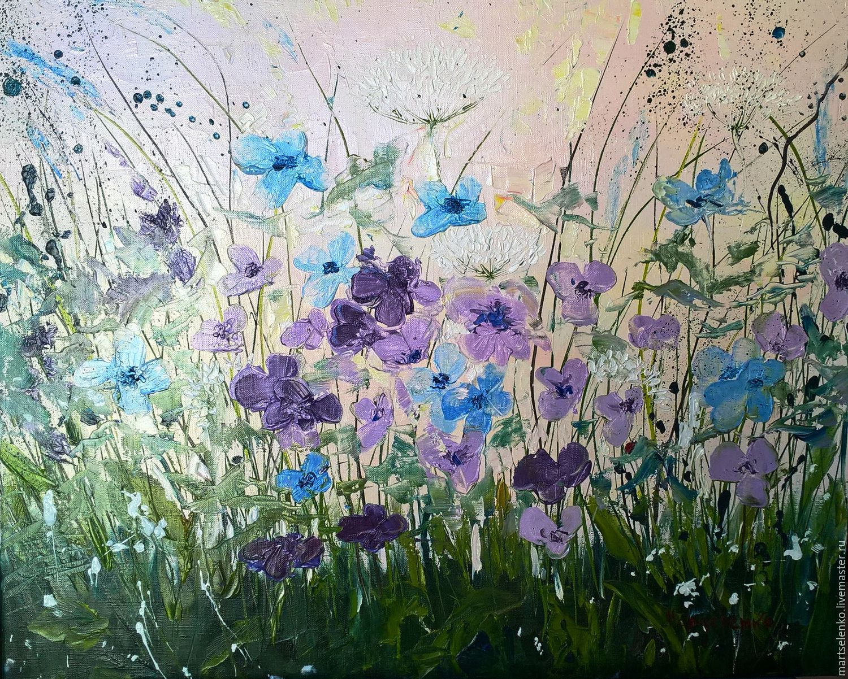
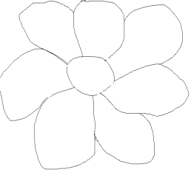
Past Simple

Slide 3

last week the day before
yesterday
Past Simple
last summer a week ago
month ago
last year yesterday

Slide 4
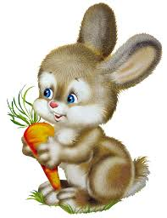
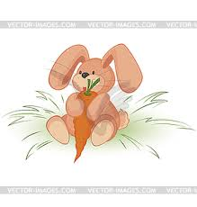
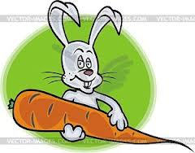
[t]
[d]
[id]
danced painted cried
walked wanted listened
needed arrived washed collected smiled jumped skated opened played
liked invited talked

Slide 5
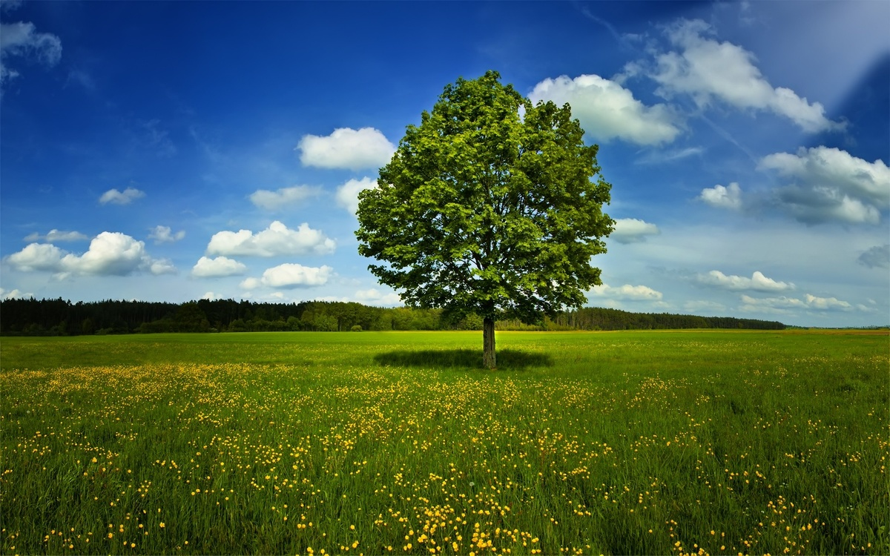

swim do go did rode see run went
sang came eat flew be ate fly take ran
sing ride saw was/were took swam come
кушать ходить видеть делать прийти петь
ехать верхом брать плавать быть летать бегать

Slide 6
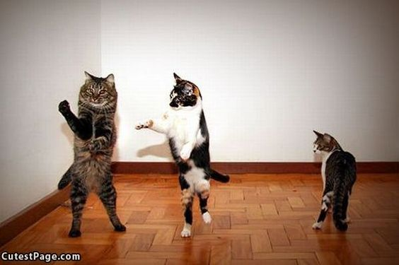
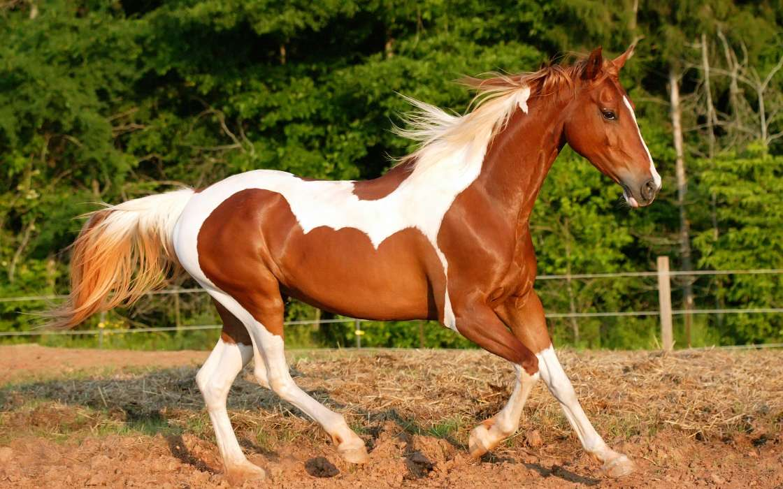
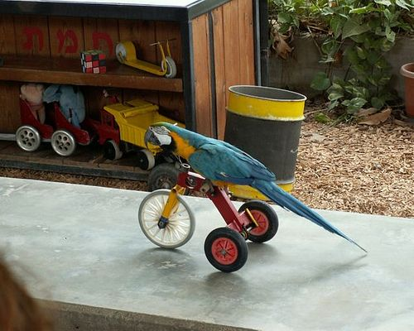
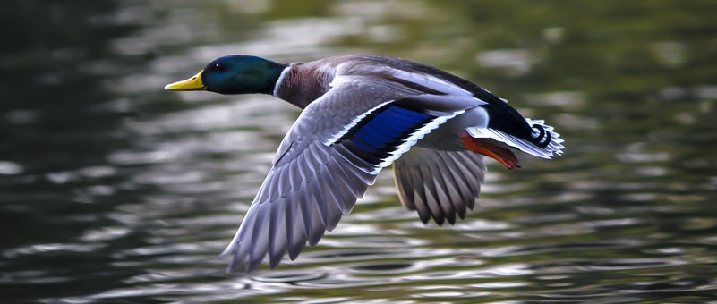
The сats watched TV yesterday.
The horse flew last week.
The duck ran a week ago.
The parrot rode a horse last summer.

Slide 7
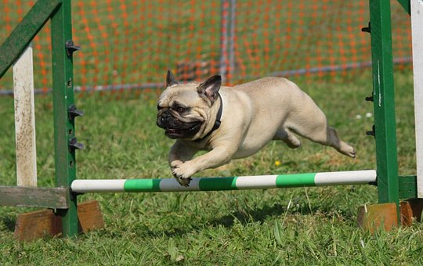

The dog walked yesterday.
The bear watched TV yesterday.

Slide 8
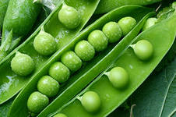
Listen to the song and fill in the missing verbs
Did the Irish ants arrive?
___ the Irish ants arrive? Yes, they did. Yes, they did.
Did they dance? Did they fly? Yes, they ___. Yes, they did.
___ they ride? Did they drive? Did they swim across the sea?
Yes, they ___. Yes, they ___. Yes, they ___.
Oh, they ____(come) to us from Ireland, across the Irish sea.
They ___ (eat) all the biscuits.
They didn’t eat the peas.
They brought us Irish butter, but they didn’t bring us cheese. Oh, they came to us from Ireland, across the Irish sea.

Slide 9
Did the Irish ants arrive?
Did the Irish ants arrive? Yes, they did. Yes, they did.
Did they dance? Did they fly? Yes, they did. Yes, they did.
Did they ride? Did they drive? Did they swim across the sea?
Yes, they did. Yes, they did. Yes, they did.
Oh, they came to us from Ireland, across the Irish sea.
They ate all the biscuits.
They didn’t eat the peas.
They brought us Irish butter, but they didn’t bring us cheese.
Oh, they came to us from Ireland, across the Irish sea.

Slide 10
Thank you for your work!

