Slide 1
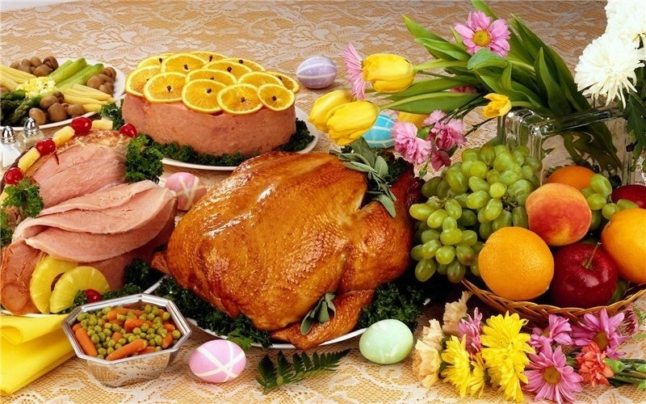
How to be healthy?

Slide 2
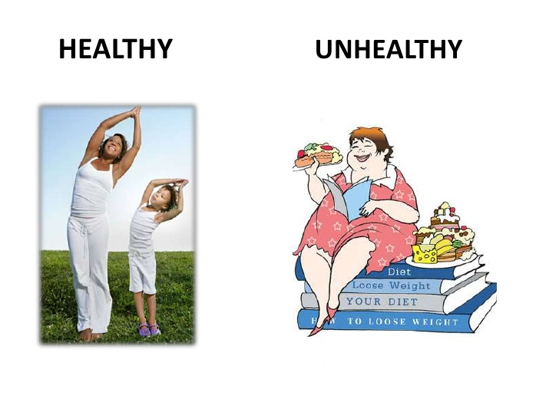

Slide 3
1 Which of them are vegetables or fruit?
a kiwi →
a potato→
a carrot →
an apple →
cabbage →
a grapefruit →
a tomato
2 Put the letters in the following words into the correct order and write them down.
wdanschi →
dbare →
lcoa →
ikml →
dlaas →
cie rmeca →

Slide 4
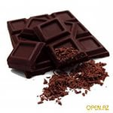
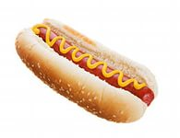
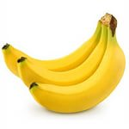
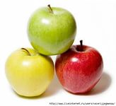
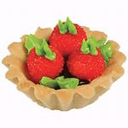
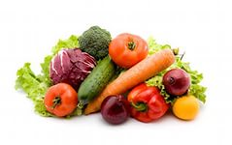
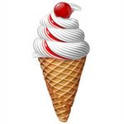

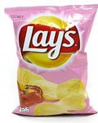
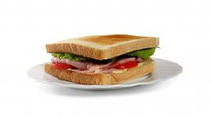
Healthy or Unhealthy ?
Chocolate | Hot dog | Bananas | Apples | Cakes
Vegetables | Ice cream | Juice | Chips | Sandwich

Slide 5
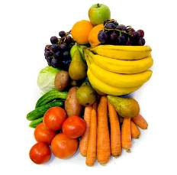
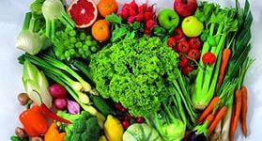
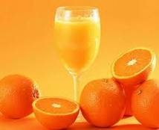
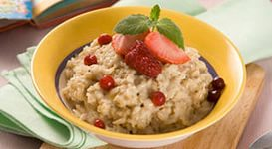
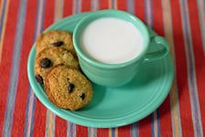
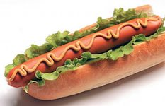
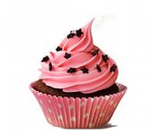
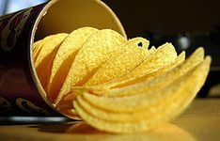
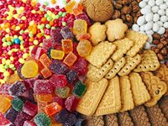
Healthy Food:
Unhealthy Food:

Slide 6
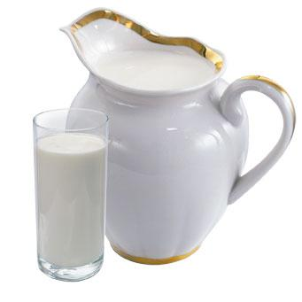
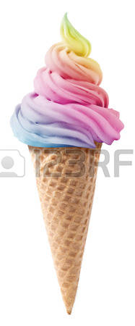
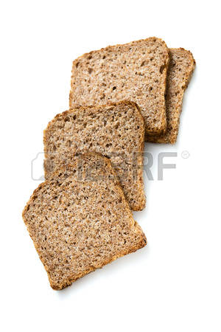
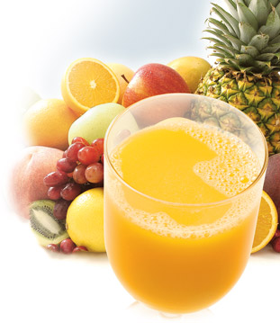

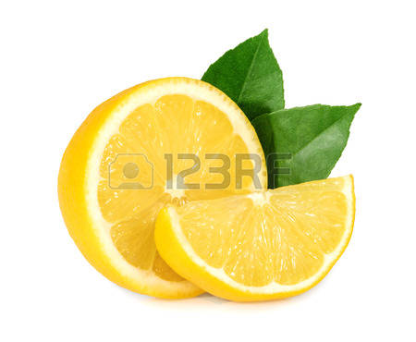
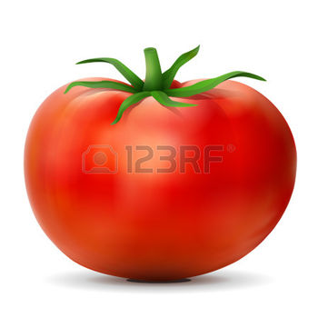
Riddles
1 It’s yellow. I drink tea with it. It’s уuck. What is it? 2 It’s white. It’s good to drink. What is it?
3 It’s brown but not tea. I eat it with soup.
4 It’s red. It’s not a fruit. I eat it in salad
and pizza.
5 It’s a long, thin fruit that starts with “B”. Monkeys like to eat it.
6 It's white, cold and sweet.
All children like it.

Slide 7
MUST (должен)
You must swim
You must not swim

Slide 8
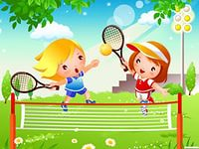

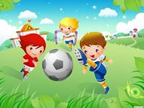
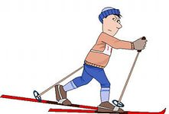
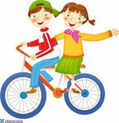
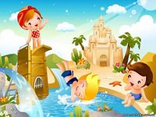
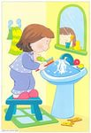

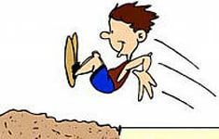
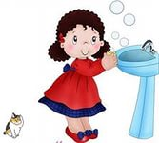
SPORT is FUN!

Slide 9
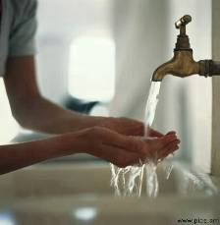

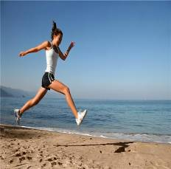
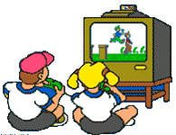
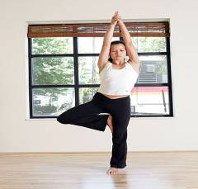
I think I must /mustn't ...

Slide 10
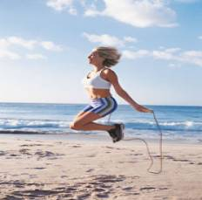

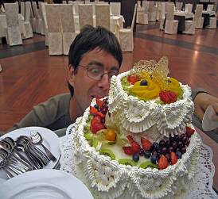
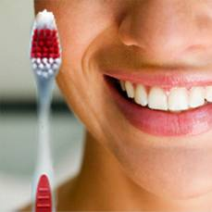
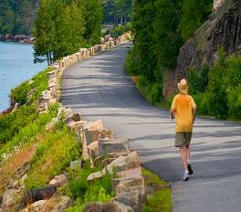
I think I must /mustn't ...

Slide 11
Group 1 What must you eat to be healthy?
Group 2 What must you do to be healthy?
Group 3 What mustn’t you do to be unhealthy?
I think I must eat … because I want to be healthy.
I must clean my teeth ….
I have ….. for breakfast.
I know I mustn’t eat ….
I don’t eat ….

Slide 12
Eat carrots, apples Have porridge, cheese
and cabbage and milk for breakfast
How can you be healthy?
You must run, skate, swim,
play football or tennis
Don’t eat sweets, cakes You mustn’t read in
and sandwiches. Don’t bed.
be lazy!
You must wash your face, clean your teeth

Slide 13


A success light signal
Choose:
if you understood everything
and liked the lesson
If you understood little
and didn’t like the lesson

