Slide 1
What does red symbolize in Russia
The 6th form. Module №3

Slide 2
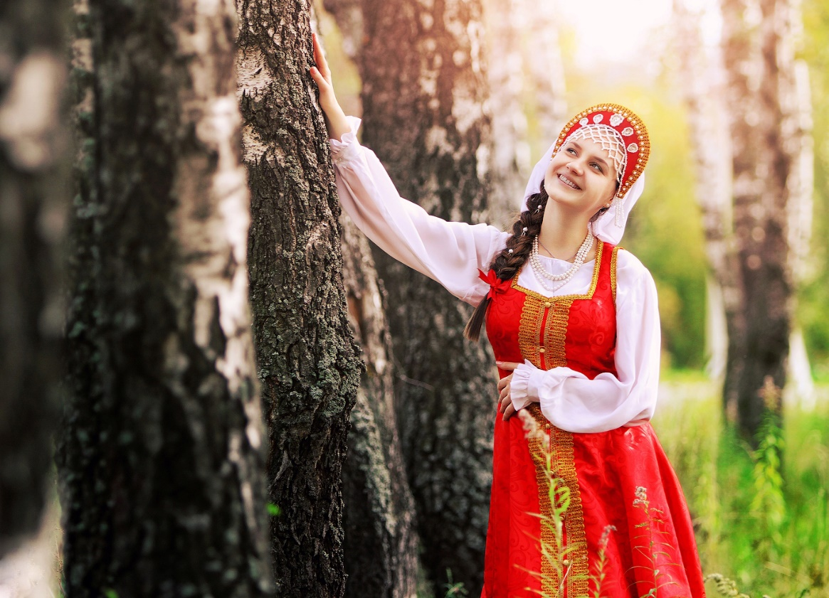
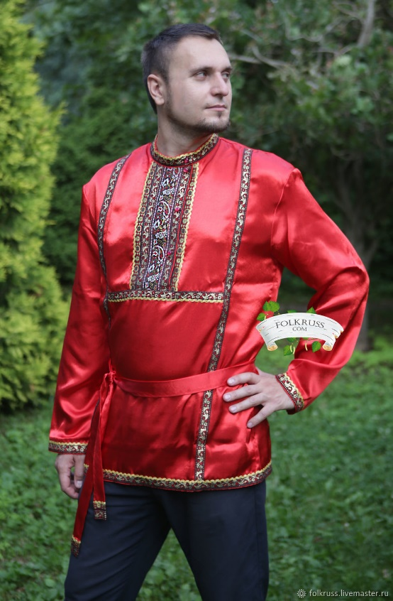
Red had the meaning of beautiful
Red colour
in Russia folk
costumes

Slide 3
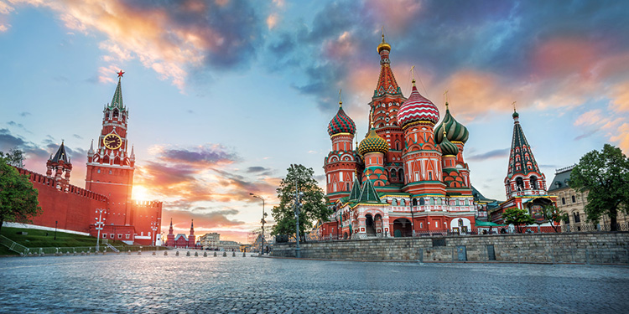
Red Square in Moscow

Slide 4

The soviet flag

Slide 5
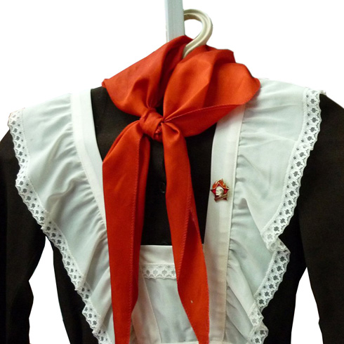
Pioneer searves

Slide 6
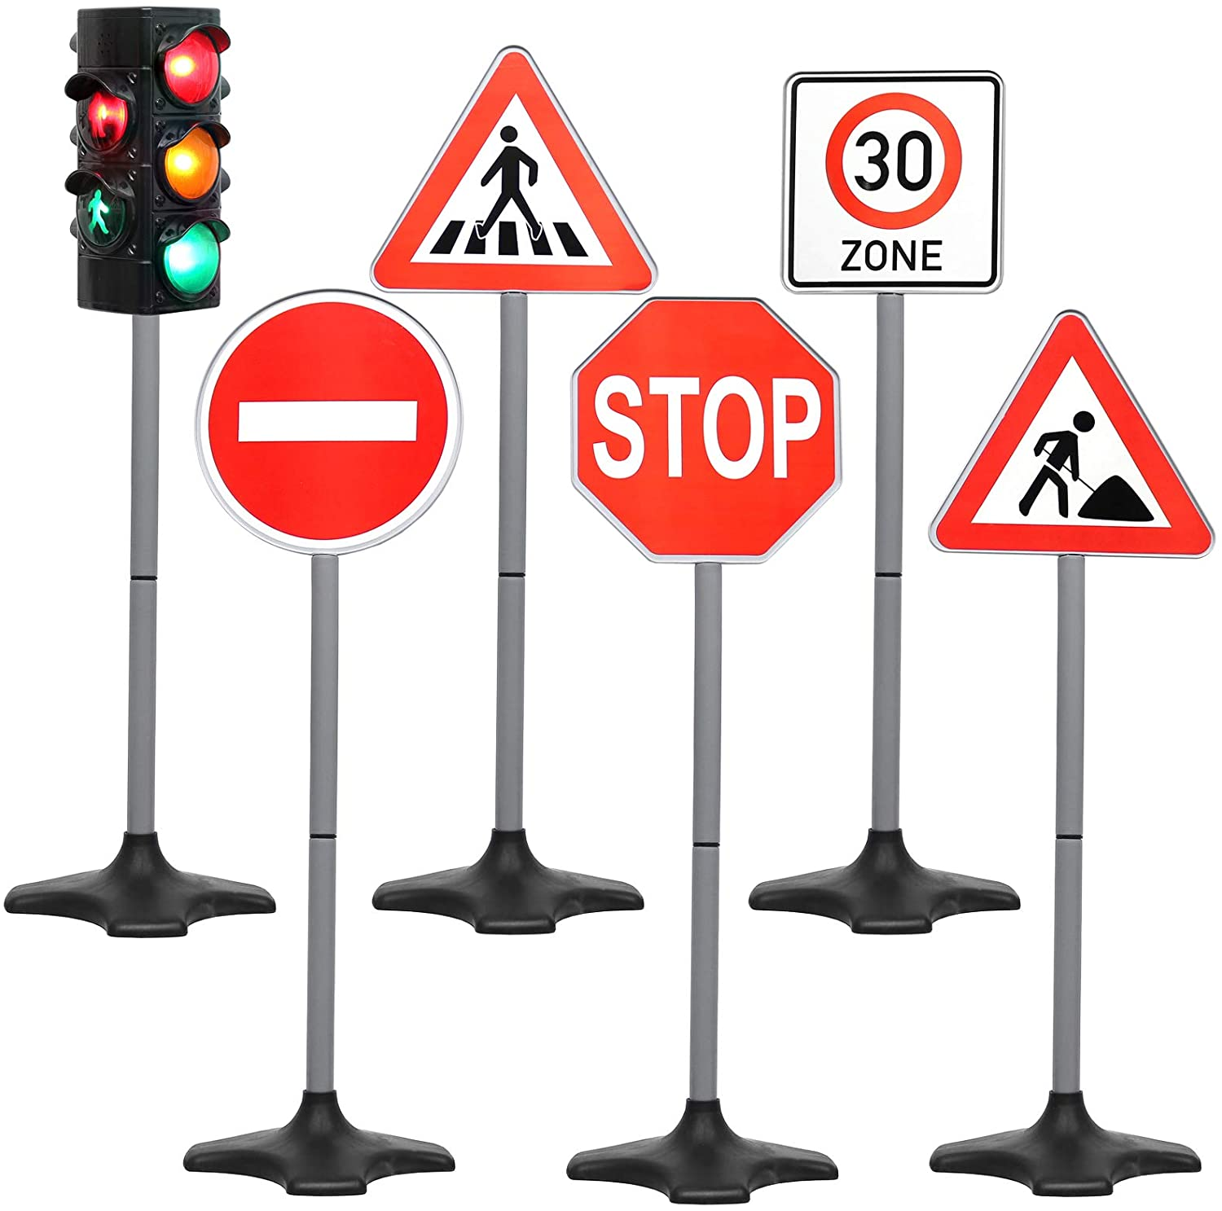
Traffic lights
and sings

Slide 7
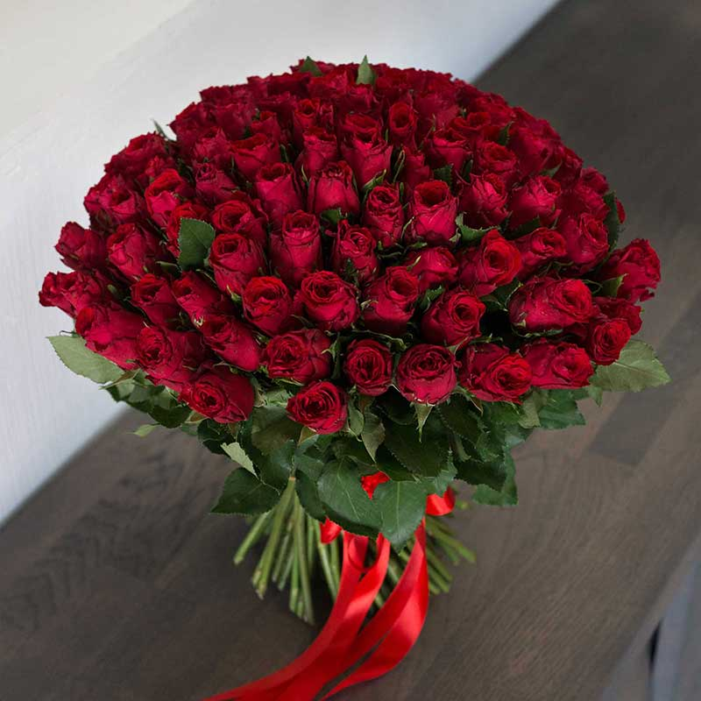
Red rose – I love you

