Slide 1

Diseases of the cardiovascular system
Комсомольский-на-Амуре филиал краевого государственного бюджетного профессионального образовательного учреждения
«Хабаровский государственный медицинский колледж» имени Г.С. Макарова
министерства здравоохранения Хабаровского края
Преподаватель: Заремская А.С.
Студентка группы 33-С: Базанова Виктория

Slide 2

Cardiovascular diseases affect different components of the circulatory system. Сardiovascular system as a whole is affected hypertension. However, cardiovascular disease can be caused by a failure of the mechanisms of regulation of activity of the heart and blood vessels, disorders of metabolism.

Slide 3
Symptoms
Shortness of breath
Chest pain
Puffiness
Headaches
Nausea
Cough
Pallor
Quickening of the pulse

Slide 4
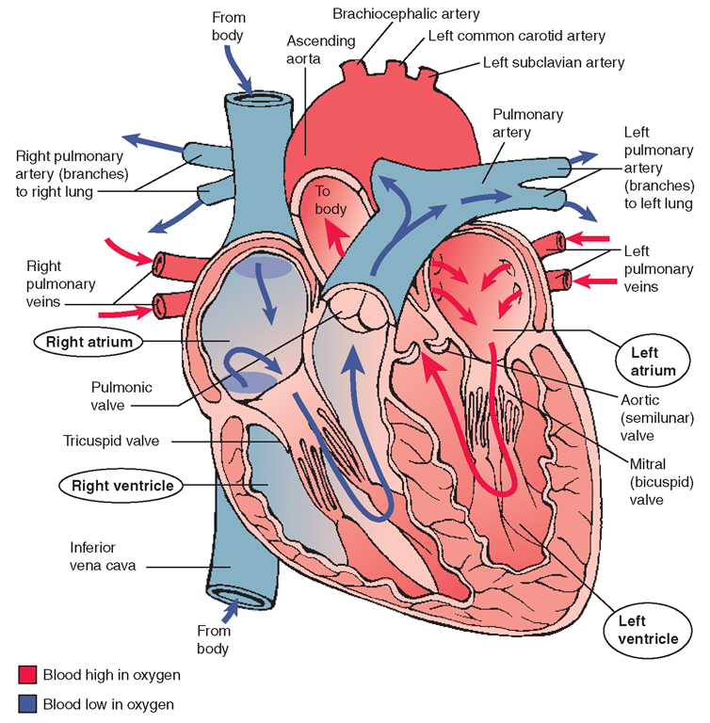

Slide 5
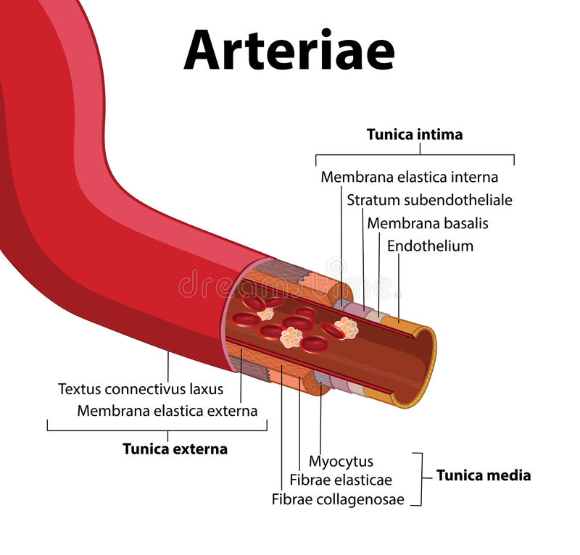
Arteries - the blood vessels bearing blood enriched with oxygen from heart to bodies and fabrics .
The wall of an artery is presented by three layers: external cover; average, consisting from the elastic fibers and smooth muscles; internal, educated endotely and connecting fabric.
Diameter of arteries fluctuates is 0,4 - 2,5 cm. The total amount of blood in arterial system averages 950 ml.
The aorta is the largest artery in the body.

Slide 6

Arrhythmia - a variety of deviation and arrhythmias heartbeat.
Normal heart rate in humans of 60-90 beats per minute.
Arrhythmias occur in diseases of the central and autonomic nervous systems, endocrine diseases, myocardial injury.

Slide 7
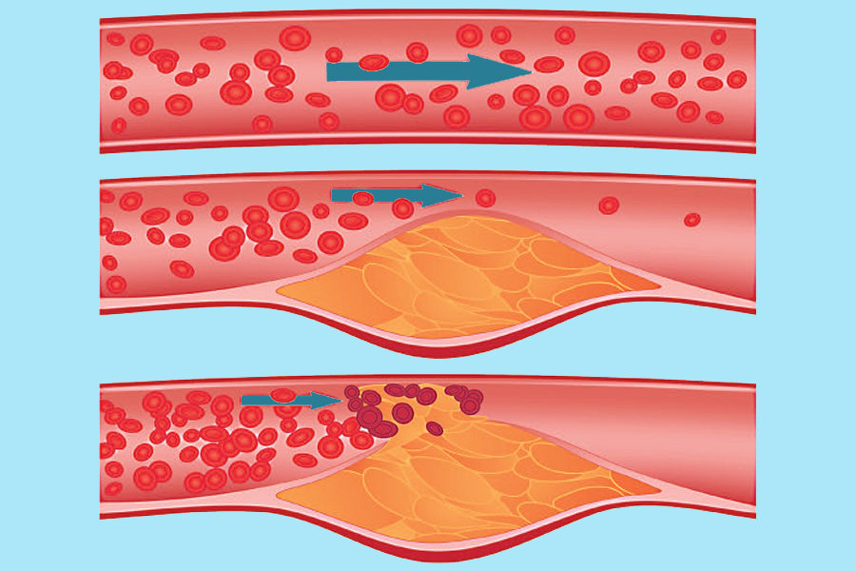
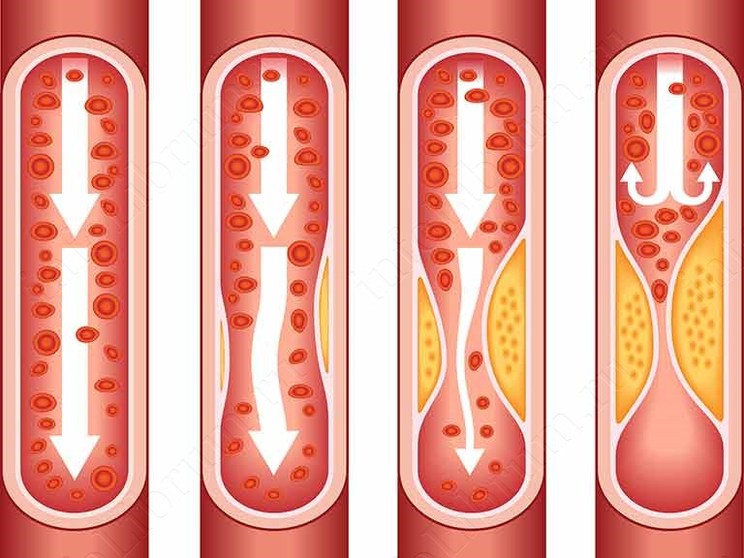
Atherosclerosis - is a chronic disease that affects large and medium arteries.
In this disease in the inner lining of arteries is delayed cholesterol.

Slide 8
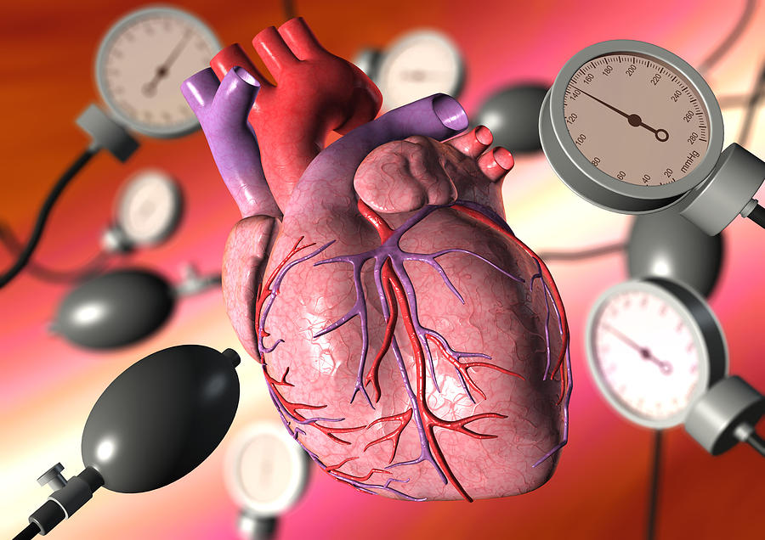
Hypertension - is increased tone of arterial vessels.
As a result of increased blood pressure, which entails various pathological changes in the organs and systems of the body.
Normally blood pressure 120/80.

Slide 9
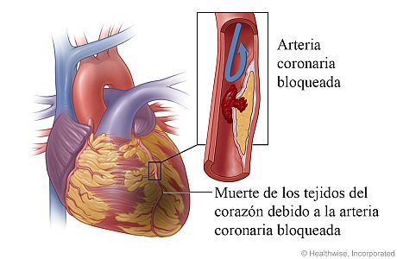
Myocardial infarction - a disease caused by damage to the heart muscle - the myocardium - caused by blockage a coronary artery, which may result from of atherosclerosis.

Slide 10
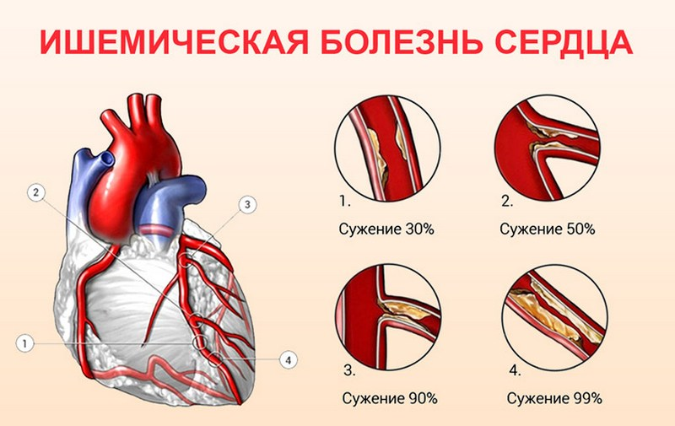
Coronary heart disease (CHD) - a disease that develops when there is insufficient supply of oxygen to the heart muscle by the coronary arteries. The most common reason for this - coronary atherosclerosis.

Slide 11
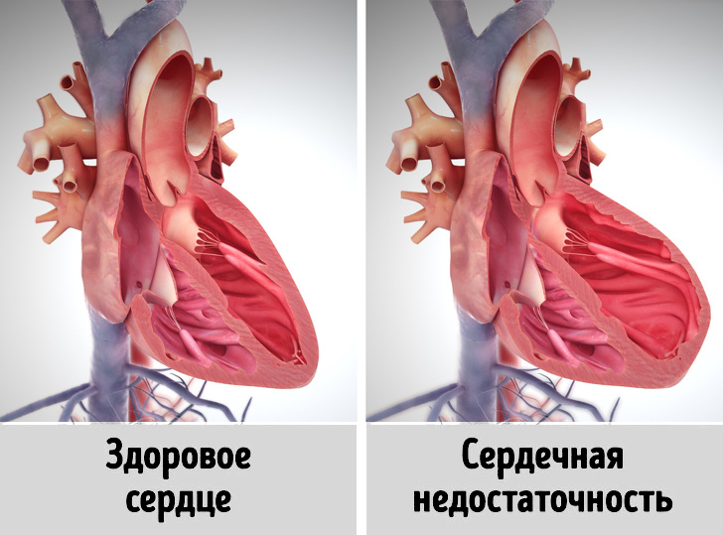
Heart failure - a pathological condition caused by failure of the heart as a pump, to provide adequate circulation.

Slide 12
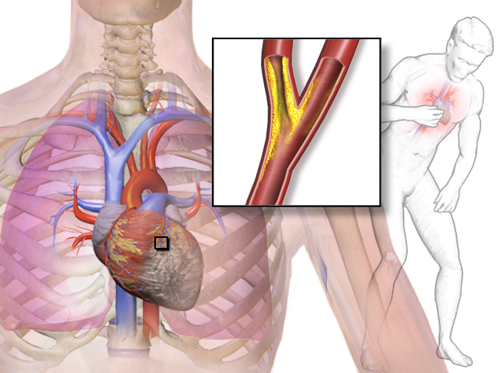
Angina - a form of coronary artery disease, characterized by paroxysmal pain in the heart, due to acute failure of myocardial perfusion.

Slide 13
https://chekhovsc.ru/blog/prichiny-i-priznaki-serdechno-sosudistykh-zabolevanij
https://www.yamed.ru/services/terapiya/zabolevaniya-serdechno-sosudistoi-sistemy/
https://www.vidal.ru/encyclopedia/zabolevaniya-serdechno-sosudistoyi-sistemi-kardiologiya/bolesni-serdtsa
https://genomed.ru/serdechno-sosudistye-zabolevaniya
http://www.unn.ru/books/met_files/angiologyia.pdf

