Slide 1

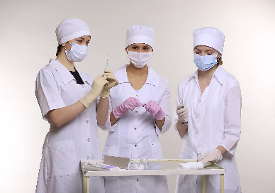
«My future profession is a nurse »
Комсомольский-на-Амуре филиал краевого государственного бюджетного профессионального образовательного учреждения "Хабаровский государственный медицинский колледж"
министерства здравоохранения Хабаровского края
Подготовила: Балабанова В.В.
Студентка группы 11С
Отделение: «Сестринское дело»
Руководитель:
Заремская Анастасия Сергеевна
2021

Slide 2





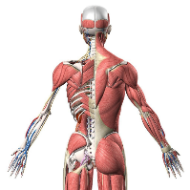
My name is Balabanova Victoria.
I was born on the 11th of February in 2002.
I am from Komsomolsk-on-Amur.
I am an only child in my family.
My father works in the aircraft factory, he’s a workshop foreman.
My mother works in the aircraft factory, she’s a storekeeper.
I am a students of the medical college.
My favorite subjects are:
psychology,
anatomy,
genetics,
English

Slide 3
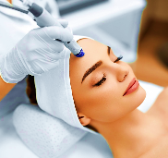
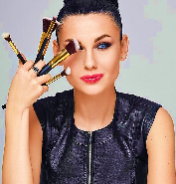
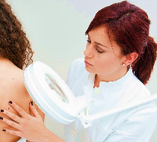
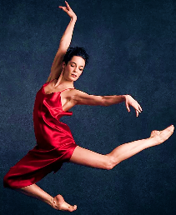

I am currently receiving appropriate training in such subjects as anatomy, psychology, pharmacology, English and medicine.
I like these subjects because I am interested in medicine and modeling, and I have long wanted to learn how to do various types of injections.
In the future, I would like to become a cosmetologist, make-up artist or dermatologist.
As a child, I dreamed of becoming a veterinarian or a dancer.
My friends and relatives say that I am a kind, sympathetic, modest, purposeful girl.

Slide 4


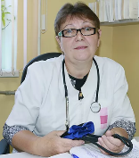
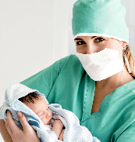

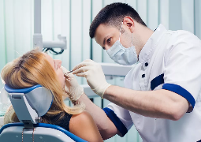
My college
Komsomolsk-on-Amur Medical College accepts applicants
at the end of the 11th grade and includes the following
departments:
Nursing Affair ( 2 years and 10 months)
Curative Affair (3 years and 10 months)
Obstetrician Affair (2 years and 10 months)
Laboratory diagnostics (2 years and 10 months)
Preventive dentistry (1 year and 10 months)

Slide 5


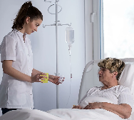
Medical nurse
Nurse — the right hand of the attending physician.
She writes at the direction of the doctor's prescriptions, certificates, referrals for medical examinations.
In hospitals, nurses keep order in the wards, organize the mode of patients referred for designated doctor examination, give medication.

Slide 6
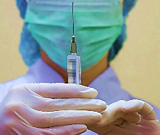
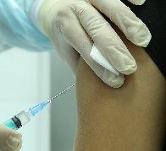


The direct responsibility of the nurses: injections, vaccinations, measurement of blood pressure.
The nurse, unlike the doctor and the doctor assistant, doesn’t have the right to appoint a course of treatment and prescribe at their own discretion.

Slide 7
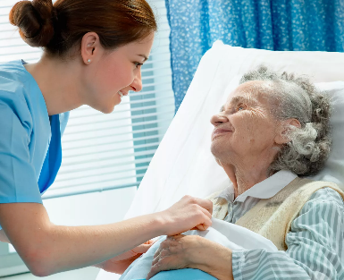
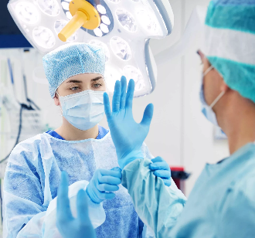
The types of activities nurses:
patient care in hospitals
help surgeons in
operations

Slide 8
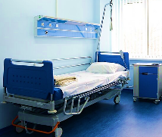
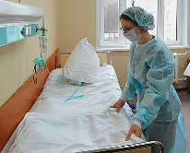
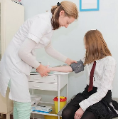
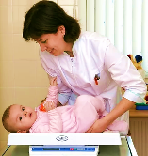
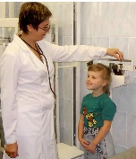

Place of work:
the local clinic
hospitals
educational institution
orphanages
carers for the
disabled
kindergartens

Slide 9
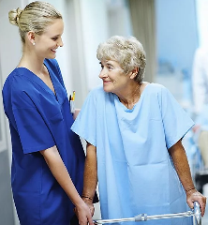
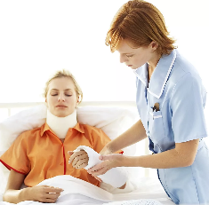

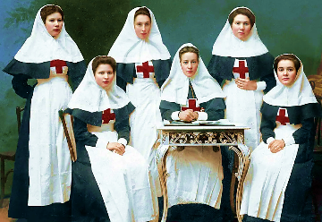
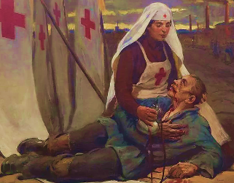
People who are able and willing to help others need to choose nursing. Without this intention, work will not bring joy, but only irritation.
Let me remind you that this profession originated in a military context. Women rescued the wounded on the battlefields. They were also called the Sisters of Mercy.

Slide 10
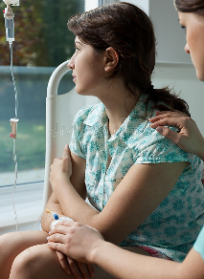
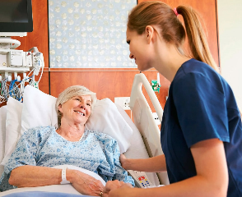
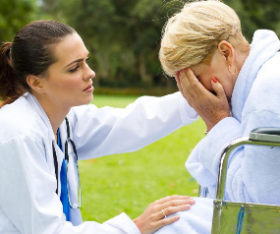
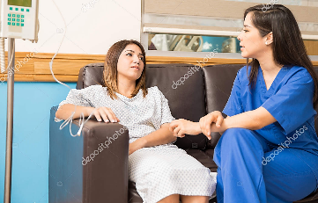

A nurse tries to understand the patient, patiently listening to him when he talks about his worries and fears, she strives to support and console him.
!A nurse`s duty is to be honest and truthful toward the patient!

Slide 11


Why did I choose this profession?
The main reason for my choice is the desire to help people. Nursing is also a very noble profession. People who are in the hospital do not have enough care and attention, and a nurse can comfort the patient when no one is around. In addition, walking down the street, I may encounter the fact that someone will need medical attention. For example, some old woman will get sick, or a young guy will fall and break his leg. I want to have the professional skills and knowledge to help in such cases.
I believe that the nursing profession is very useful. It will be useful in life, because a nurse always knows how to provide first aid. I have parents, I will have children, and I want to be able to provide them with medical care that can save their lives.

