Slide 1
December, 14 th
Monday
Classwork

Slide 2
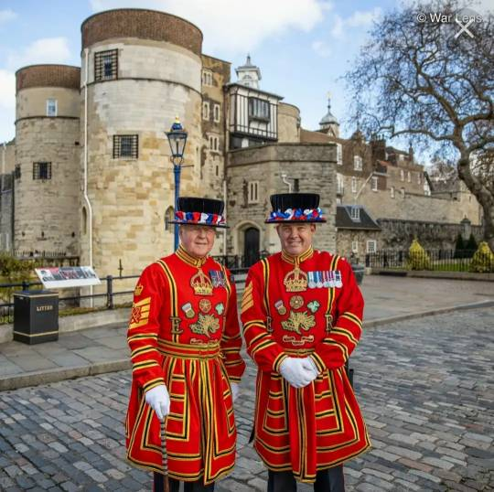
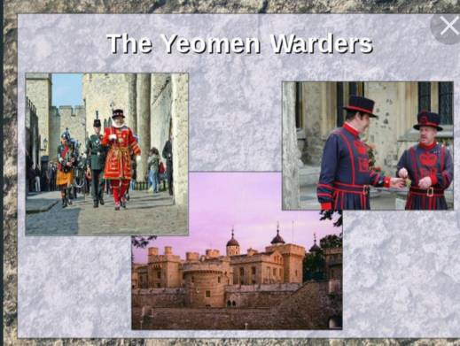
On guard of the Tower/
The Yeoman Warders

Slide 3
What is the topic of the lesson today?
Какая сегодня тема урока?
Today we’ll talk about…
learn…
read…
write…
can…

Slide 4
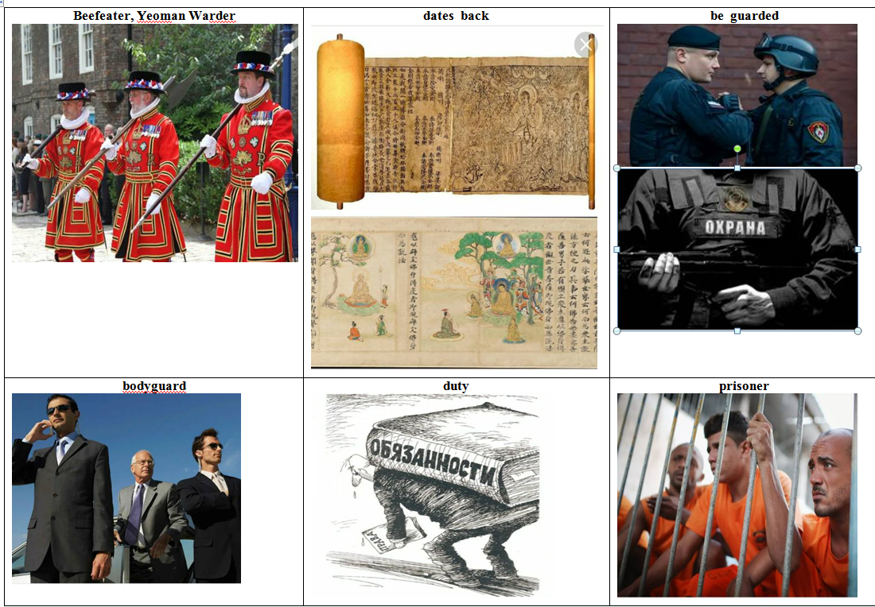

Slide 5
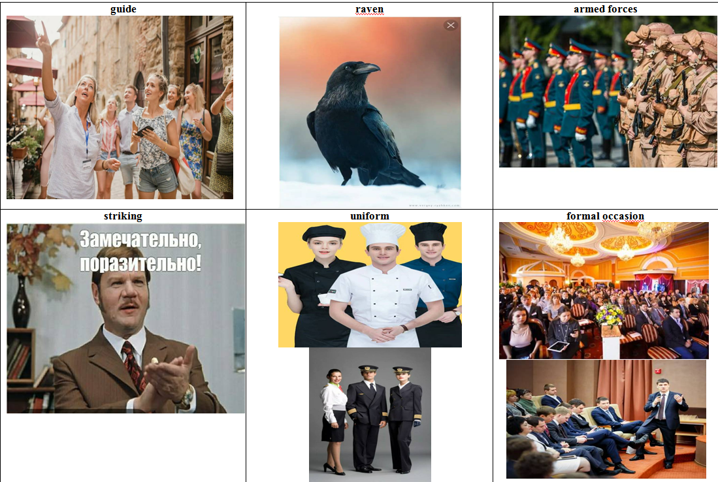

Slide 6
Beefeater, Yeomаn Wаrder – бифитеры, Йомены- стражники
dates back to – датируется, зарождаться
be guarded - охраняется
bodyguаrd - телохранитель
duty - обязанность
prisoner – заключенный, узник
guide – гид, экскурсовод
rаven - ворон
armed forces – вооруженные силы
striking – необыкновенный, поразительный
uniform - униформа
formаl occаsion – официальное мерориятие, повод

Slide 7
Crown Jewels – королевские сокровища
guаrd – охрана, охранять
pаlаce - дворец
site – достопримечательность, здание
tourists - туристы
tourist аttrаction – достопримечательность среди туристов
trimmings - вставки (кусочки материи, используемые для украшения одежды)

Slide 8
Relative pronouns / adverbs
Relative pronouns/adverbs – это относительные местоимения и
наречия, служащие для связи главного предложения с
придаточным определительным.
who/that/whom – употребляются по отношению к лицам – «кто, который»
which/ that – употребляется по отношению к неодушевленным предметам- «который»
whose – употребляется по отношению к людям, животным и предметам, чтобы выразить принадлежность - «которого, чей»
when – употребляется по отношению ко времени- «когда»
where – употребляется по отношению к месту- «где»
why – выражает причину - «почему»

Slide 9
Ex. 2, p. 31
1- when
2- that
3- that
4- who
5- where

Slide 10
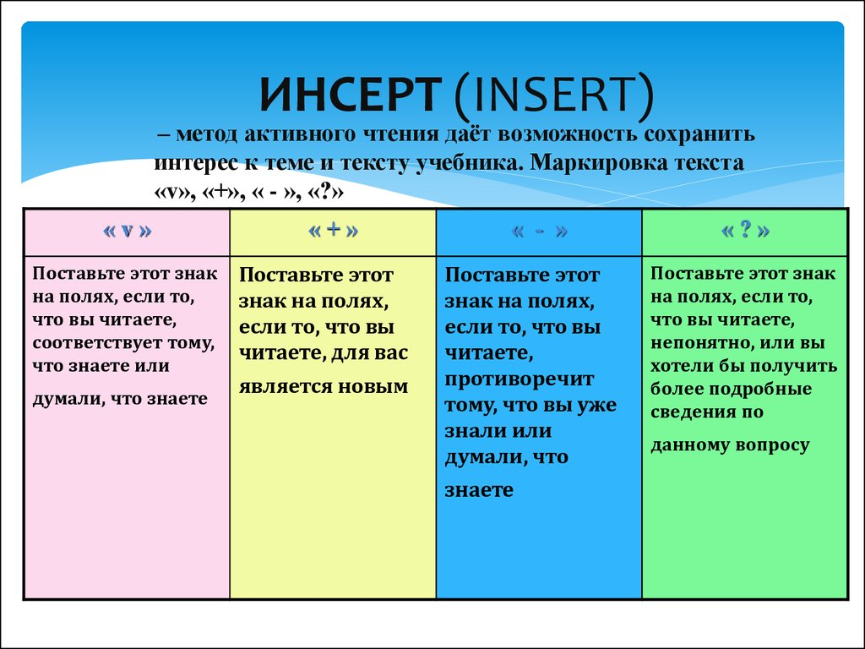

Slide 11
Ex. 3, p. 31
1- T
2- T
3- F
4- T
5- DS

Slide 12
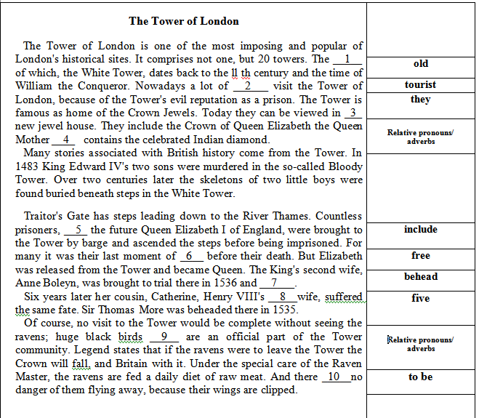
Section 3 Vocabulary and grammar
Раздел 3. Лексика и грамматика

Slide 13
1- oldest
2- tourists
3- their
4- which
5- including
6- freedom
7- beheaded
8- fifth
9- who
10- is

Slide 14
The Tower of London
The Tower of London is one of the most imposing and popular of London's historical sites. It comprises not one, but 20 towers. The oldest of which, the White Tower, dates back to the ll th century and the time of William the Conqueror. Nowadays a lot of tourists visit the Tower of London, because of the Tower's evil reputation as a prison. The Tower is famous as home of the Crown Jewels. Today they can be viewed in their new jewel house. They include the Crown of Queen Elizabeth the Queen Mother which contains the celebrated Indian diamond.
Many stories associated with British history come from the Tower. In 1483 King Edward IV's two sons were murdered in the so-called Bloody Tower. Over two centuries later the skeletons of two little boys were found buried beneath steps in the White Tower.
Traitor's Gate has steps leading down to the River Thames. Countless prisoners, including the future Queen Elizabeth I of England, were brought to the Tower by barge and ascended the steps before being imprisoned. For many it was their last moment of freedom before their death. But Elizabeth was released from the Tower and became Queen. The King's second wife, Anne Boleyn, was brought to trial there in 1536 and beheaded. Six years later her cousin, Catherine, Henry VIII's fifth wife, suffered the same fate. Sir Thomas More was beheaded there in 1535.
Of course, no visit to the Tower would be complete without seeing the ravens; huge black birds who are an official part of the Tower community. Legend states that if the ravens were to leave the Tower the Crown will fall, and Britain with it. Under the special care of the Raven Master, the ravens are fed a daily diet of raw meat. And there is no danger of them flying away, because their wings are clipped.

Slide 15
What have you learnt about The Yeoman Warders?
1. The site dates back…
2. The Tower of London is guarded by …
3. “Beefeaters” were first introduced by…
4. Their duties included …
5. Also they take care of the…
6. They live … .
7. They are most famous for …

Slide 16
Reflextion
What have you done at the lesson today?
We’ve talked
learnt
read
written
repeated
known

Slide 17

It’s time to stop now.
That’s all for today.
The lesson is over.
Goodbye!
See you!

