Slide 2
Личные местоимения и спряжение глагола to have got
I have got a dog.
You have got a frog.
They have got a fox.
We have got a box.
He has got an owl.
She has got a doll.
It has got a ball.
That’s all!

Slide 3
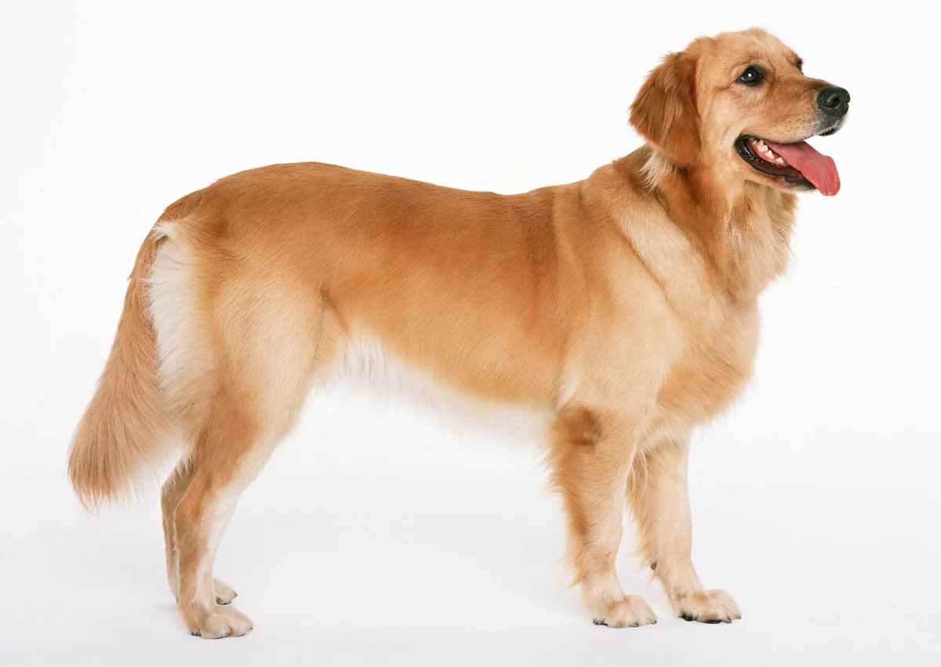
I have got a

Slide 4
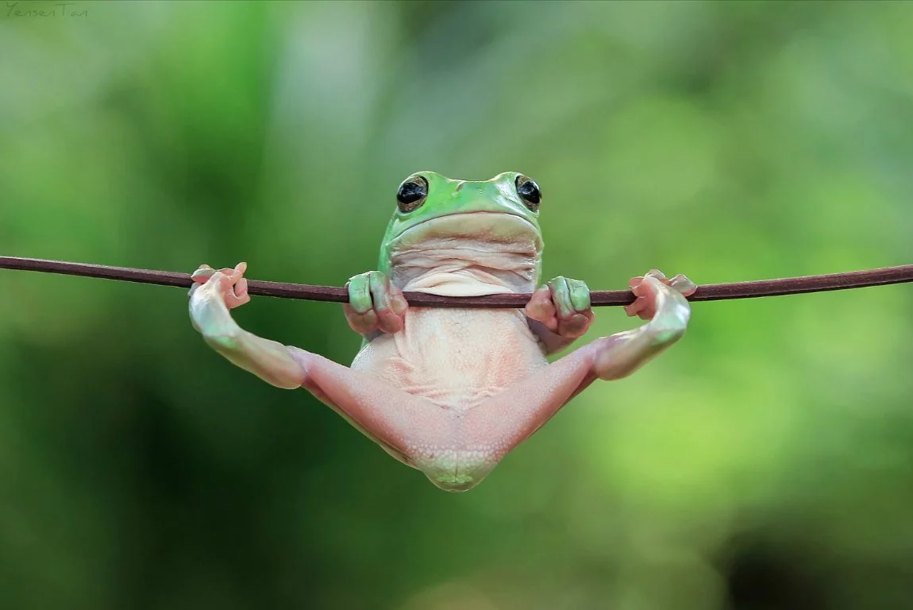
You have got a

Slide 5
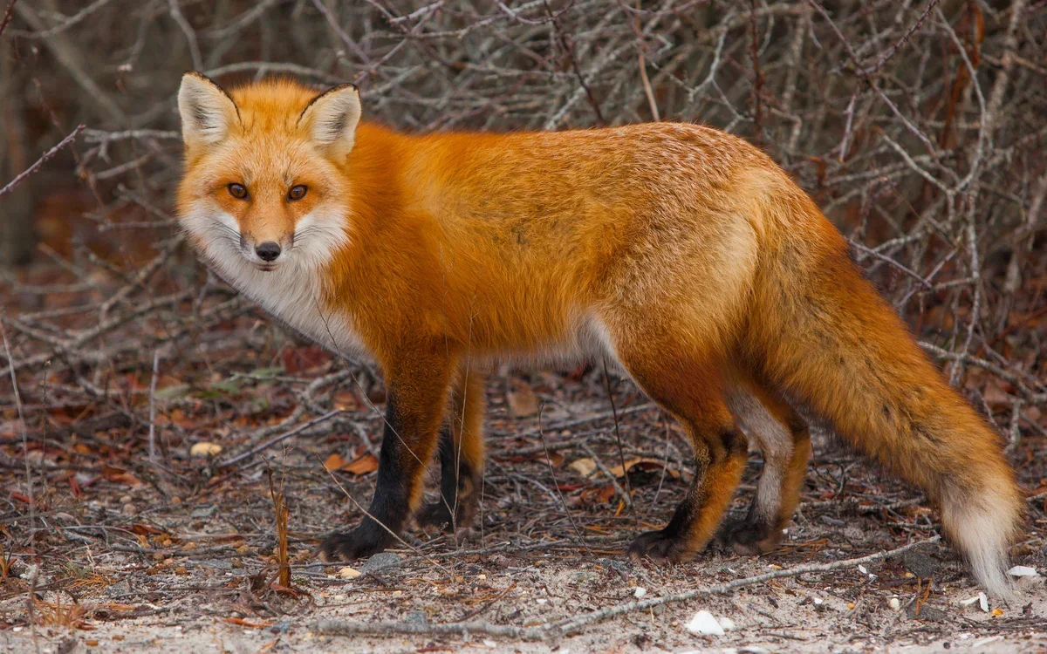
They have got a

Slide 6

We have got a

Slide 7
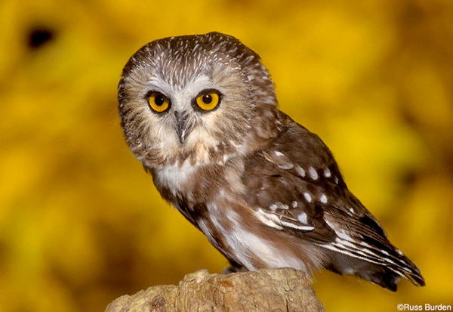
He has got an

Slide 8
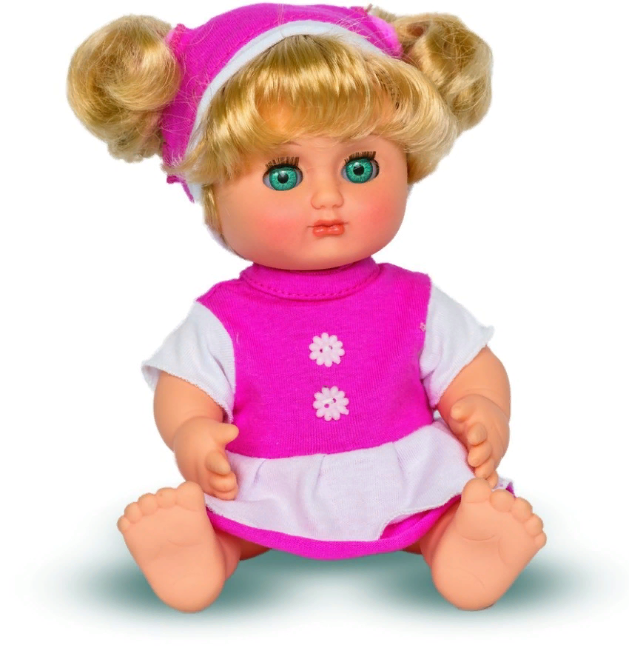
She has got a

Slide 9
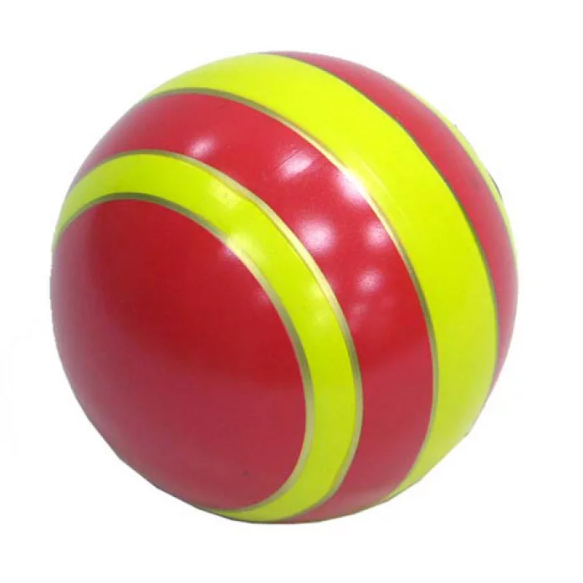
It has got a

Slide 10

That’s all!

