Slide 1
I can see…and…
Презентация к учебнику О.В. Афанасьевой, И. В. Михеевой Rainbow English 3 класс

Slide 2
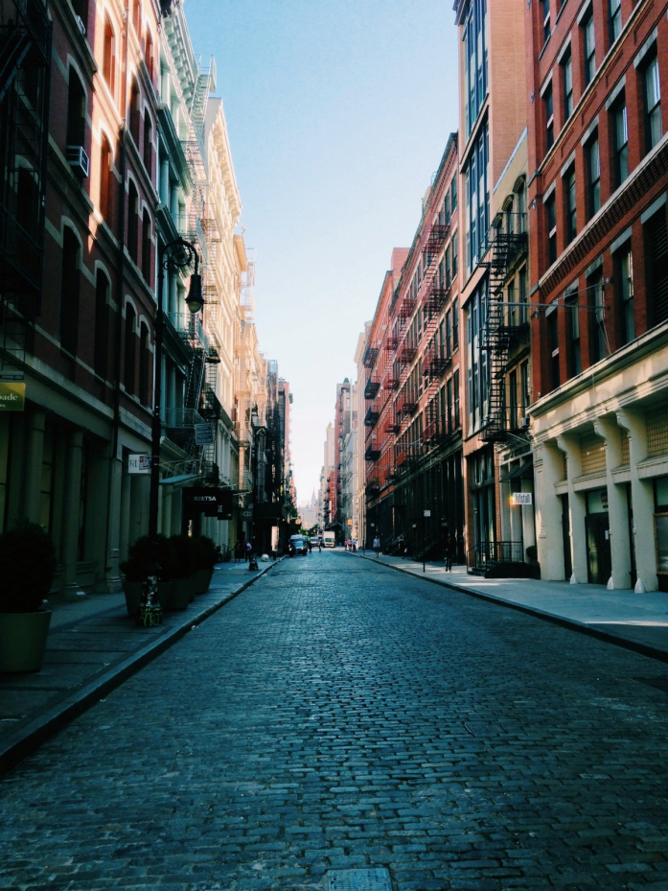

I can see
a street
a tree

Slide 3

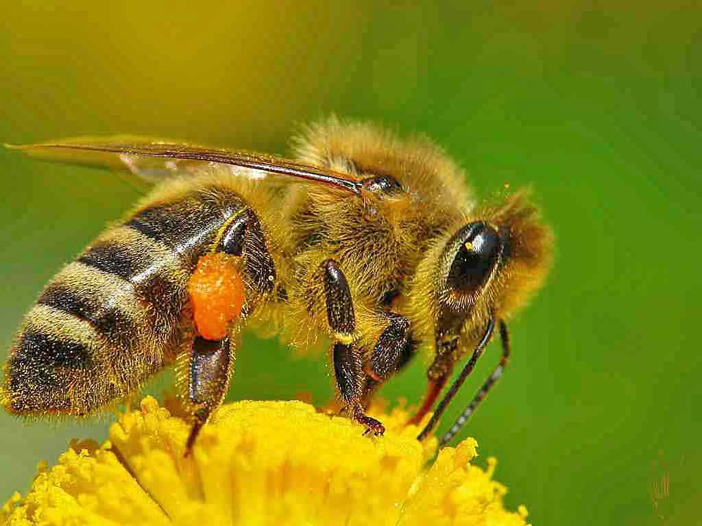
I can see
a frog
a bee

Slide 4
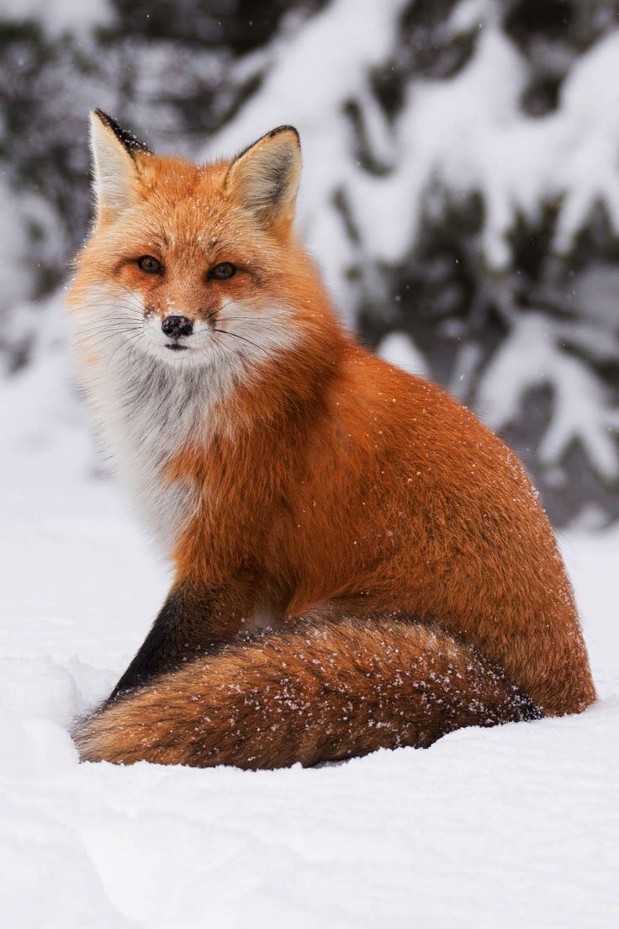
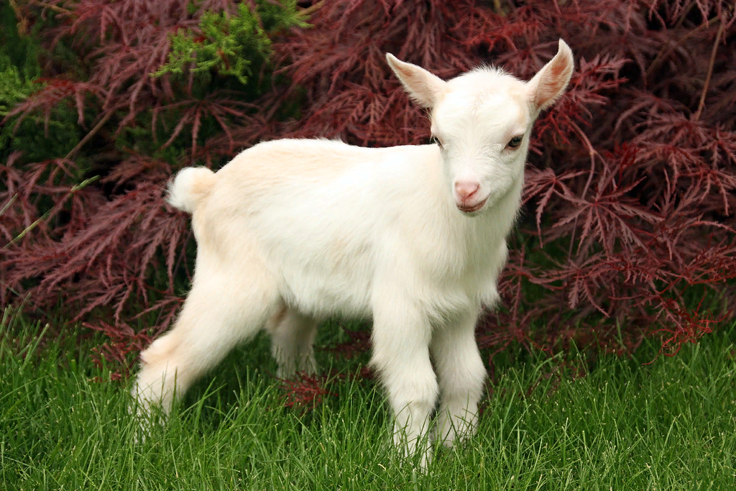
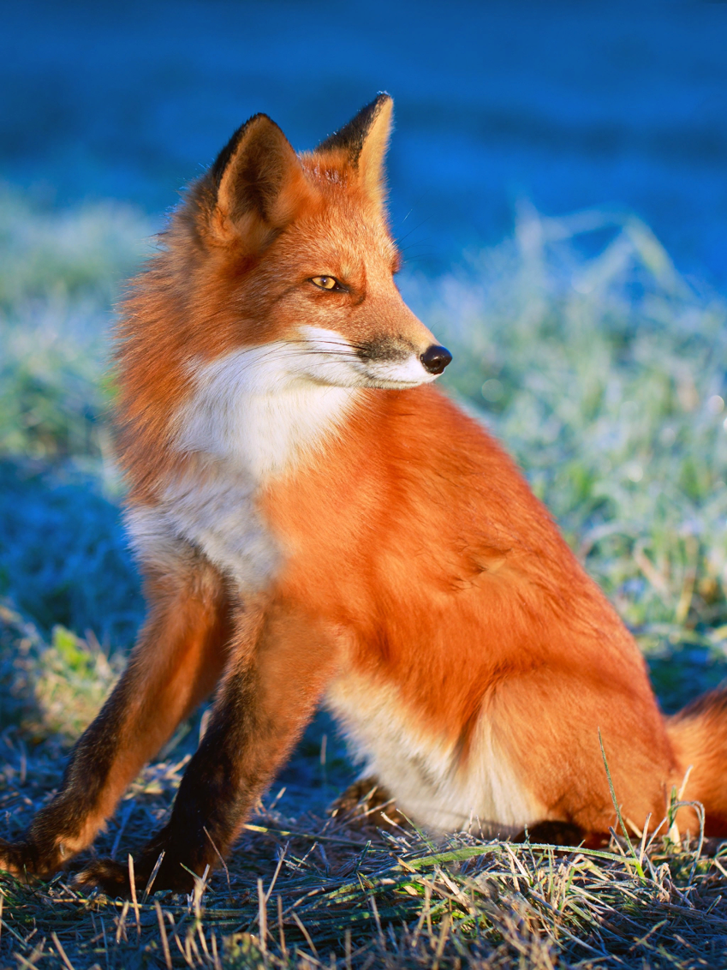
I can see
a kid
a fox

Slide 5

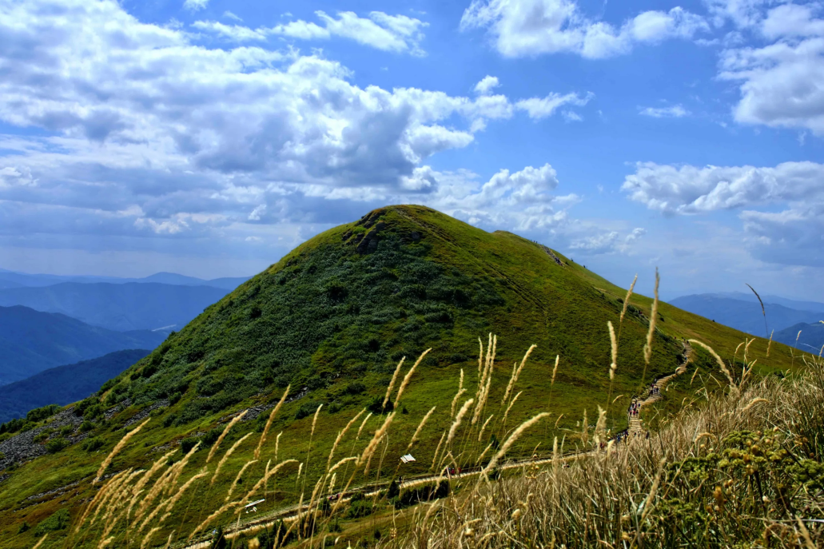
I can see
a hill
a tree

Slide 6
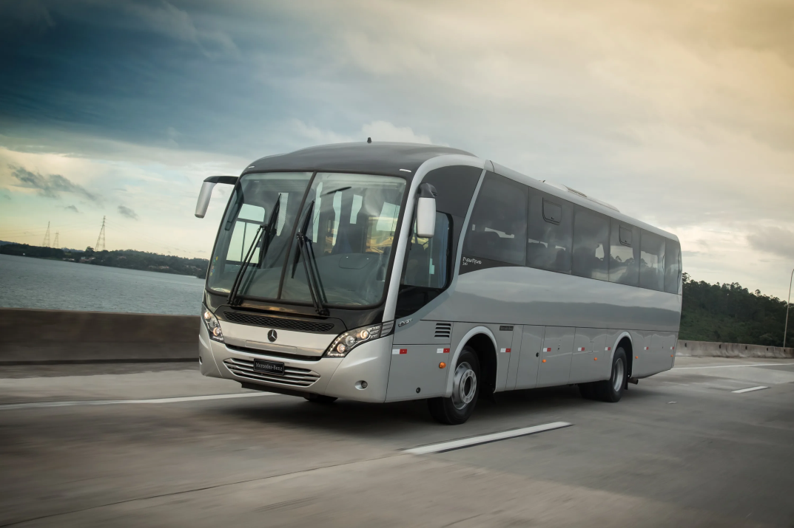
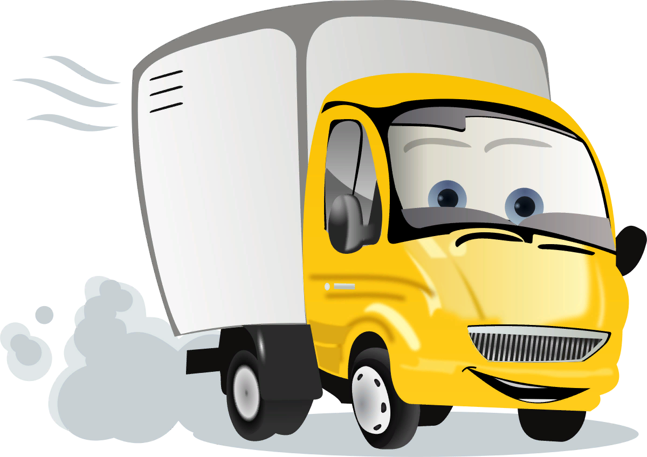
I can see
a bus
a lorry

Slide 7
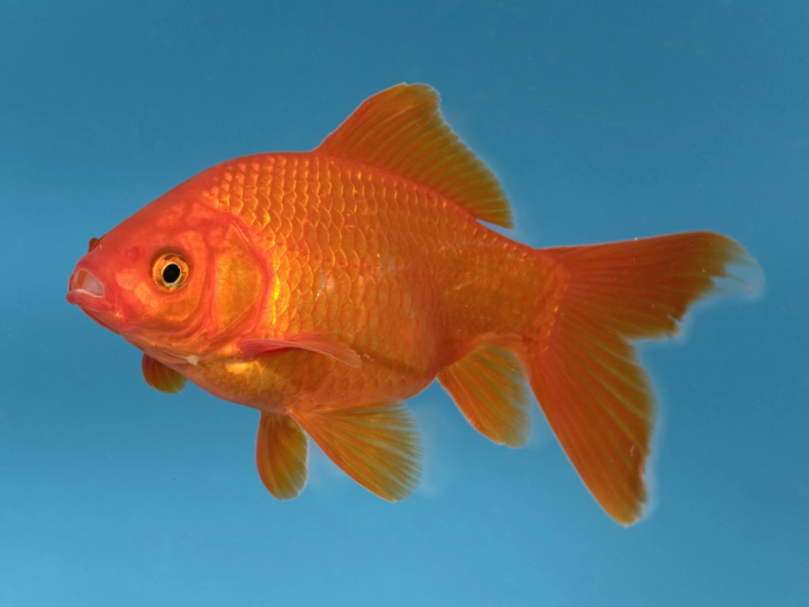
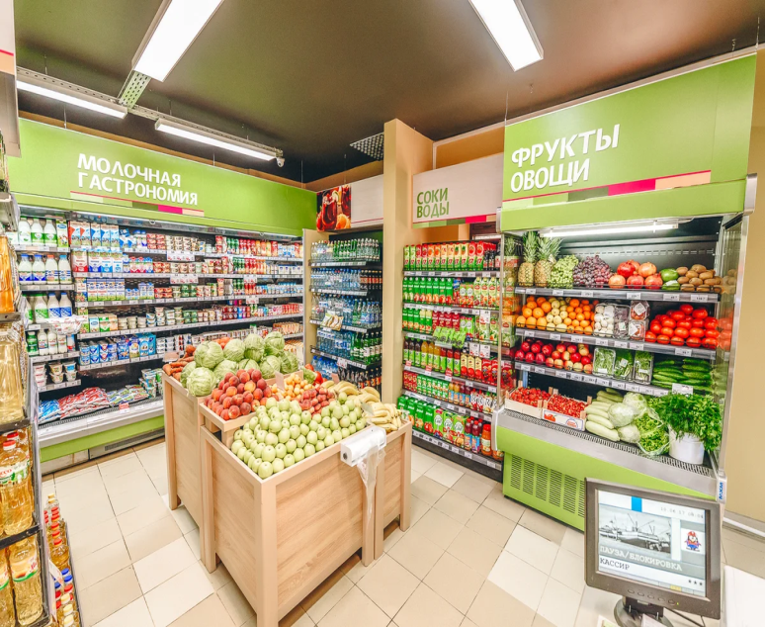
I can see
a shop
a fish

Slide 8
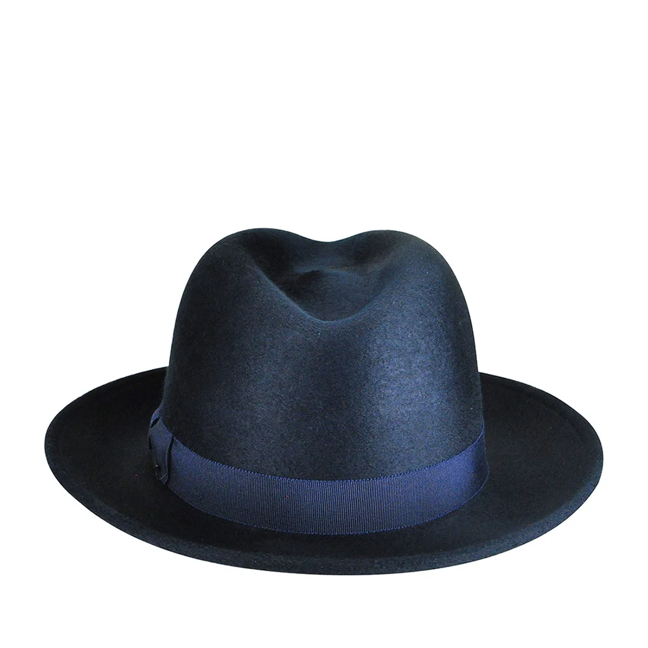

I can see
a cap
a hat

Slide 9
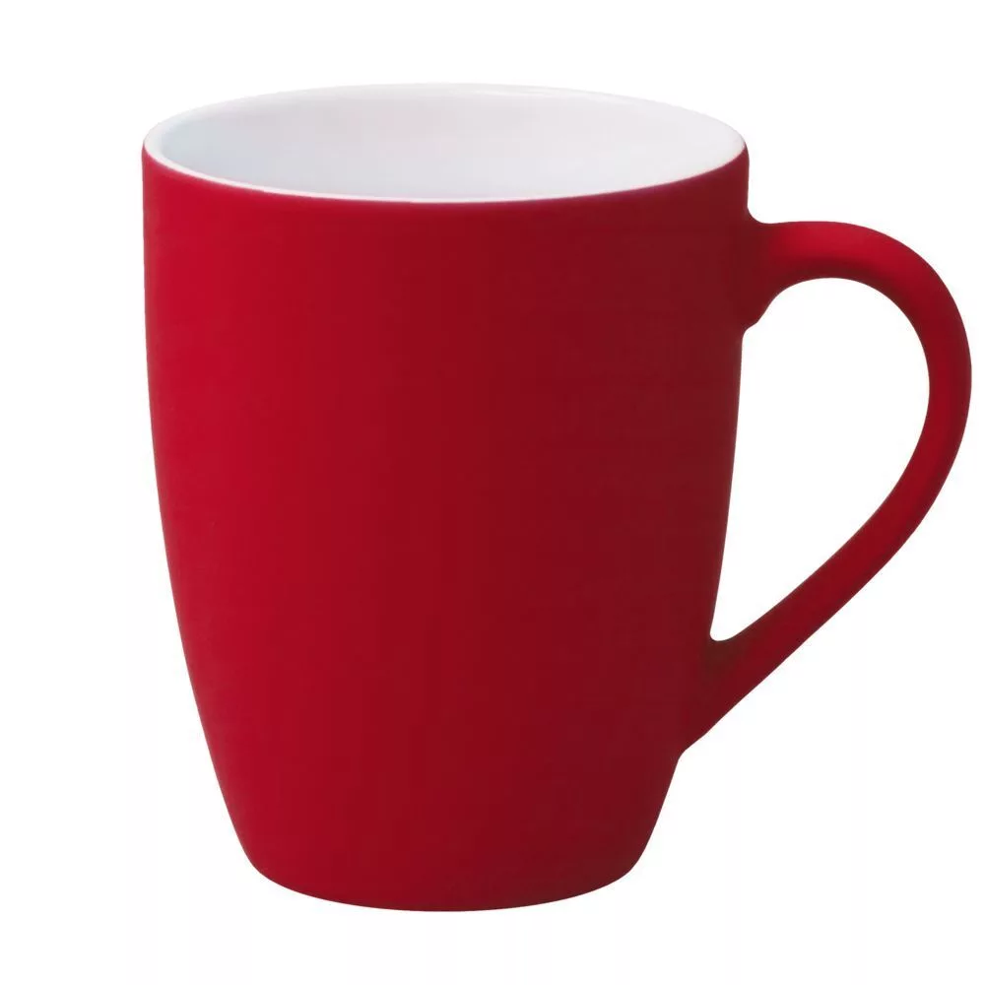
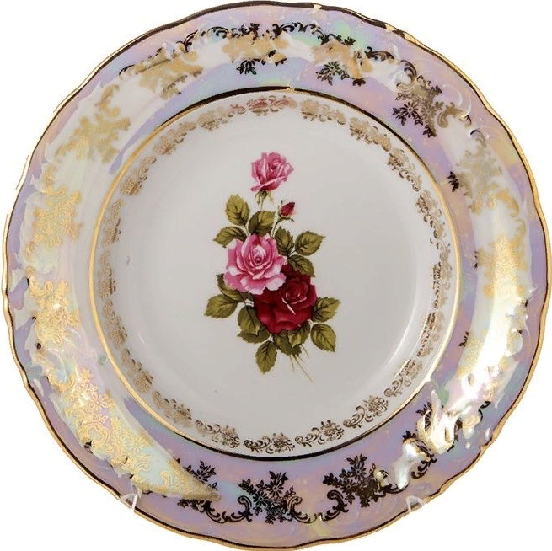
I can see
a mug
a dish

