Slide 1
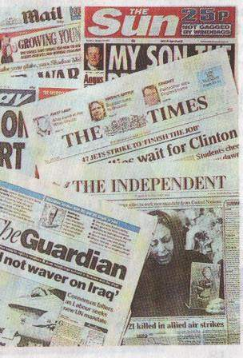

The jOURNALISM

Slide 2


Slide 3
Newspaper
fashion
News
Stories about famous people
Advertisement

Slide 4



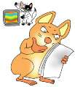

MASS MEDIA
TELEVISION
NEWSPAPERS
RADIO
INTERNET
MAGAZINES

Slide 5

NEWSPAPERS IN BRITAIN
Quality newspapers (known as «heavies») contain a lot of serious articles, e.g. about politics, business, science, cultural news.
Popular newspapers (known as «tabloids») carry a lot of big photographs, contain short, simple reports on the main news, stories about famous people.
THE TIMES
THE DAILY MAIL
THE DAILY MIRROR
THE GUARDIAN
QUILITY
PRESS
POPULAR
PRESS
THE DAILY
EXPRESS
THE INDEPENDENT
THE SUN
THE DAILY TELEGRAPH
THE DAILY STAR

Slide 6








WHAT’S IN THE PAPERS?
Johnson condemns hacker to Xmas in a US jail
by Paddy McGuffin
Computer hacker Gary McKinnon is facing Christmas in a US jail after the Home Secretary refused to block his extradition.
Bomb suspected in Russian crash
At least 39 people were killed and nearly 100 injured when a Russian express train came off the rails last night in what is being investigated as a bomb attack.

Slide 7
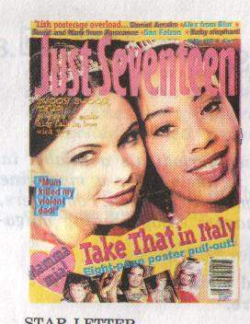
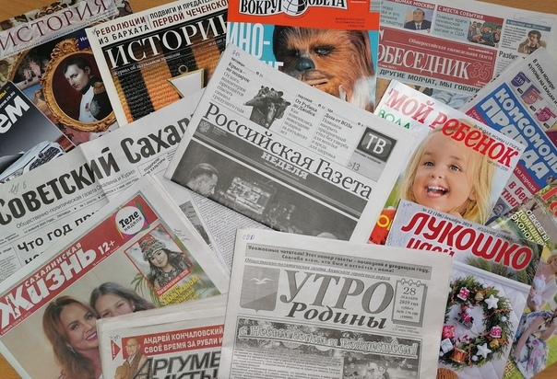



Slide 8
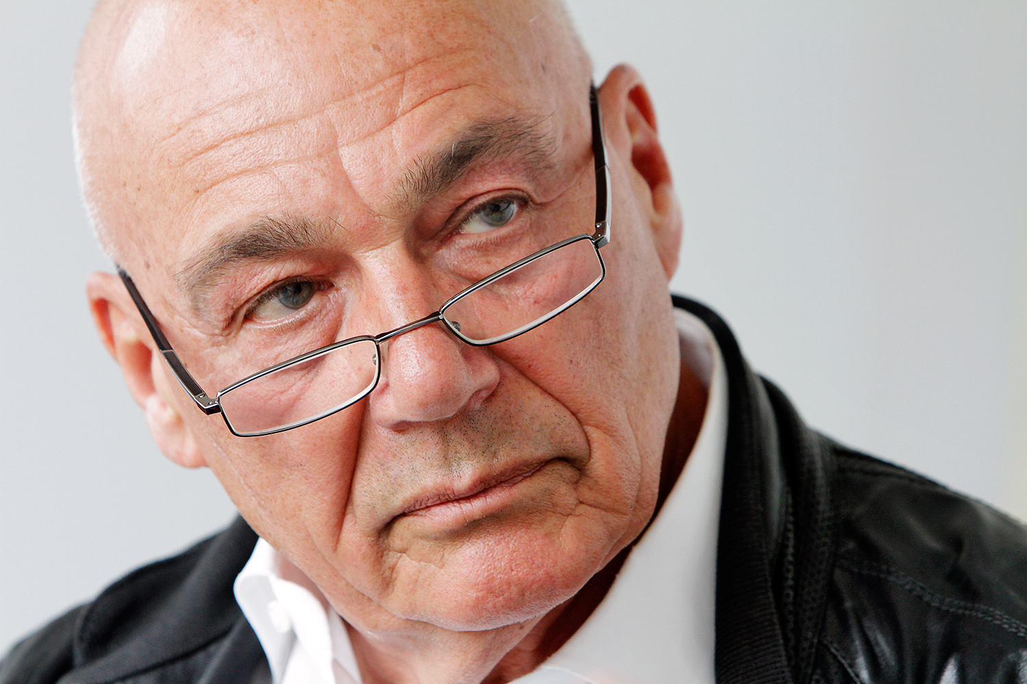
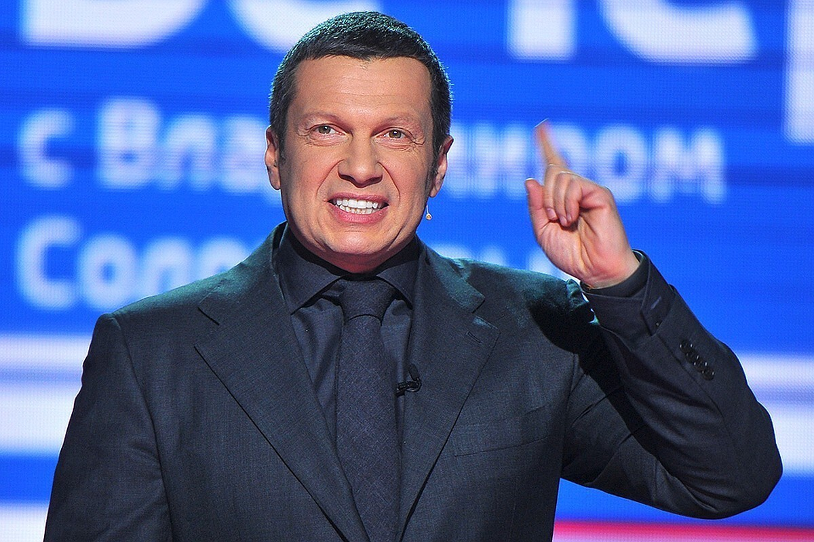
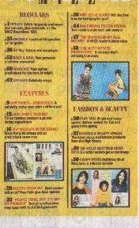
Jackie.
It is weekly magazine for girls around the age of 12-14 containing love stories in photographs and features on school parents romance pop music and fashion. There is a lot of confidential chatter and advice on various areas of life.

Slide 9

Just Seventeen.
Lets have a rest.

