Slide 1
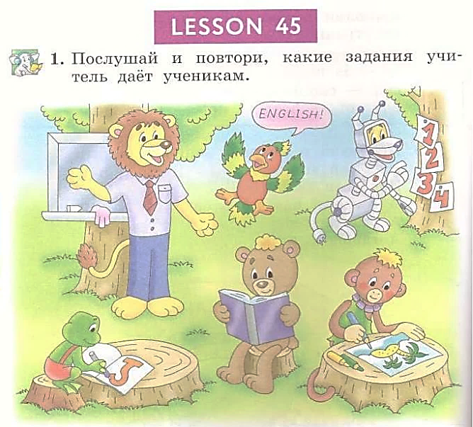


Student’s Book
p. 88

Slide 2


Slide 3


Slide 4


Slide 5


Slide 6


Slide 7
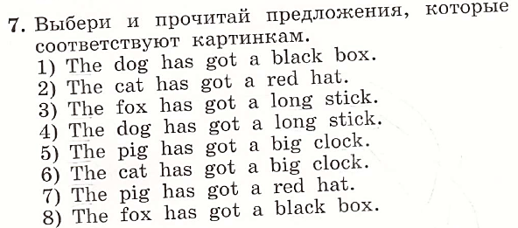





Slide 8


