Slide 1
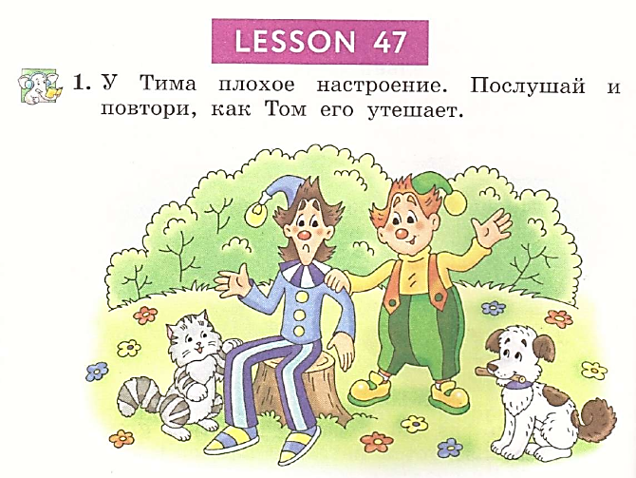


Student’s Book
p. 92

Slide 2
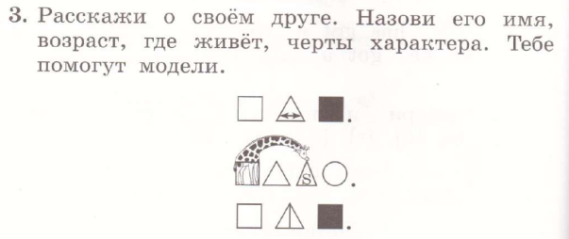
e.g. I have got a friend.
His name is Mike.
He is seven.
He is funny, kind and merry
He lives in the house.

Slide 3


Slide 4
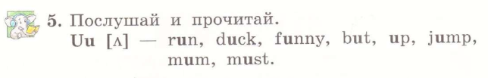

Slide 5
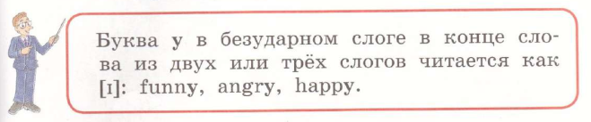

Slide 6
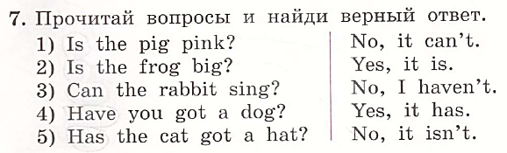

Slide 7
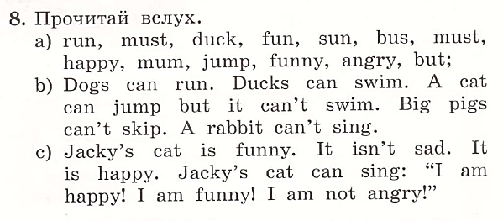

Slide 8
