Slide 1
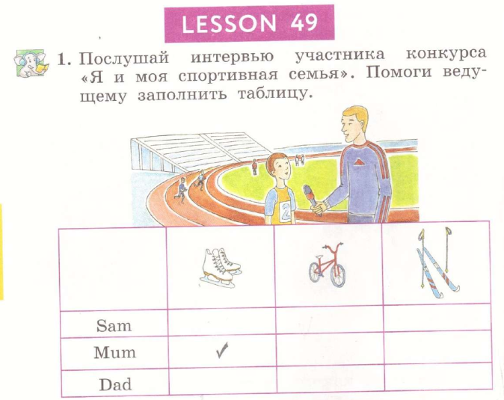



Slide 2



Slide 3
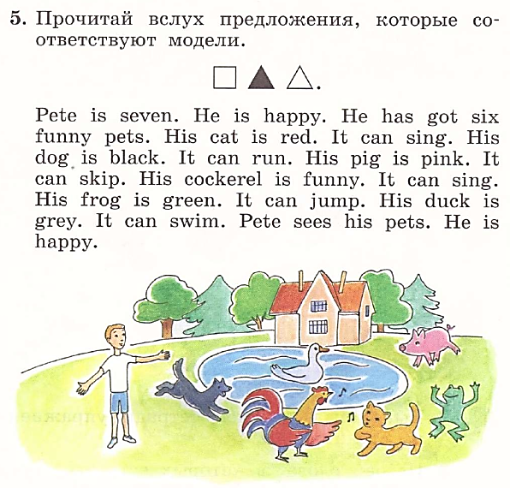
can

Slide 4


Slide 5


