Slide 1

Student’s Book p. 105

Slide 2
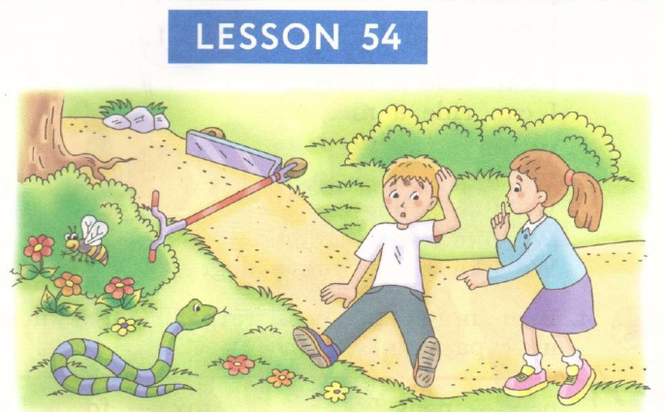



Slide 3
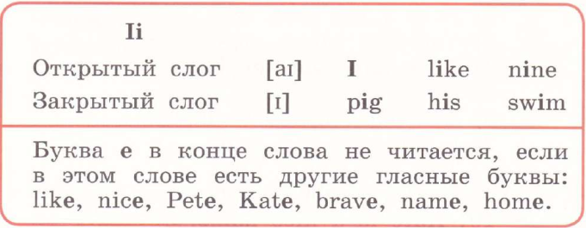


Slide 4


Slide 5


Slide 7



Slide 8
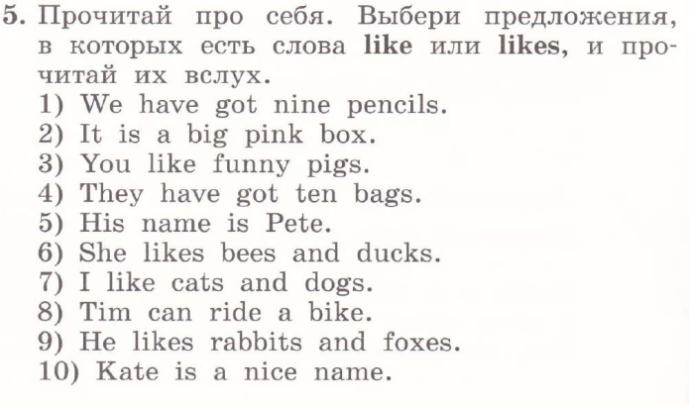

Slide 9


Slide 10


Slide 11


