Slide 1

Student’s Book p. 112

Slide 2



Slide 3



Slide 4


Slide 5


Slide 6
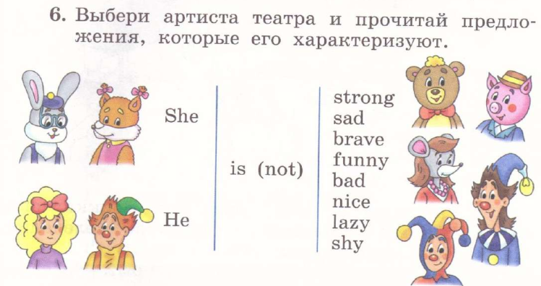

Slide 7


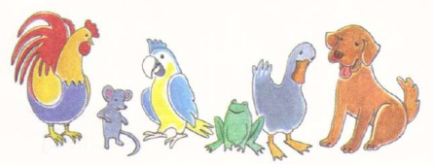

Slide 8


