Slide 1

Student’s Book p. 118

Slide 2


Slide 3


Slide 4
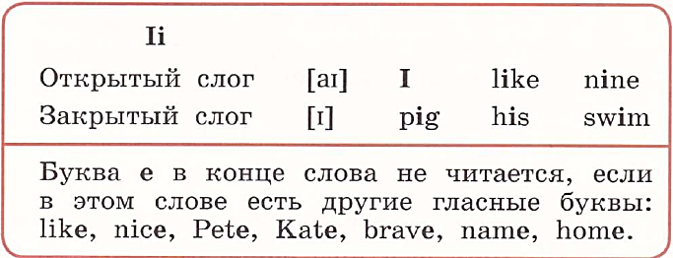

Slide 5


Slide 6


Slide 7




Slide 9


Slide 10
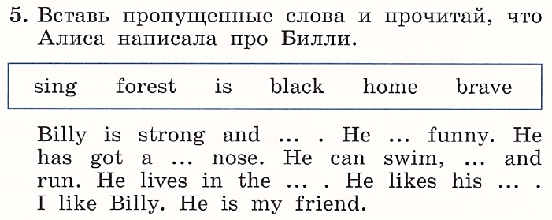







Slide 11


Slide 12



Slide 13


Slide 14


