Slide 1

Student’s Book p.120

Slide 3
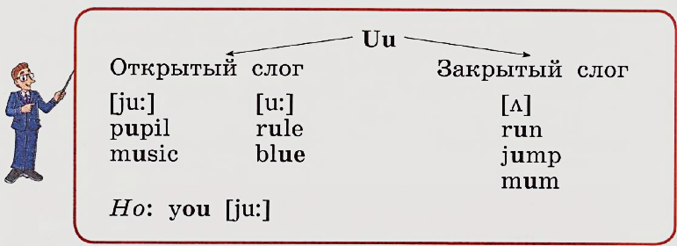



Slide 5
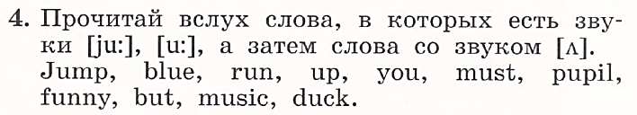

Slide 6
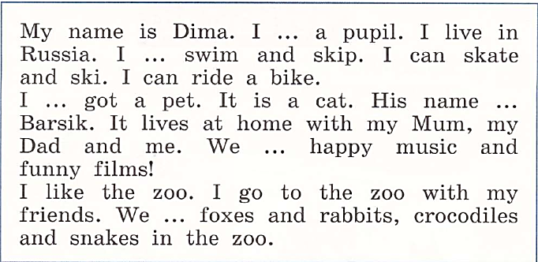
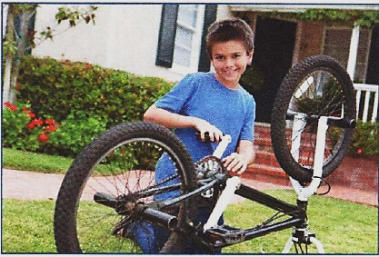

Slide 7


His name is Dima.
Yes, he is.
He is a pupil.
Yes, he can.
He can ride a bike.
Yes, he can.
He can skate.
Yes, he has.
He has got a cat.

Slide 8
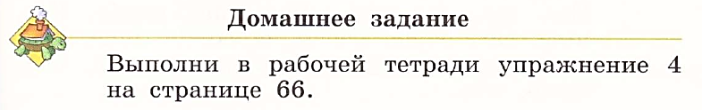

Slide 9
