Slide 1

Student’s Book p. 122

Slide 2
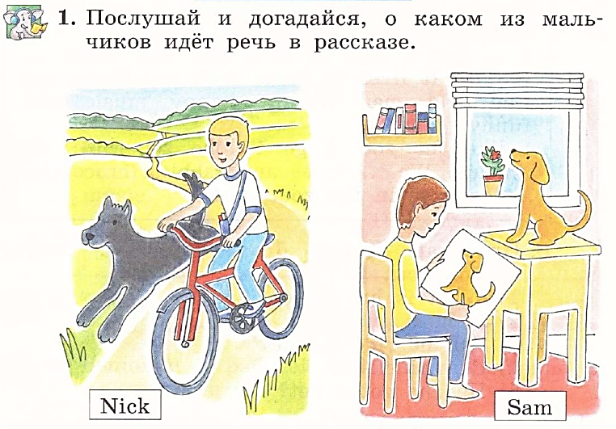


Slide 3
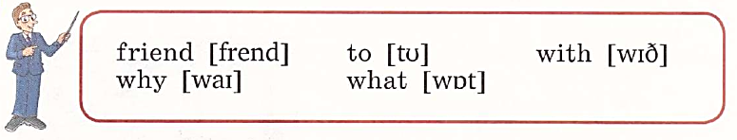


Slide 4
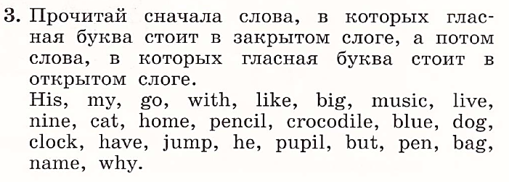

Slide 5
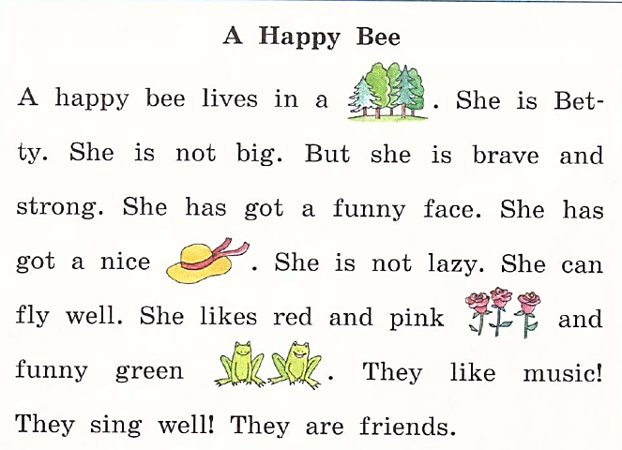
forest
hat
roses
frogs

Slide 6




A happy bee lives in a forest.
She has got a funny face.
She has got a nice hat.
She cannot fly.

Slide 7
