Slide 1

Student’s Book p. 124

Slide 2


Slide 3


Slide 4




Slide 5



Slide 6
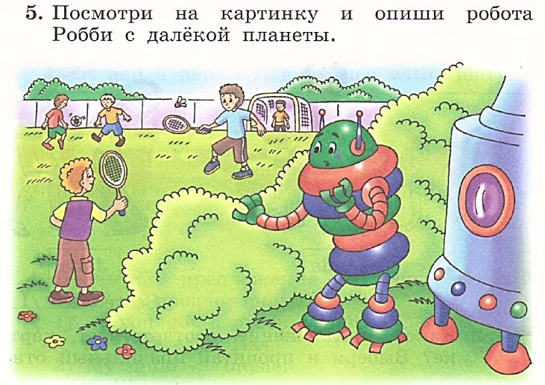

Slide 7


Slide 8


