Slide 1
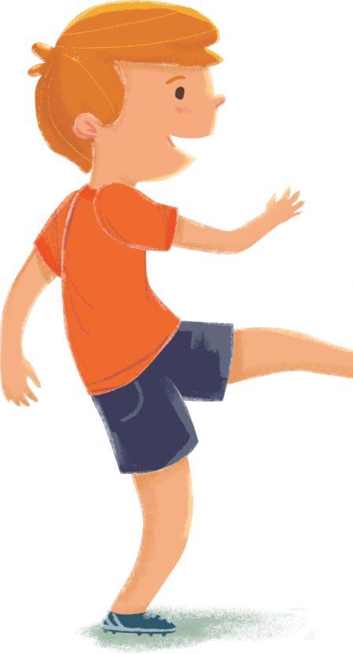
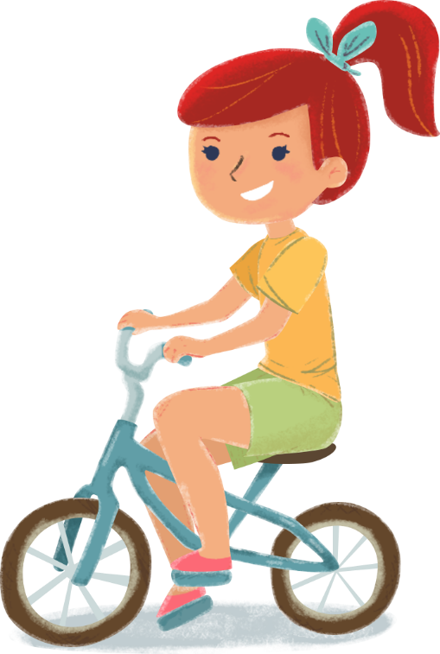


Открытый урок по Английскому языку
в 6 «А» классе школы-интерната №91
учитель английского языка
Гапонова Ольга Анатольевна

Slide 2
P
a
16
1
s
m
19
20
i
13
s
t
9
5
e
19

Slide 3
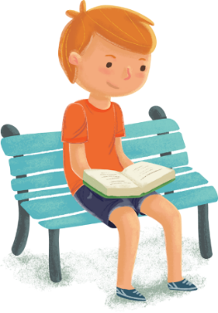

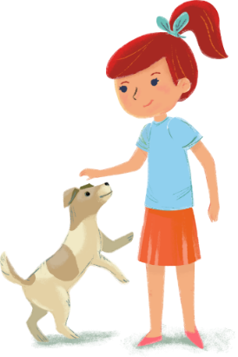
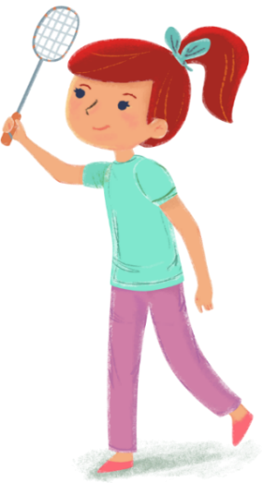
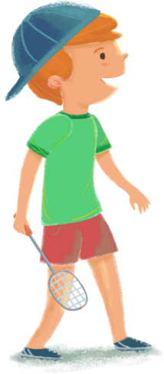
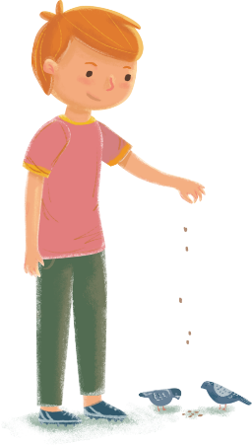
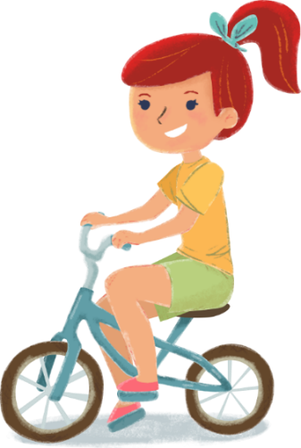
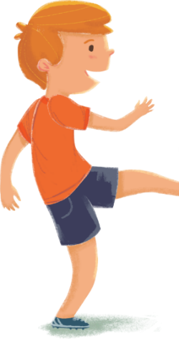
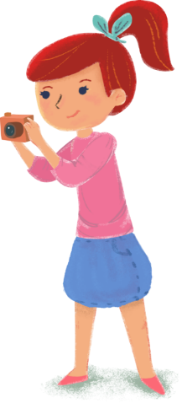


Pastimes

Slide 4
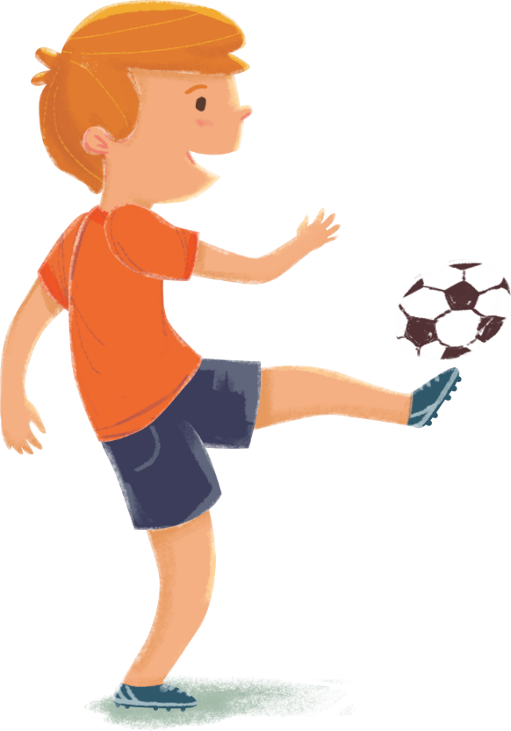
All work and no play makes Jack a dull boy

Slide 5
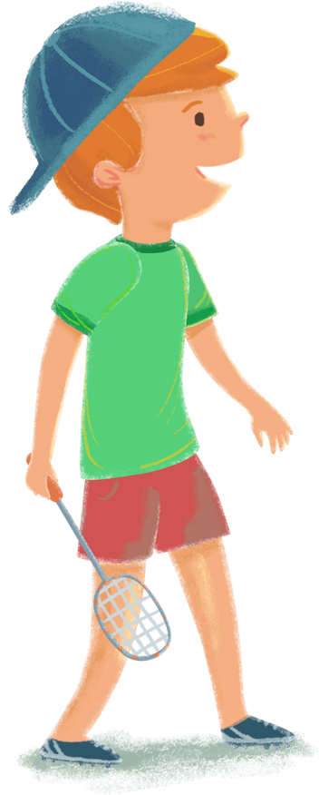
The English say,
«Только работа и никакой игры делают Джека скучным малым».

Slide 6
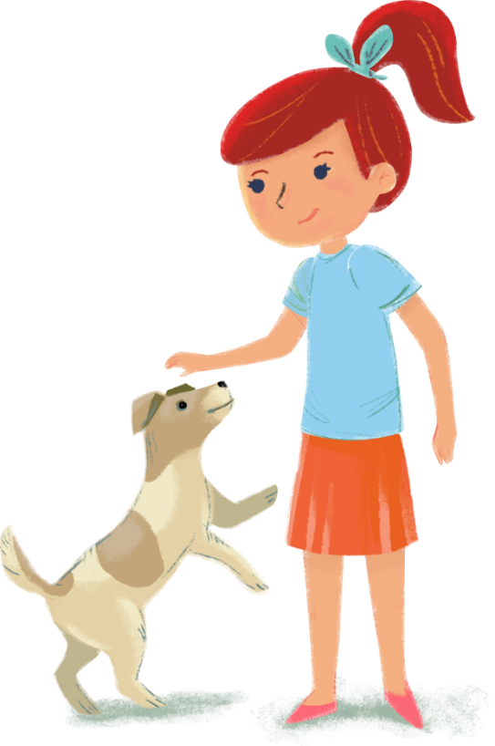
In Russia we say,
«Мешай дело с бездельем – проживешь век с весельем».

Slide 7


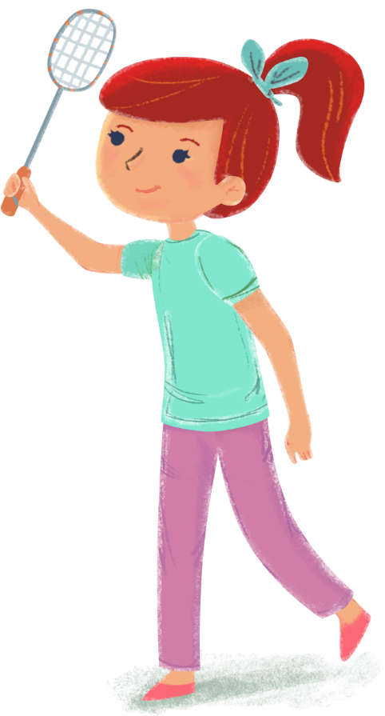
My favourite pastime is…
…is not my cup of tea!

Slide 8
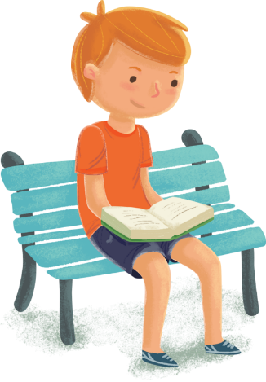
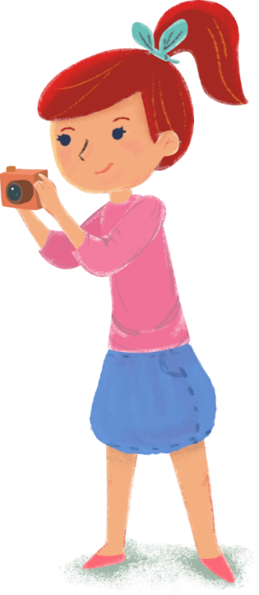

Slide 9
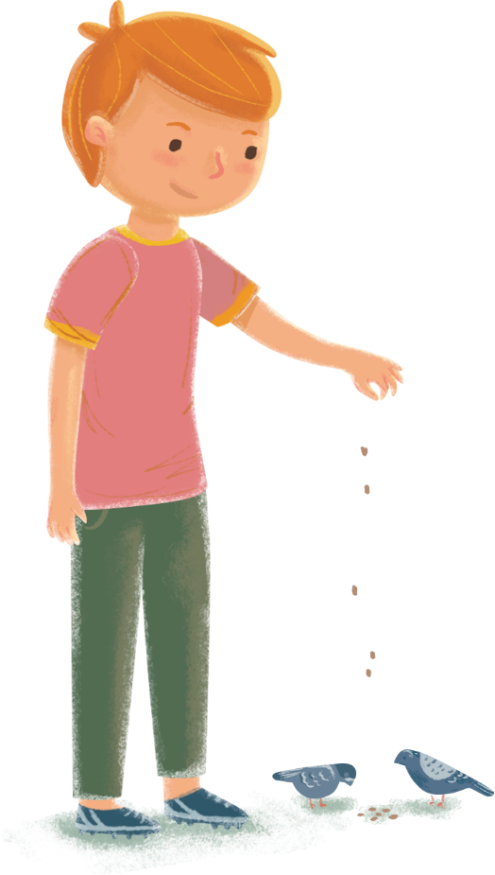
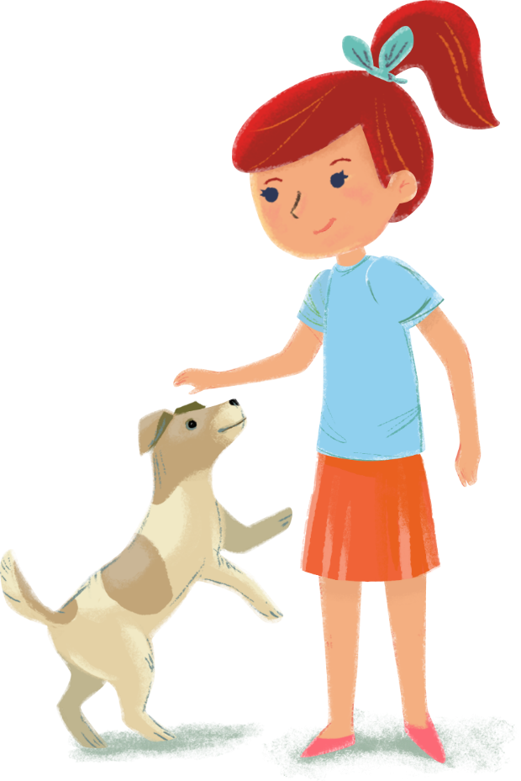

Physical culture break

Slide 10
BEN’S HOBBY
Ben’s hobby is playing chess. He is learning to play the game and usually plays with his father. It is difficult to play chess. Ben must know what his father is going to do. When Ben plays chess, he is learning to think.
Sometimes Ben plays with his friend John. They play chess in the garden or in John’s house. John plays chess very well and he says it helps him to play football. He sees the playground as he sees the chess board.

Slide 11
Answer the questions:
Is Ben’s hobby interesting?
Is it difficult to play chess?
Does Ben play chess only with his father?
Who plays better – Ben or his friend?
Now tell about Ben’s hobby.

Slide 12
GARDENING
English people like gardening. They talk about it in their offices, factories and at home. In the evening they work in their gardens, large and small, and they do it in any weather. They grow flowers, vegetables and fruit there.
If an Englishman has no garden he grows something in a window box outside his kitchen.
If you want to please an Englishman, be very polite about his garden. Perhaps, he will show you his garden and tell you about it. So you will listen to it and say, «How nice!» or «How interesting!».

Slide 13
Repeat and complete the sentences:
1) English people like…
2) They talk about it…
3) They work in their gardens…
4) They grow…
5) An Englishman can show you…
6) You can say…

Slide 14
Exсеllent!!!

