Slide 1
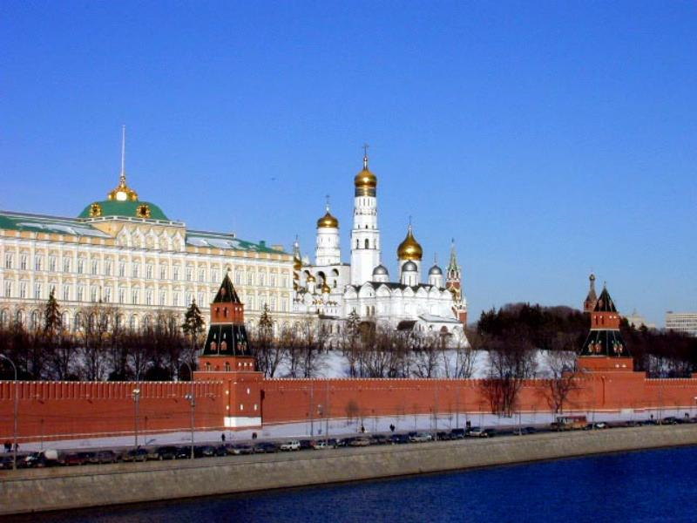
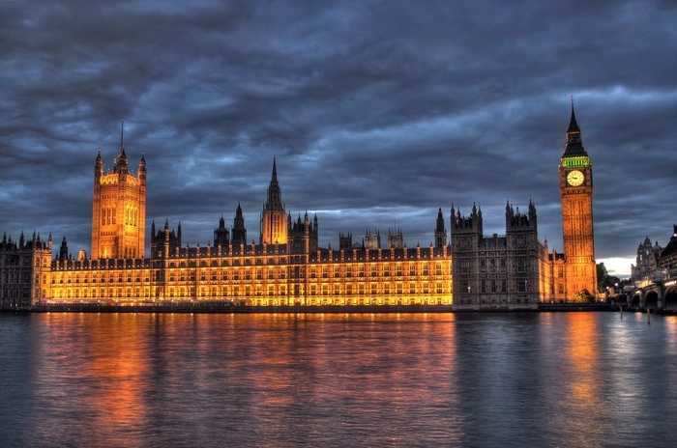
MOSCOW - LONDON
“Comparison of the cultural peculiarities of Moscow and London”
Сигусова Ольга Алексеевна 2022-2023 уч год

Slide 2
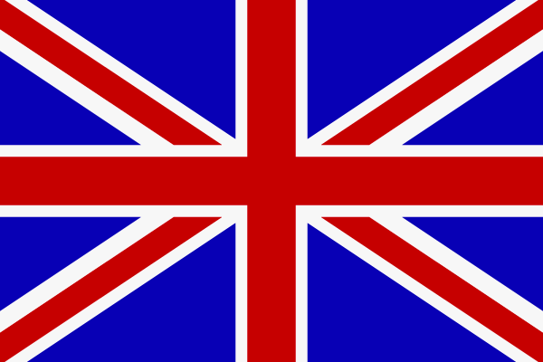
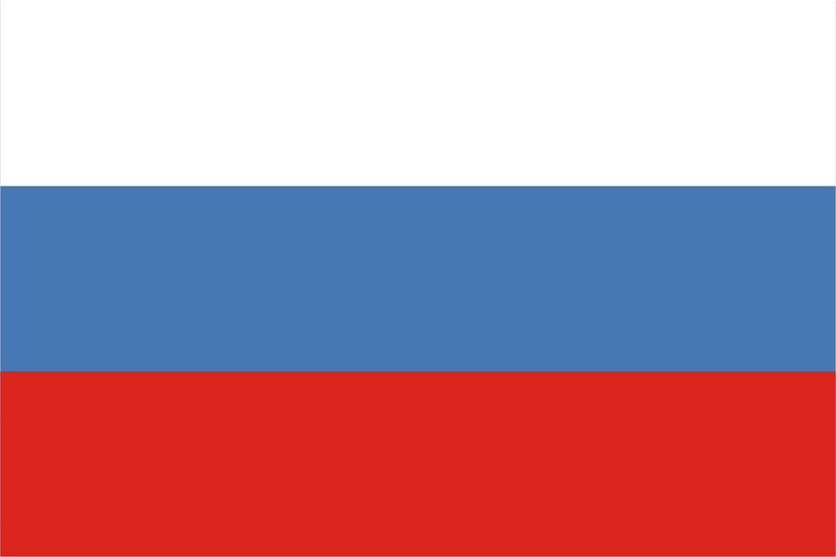
What are their NAMES :
UNION JACK
ТРИКОЛОР

Slide 3
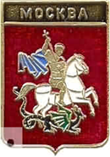
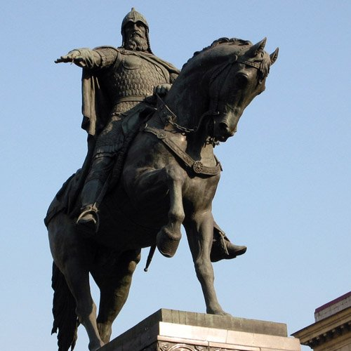

Moscow was founded in 1147 by Prince Yuri Dolgoruky .

Slide 4
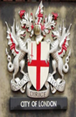
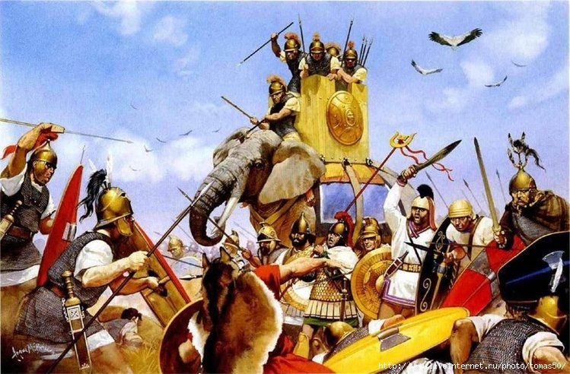

Londinium was founded by the Romans about 43 A.D.

Slide 5
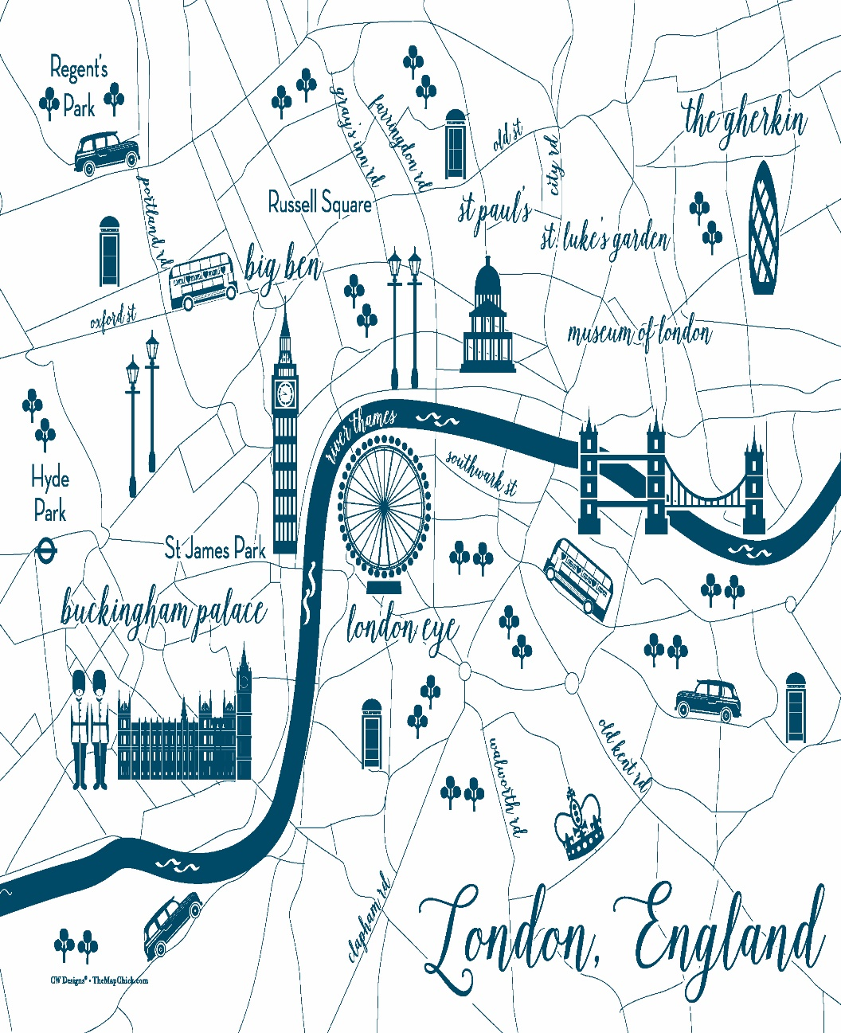
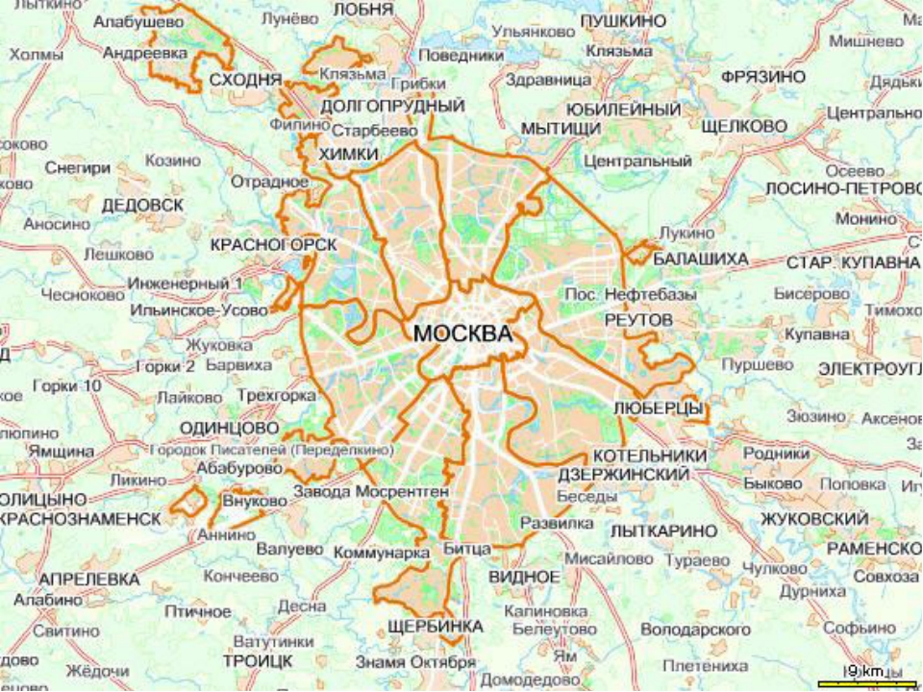
MAPS

Slide 6
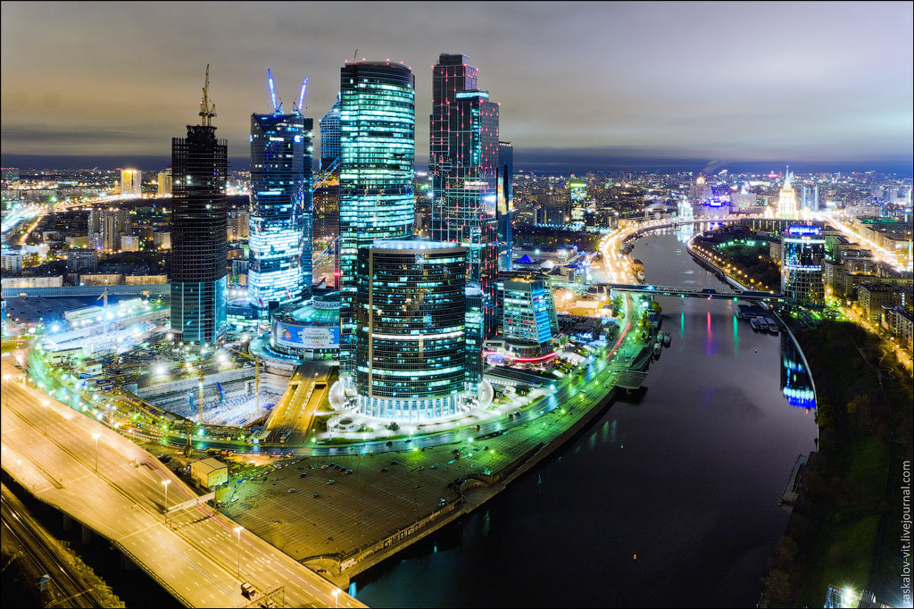

Moscow is one of the largest cities in Europe. The population of Moscow is over 12 million people.

Slide 7
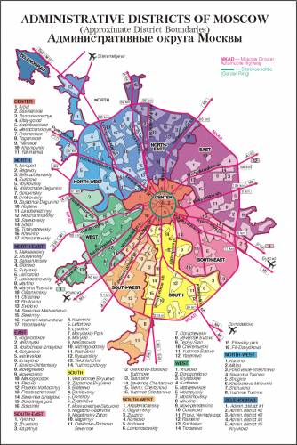

The total area of Moscow is 2511 square km.
There are 125 districts in Moscow.

Slide 8
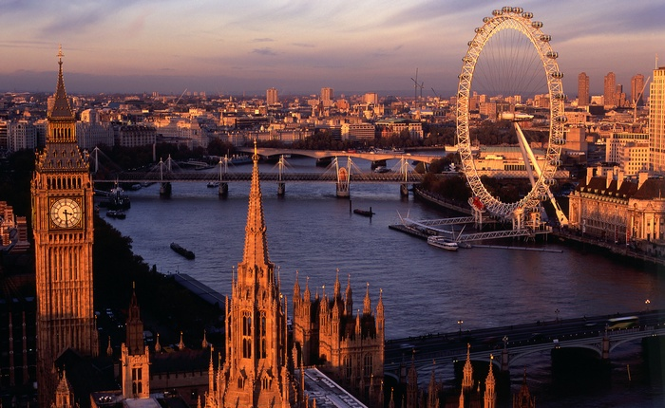

London is one of the largest European cities too. The population of the city is over 8.5 million people.

Slide 9
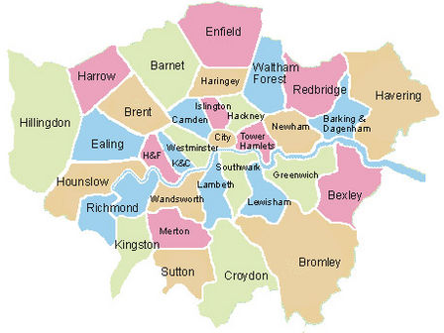
The total area of London is 1580 square km. There are 35 boroughs in London.

Slide 10
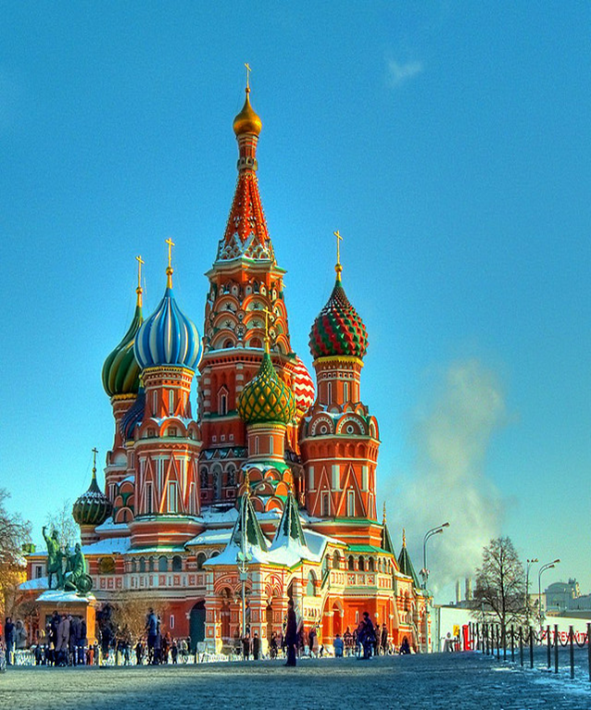
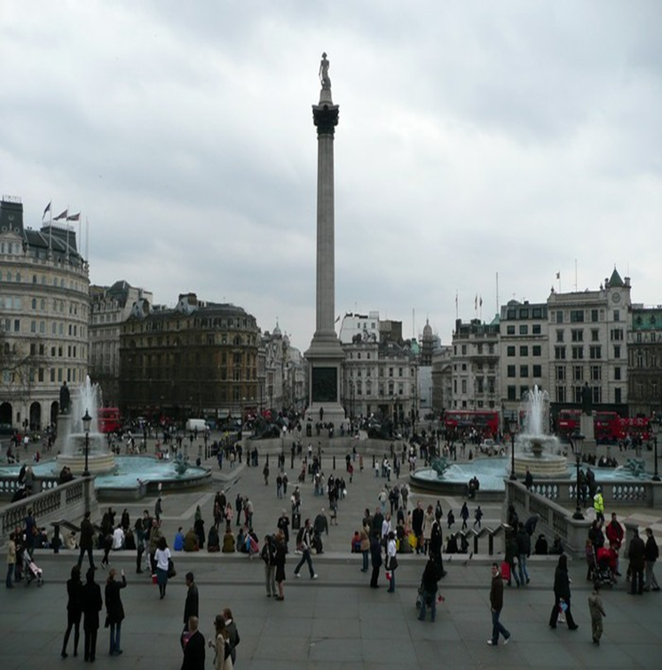
The central squares of the capitals

Slide 11
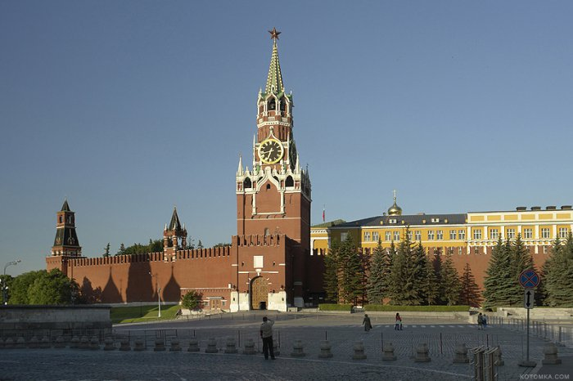

Red Square is the geographical center of Moscow. The Kremlin and the Spasskaya Tower are the symbols of Moscow and Russia.

Slide 12

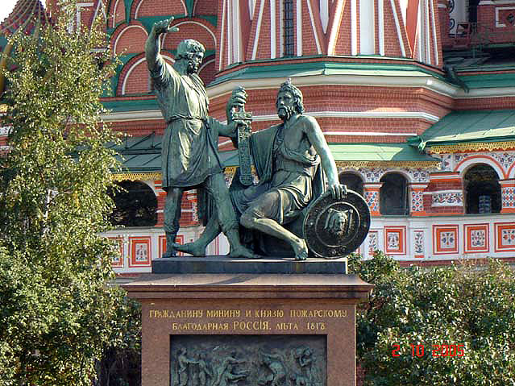
You can see a lot of masterpieces in Red Square. For example, St Basil’s Cathedral , the monument to Minin and Pozharsky.

Slide 13
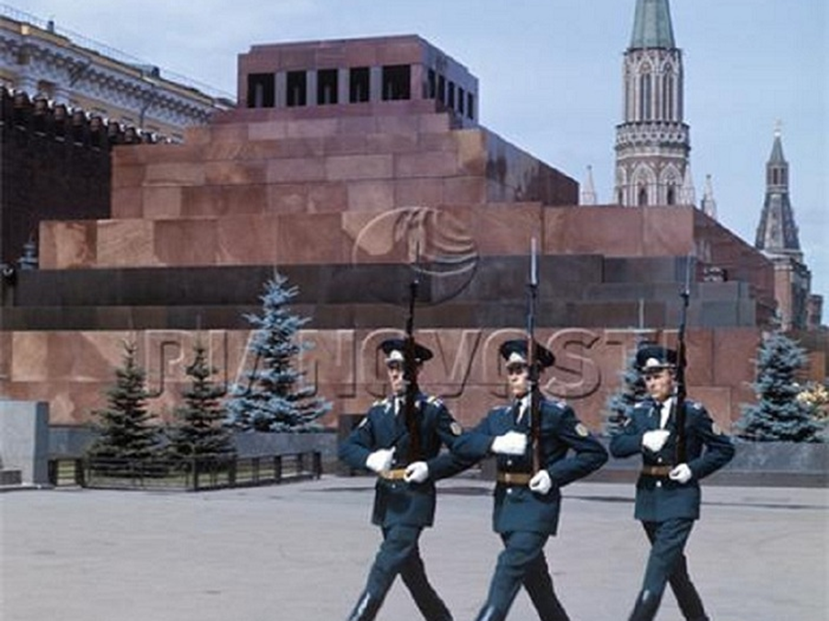
Many tourists attract the ceremonial “Changing of the Guard” in Red Square.

Slide 14

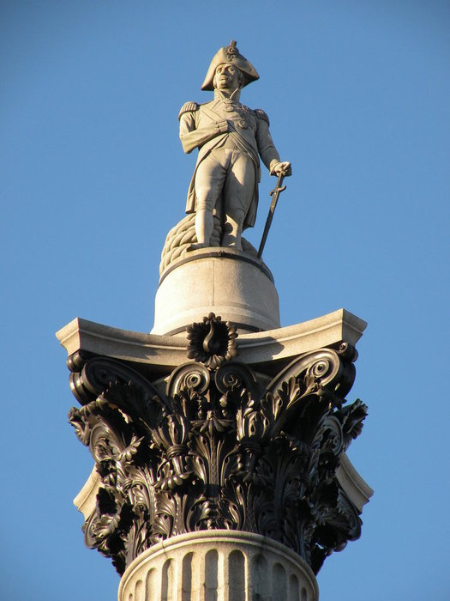
Trafalgar Square is the geographical center of London. At the middle of the square stands a monument honoring admiral Nelson.

Slide 15
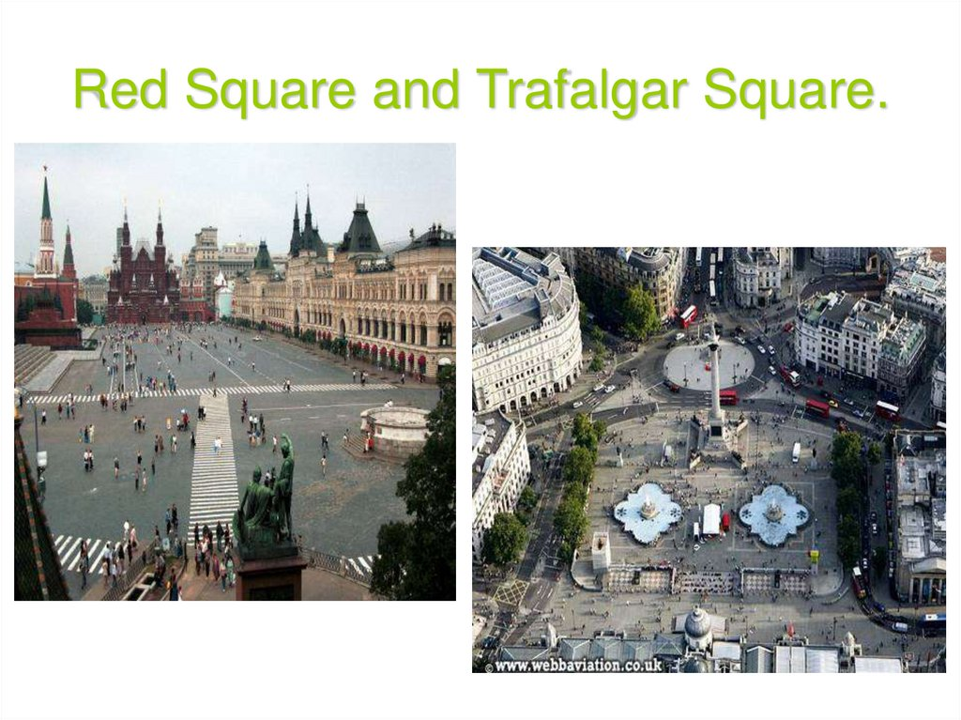

Slide 16
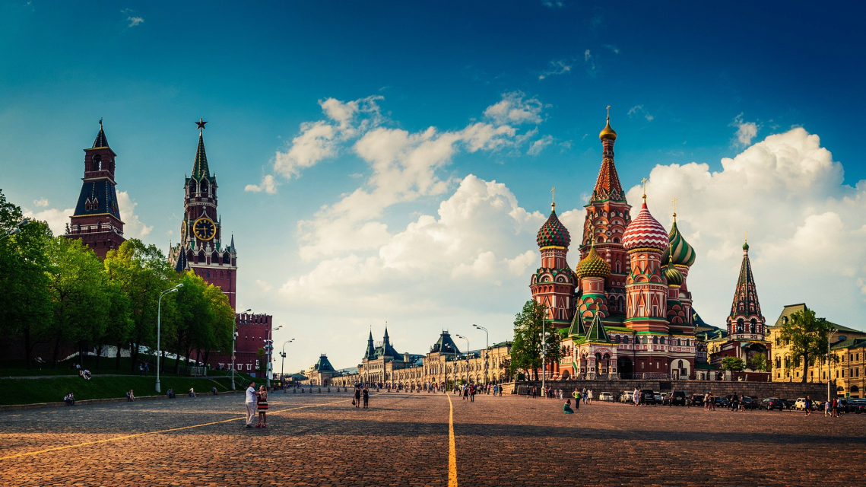
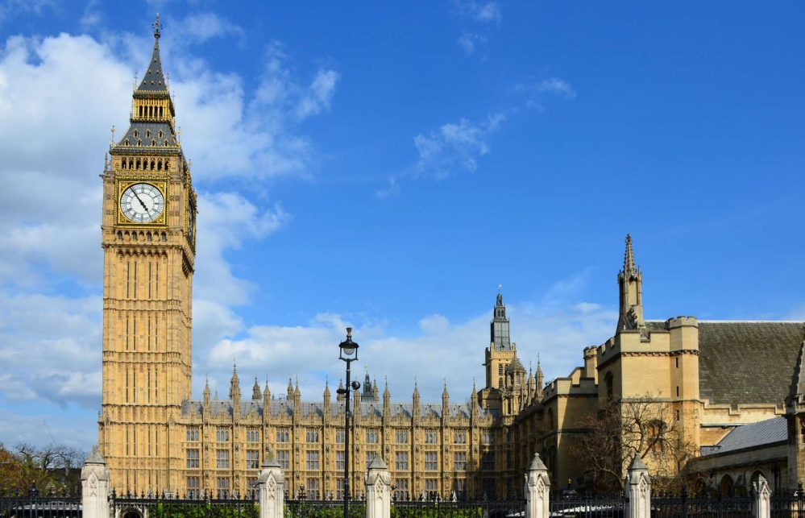
The places of interest of the two capitals:

Slide 17
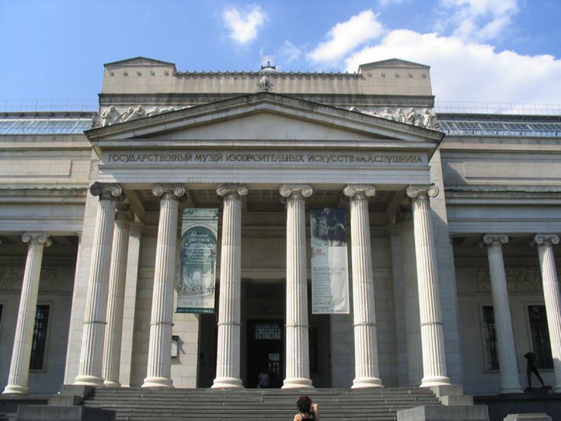
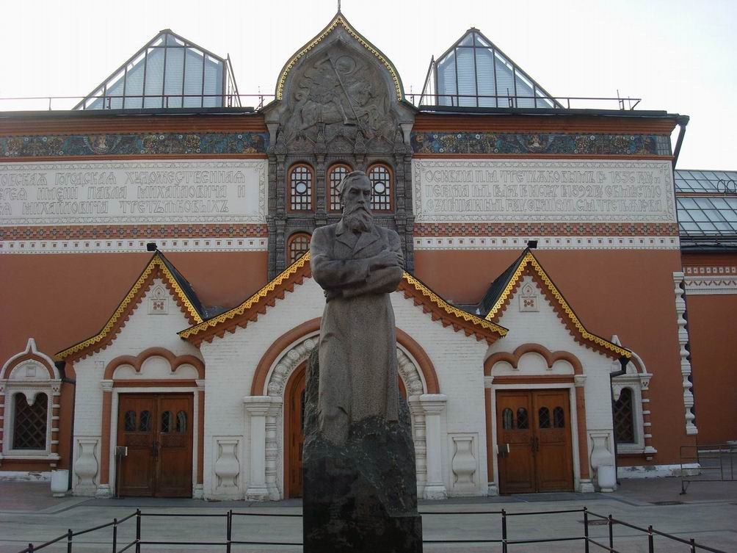
The most famous museums in Moscow are the Pushkin Museum of Fine Arts, the Tretyakov Gallery and others.

Slide 18
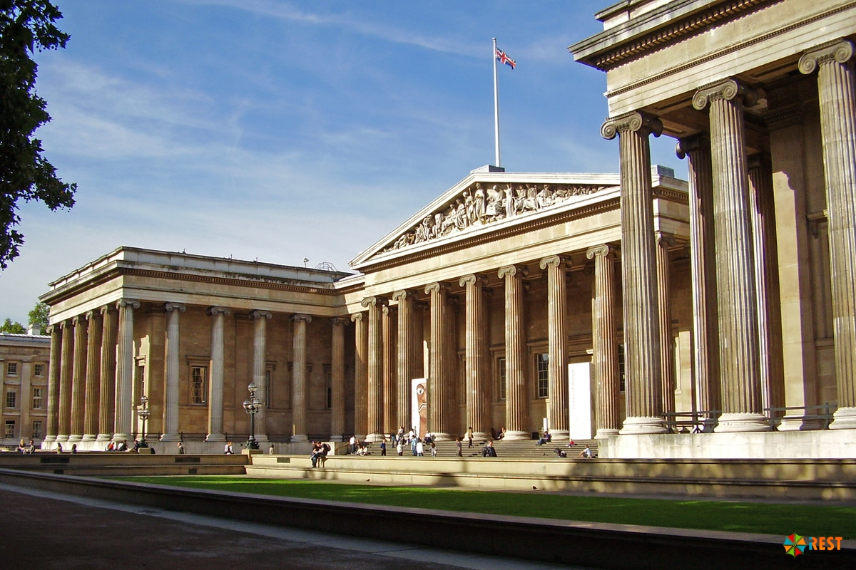
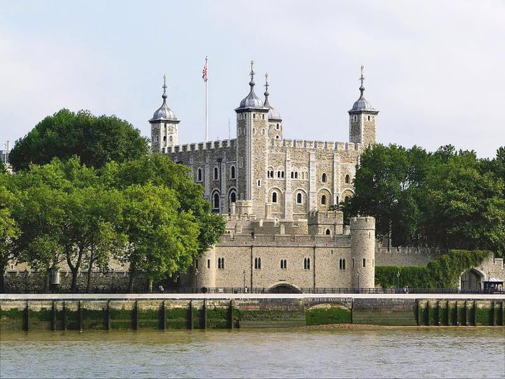
The most famous museums in London are the British Museum, the Tower of London and others.

Slide 19
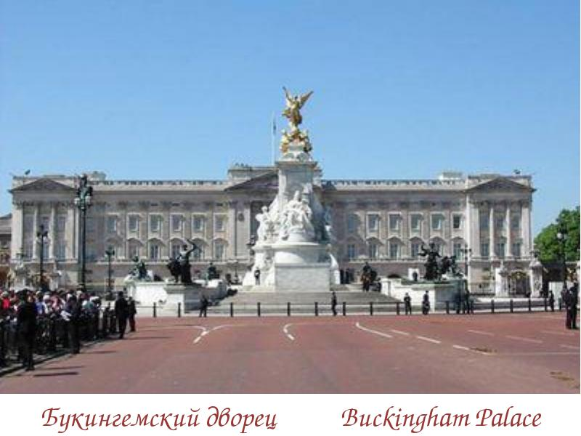
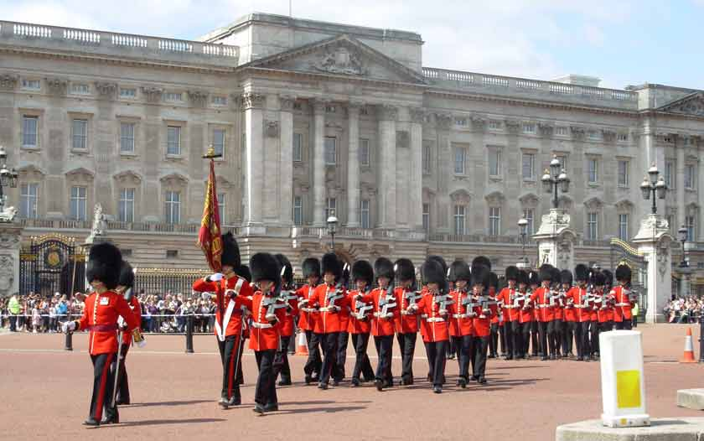
Buckingham Palace is the official residence of the Queen. The ceremonial “Changing of the Guard” takes place near the palace.

Slide 20
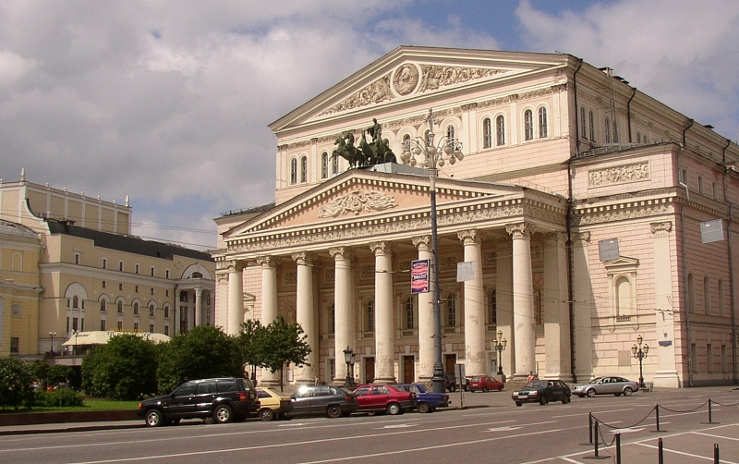
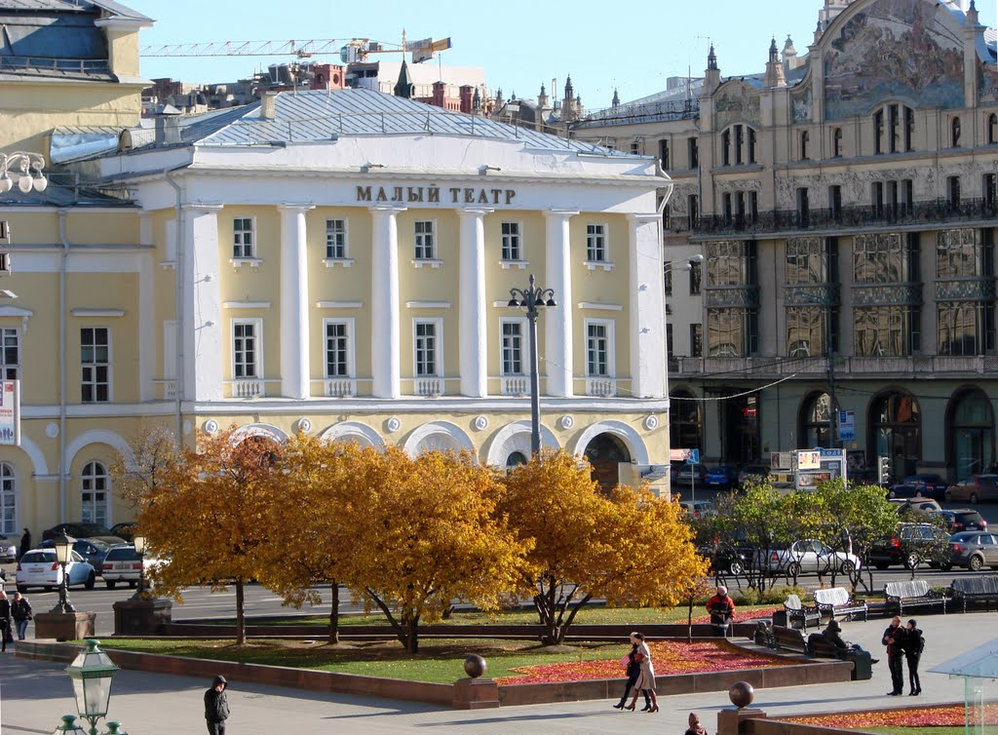
The most famous THEATRES in Moscow: the Bolshoi Opera House, the Mali Theatre.

Slide 21
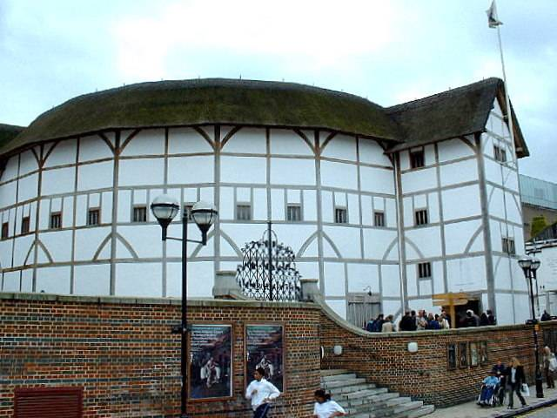
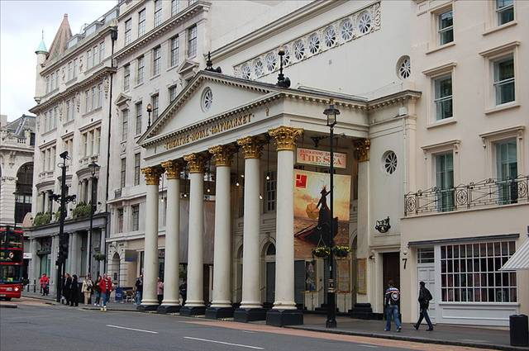
The most famous theatres in London:
Shakespeare’s Globe Theatre, the Royal Opera House.

Slide 22
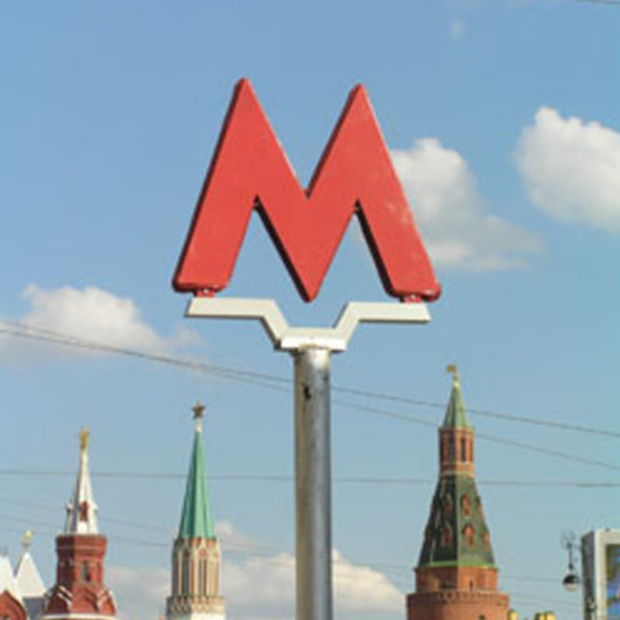
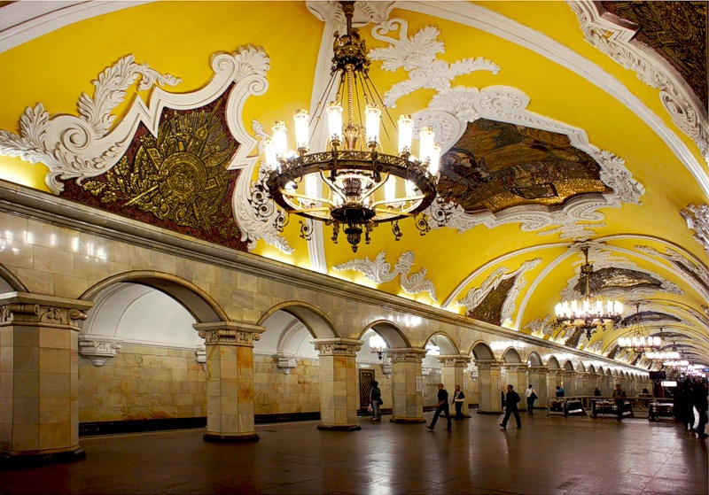
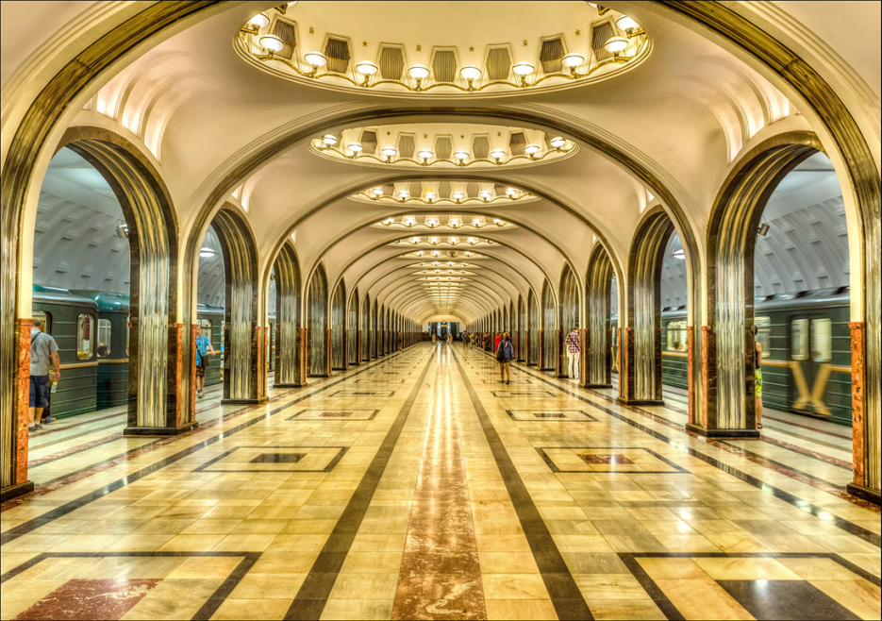
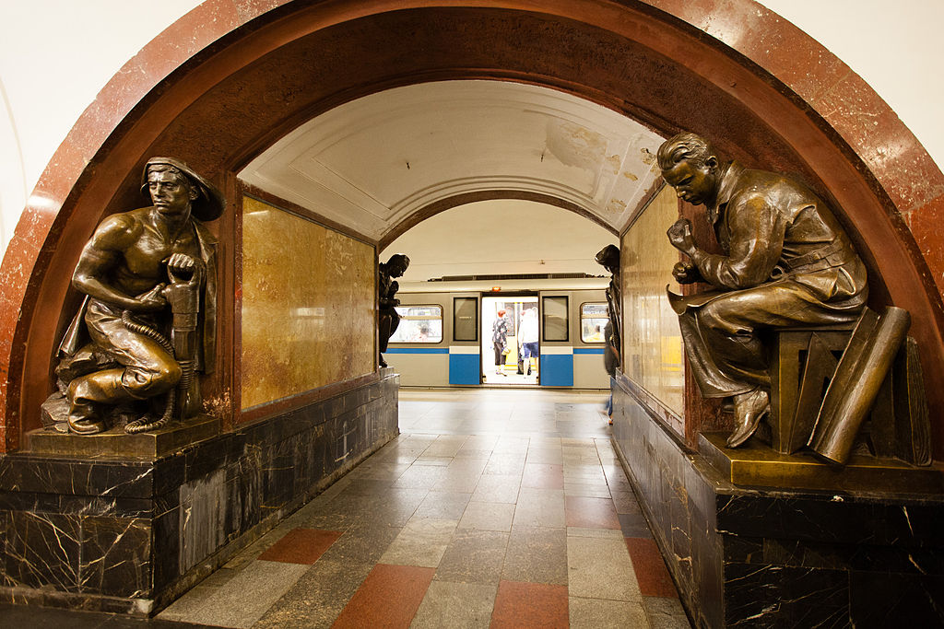
The Moscow metro has 200 stations around the city. Seven million passengers use it every day. The Moscow metro is called “The Underground Palace”, because many stations are really beautiful with mosaic ceilings, wonderful chandeliers, beautiful sculptures and brilliant paintings. It is one of Moscow’s major tourist attractions.

Slide 23
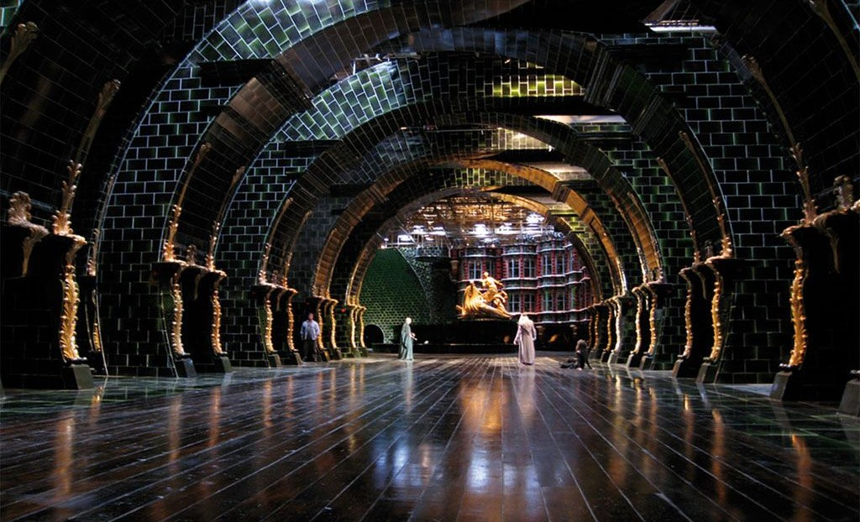
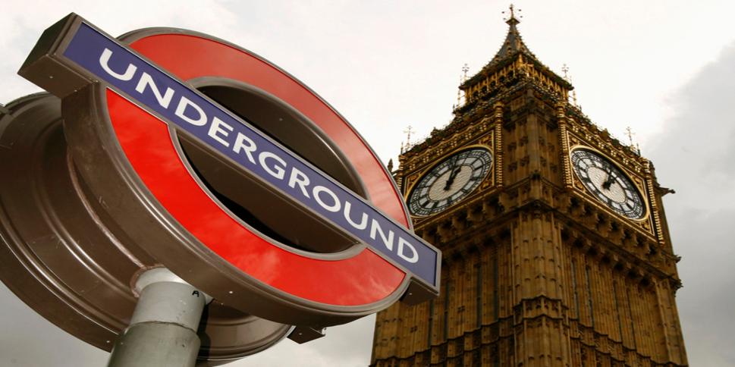
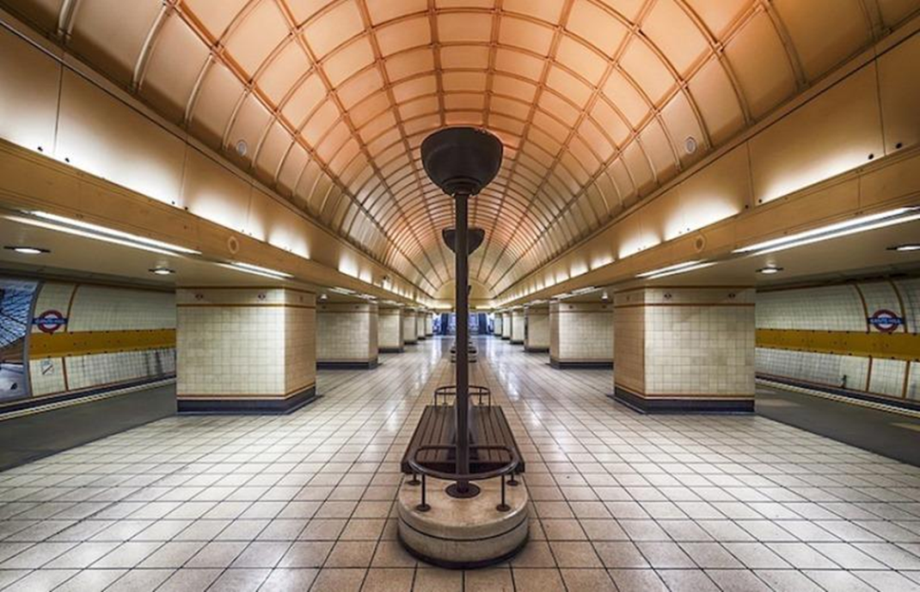
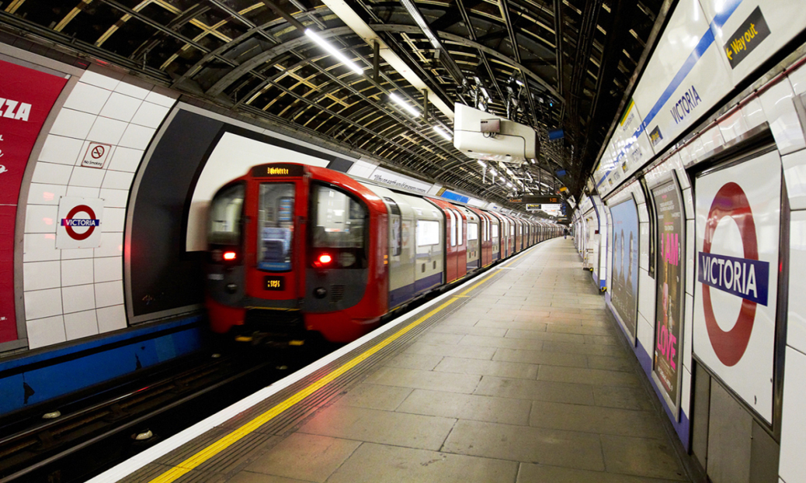
The London underground is the oldest in the world. It has 275 stations around the city. More than3,5million people use it every day. Londoners call the subway in your city “the Tube" because of the form of the deep underground tunnels.

Slide 24
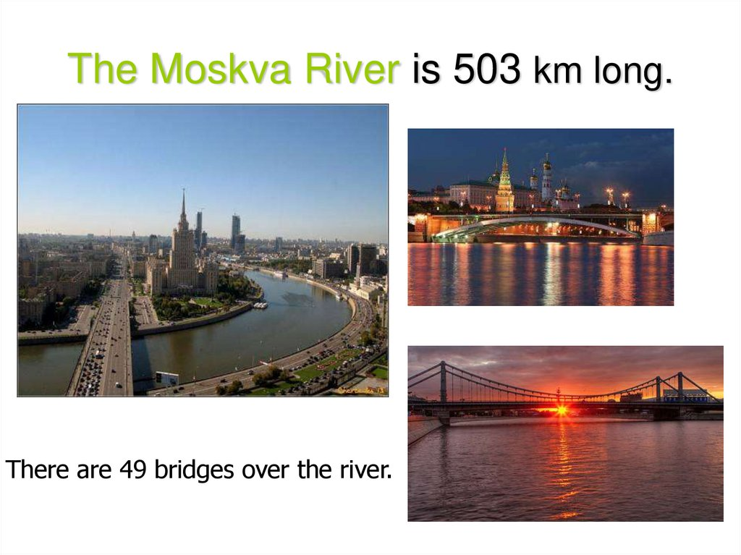

Slide 25
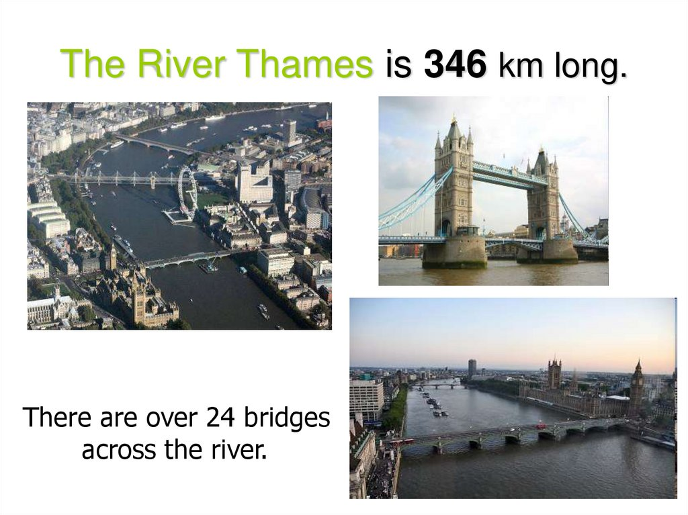

Slide 26
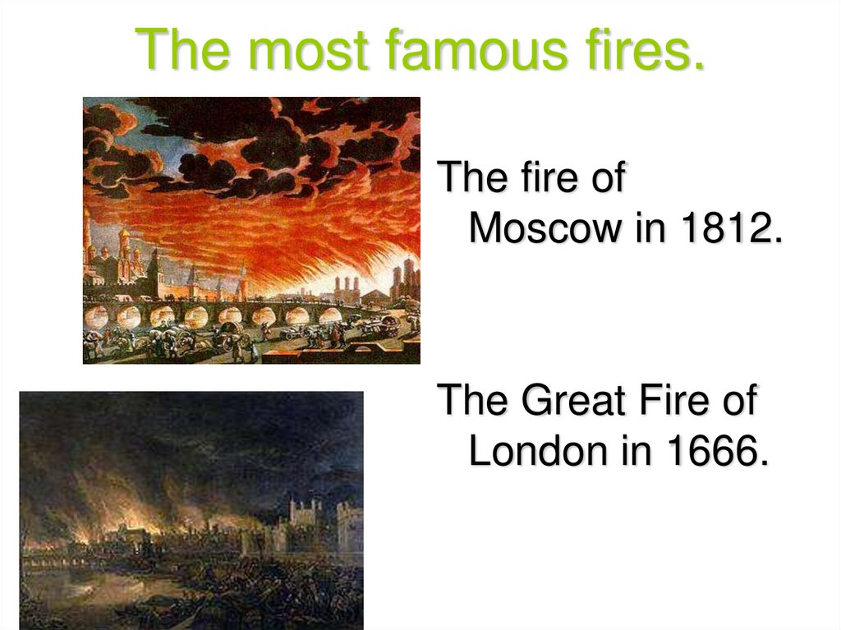

Slide 27

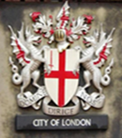
The comparative table of Moscow and London
 | Moscow | London
The start of foundation | 1147 | 43 A.D.
The total area | 2511 square km. | 1580 square km.
The administrative division | 125 districts | 35boroughs
The population | more 12 million | 8.5 million
The main square | Red Square | Trafalgar Square
The number of the streets and squares | 3805 | 25 000
The number of the museums | 445 | 240
The square of the parks | 15% of the city’s square | 19% of the city’s square
The number of the universities | 57 | 40
The numbers of the theatres | 400 | 200
The numbers of the underground stations | 200 | 275

