Slide 1
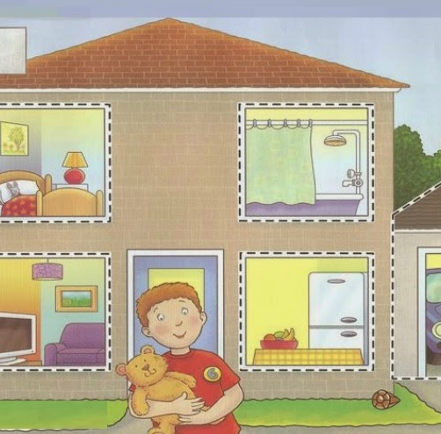
MY HOME
Морозова Ксения Александровна

Slide 2


TONGUE-TWISTER

Slide 3

What colour is it?

Slide 4
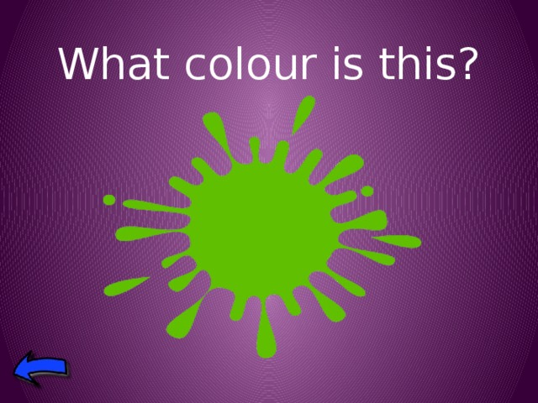

Slide 5
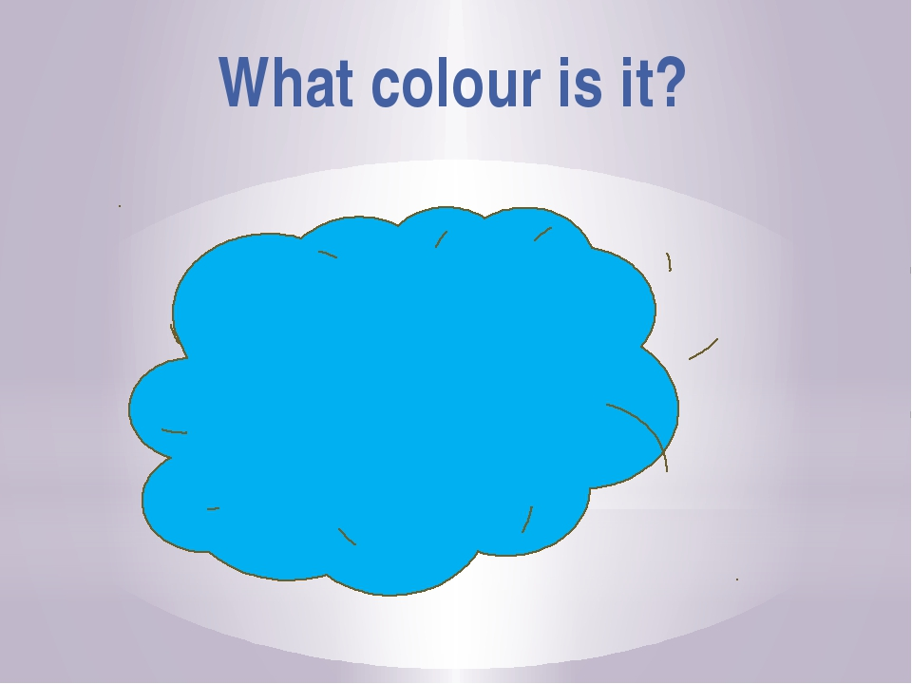

Slide 6

What colour is it?

Slide 7


House

Slide 8
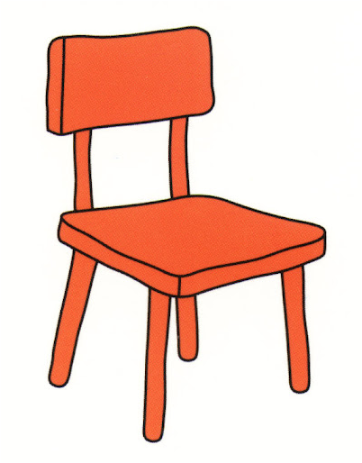
What's this?
It's a chair.

Slide 9
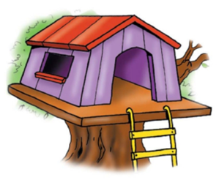
It's a tree house.

Slide 10
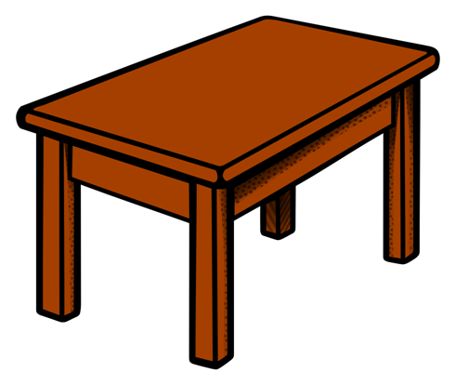
What's this?
It's a table.
It's a brown table.

Slide 11
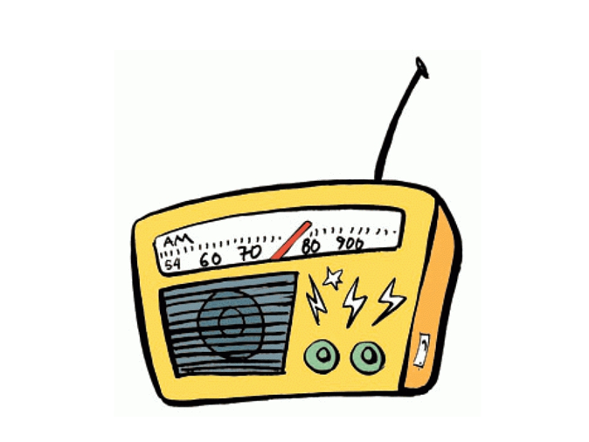
What's this?
It's a yellow radio.

Slide 12
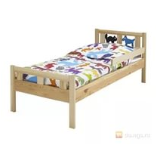
What's this?

Slide 13
Look at the pictures and remember

Slide 14
What's missing?

Slide 15
What is missing?

Slide 16
What's missing?

Slide 17
Thanks for attention!

