Slide 1
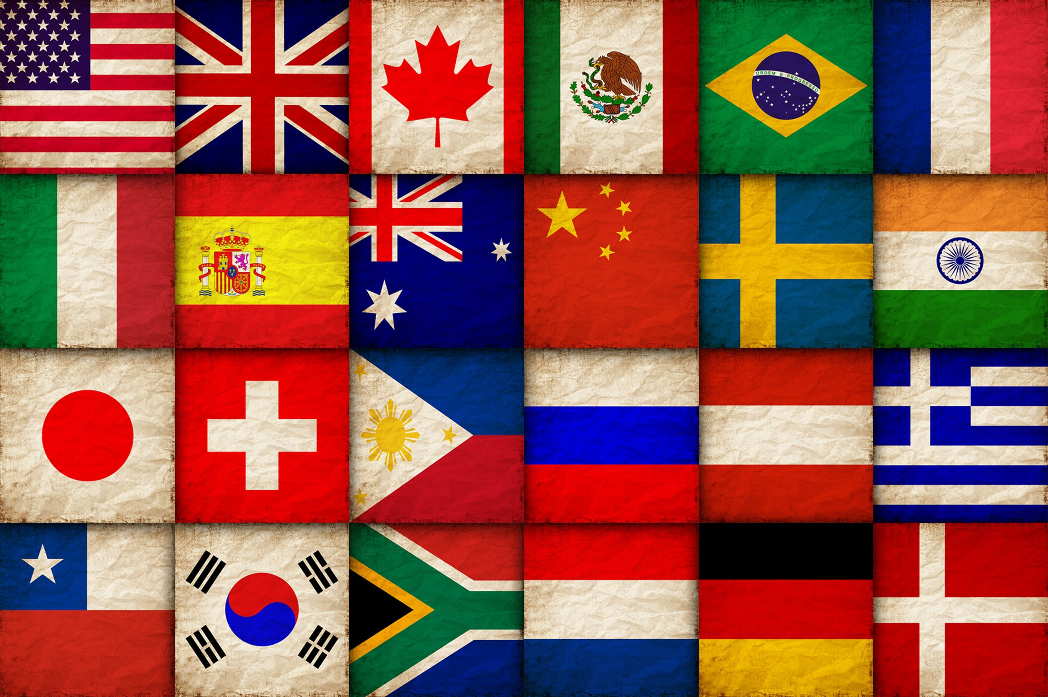

Slide 2
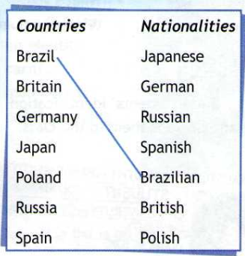
September, 18
Monday
Classwork

Slide 3
in the north - на севере
in the south - на юге
in the east - на востоке
in the west - на западе
capital city - столица
beautiful - красивый
ice - лед
snow - снег
lots to see - много что посмотреть
desert - пустыня
tourist - турист
river - река
place - место

Slide 4
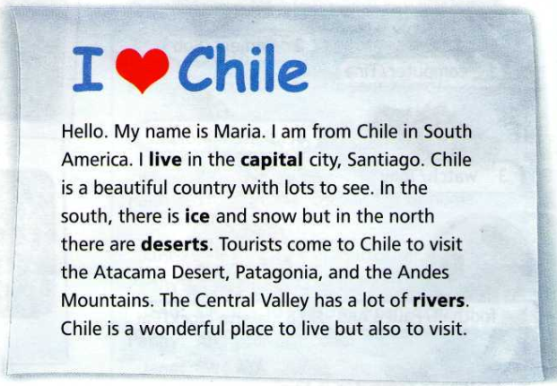

Slide 5
Answer the questions:
1. Where is Maria from?
2. Where does she live?
3. What is the capital city of Chile?
4. What can you see in the south of Chile?
5. What can you see in the north of Chile?
6. Why do tourist come to Chile?
7. Would you like to visit Chile?

