Slide 1



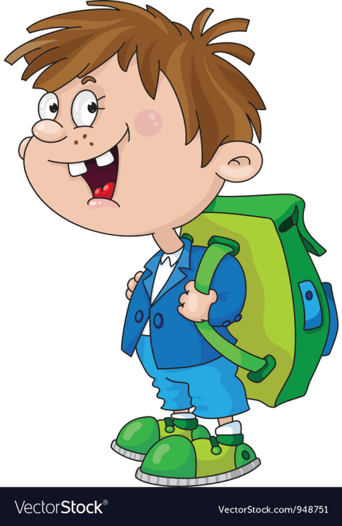
Answer the questions.
How old are you?
What are your favourite school subjects?
What is in your school bag?
I’m 11 years old.
My favourite school subjects are Maths and Art.
There are 5 books, 2 copybooks, a pen, a pencil and a ruler in my school bag.

Slide 2
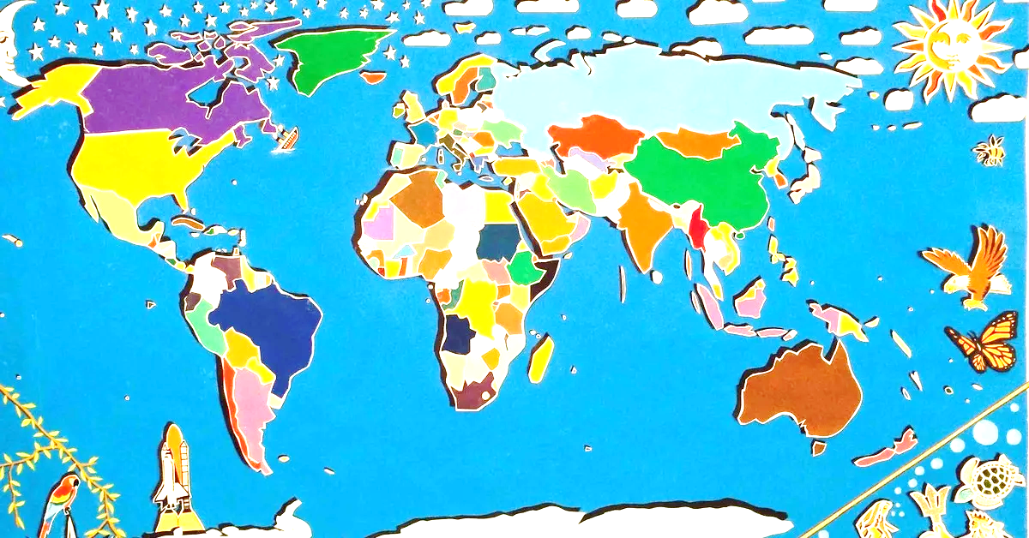
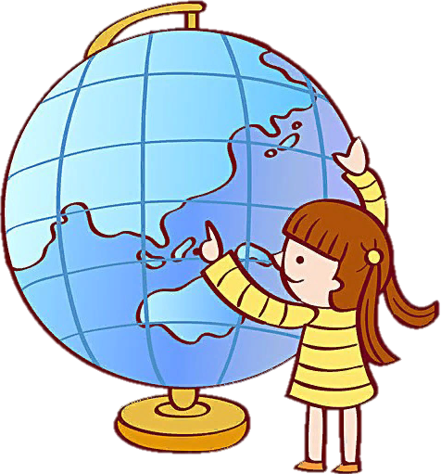
Canada
Do you like Geography?
the UK
What countries do you know in English?
Japan
France
the USA
Australia
New Zealand

Slide 3

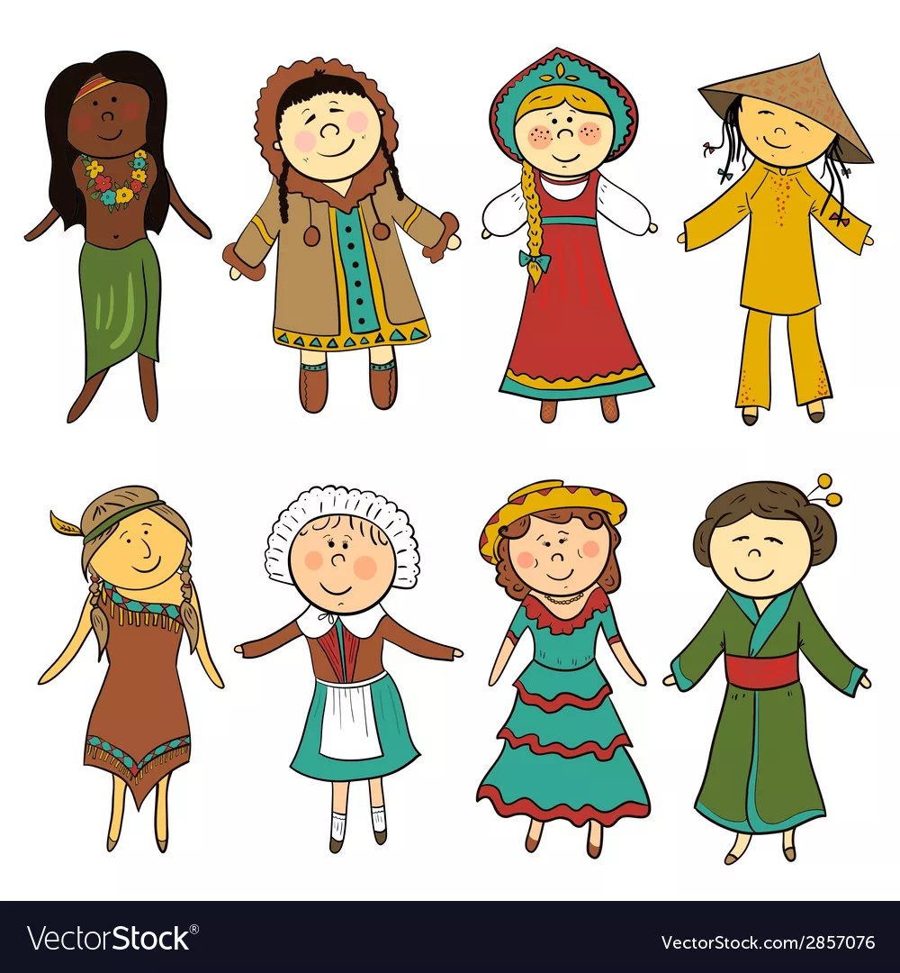
Ex. 1. Match the countries to the nationalities. Listen and check. Listen again and repeat.
COUNTRIES
NATIONALITIES
the UK
the USA
Canada
Australia
New Zealand
France
Japan
American
Australian
British
New Zealander
Canadian
French
Japanese

Slide 4
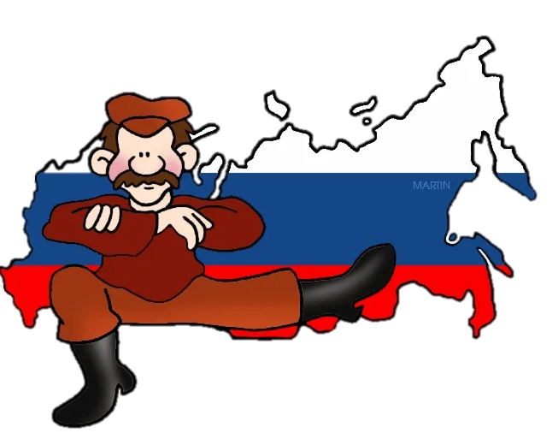
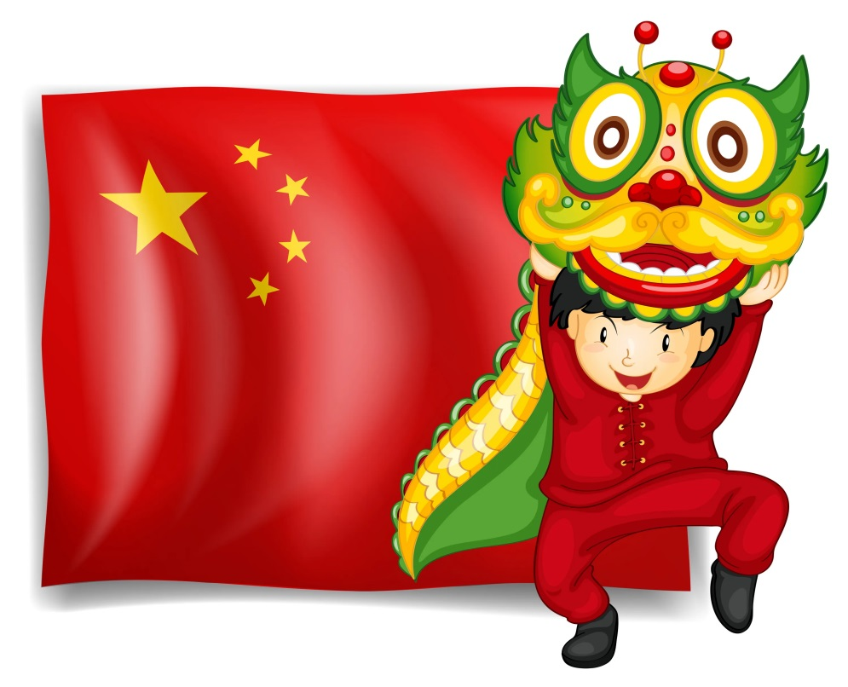
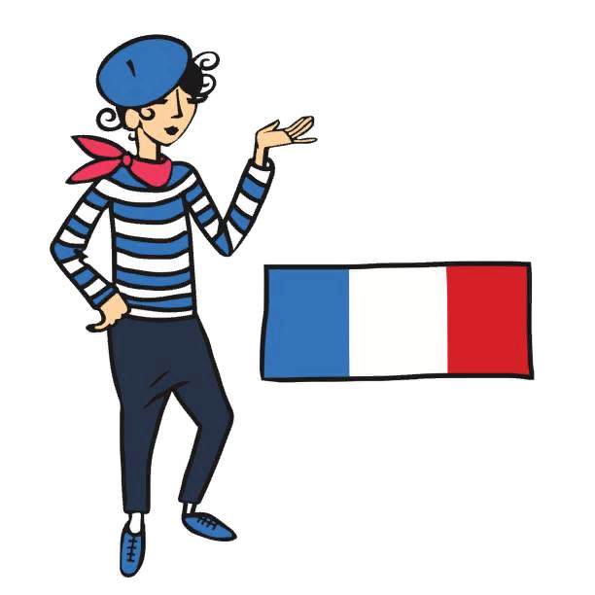
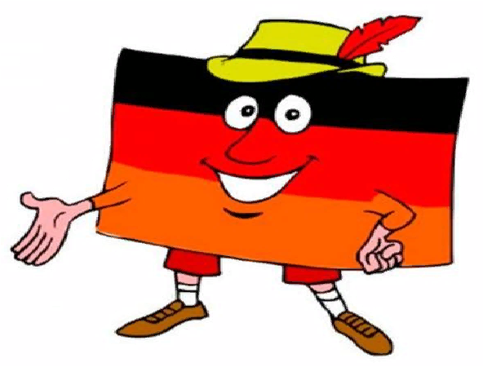

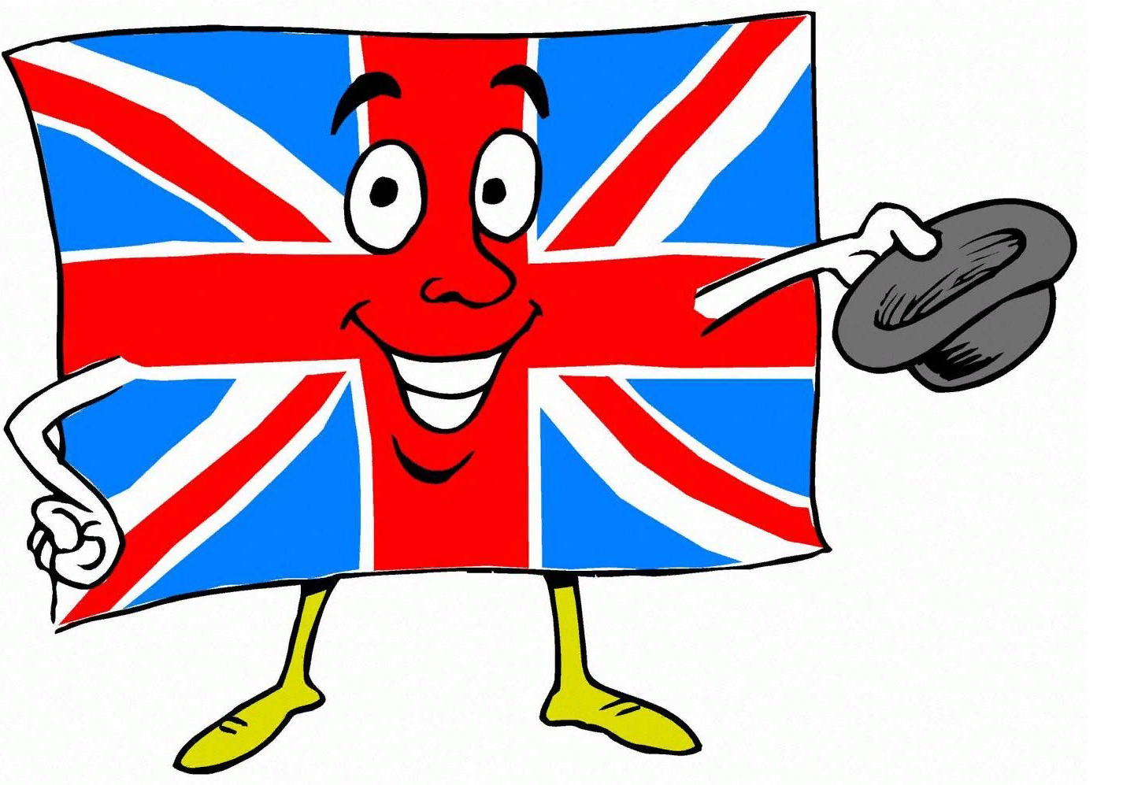


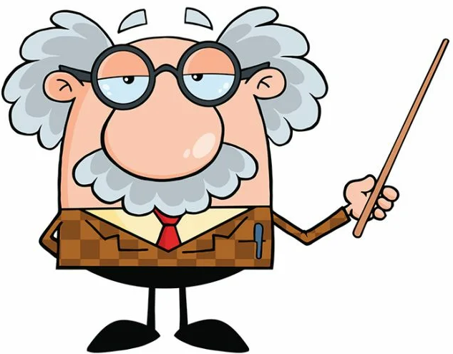
How many flags and languages do you know?
Japan
France
Germany
the UK
China
the USA
Russia
Japanese
French
German
English
Chinese
English
Russian

Slide 5
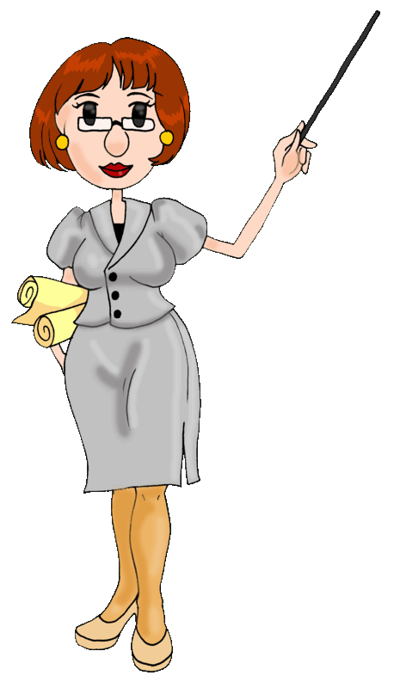
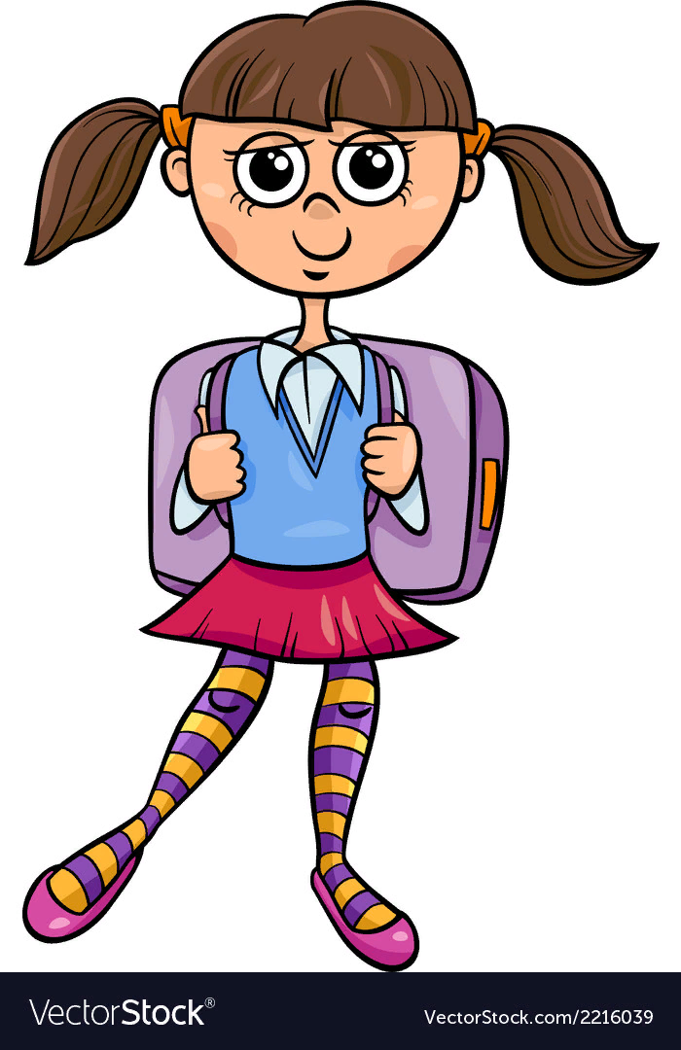
Ex. 1b. Imagine that you’re students from different countries. Introduce yourself, please.
Where are you from?
What languages can you speak?
Hello! I’m Natasha. I’m from Russia. I can speak Russian and English, but I can’t speak French.

Slide 6

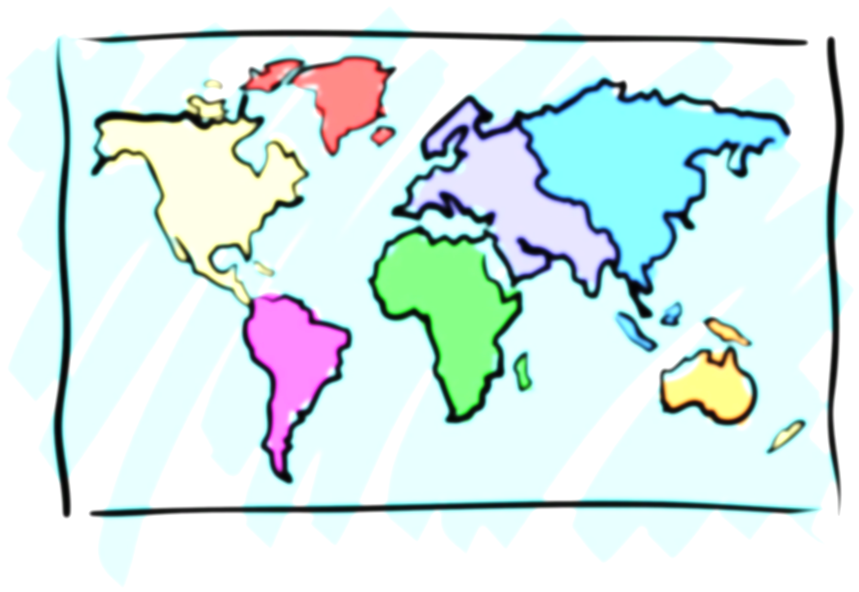

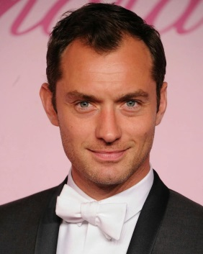
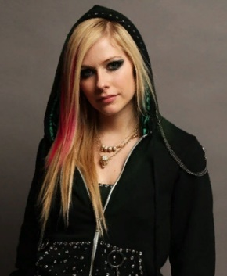


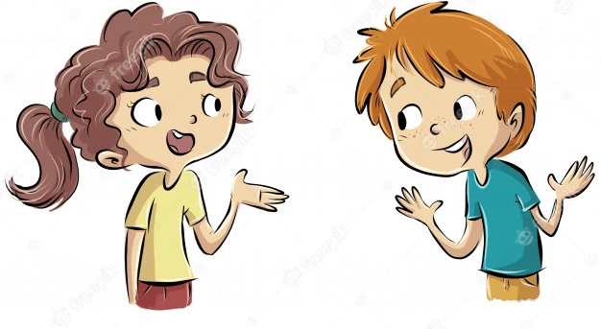
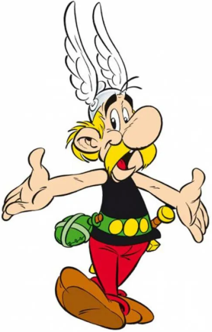
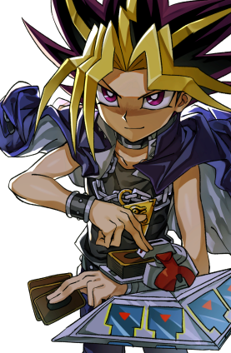

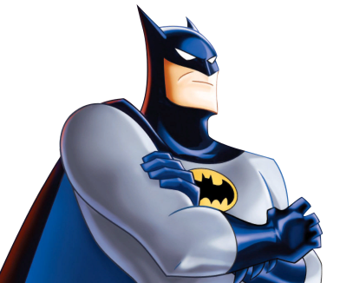
Ex. 2. Do you know the cartoon characters and people in the pictures? Where are they from? Act out similar dialogues.
Jude Law
Avril Lavigne
Where’s Avril Lavigne from?
She’s from Canada. She’s Canadian.
Batman
Asterix
Ju-Gi-Oh

Slide 7
Ex.3. Group the nationalities under: -an, -ish, -ian, -er, -ese, other.
-an | -ish | -ian | -er | -ese | other
African
Spanish
Russian
Chinese
French
New Zealander
Mexican
British
Canadian
Japanese
Greek
American
Irish
Australian
Portuguese
China
France
Japan
Russia
Spain
Canada
Africa
the UK
New Zealand
Mexico
Australia
the USA
Greece
Portugal
Ireland

Slide 8
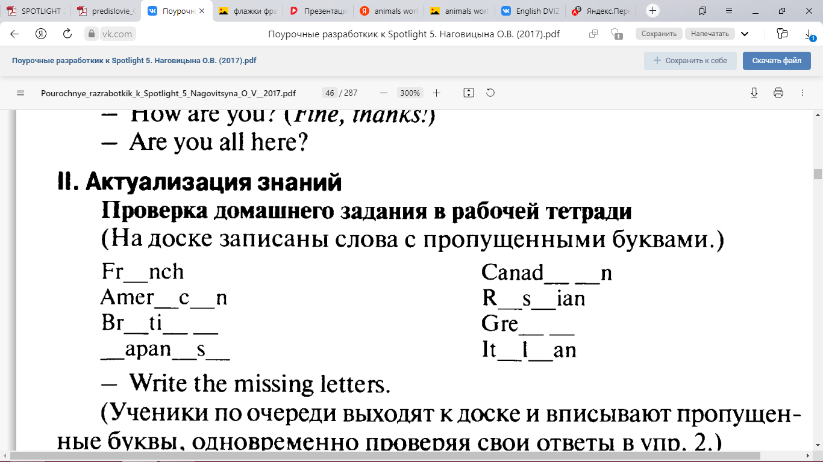
Write the missing letters.
French
Canadian
American
Russian
British
Greek
Japanese
Italian

Slide 9
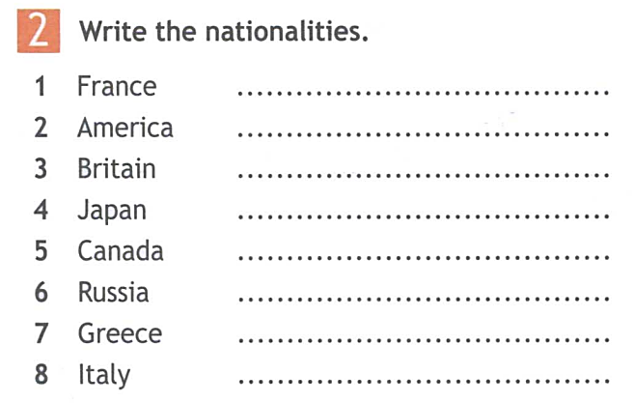
French
American
British
Japanese
Canadian
Russian
Greek
Italian

Slide 10
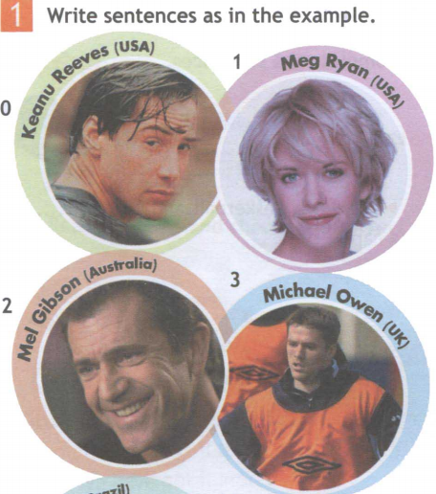
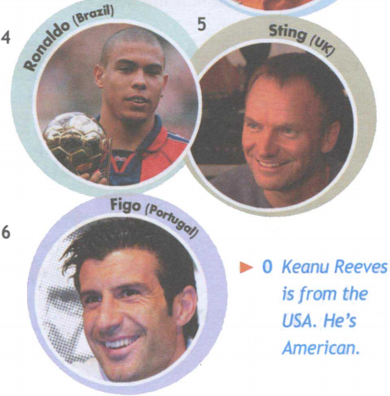
Workbook
1
5
4
3
2
6
Meg Ryan is from the USA. She’s American.
Ronaldo is from Brazil. He’s Brazilian.
Mel Gibson is from Australia. He’s Australian.
Michael Owen is from the UK. He’s British.
Figo is from Portugal. He’s Portuguese.
Sting is from the UK. He’s British.

Slide 11
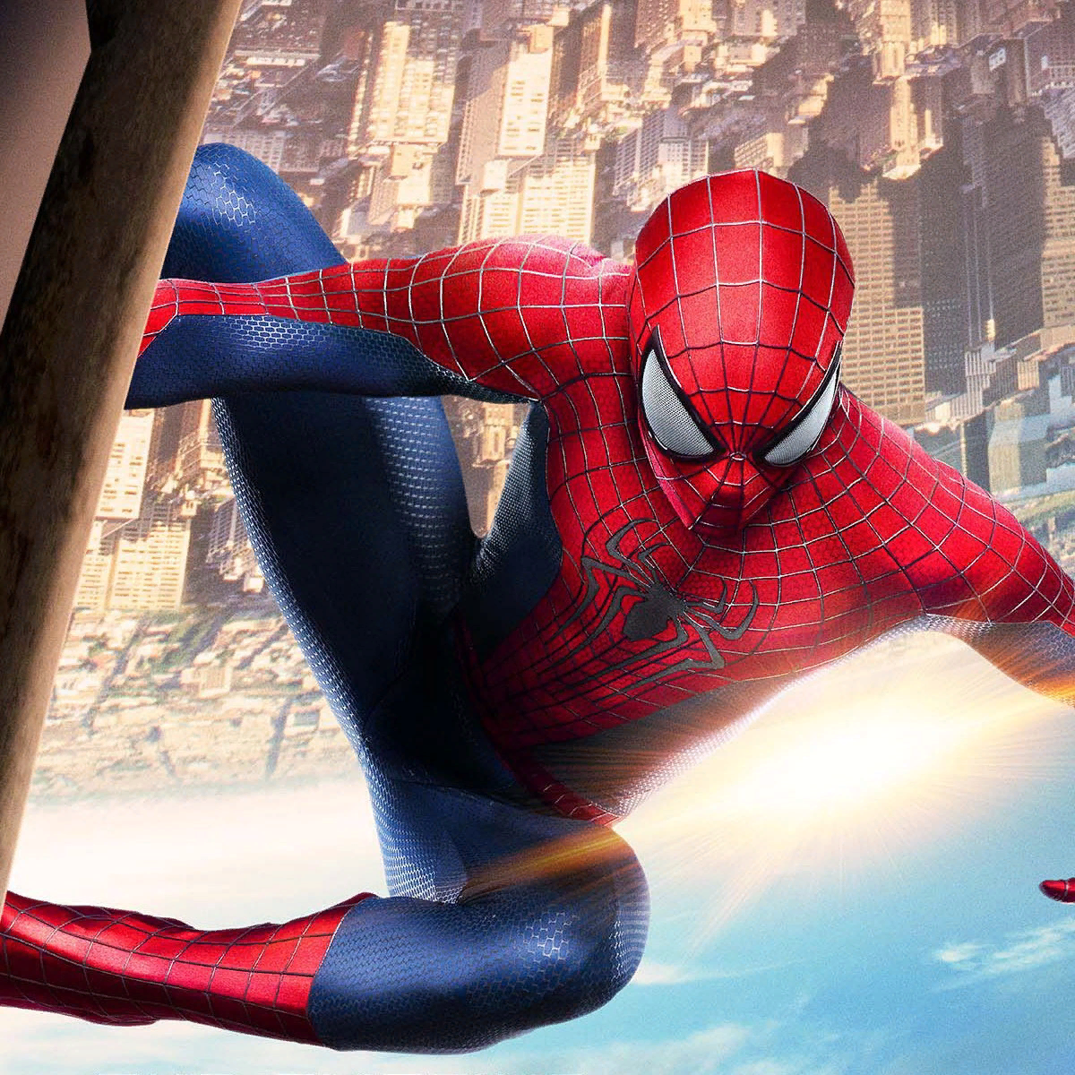
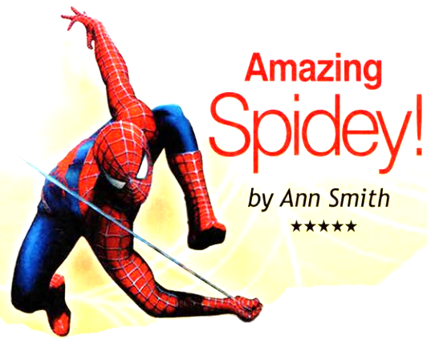
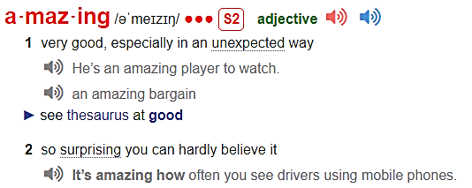
Ex. 4. Look at the picture and the title of the text. Who is the text about?
amazing
What do you know about Spider-Man?

Slide 12

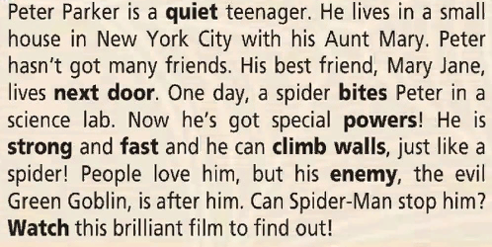

Listen and read the text and answer the questions.
Spider-Man’s real name
Who are these people?
quiet – тихий
next door – по соседству
to bite – кусать
powers – способности
strong – сильный
fast – быстрый
to climb – лазать
enemy – враг
to watch - смотреть
Aunt Mary
Mary Jane
Peter Parker
the Green Goblin
wordlist

Slide 13
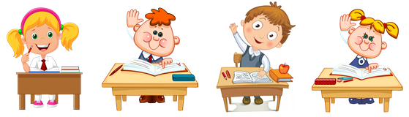
Ex. 5. Read again and answer the questions.
Where’s Spider-Man from?
quiet – тихий
next door – по соседству
to bite – кусать
powers – способности
strong – сильный
fast – быстрый
to climb – лазать
enemy – враг
to watch - смотреть
Who’s his best friend?
What can Spider-Man do?
Who is against him?
He can climb walls.
He’s from New York City.
His best friend is Mary Jane.
The Green Goblin is against him.
wordlist

Slide 14
Match.
quiet
in the next room, house or building
next door
not weak
to bite
to go up the sides of buildings
powers
to see
strong
quick, not slow
fast
calm
to climb walls
to use the teeth to cut into something
enemy
special abilities
to watch
a person who hates somebody or acts against somebody

Slide 15
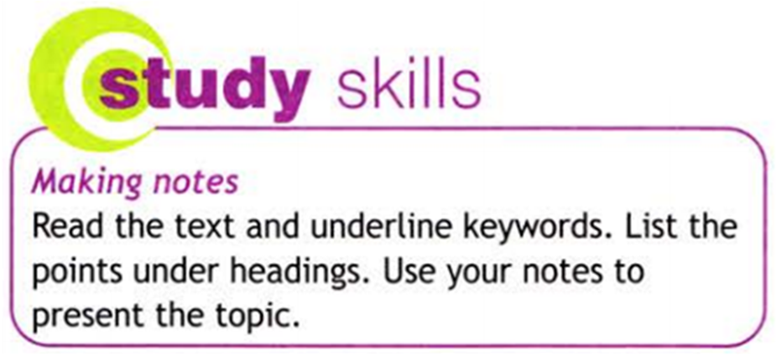



Ex. 6. Make notes, then present the story of Spider-Man to the class.
People
Peter Parker (a quiet teenager, and then Spider-Man)
his Aunt Mary
Mary Jane (Peter’s best friend)
the Green Goblin (Peter’s enemy)
Study Skills
Events
Place
Peter lives in a small house with his aunt.
A spider bites Peter.
Peter gets special powers, he can climb walls like a spider.
The Green Goblin is after Peter.
New York City

Slide 16
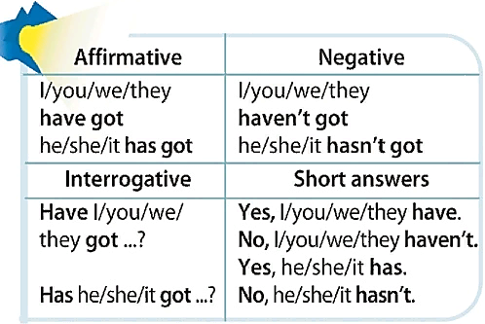
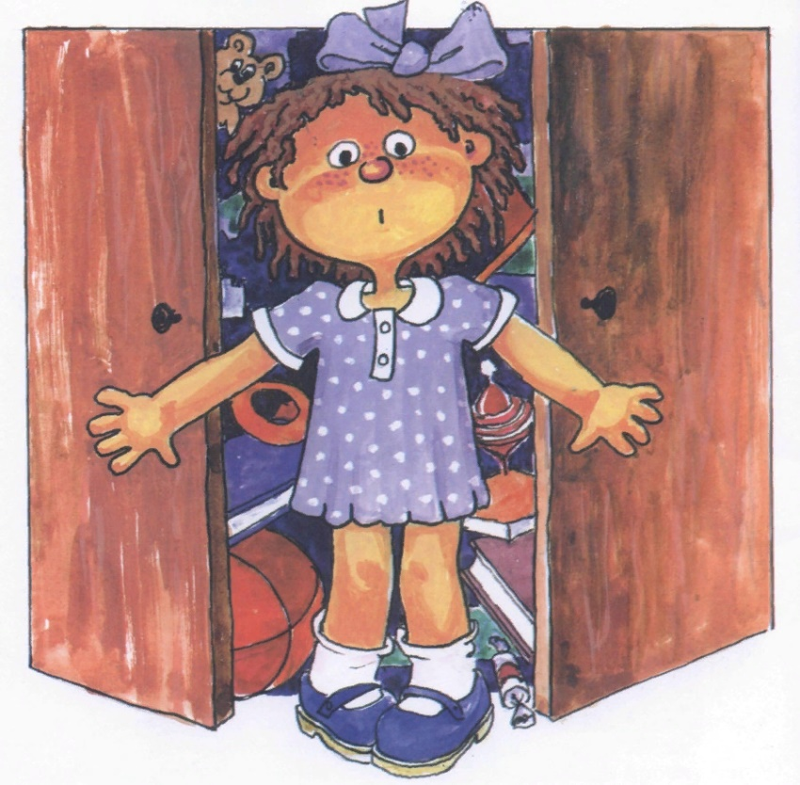
Ex. 7. Read the table. Find examples in the text.
text
examples
I have got…

Slide 17
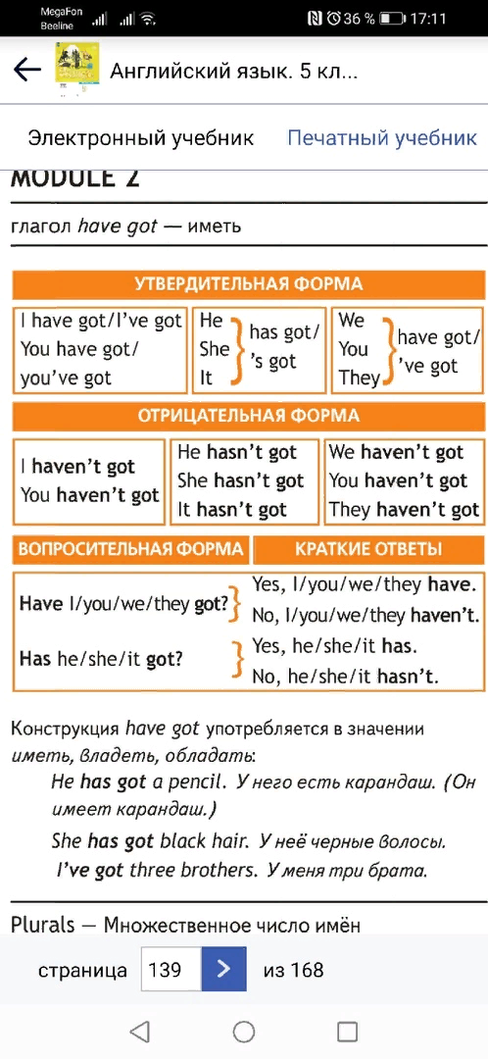
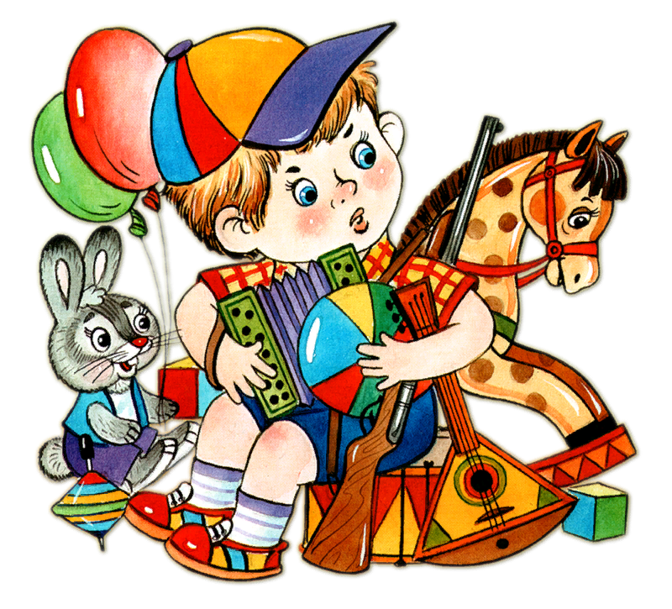
I’ve got a horse …

Slide 18

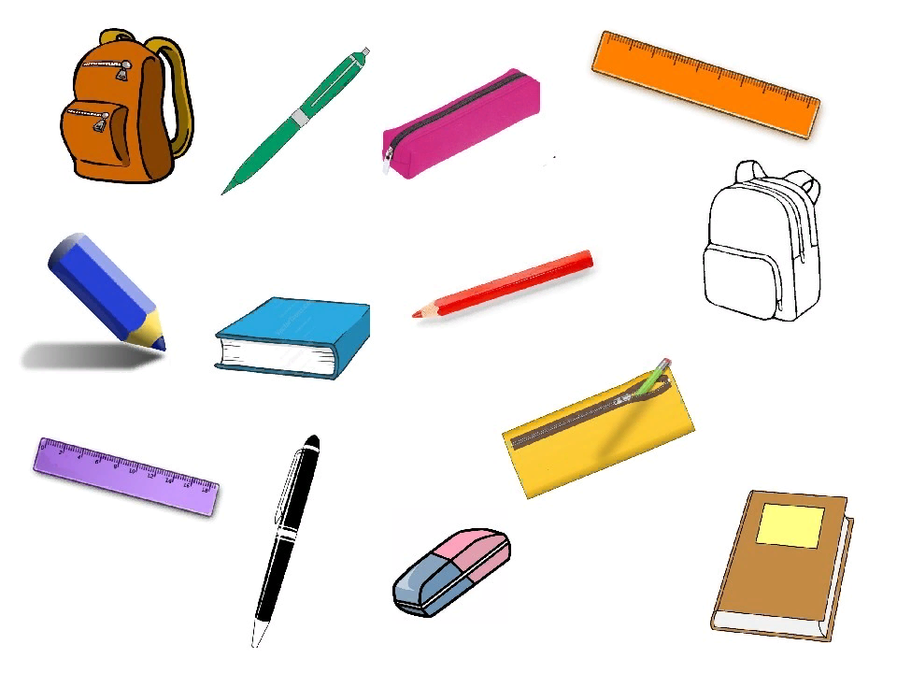






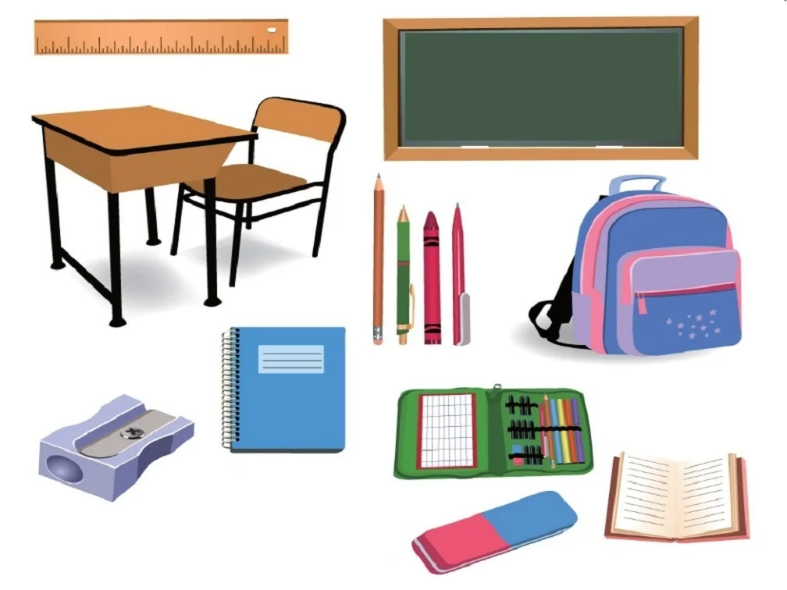


What has your partner got?
pencil case
He has got…
ruler
pen
sharpener
book
school bag
notebook
eraser/
rubber

Slide 19
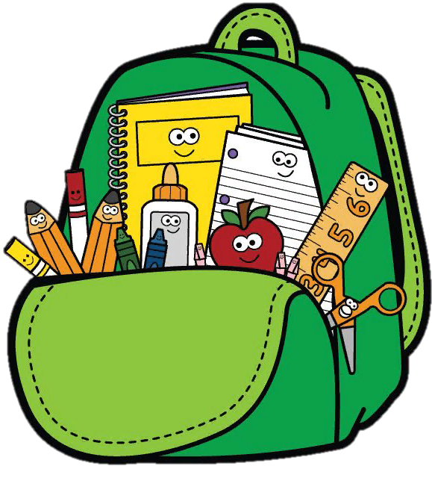
What have you got in your school bag?

Slide 20


we
he
I
you
it
she
they
have got
has got

Slide 21
we
he
I
you
it
she
they
haven’t got
hasn’t got

Slide 22
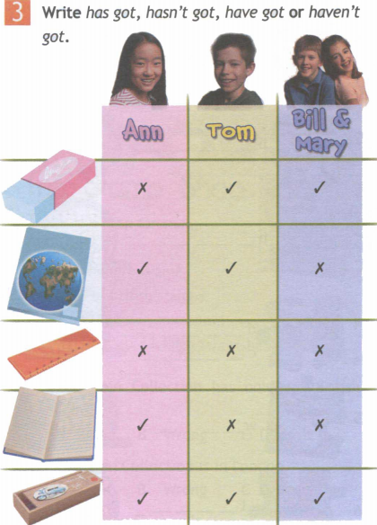
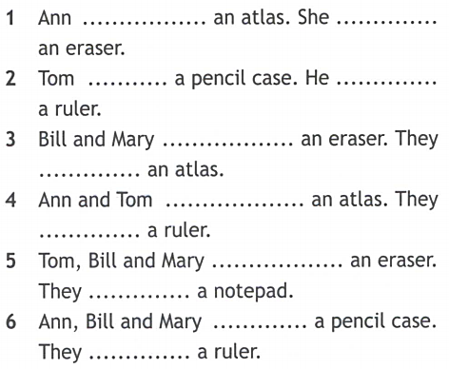
has got
hasn’t got
has got
hasn’t got
have got
haven’t got
have got
haven’t got
have got
haven’t got
have got
haven’t got

Slide 23
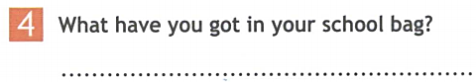



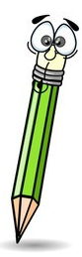


I have got … / I haven’t got …

Slide 24
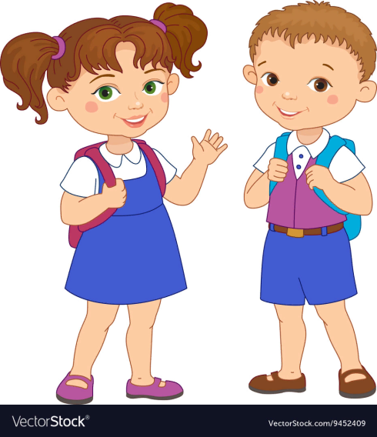
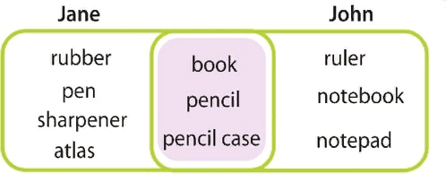
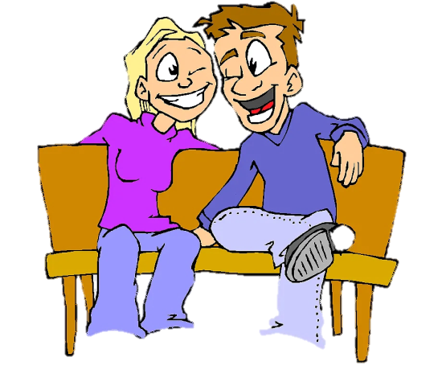
Ex. 8. What have Jane and John got in their school bags?
Ask and answer.
Has Jane got a ruler in her school bag?
No, she hasn’t.
Has John got a ruler in his school bag?
Yes, he has.

Slide 25
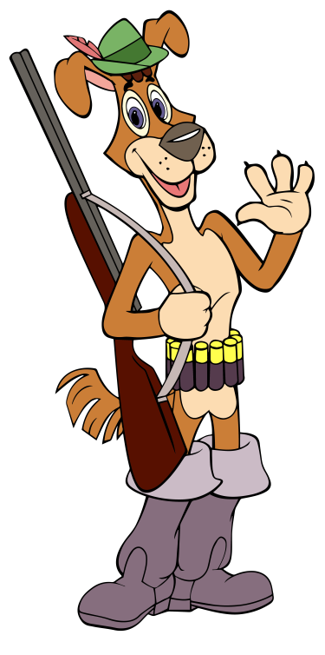
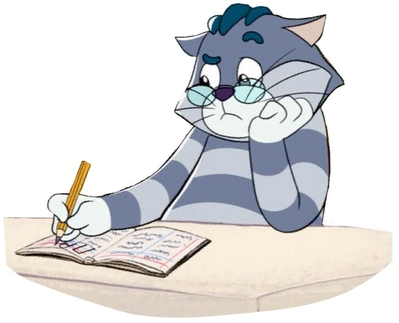
Ex. 9. Make a poster of your favourite cartoon characters. Stick on pictures. Write a few sentences about each character.
Write:
name
who the character is
what the character does
My favourite cartoon character is Sharik.
Sharik is a dog and he lives in the village Prostokvashino.
He is strong and brave.
He can hunt.

