Slide 1
Icons of Russia.

Slide 2
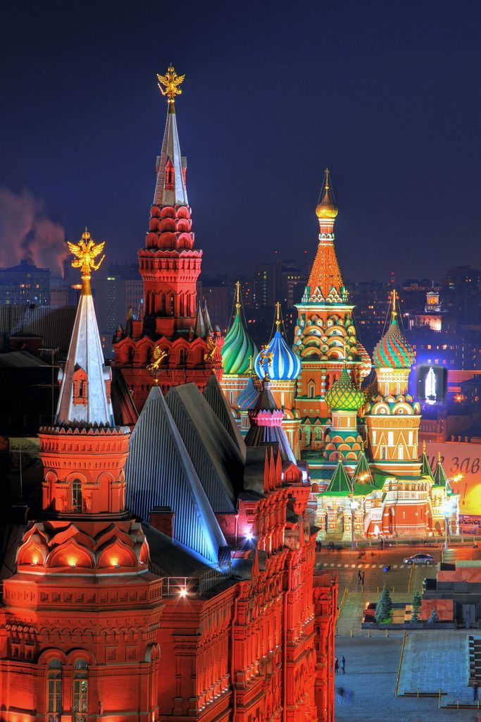
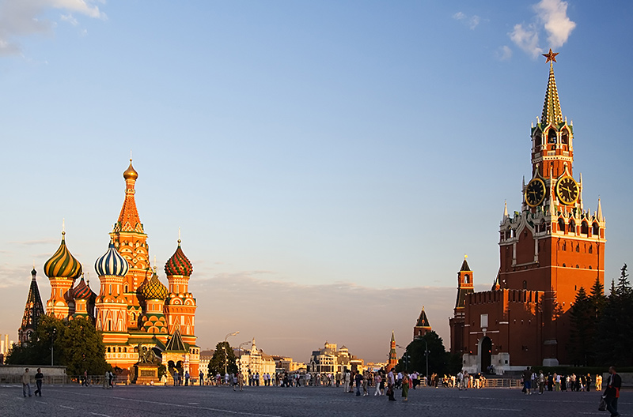
Kremlin
It’s the heart of Moscow, our capital city. It was built in 15-16 centuries. The main Kremlin Tower, the Spasskaya Tower, has become a symbol of Russia.

Slide 3
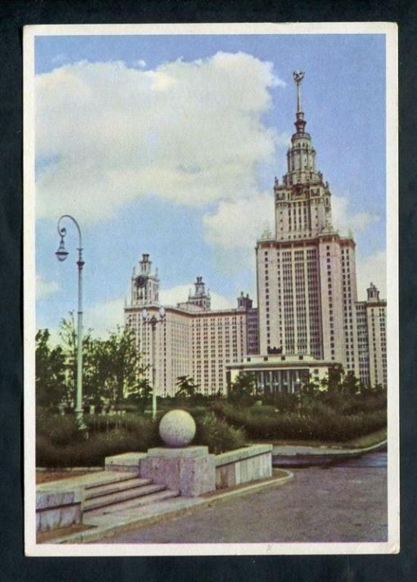
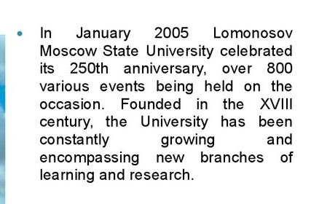
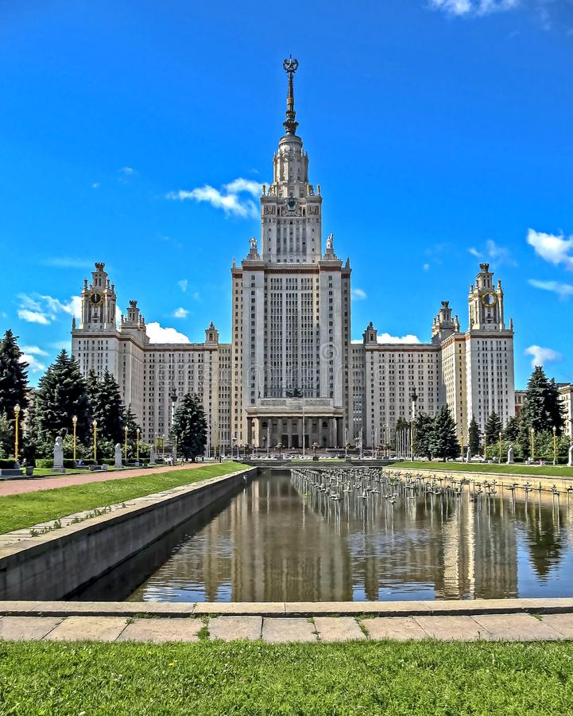
Moscow University

Slide 4
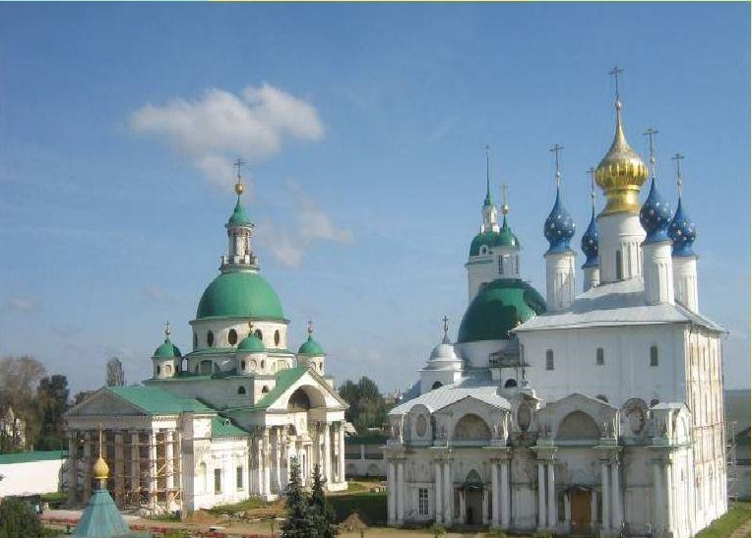
Rostov-Weilikij

Slide 5
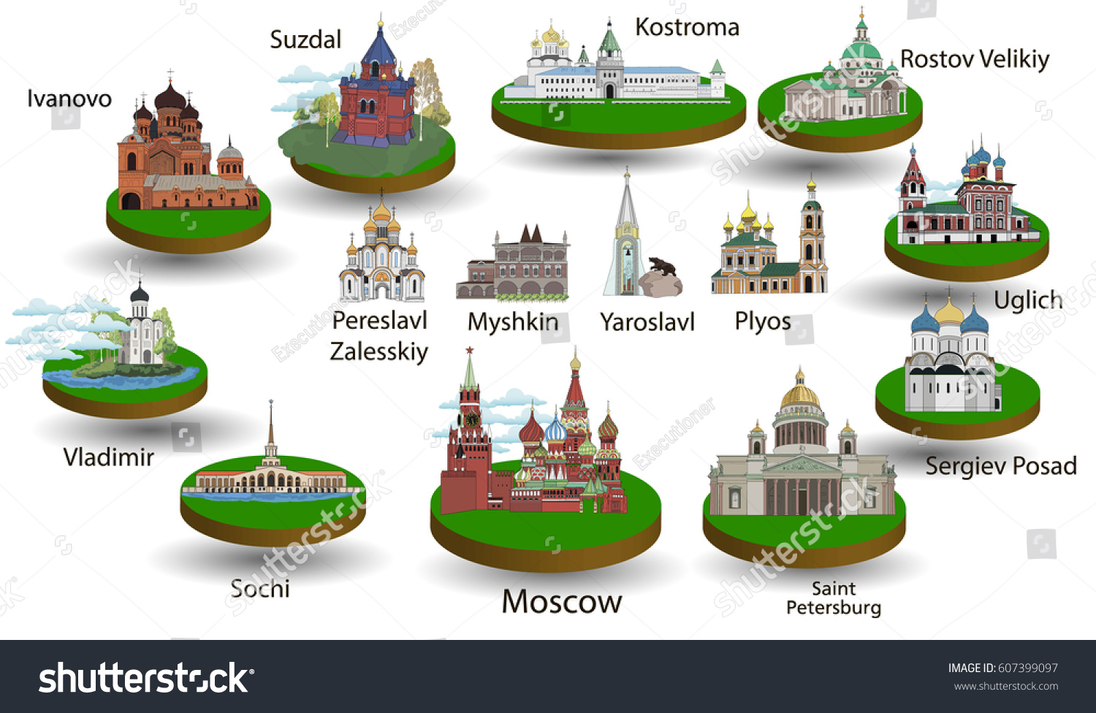

Slide 6
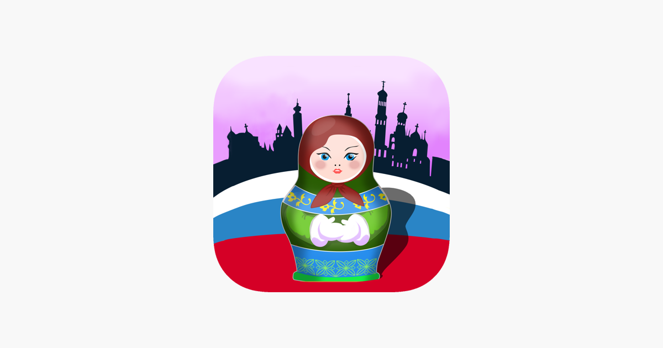
Matryoshka
*Matryoshka - Russian wooden toy in the form of a painted doll, inside of which are similar to her dolls smaller. Number of nested dolls usually 3 or more.

Slide 7
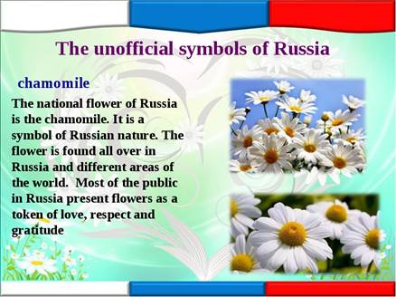

Slide 8
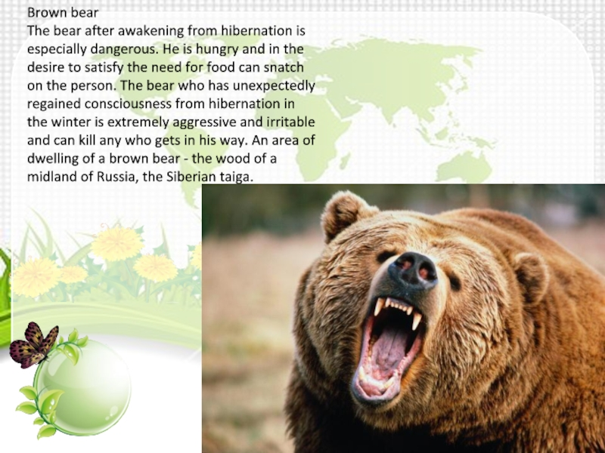
Brown bear

Slide 9
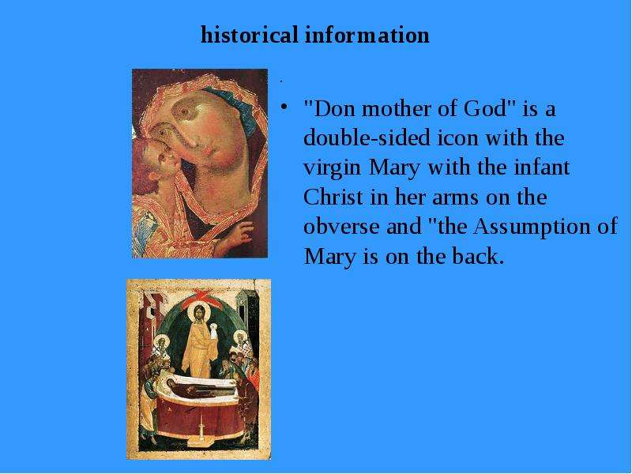
Historical information

Slide 10
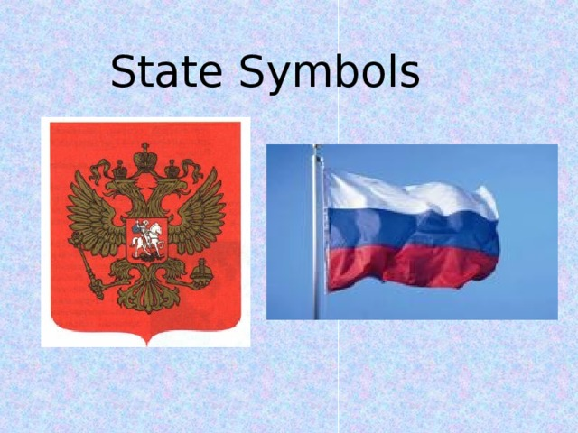
Symbols

