Slide 1
«Своя игра»
Дидактическая игра для учащихся 3 классов (УМК «Английский в фокусе»)
Копотилова И.А.
Учитель иностранных языков МБОУ «СОШ№13»
С.Надежда, Шпаковский район, Ставропольский край

Slide 2
Jeopardy
school
1
2
3
4
5
6
7
8
my family
1
2
3
4
5
6
7
8
food
1
2
3
4
5
6
7
8
animals
1
2
3
4
5
6
7
8
grammar
1
2
3
4
5
6
7
8
Team 1
Team 2
Team 3
Team 4
1
2
3
4
5
6
7
8
9
10
11
12
13
14
15
16
17
18
19
20
21
22
23
24
1
25
2
3
4
5
6
7
8
9
10
11
12
13
14
15
16
17
18
19
20
21
22
23
24
25
1
2
3
4
5
6
7
8
9
10
11
12
13
14
15
16
17
18
19
20
21
22
23
24
25
1
2
3
4
5
6
7
8
9
10
11
12
13
14
15
16
17
18
19
20
21
22
23
24
25

Slide 3

What’s this?
ОТВЕТ
pen

Slide 4

What’s this?
ОТВЕТ
pencil

Slide 5
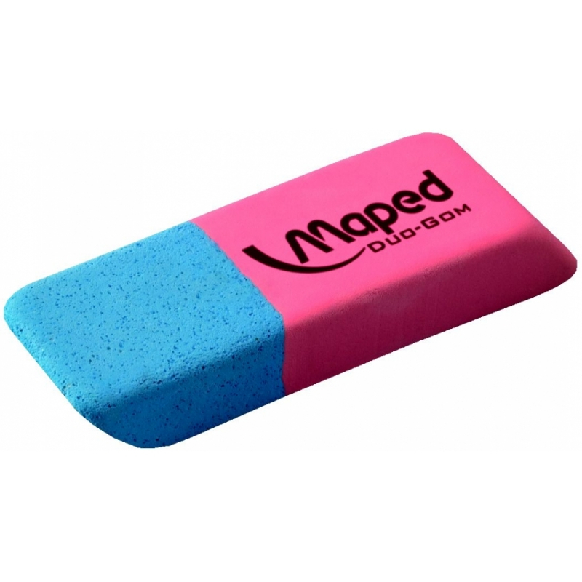
What’s this?
ОТВЕТ
rubber

Slide 6
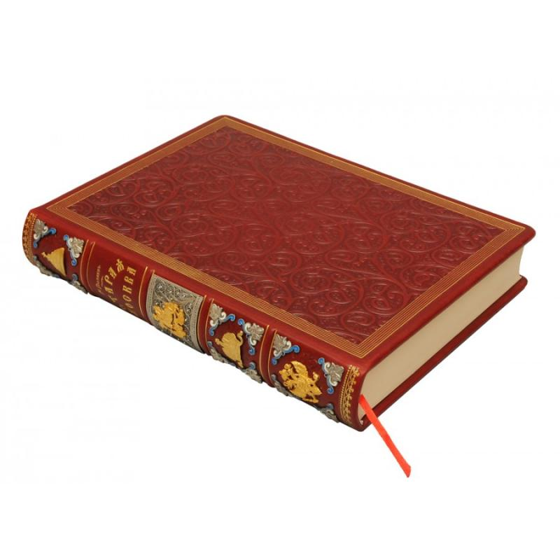
What’s this?
ОТВЕТ
book

Slide 7
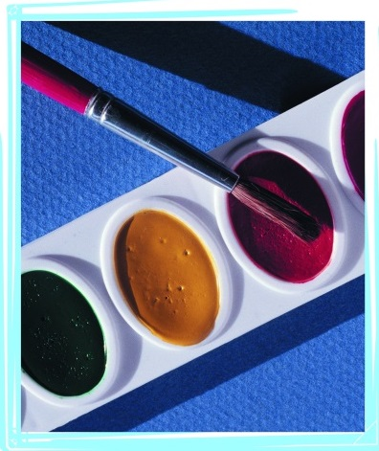
What subject is this?
ОТВЕТ
Art

Slide 8

What subject is this?
ОТВЕТ
English

Slide 9
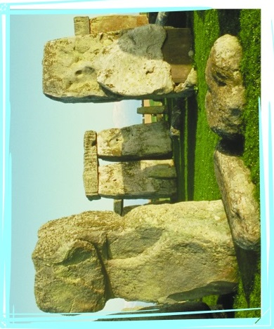
What subject is this?
ОТВЕТ
History

Slide 10
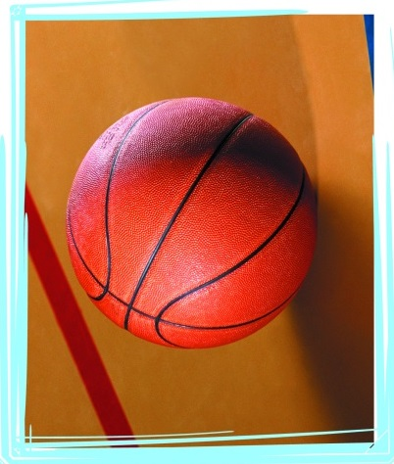
What subject is this?
ОТВЕТ
PE

Slide 11
My family
Who’s Mary to Betty?
John
Mary
Bob
Sarah
Betty
Jeff
Tom
ОТВЕТ
Her grandmother.

Slide 12
My family
Who’s Bob to Jeff and
Tom?
John
Mary
Bob
Sarah
Betty
Jeff
Tom
ОТВЕТ
Their father.

Slide 13
My family
Who’s Sarah to Betty?
John
Mary
Bob
Sarah
Betty
Jeff
Tom
ОТВЕТ
Her mother.

Slide 14
My family
Who’s John to Jeff and
Tom?
John
Mary
Bob
Sarah
Betty
Jeff
Tom
ОТВЕТ
Their grandfather.

Slide 15
My family
Who’s Betty to Jeff and
Tom?
John
Mary
Bob
Sarah
Betty
Jeff
Tom
ОТВЕТ
Their sister.

Slide 16
My family
Who’s Jeff and Tom to
Betty?
John
Mary
Bob
Sarah
Betty
Jeff
Tom
ОТВЕТ
Her brothers.

Slide 17
My family
Who’s Bob to Betty?
John
Mary
Bob
Sarah
Betty
Jeff
Tom
ОТВЕТ
Her father.

Slide 18
My family
Who’s Sarah to Jeff
and Tom?
John
Mary
Bob
Sarah
Betty
Jeff
Tom
ОТВЕТ
Their mother.

Slide 19

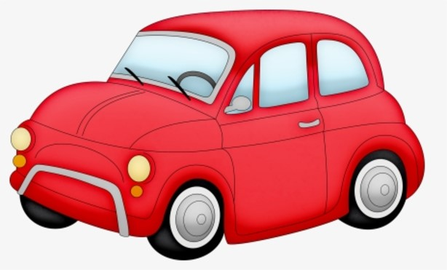
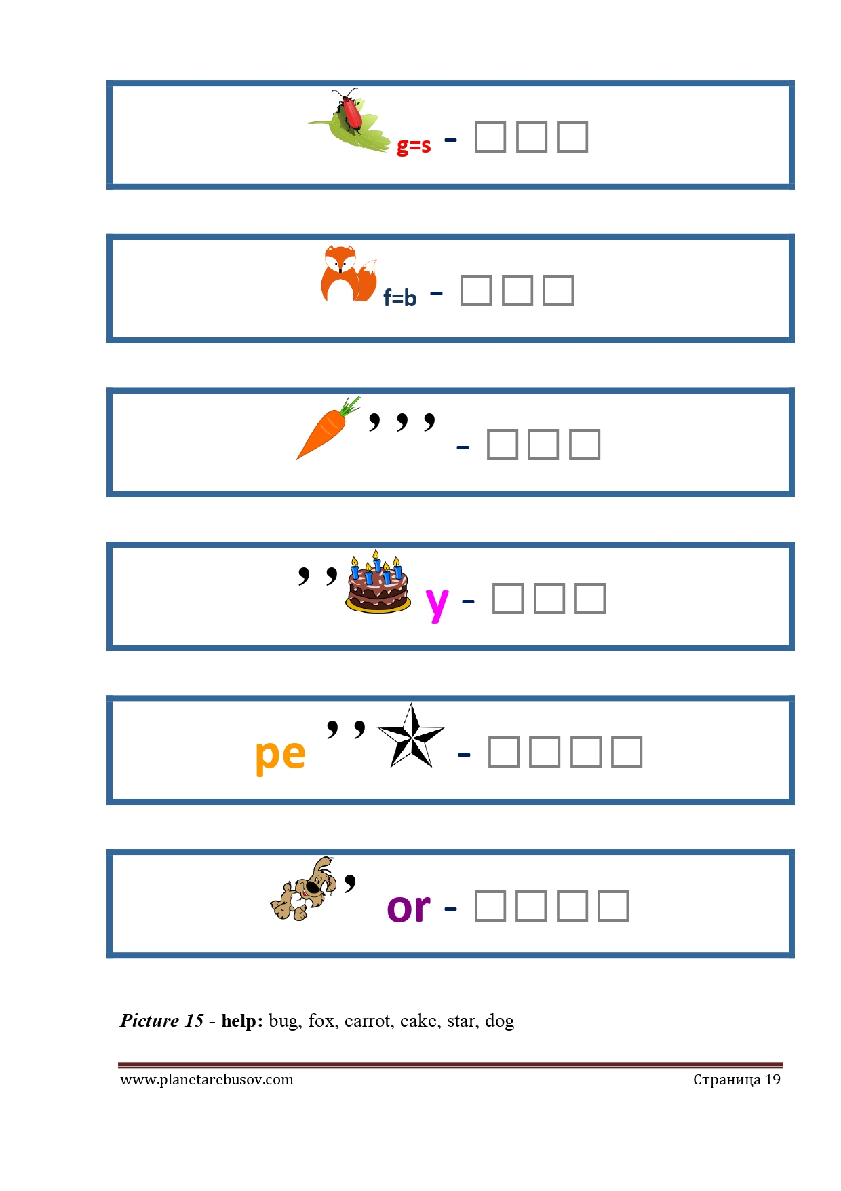
What’s this?
t
ОТВЕТ
carrot

Slide 20
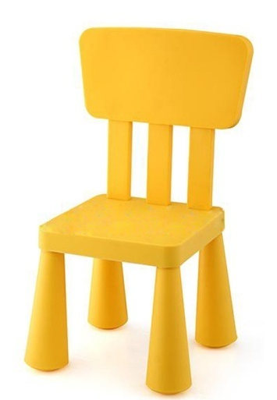
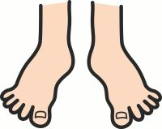
What’s this?
se
ОТВЕТ
cheese

Slide 21
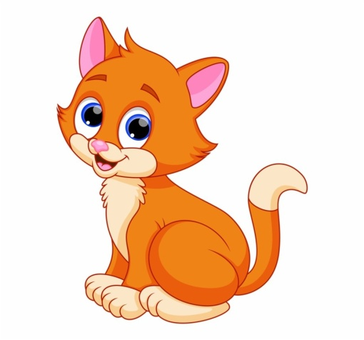
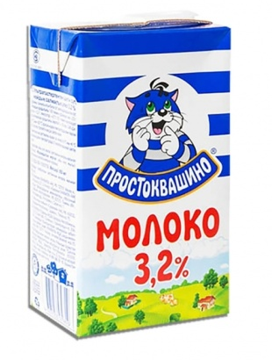
What’s this?
e
ОТВЕТ
cake

Slide 22

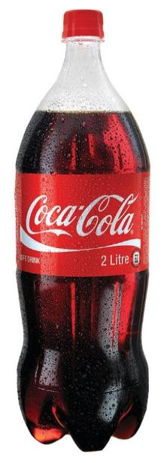

What’s this?
10
a=o
ОТВЕТ
chocolate

Slide 23

What’s this?
r
10
i=a
ОТВЕТ
water

Slide 24
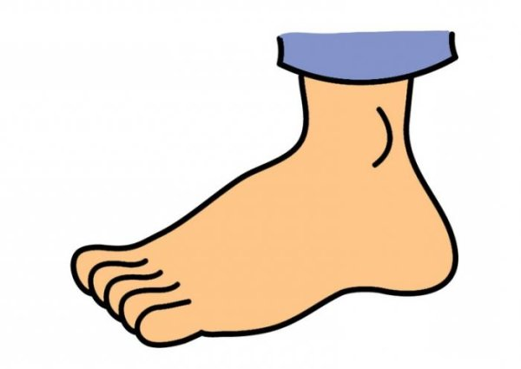

What’s this?
p
o
ОТВЕТ
potato

Slide 25
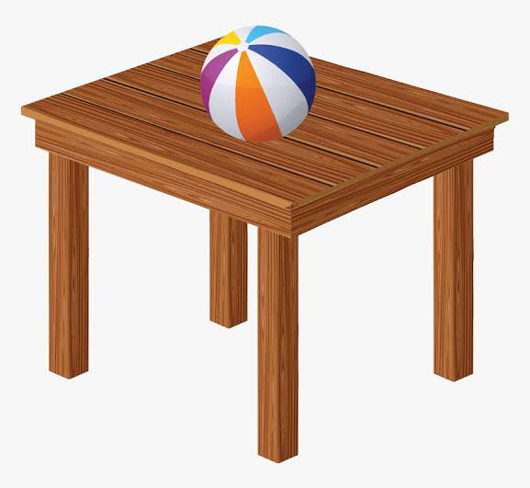

What’s this?
a
a=e
ОТВЕТ
lemonade

Slide 26


What’s this?
i
ОТВЕТ
chicken

Slide 27
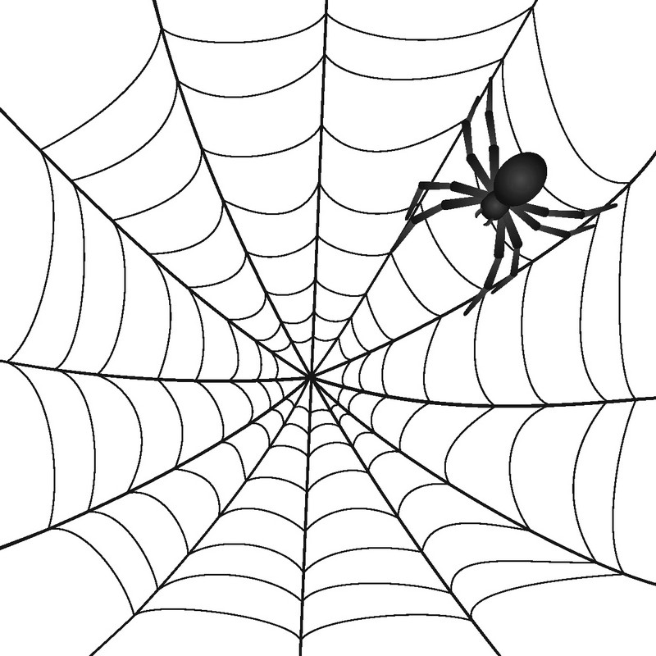
Who’s this?
It has
It has got 8 legs, but it hasn’t got a tail. It can be black, brown, yellow, red. It can crawl, but it can’t swim.
ОТВЕТ
spider

Slide 28
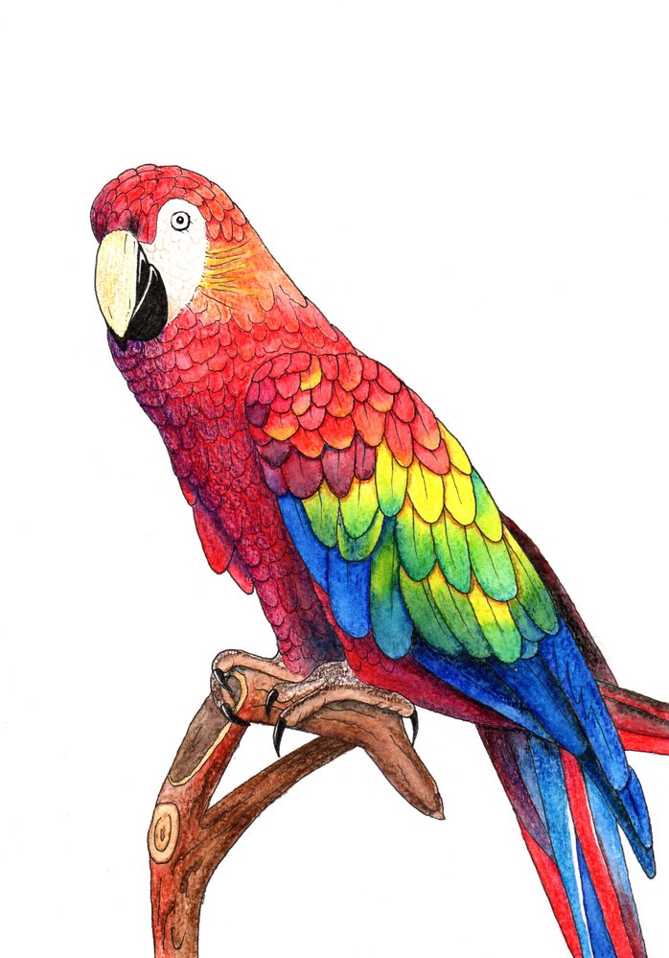
Who’s this?
It has got a long tail, but it hasn’t got any teeth. It can be blue, brown, yellow, red, green. It can fly, but it can’t swim. It can talk too.
ОТВЕТ
parrot

Slide 29

Who’s this?
It has got a long tail, but it hasn’t got legs. It looks like a horse. But it can’t run, it can swim.
ОТВЕТ
seahorse

Slide 30

Who’s this?
It has got a long tail, short legs. It has got a lot of teeth. It is green. It can swim, it can’t jump.
ОТВЕТ
crocodile

Slide 31
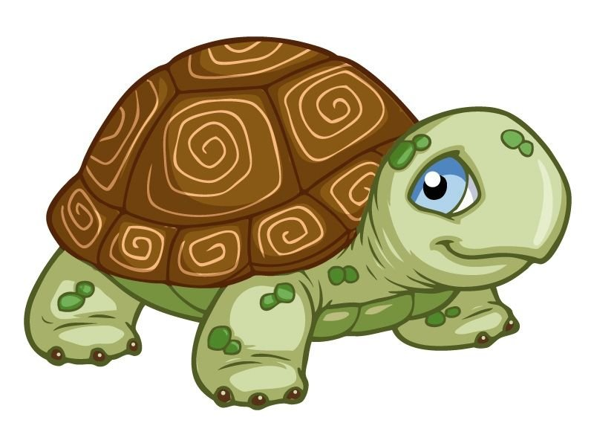
Who’s this?
I have four legs and a tail.
I have no teeth.
I can swim and walk.
I carry my house around with me.
ОТВЕТ
tortoise

Slide 32

Who’s this?
It has a long nose, big ears and a long tail. It is big. It is grey. It can walk and run.
ОТВЕТ
elephant

Slide 33
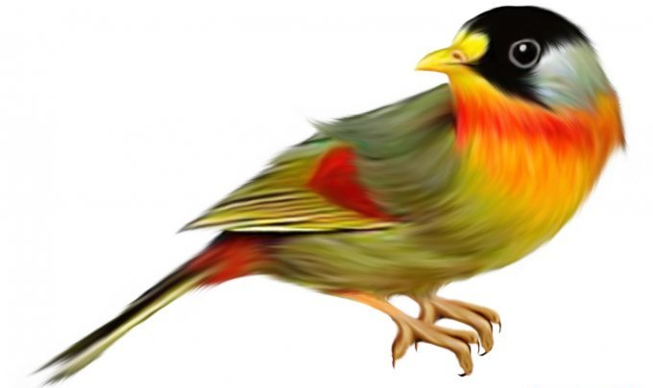
Who’s this?
It has got 2 legs, a tail and 2 wings. It can be black, brown, yellow, red. It can fly and jump, but it can’t swim.
ОТВЕТ
bird

Slide 34
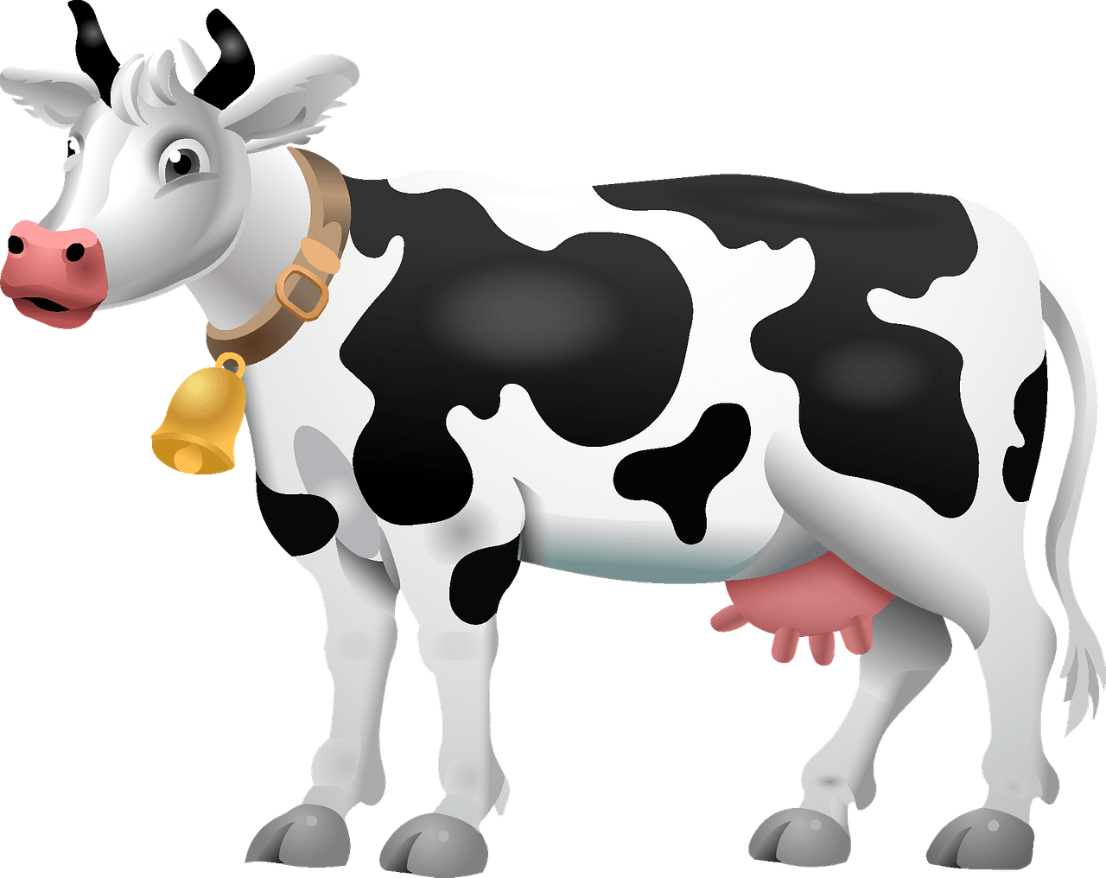
Who’s this?
It has got a fat body, a big mouth, small ears, a long tail. It can walk and run, but it can’t crawl. It gives us milk.
ОТВЕТ
cow

Slide 35
am/is/are
Anna is in the garden.
Anna … in the garden.
ОТВЕТ
is

Slide 36
am/is/are
We .... at school now.
We are at school now.
ОТВЕТ
are

Slide 37
am/is/are
I … in the bedroom.
I am in the bedroom.
ОТВЕТ
am

Slide 38
am/is/are
My friends are
in the garden.
My friends … in the garden.
ОТВЕТ
are

Slide 39
am/is/are
She is at home now.
She … at home now.
ОТВЕТ
is

Slide 40
am/is/are
… you good at school?
Are you good at school?
ОТВЕТ
are

Slide 41
am/is/are
There … a table in the kitchen.
There is a table in the kitchen.
ОТВЕТ
is

Slide 42
am/is/are
There … four chairs at the table.
There are four chairs at the table.
ОТВЕТ
are

Slide 43
Ссылки:
Шаблон игры «Своя игра» Аствацатурова Г.О. , http://didaktor.ru/kak-polzovatsya-shablonom-viktoriny-svoya-igra/
Шаблон презентации Пасечник Елены Аркадьевны, учитель истории, МБОУ «СОШ№6» г.Братска Иркутской обл
https://easyen.ru/load/shablony_prezentacij/istorija_obshhestvoznanie/anglija/516-1-0-42220 https://media.baamboozle.com/uploads/images/157688/1606652298_39910 машина
https://gas-kvas.com/uploads/posts/2023-01/1673553005_gas-kvas-com-p-detskii-risunok-tsvetok-roza-1.jpg роза
https://gd3.alicdn.com/imgextra/i3/194717539/TB2aOE3XNPI8KJjSspfXXcCFXXa_!!194717539.jpg стул
https://assets.ldscdn.org/74/4c/744c338e203f5d4255940623aad5ea91ecdf9bc4/pair_of_feet.jpeg ноги
https://kartinkin.net/uploads/posts/2022-03/1647331283_42-kartinkin-net-p-kot-kartinki-risunki-47.jpg кошка
https://www.itsfresh.ru/upload/iblock/3c9/3c92beb618dde76a5715fd33c0c5acae.jpg кока
https://png.pngtree.com/element_our/20190602/ourlarge/pngtree-blue-table-lamp-decoration-illustration-image_1381631.jpg лампа
https://media.baamboozle.com/uploads/images/11732/1638309229_23759_url.jpeg мяч на столе
https://i.pinimg.com/originals/ae/f3/7a/aef37a140fc2293522896eadb286d19e.jpg письменный стол
https://papik.pro/uploads/posts/2022-01/thumbs/1642330776_4-papik-pro-p-noga-klipart-4.jpg ступня
https://pickimage.ru/wp-content/uploads/images/detskie/handles/ruchki4.jpg ручка
https://www.pinclipart.com/picdir/big/13-138011_ketchup-clipart-splat-paint-splatter-clipart-black-and.png чёрный
https://botana.biz/prepod/_bloks/pic/jw5c2tb-002.jpg карандаш
https://good-books.ru/image/cache/catalog/5/6/1814-1-800x800.jpg книга
https://manera.by/media/img/catalog/hd/yeipxynhr7yg__10.jpg.jpg ластик
https://i.ytimg.com/vi/yoPIjwXe_h0/maxresdefault.jpg крокодил
https://i.pinimg.com/736x/32/43/9e/32439e83e067b7a84df08219e99fdba8.jpg слон
https://img1.liveinternet.ru/images/attach/c/6/93/690/93690013_1244544552_70df9ce53616.jpg птица

Slide 44
Ссылки:
https://p1.zoon.ru/preview/N3Ud4TBY_xrTyy9XdYqXCw/2400x1500x75/1/7/5/original_615770a756fc6f1d2e1fb14c_6268fcbb94c9e0.40724221.jpg плавать
http://static.tildacdn.com/tild3238-3338-4561-a265-656361306565/3155_1501075241.jpg молоко https://fs02.vseosvita.ua/0200ot2h-196c-940x686.png попугай https://www.clipartmax.com/png/full/112-1121641_maría-josé-en-imagenes-de-caballito-de-mar-animados.png морской конёк
https://gas-kvas.com/uploads/posts/2023-01/1673458237_gas-kvas-com-p-cherepashka-risunok-detskii-5.jpg
Черепаха
https://creazilla-store.fra1.digitaloceanspaces.com/cliparts/9101/cow-clipart-lg.png корова

