Slide 1



Slide 2
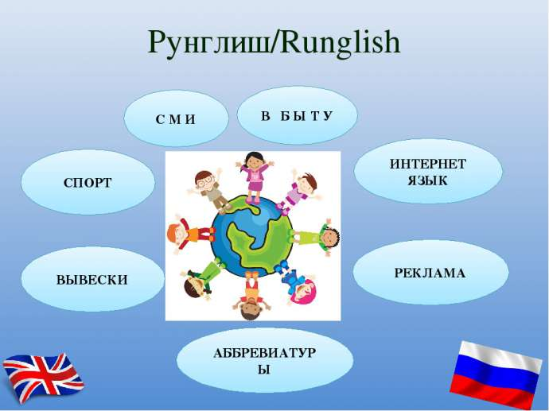

Slide 3
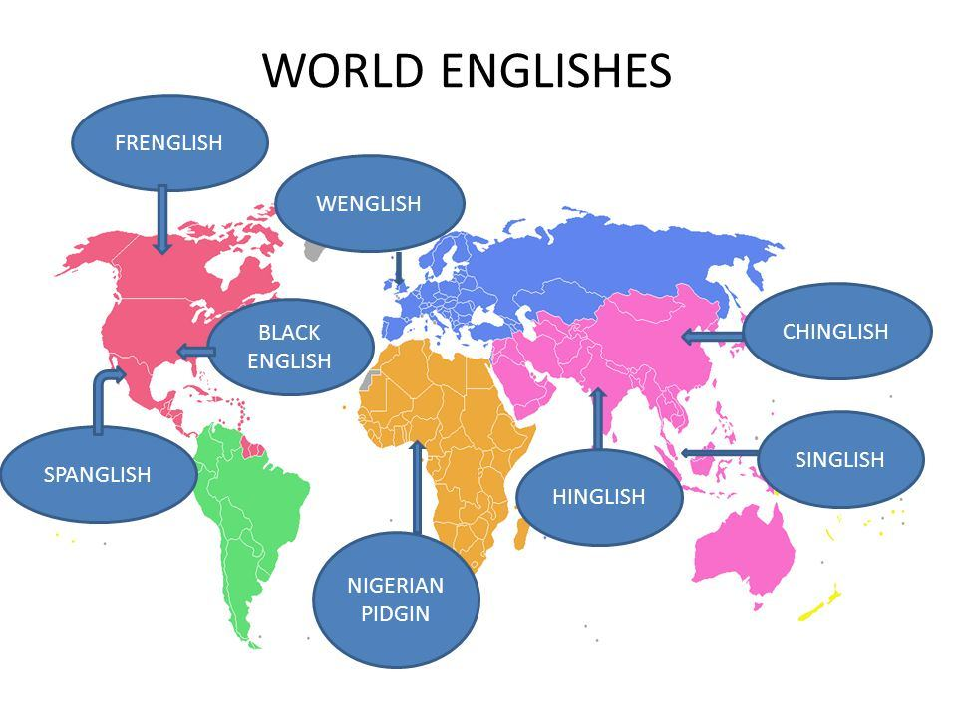

Slide 4


Slide 5
Glossary
Pidgin languages
In midconversation
Means of communication
Community
Mix the languages
Local dialects
Non native

Slide 6
Complete the sentences with the expressions
New languages which develop as a……
We communicate in Runglish, we just…..
It is spoken in a number of English-Russian…..
They understand each other in…..
…. are used for oral communication.

Slide 7


Slide 8
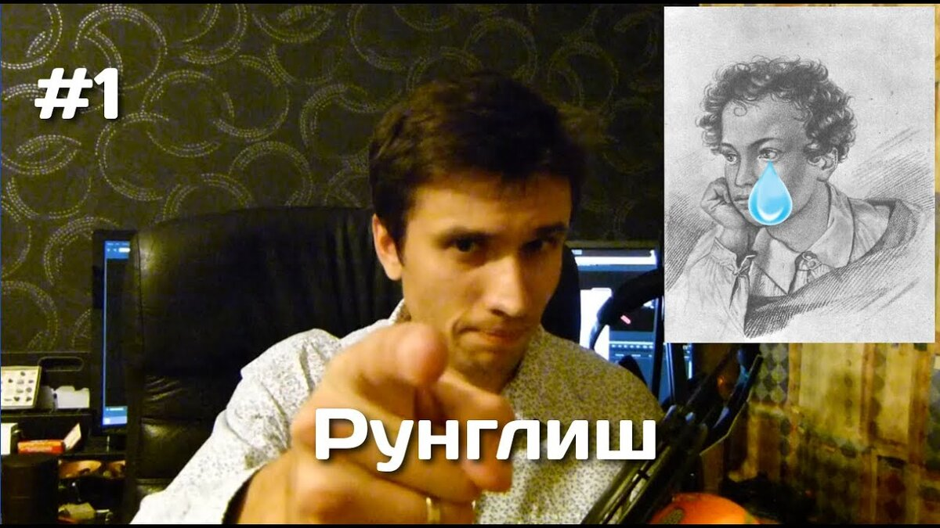

Slide 9

GOODBYE!

