Slide 1

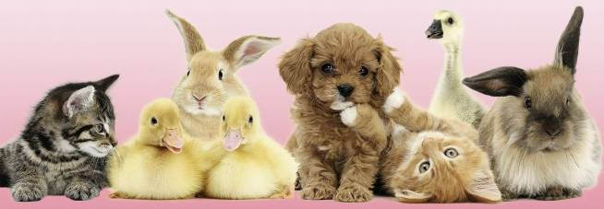
Презентация к учебнику Spotlight 3
Модуль 5
Множественное число существительных
Автор:
Хажумарова А.А., учитель английского языка
МБОУ СОШ№2 с.Кизляр, РСО-Алания, Моздокский р-он

Slide 2
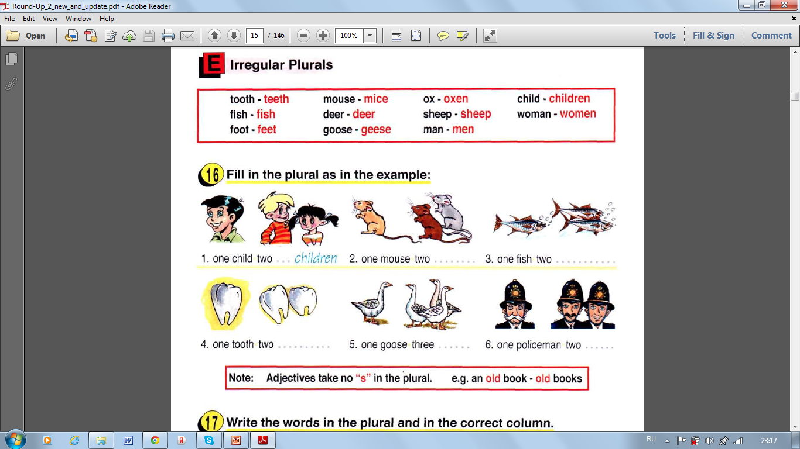
Повторяем слова - исключения
Проверяем себя! Check yourself!

Slide 3

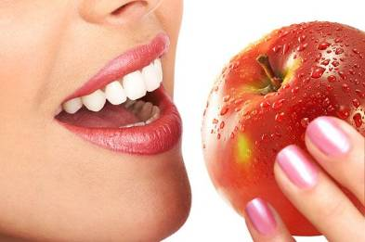
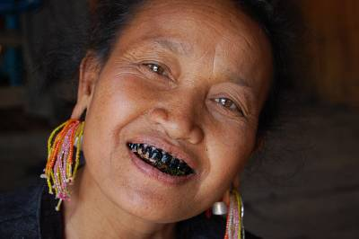

Заполни пропуски! Fill in the gaps!
The tooth … white.
The teeth can be white and … .

Slide 4
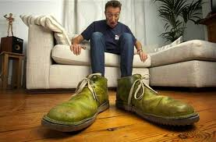
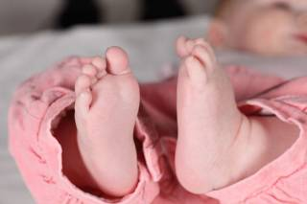
Заполни пропуски! Fill in the gaps!
The man has got big … .
The child has got … feet.

Slide 5
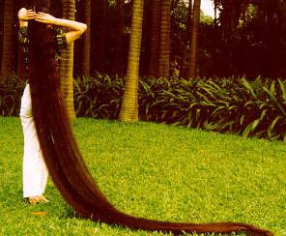
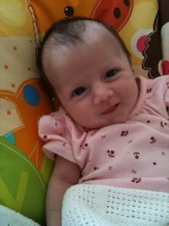
Заполни пропуски! Fill in the gaps!
The woman … got long hair.
The child has got … hair.

Slide 6
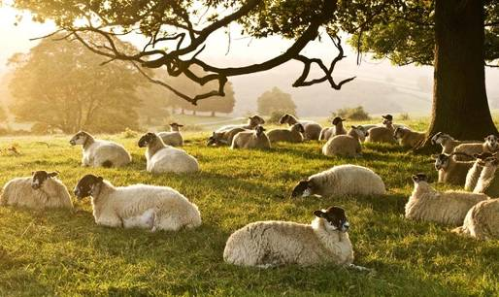
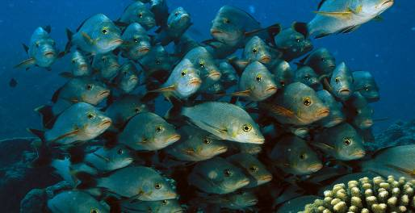
Заполни пропуски! Fill in the gaps!
Sheep … furry.
Fish have got … hair

Slide 7
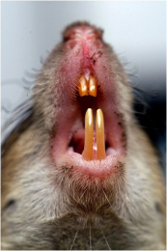
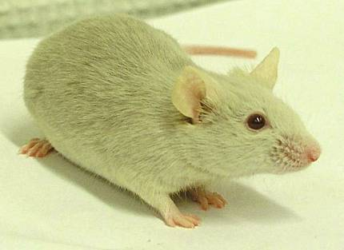
Заполни пропуски! Fill in the gaps!
Mice … got sharp teeth.
The mouse … got little eyes, ears, legs and …

Slide 8
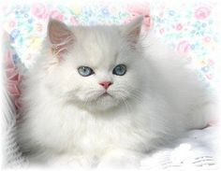
I have got a pet!
Заполни пропуски! Fill in the gaps!
It's … саt. Нег nаmе … Murka. Mу pet answers to her name. Mу pet … 2. Му cat is white. … is big. I teach mу cat to … football. She is clever. Му pet … run and jump.
I give my cat to eat fish and sausages and to … milk. I take my pet for a walk. I plау … my pet. I look after mу cat. I love my pet very much.

Slide 9

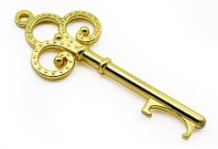
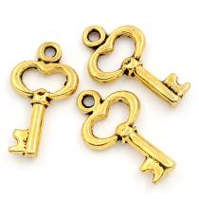
Ключи! Keys!
The tooth is white. The teeth can be white and black.
The man has got big feet. The child has got little feet.
The woman has got long hair. The child has got short hair.
Sheep are furry. Fish have got no hair.
Mice have got sharp teeth. The mouse has got little eyes, ears, legs and feet.
I have got a pet!
It's a/my саt. Нег nаmе is Murka. Mу pet answers to her name. Mу pet is 2. Му cat is white. She is big. I teach mу cat to play football. She is clever. Му pet can run and jump. I give my cat to eat fish and sausages and to drink milk. I take my pet for a walk. I plау with my pet. I look after mу cat. I love my pet very much.

Slide 10


