Slide 1
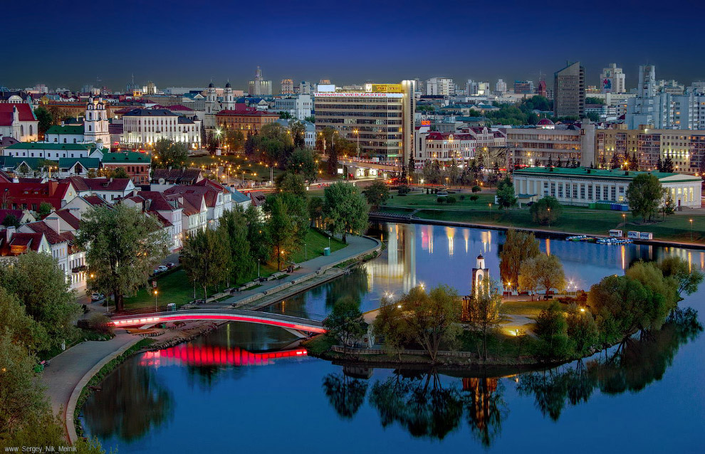
Minsk is the capital of Belarus

Slide 2
What’s the population of Minsk? 1) 1 million people 2) 2 million people 3) 3 million people

Slide 3
2. When was Minsk founded? In 1076 In 1067 In 1670

Slide 4
3. What region isn’t there in Minsk? Sovetsky Region Pervomaisky Region Kupalovsky Region Frunzenski Region

Slide 5
4. What street isn’t there in Minsk? Nikiforov Street Lopatin Street Caterpillar Street Nezavisimosti Prospect

Slide 6
5. What river isn’t there in Minsk? The Myshka The Svisloch The Dnepr

Slide 7
6. What can we see in Minsk? Trafalgar Square The British Museum Pobeda Square

Slide 8
7. What parks can we find in Minsk? Gorky Park Hyde Park Cheluskintsev Park

Slide 9
8. What is the oldest place in Minsk? Pobeda Square The Circus The Troitskoye Suburb

Slide 11
the central a) and Ballet House the b) Park the Opera c) Square Pobeda d) Railway Station the Troitskoye e) Circus Gorky f) Suburb

Slide 13
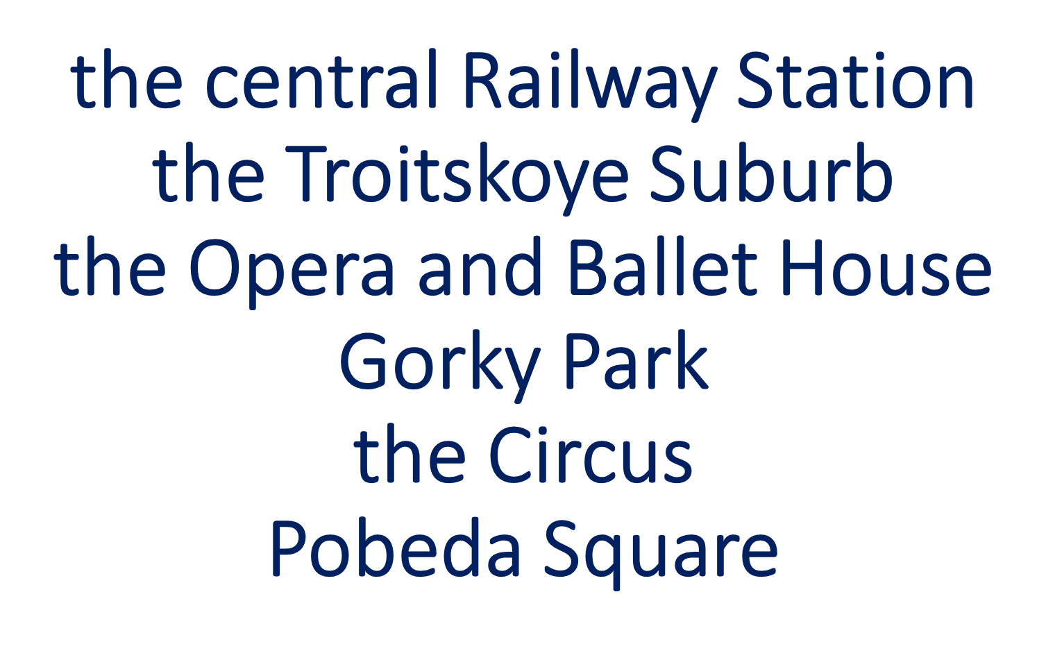

Slide 14
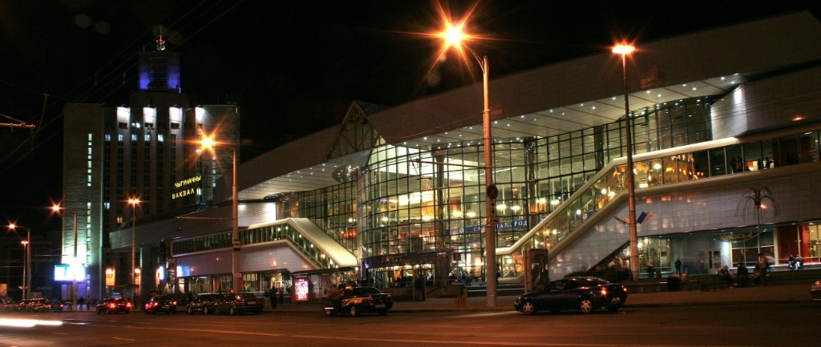
The central Railway Station

Slide 15
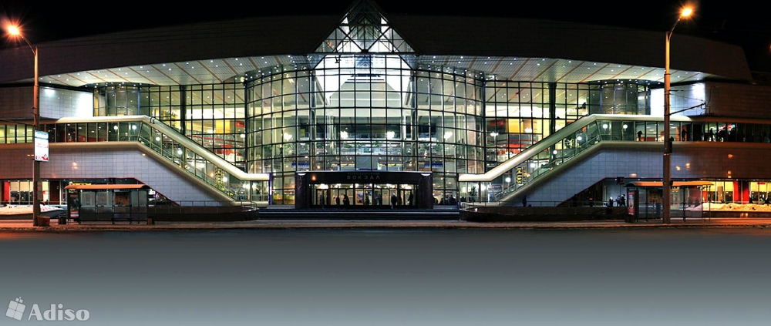
The central Railway Station

Slide 16
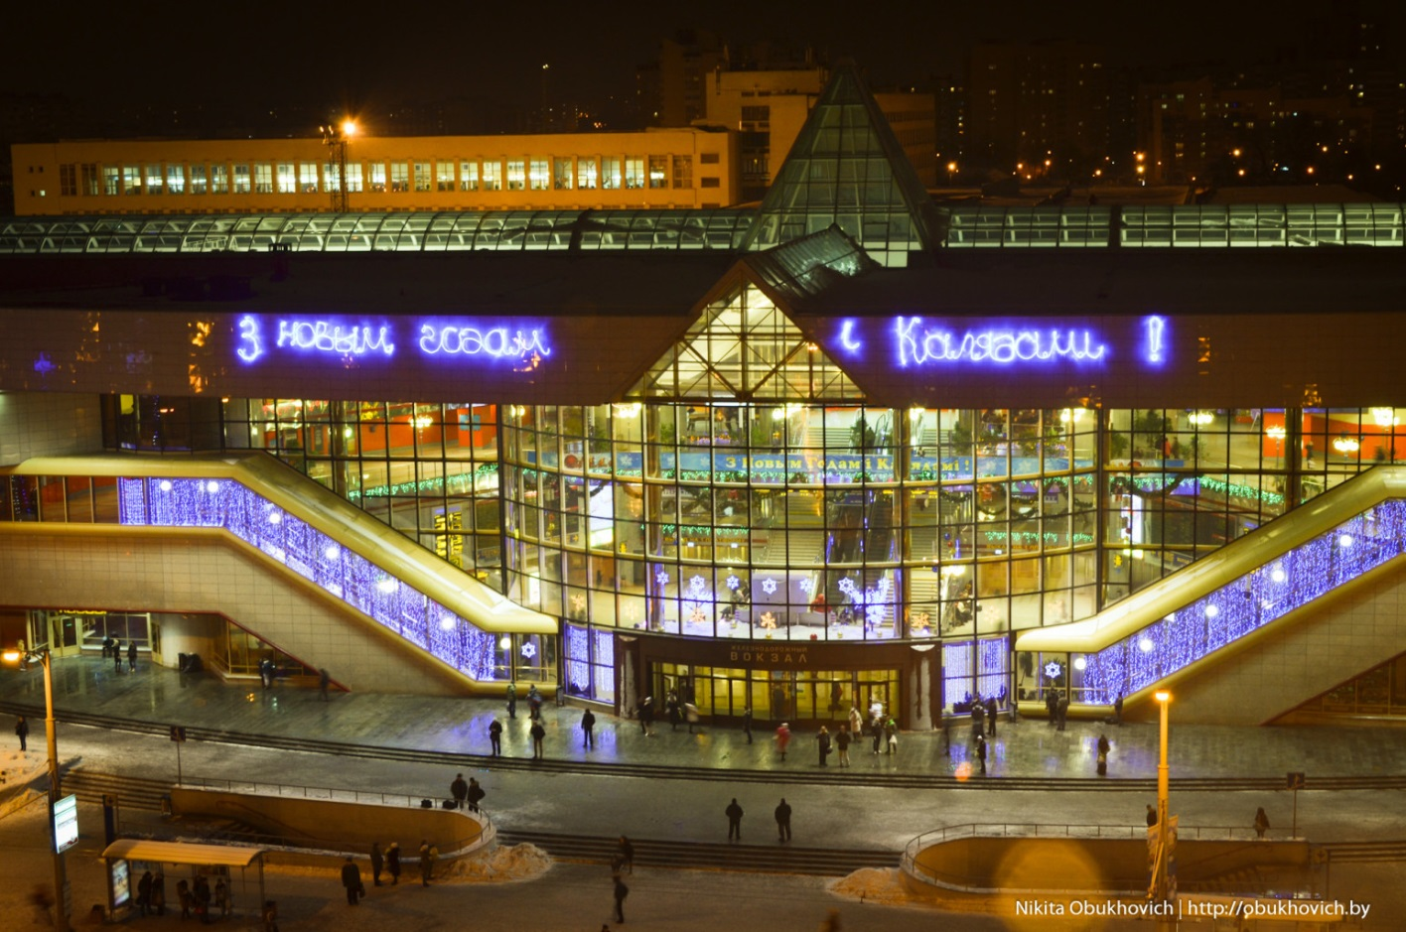
The central Railway Station

Slide 17
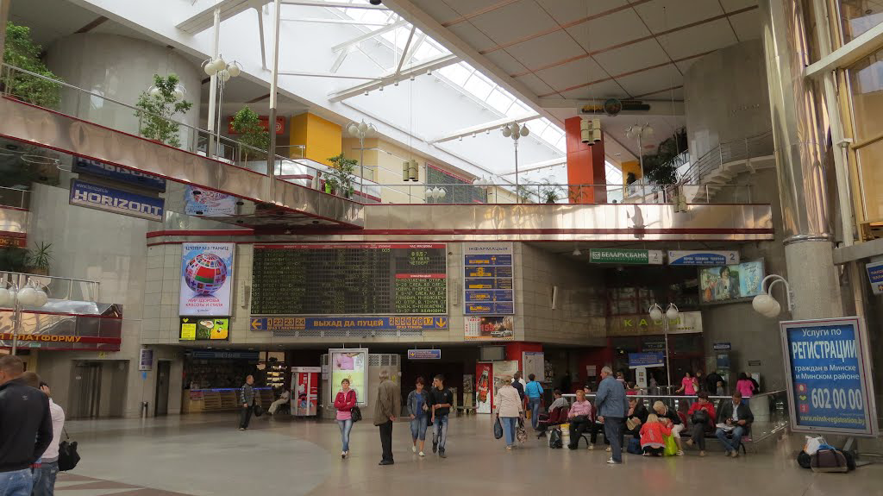
The central Railway Station

Slide 18
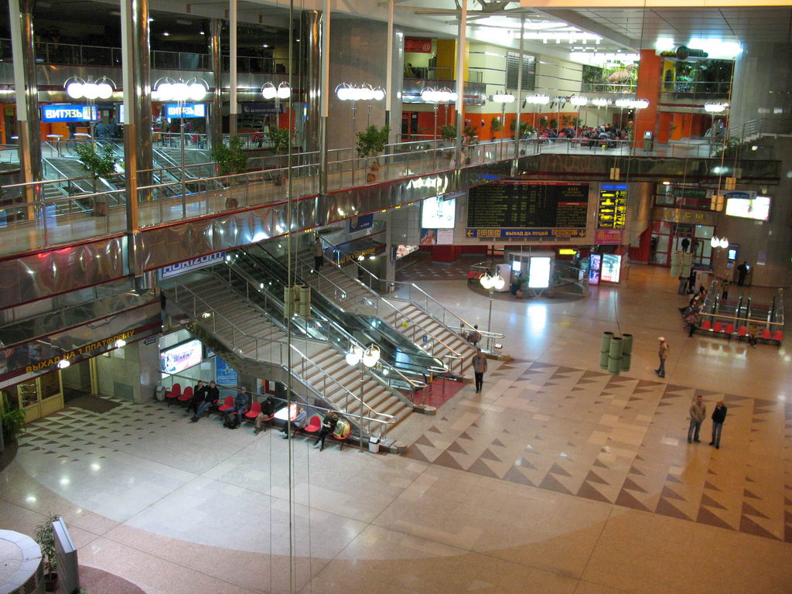
The central Railway Station

Slide 20
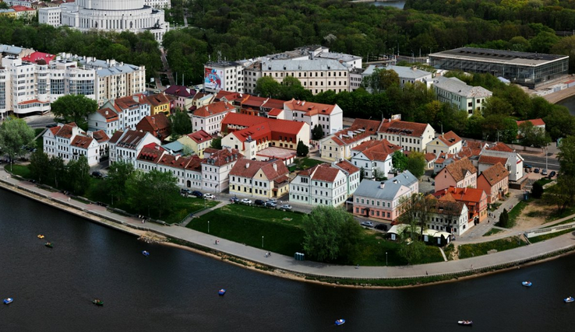
The Troitskoye Suburb

Slide 21
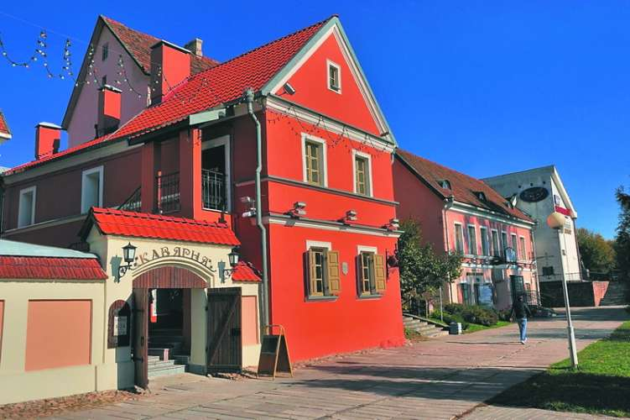
The Troitskoye Suburb

Slide 22
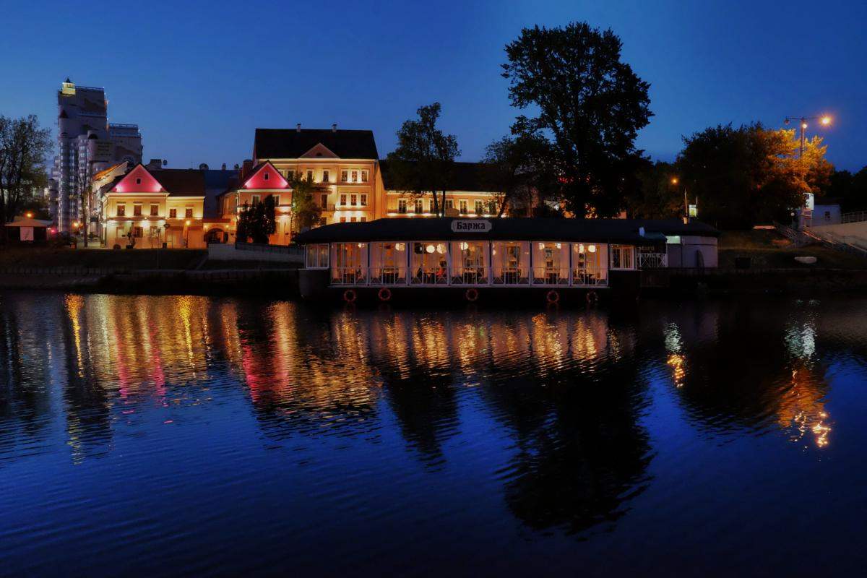
The Troitskoye Suburb

Slide 24
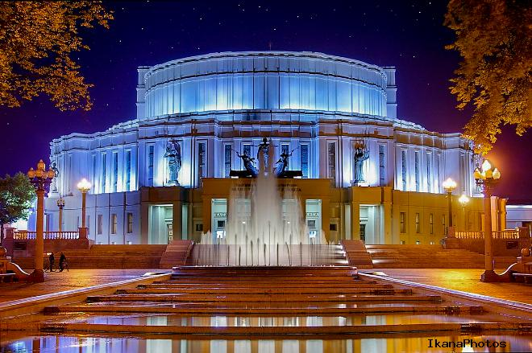
The Opera and Ballet House

Slide 25
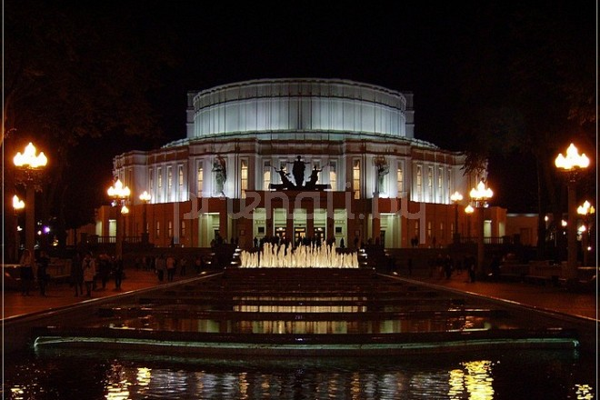
The Opera and Ballet House

Slide 26
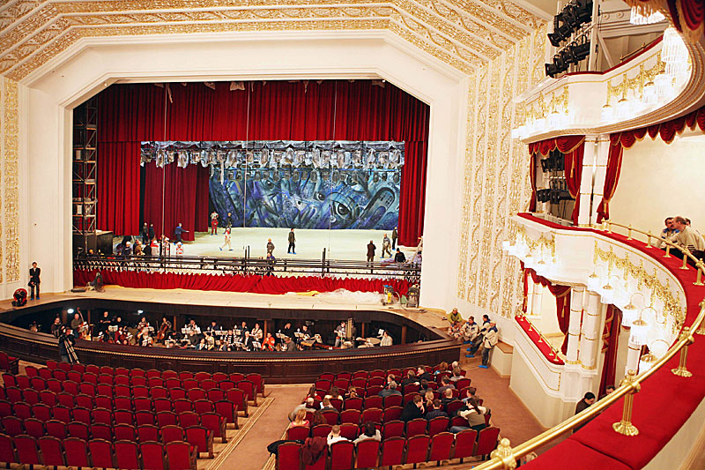
The Opera and Ballet House

Slide 27
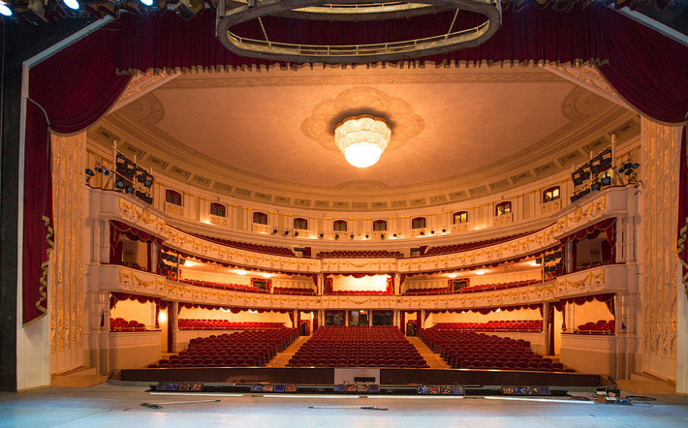
The Opera and Ballet House

Slide 28

must / mustn’t
While travelling
You ______ cross the street when the traffic lights are red.
You ______ play on the road.
You ______cross the street when the traffic lights are green.
You ______ run when the bus is moving.
You ______listen to loud music on a bus.
You ______ listen to your parents.
mustn’t
mustn’t
must
mustn’t
mustn’t

Slide 30
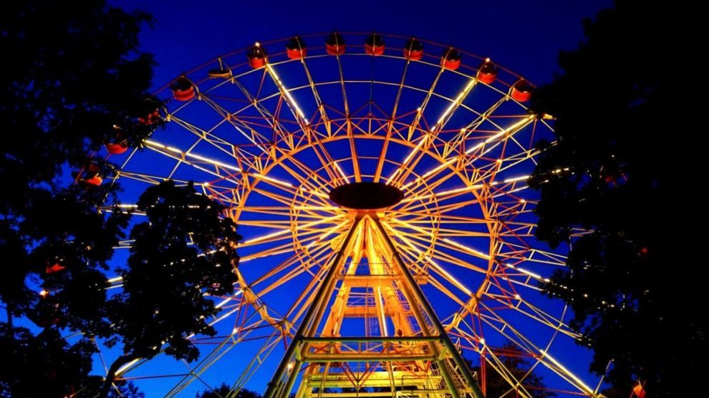
Gorky Park

Slide 31
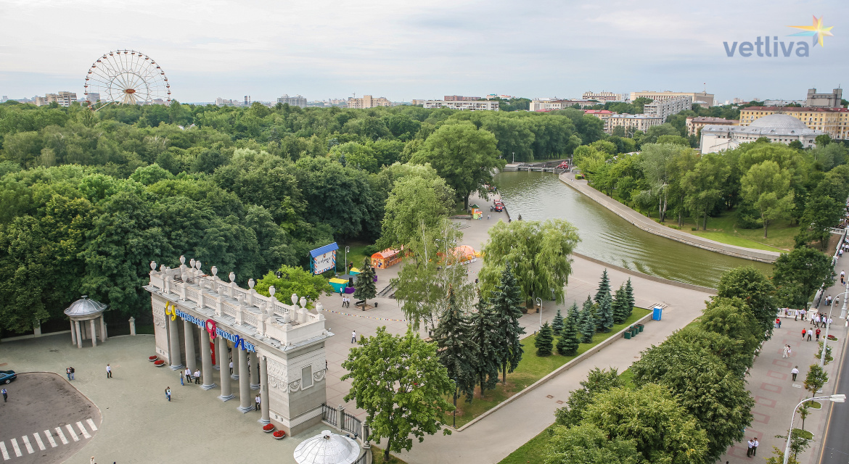
Gorky Park

Slide 32
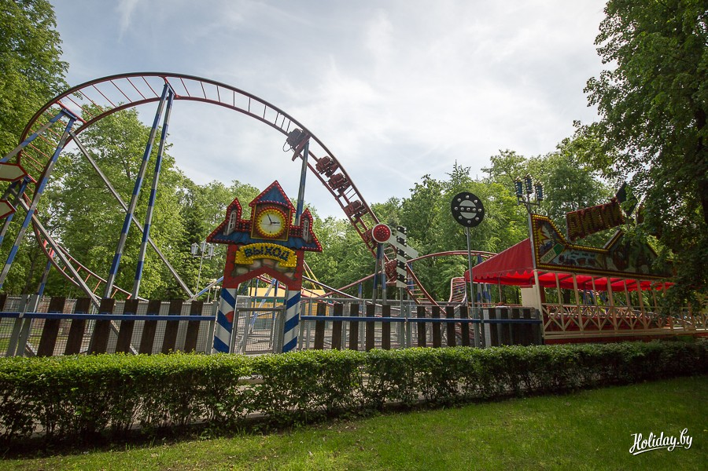
Gorky Park

Slide 33
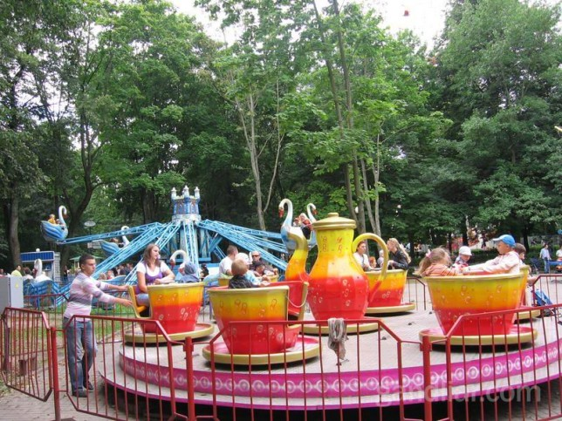
Gorky Park

Slide 35
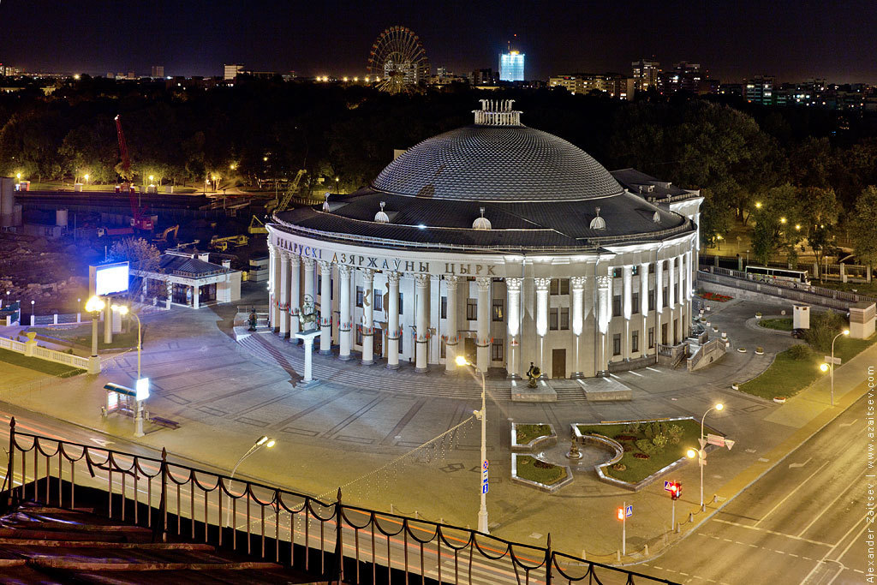
The Circus

Slide 36
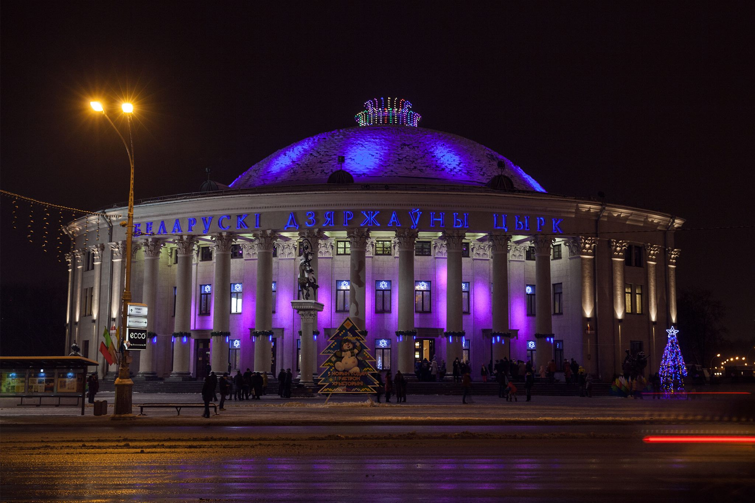
The Circus

Slide 37
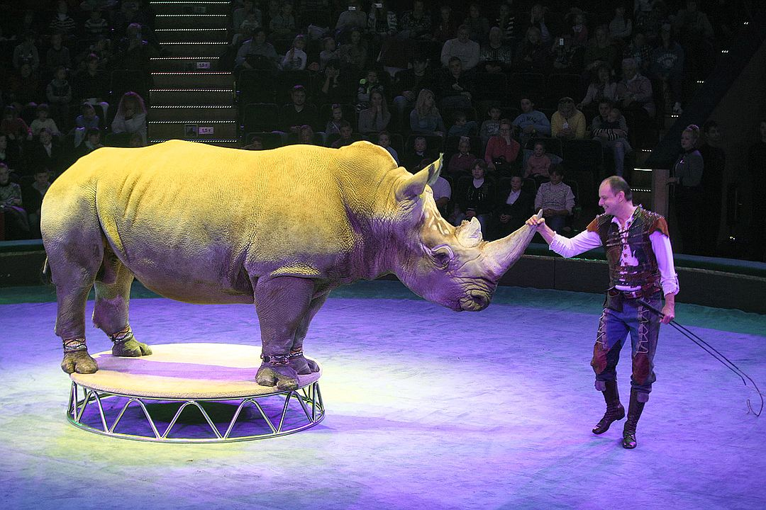
The Circus

Slide 38
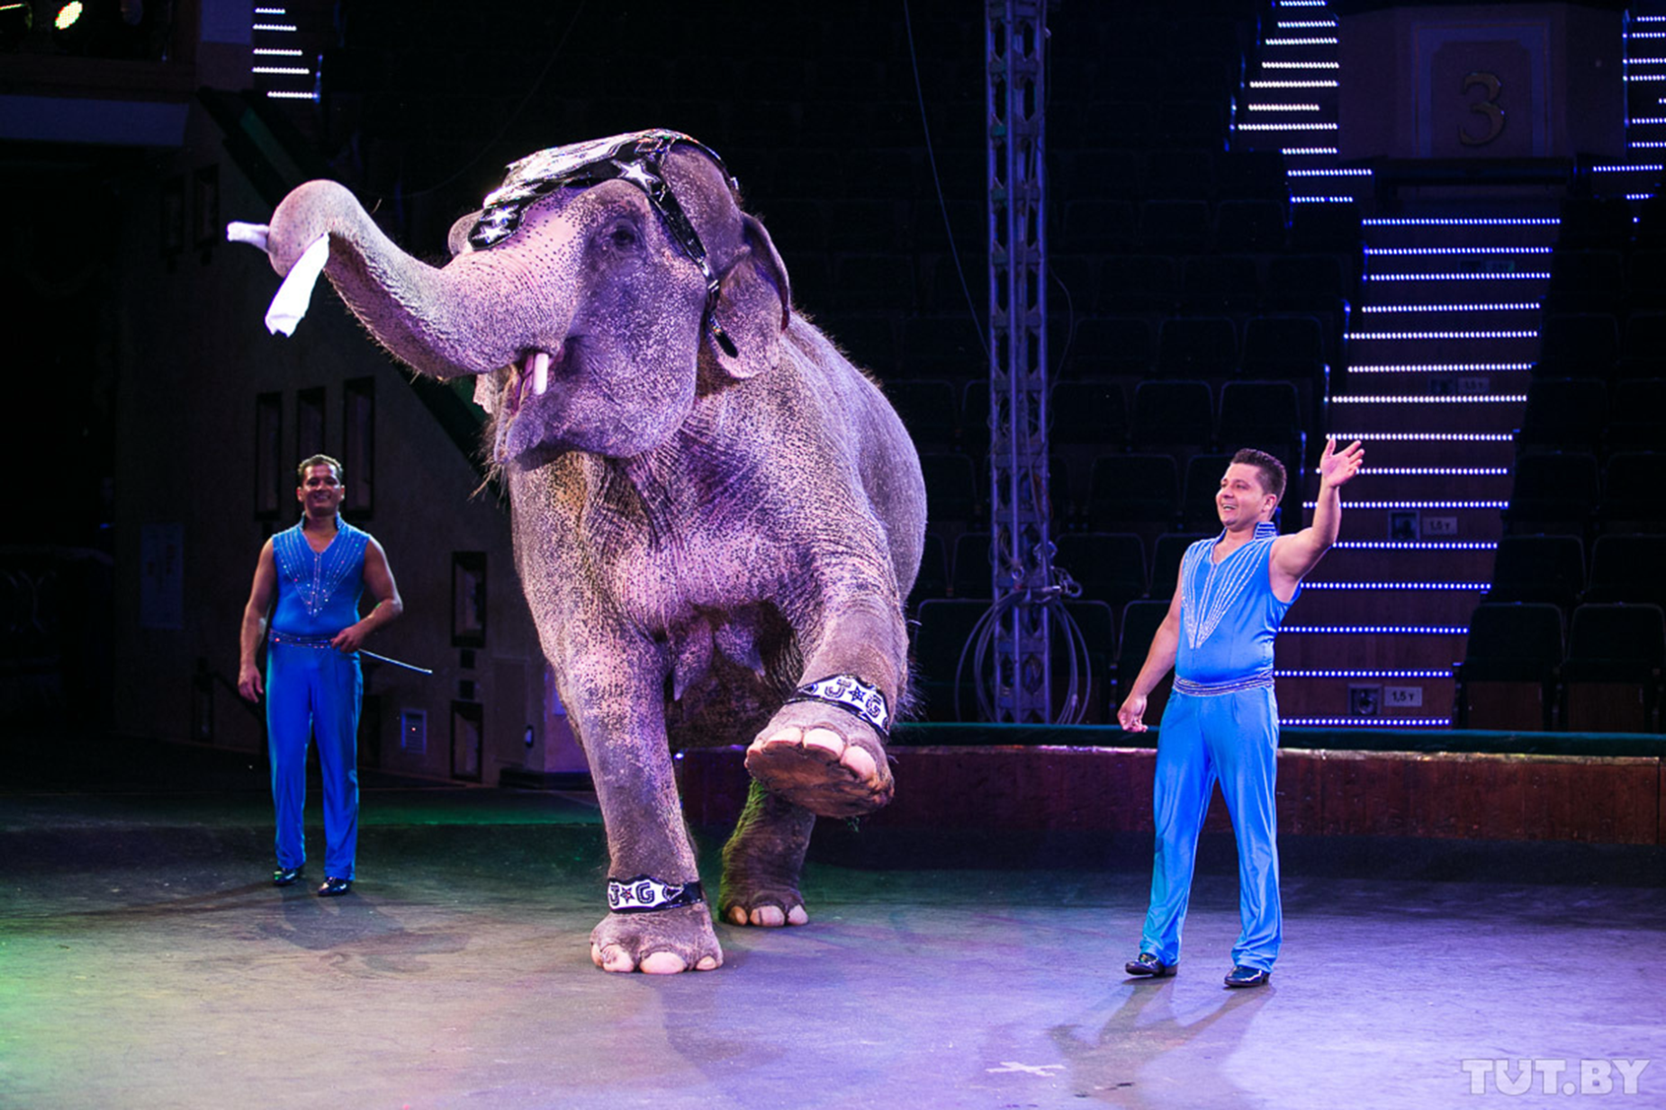
The Circus

Slide 39
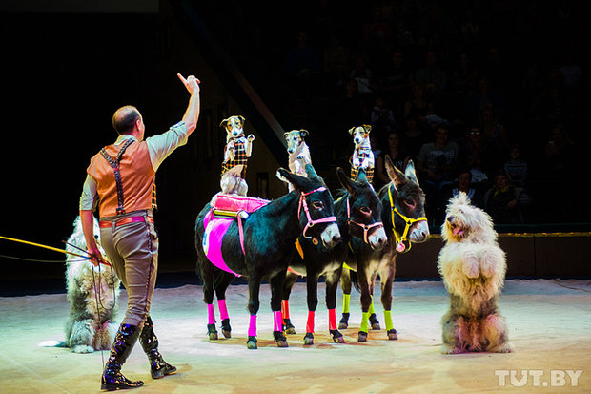
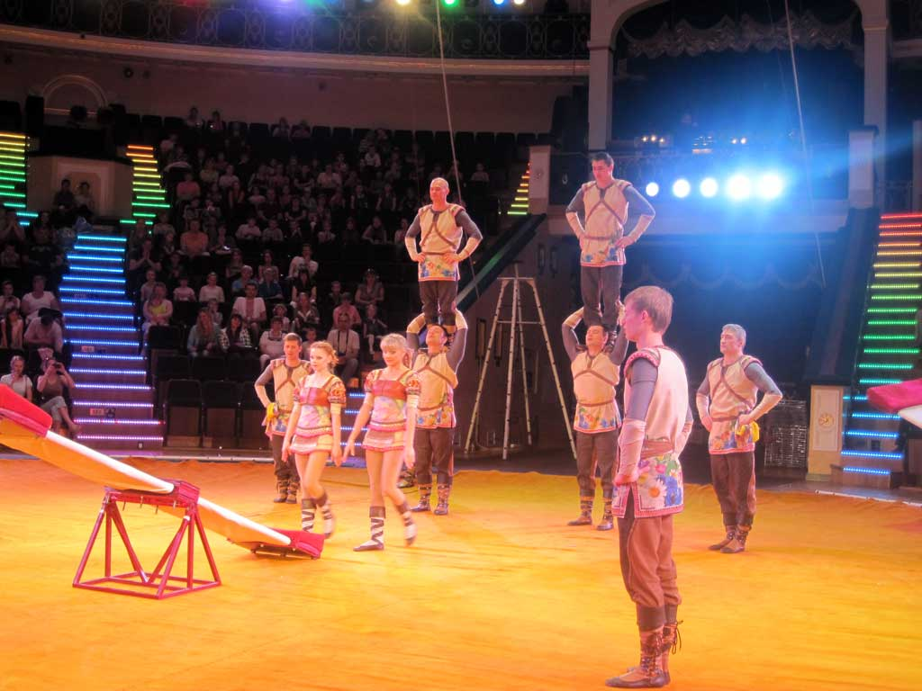
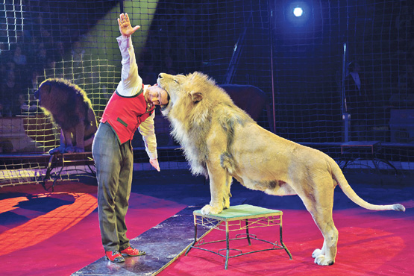
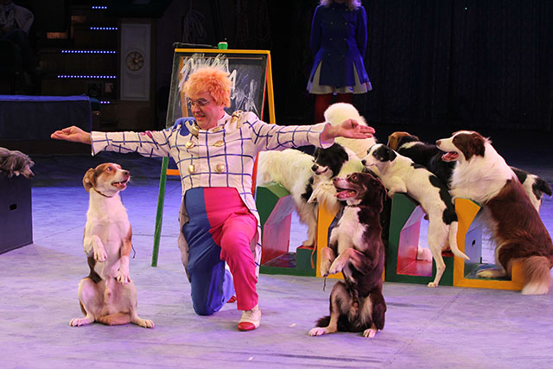
The Circus

Slide 41
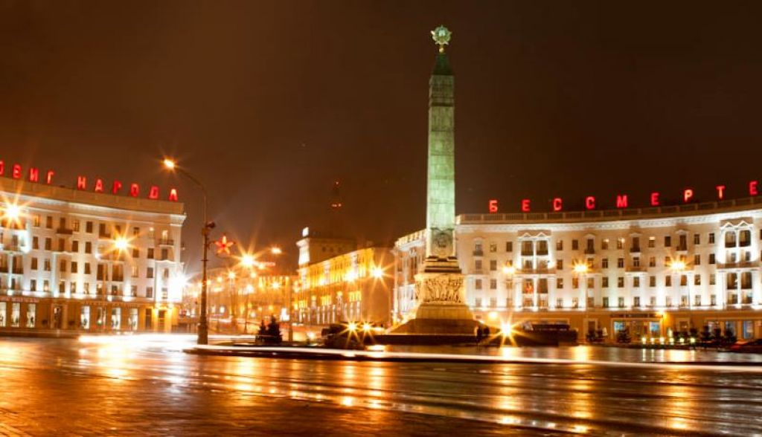
Pobeda Square

Slide 42
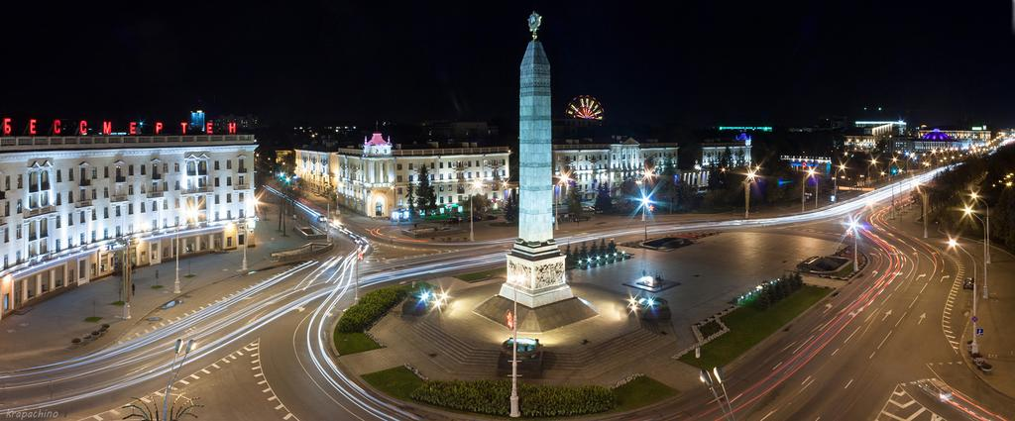
Pobeda Square

Slide 43
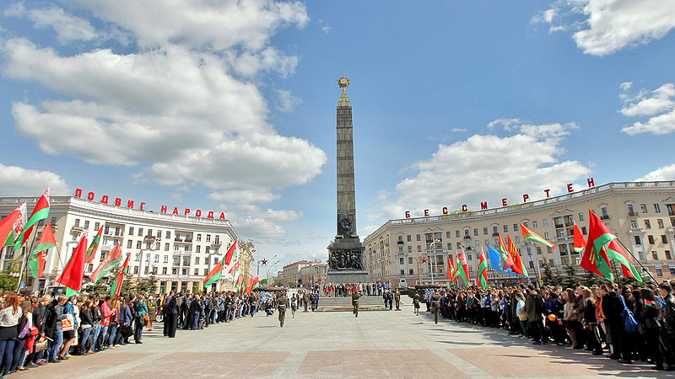
Pobeda Square

Slide 44
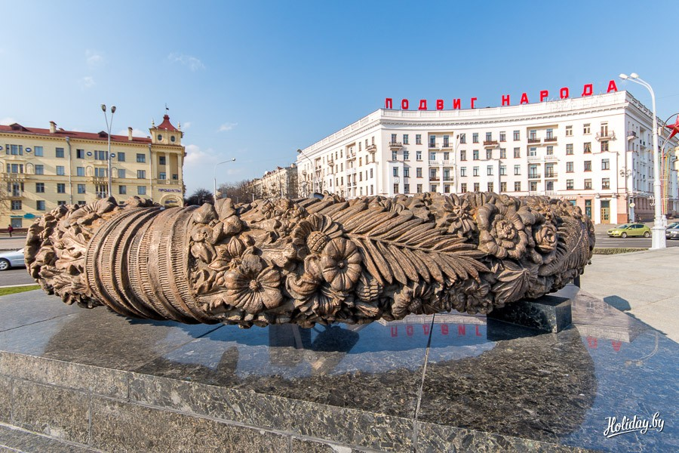
Pobeda Square

Slide 45
Minsk was founded in 1067. The central Railway Station was built in 2001. The Opera and Ballet House was built in 1933. Gorky Park was founded in 1805. The Circus was built in 1959. Minsk Zoo was built in 1984.

Slide 47
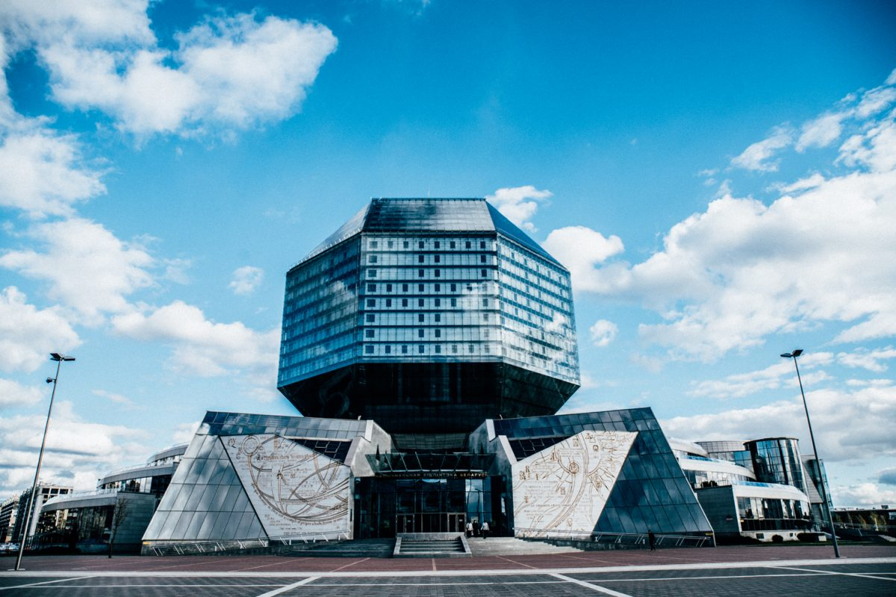
The national library

Slide 48
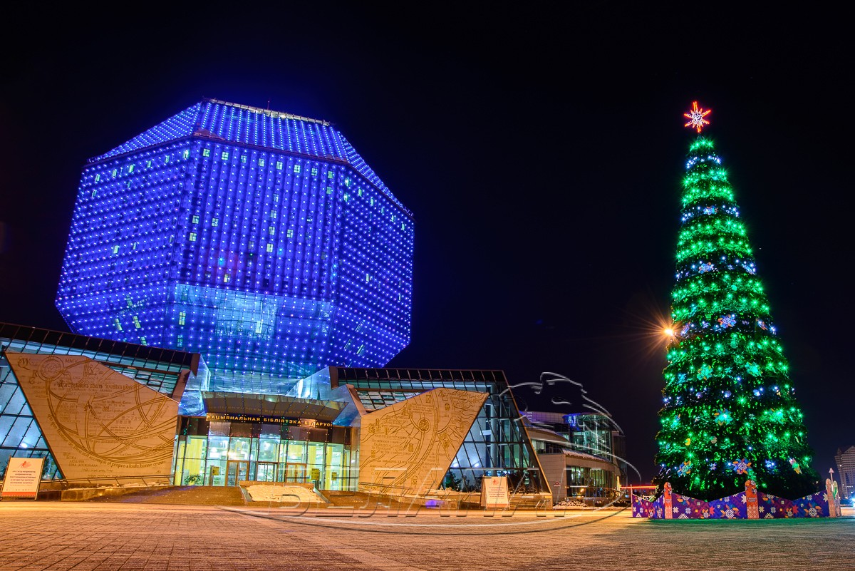
The national library

Slide 49
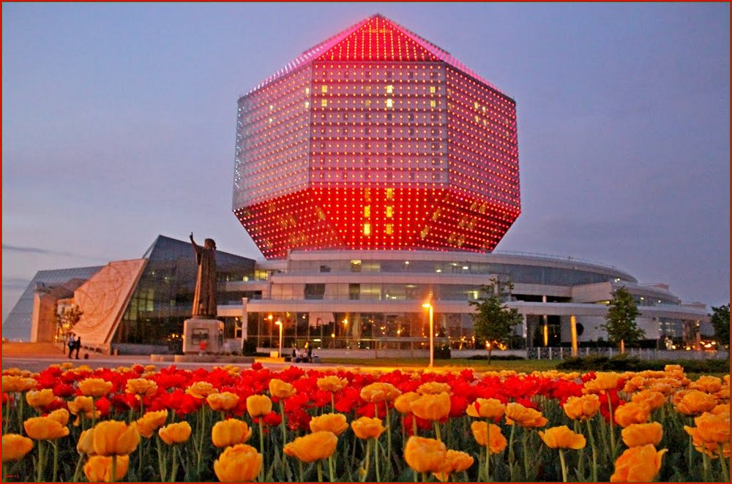
The national library

Slide 50
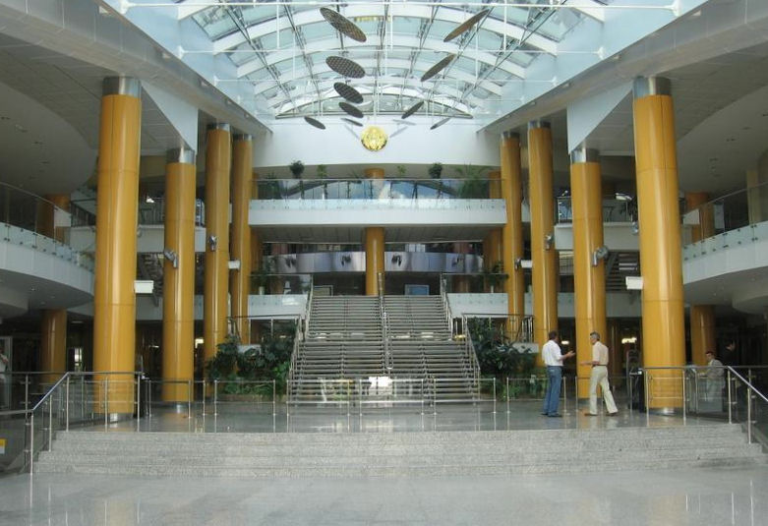
The national library

Slide 51
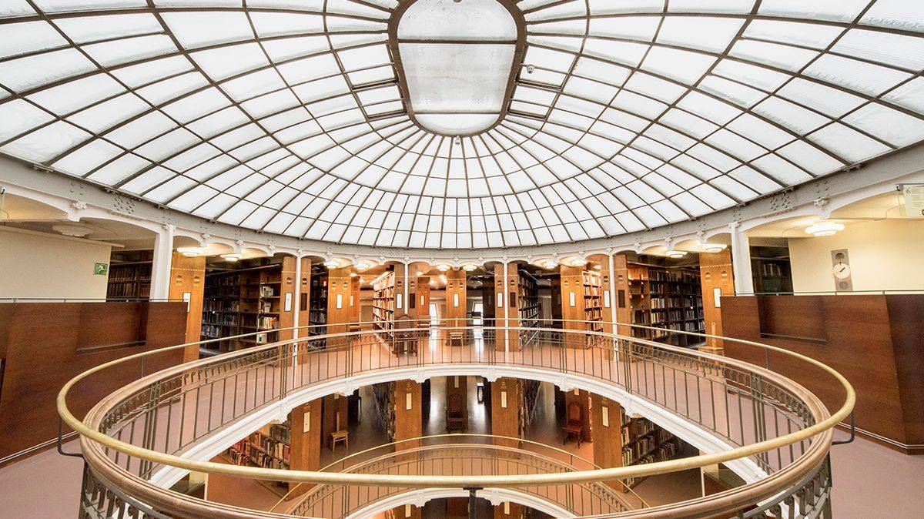
The national library

Slide 52
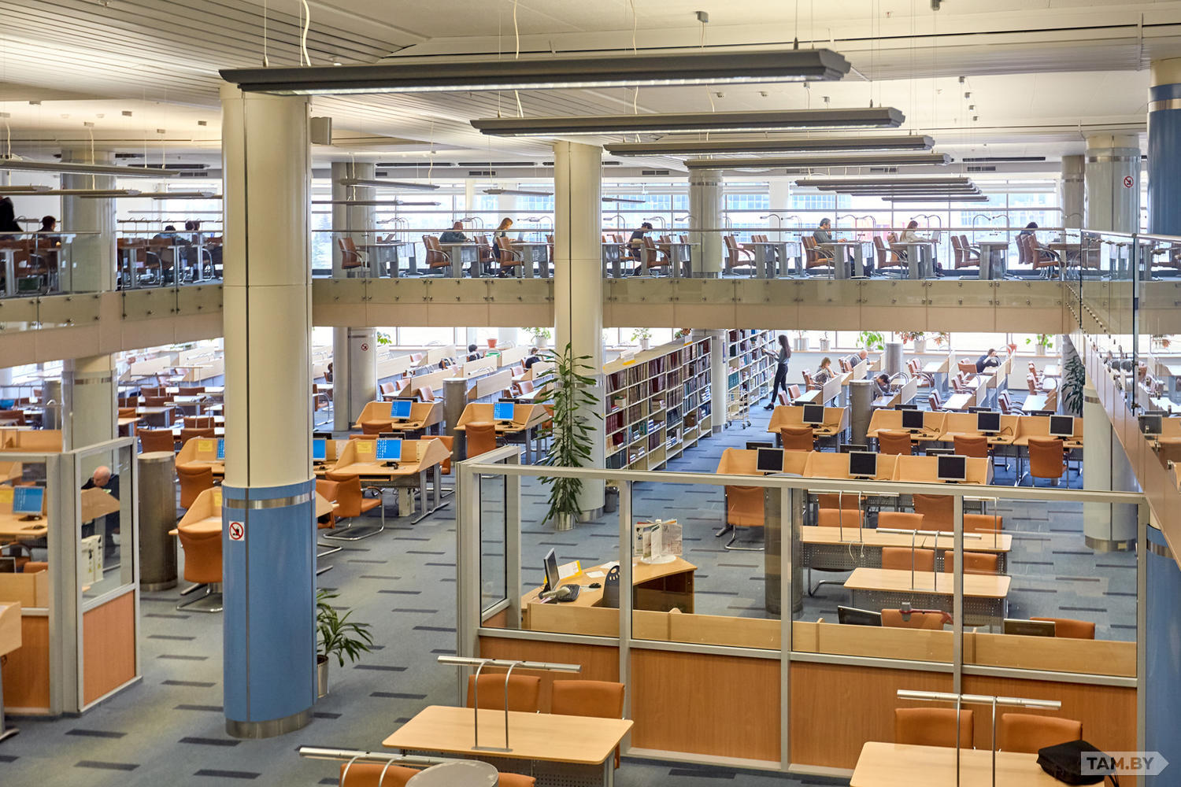
The national library

Slide 54
I’d like to visit…
the central Railway Station
the Troitskoye Suburb
The Opera and Ballet House
Gorky Park
The Circus
Pobeda Square
The National Library

